Slide 1
CI - CD
CONTINUOUS INTEGRATIONS – CONTINUOUS DELIVERY

Slide 2
INDEX
CONTINUOUS INTEGRATIONS – CONTINUOUS DELIVERY
01
Introduction to CI - CD
CI/CD with ReactJS project
02
03
CI/CD with Spring boot Maven

Slide 3
CONTINOUS INTEGRATION
CI – CD
INTRODUCTION TO
CONTINOUS DELIVERY

Slide 4
01
CONTINUOUS INTEGRATION – CI

Slide 5
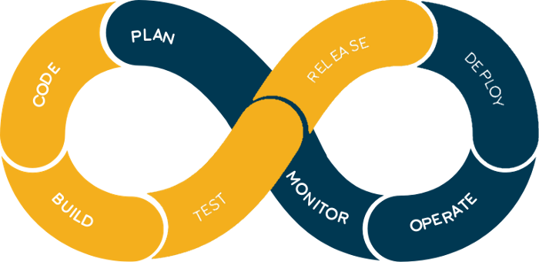
01
CI – DEFINITION
Continuous integration is a coding philosophy and set of practices that drive development teams to implement small changes and check in code to version control repositories frequently, at least once per day.

Slide 6
01
CI - BENEFITS
Low risk.
Debug easily and improve coding quality.
Decrease repeated manual processes, save time.
Save effort for testers.

Slide 7
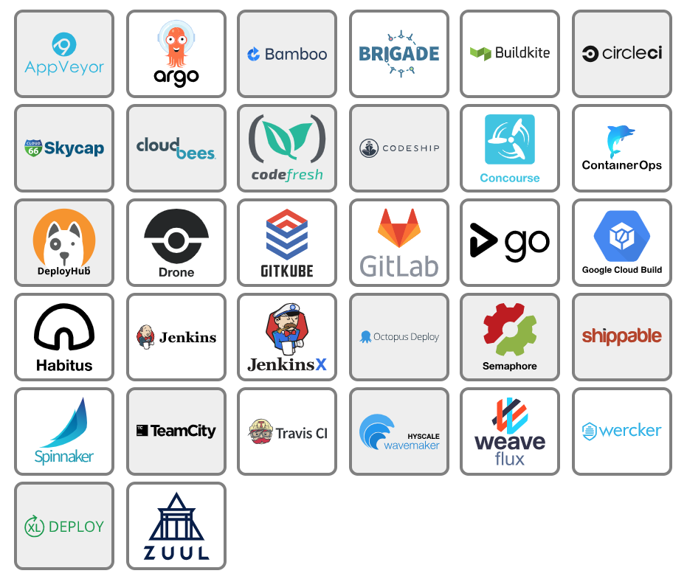
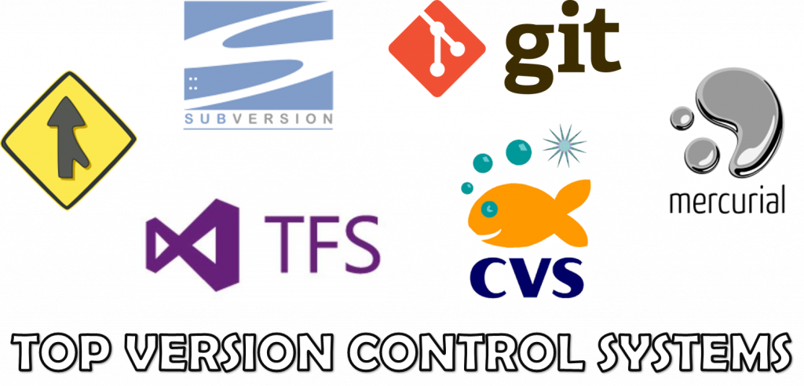
01
CI – IMPLEMETATION CONDITIONS

Slide 8
01
CI – IMPLEMETATION CONDITIONS … MORE
Keep a single main branch, limit branching too much.
Developers need integrate their code usually and continuously with moderate size.
Ensure the testing process is fast, returns test results in a short time.

Slide 9
IMPLEMENTATION
IMPLEMENTATION
CONTINUOUS INTEGRATIONS – CONTINUOUS DELIVERY

Slide 10
02
CI – CD WITH REACTJS PROJECT

Slide 11
02
REACTJS CI – CD



Checkout code from Gitlab
Build to 192.168.1.201

Slide 12
03
CI – CD WITH SPRING BOOT MAVEN PROJECT

Slide 13
03
SPRING BOOT MAVEN CI
Checkout code from Gitlab
Compile
SonnarQube scanner
Check quality gate

Slide 14
03
SPRING BOOT MAVEN CD
Checkout code from Gitlab
Compile
SonnarQube scanner
Check quality gate
Docker up
Docker build
Docker push

Slide 15
THANK
YOU
QUESTIONS ?
CONTINUOUS INTEGRATIONS – CONTINUOUS DELIVERY

