Slide 1

EFK
ELASTICSEARCH * FLUENTD * KIBANA

Slide 2
INDEX
ELASTICSEARCH * FLUENTD * KIBANA
01
Introduction to EFK
Why EFK?
02
03
Implement EFK to microservice
Good things & bad things
04

Slide 3
INTRODUCTION
INTRODUCTION
TO ELASTICSEARCH * FLUENTD * KIBANA

Slide 4
01
INTRODUCTION

Slide 5



01
INTRODUCTION
E
Save, search, analyze, query log
F
Log collector
K
Visualize log management

Slide 6
02
FLUENTD

Slide 7
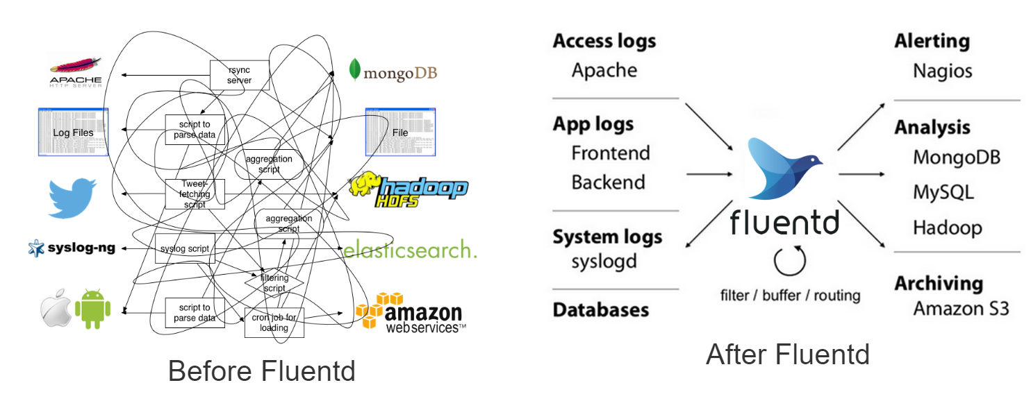
02
FLUENTD

Slide 8
03
ELASTICSEARCH

Slide 9

03
ELASTICSEARCH
- Realtime searching.
- Using index.
- JSON data saving (NoSQL).
- Implemented in Big Data.

Slide 10
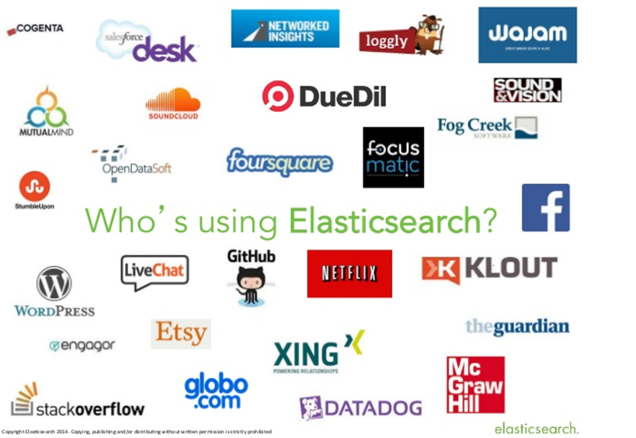
03
ELASTICSEARCH

Slide 11
04
KIBANA

Slide 12
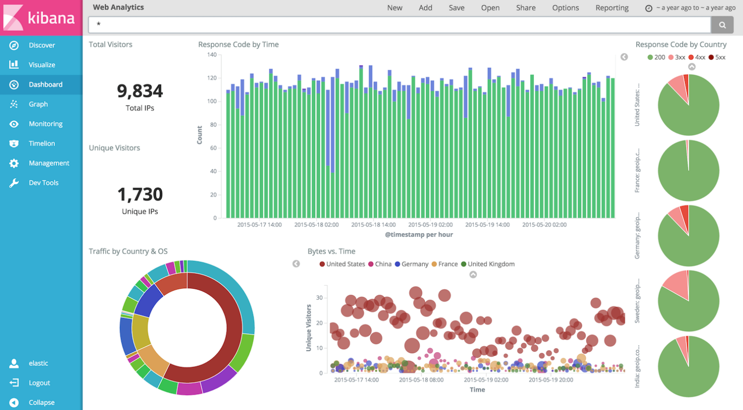
04
KIBANA

Slide 13
04
WHY EFK, NOT ELK?

Slide 14
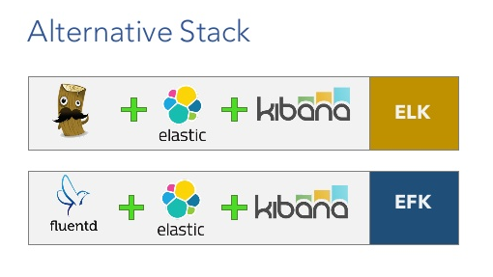
04
WHY EFK NOT ELK?

Slide 15
ADVANTAGES
WHY WE SHOULD USE EFK?
THE ADVANTAGES OF EFK

Slide 16
01
THE ADVANTAGES OF EFK
- Easy log management, collect log from multiple resources.
- Easy to integrate with other systems.



- FREE.
- Good extension and development.
- Powerful filters and search engine.
- Great support community and variety tutorials.

Slide 17
IMPLEMENTATION
IMPLEMETATION OF EFK
TO MICROSERVICE APPLICATION

Slide 18
01
SETUP EFK

Slide 19
01
SETUP EFK
- Docker-compose file.



- Kibana config file.
- Fluentd config file.

Slide 20
02
SETUP SERVICE

Slide 21
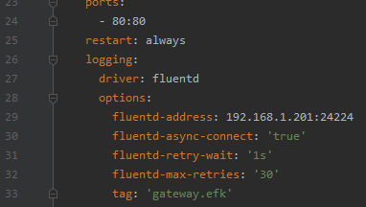
02
SETUP SERVICE




Slide 22
GOOD
GOOD THINGS & BAD THINGS
SOMETHINGS WE’VE DONE & SOMETHINGS NOT
BAD

Slide 23
01
GOOD THINGS

Slide 24
01
GOOD THINGS
- Automatic logging.



- Docker build is so simple and easy.

Slide 25
02
BAD THINGS

Slide 26
02
GOOD THINGS
- EFK version is not newest version.



- Imperfect fluentd pattern.
- Multiple line log (error, exception, …): not yet.
- X – pack security for EFK: not yet.
- All java services are under the log prefix fluentd-* => hard to manage.

Slide 27
THANK YOU
QUESTION ABOUT EFK?

Slide 28
IF YOU HAVE ANY QUESTIONS HERE
PLEASE KEEP IT IN YOUR MIND
I AM NOT GOOGLE

