Slide 1

EFK
ELASTICSEARCH * FLUENTD * KIBANA

Slide 2
INDEX
ELASTICSEARCH * FLUENTD * KIBANA
01
Introduction to EFK
Why we should use EFK?
02
03
Implement EFK to microservice

Slide 3
INTRODUCTION
INTRODUCTION
TO ELASTICSEARCH * FLUENTD * KIBANA

Slide 4
01
INTRODUCTION

Slide 5



01
INTRODUCTION
E
Save, search, analyze, query log
F
Log collector
K
Visualize log management

Slide 6
02
FLUENTD

Slide 7
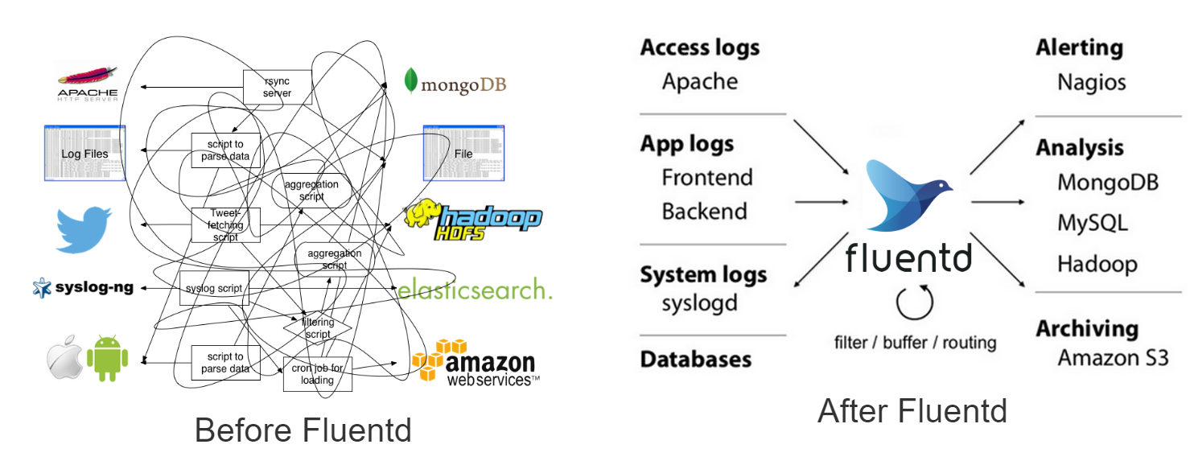
02
FLUENTD

Slide 8
03
ELASTICSEARCH

Slide 9

03
ELASTICSEARCH
- Realtime searching.
- Using index.
- JSON data saving (NoSQL).
- Implemented in Big Data.

Slide 10

03
ELASTICSEARCH

Slide 11
04
KIBANA

Slide 12
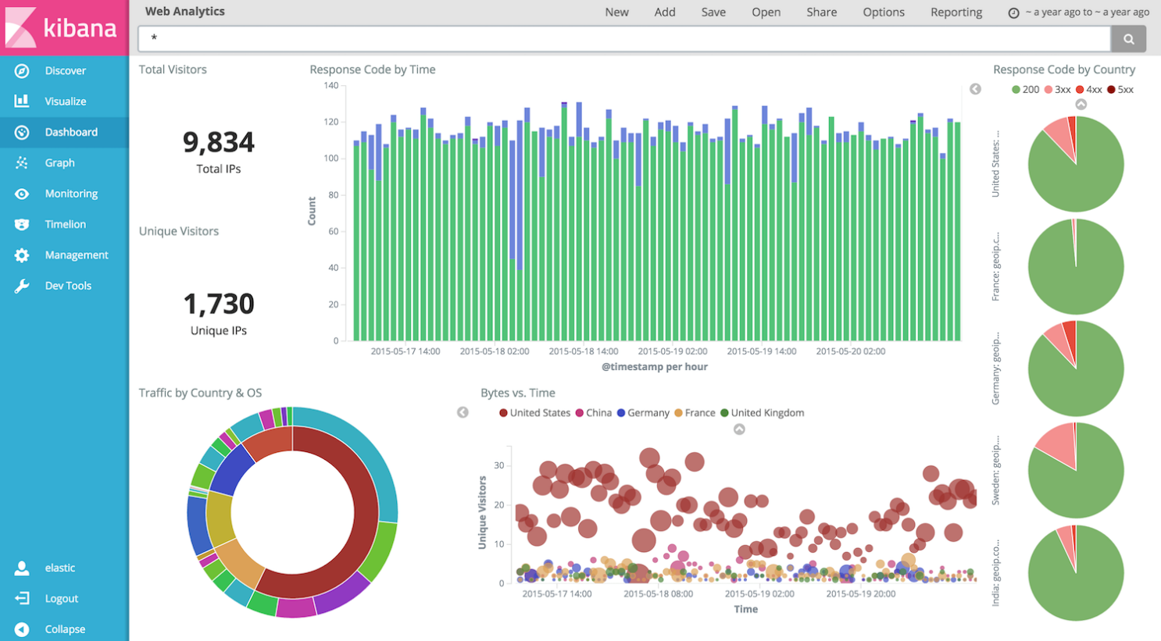
04
KIBANA

Slide 13
ADVANTAGES
WHY WE USE EFK?
THE ADVANTAGES OF EFK

Slide 14
01
THE ADVANTAGES OF EFK
- Easy log management, collect log from multiple resources.
- Easy to integrate with other systems.



- FREE.
- Good extension and development.
- Powerful filters and search engine.
- Great support community and variety tutorials.

Slide 15
IMPLEMENTATION
IMPLEMETATION OF EFK
TO MICROSERVICE APPLICATION

Slide 16
01
SETUP EFK

Slide 17
01
SETUP EFK
- Docker-compose file.



- Kibana config file.
- Fluentd config file.

Slide 18
02
SETUP SERVICE

Slide 19
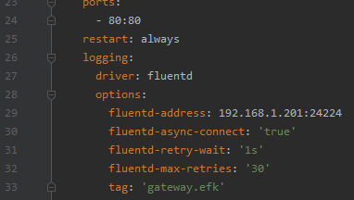
02
SETUP SERVICE




Slide 20
THANK YOU
QUESTION ABOUT EFK?

Slide 21
IF YOU HAVE ANY QUESTIONS HERE
PLEASE KEEP IT IN YOUR MIND
I AM NOT GOOGLE

