Slide 1
Rockwell automation presentation
Role: Senior engineer, embedded software
Tran truong giang

Slide 2
About me
Education
Mechanical Engineering – Mechatronics stream (NTU, 2017)
Certificate taken:
Linux device drivers for embedded system (NTU)
Professional Scrum Master 1 (Scrum.org)
Object-Oriented Design (Coursera)
Object-Oriented Data Structures in C++ (Coursera)
Python Mega course (Udemy, taking)
Leadership role:
Scrum master – ICP21 Project (Continental)
Work Experiences
Continental Automotive (2018 – Now)
Interior Camera Platform: Bring up software/drivers for hardware, develop base software for project teams (3 successful demos presented, 1 is about to be presented)
BMW Driver Camera System: Analyzed Customer requirement for Diagnostics module, fixed bug, aligned with customers and other stakeholders to get the agreement on the requirement.

Slide 3
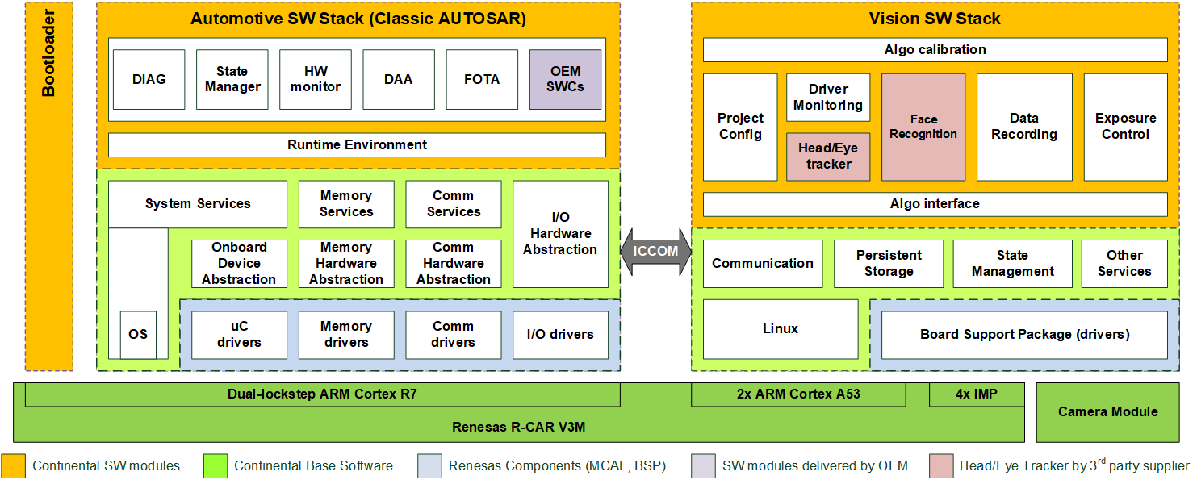
Project: ICP21 – Interior camera platform
Role: Scrum master, developer, Inventory Responsible, Jenkins maintainer
Programing Language: C (for bootloader booting time analysis, booting configuration and linux driver development, AUTOSAR), C++ (for application development), Python and Bash (for software build, Jenkins, Klocwork build process and maintaining)
Modules: Camera driver, ICCOM, Driver Monitoring, Image Fault Detection.
IDE: VS Code
Microcontroller: Renesas V3M (dual core Arm v7 and Arm v8)

Slide 4
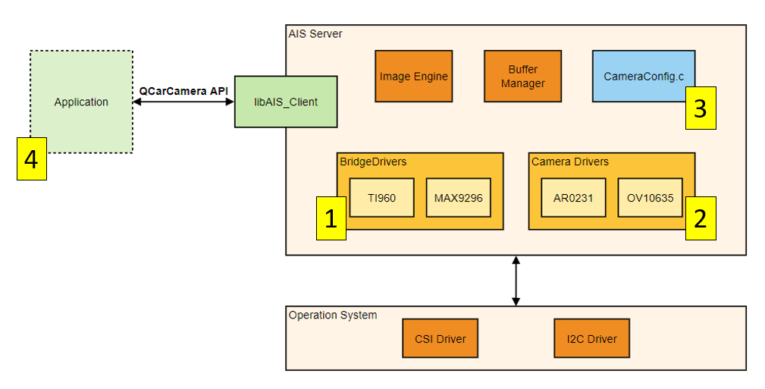
Innovation project – Interior camera platform
Role: Developer, Inventory Responsible
Programming Language: C (for QNX driver development), C++ (for application integration with new camera driver), Bash (to automate build process for personal usage), Python (to automate power source of the HW for remote access)
Modules: Camera driver, Camera integration
IDE: VSCode
Microcontroller: Qualcomm SA8155 (Arm v8)

Slide 5
Other skills
Communication: Be able to work independently and handle the communication with other stakeholders (scrum masters, integrators, HW engineers, HW FAE, POs, customers, etc.)
Team player: actively support teammates and give them guidance within my capability. Write documentations, provide ideas and automated scripts to help boost the team productivity.

Slide 6


