Slide 1
Interview presentation
Tran truong giang

Slide 2
About me
Education
Mechanical Engineering – Mechatronics stream (Nanyang Technological University, 2017)
Certificate taken:
Linux device drivers for embedded system (NTU)
Professional Scrum Master 1 (Scrum.org)
Object-Oriented Design (Coursera)
Object-Oriented Data Structures in C++ (Coursera) Leadership role:
Scrum master – ICP21 Project (Continental)
Work Experiences
Continental Automotive (2018 – Now)
Interior Camera Platform: Bring up software/drivers for hardware, develop base software for project teams (project demo was successfully delivered on time)
BMW Driver Camera System: Analyzed Customer requirement for Diagnostics module, fixed bug, aligned with customers and other stakeholders to get the agreement on the requirement (product is released on market)
Innovation project, 5MP RGB-Ir integration to HPC system: Bring up driver for camera hardware, integrate the new camera driver to driver monitoring system (project demo was successfully delivered)
Generic software working with USB camera and Raspberry Pi for internal demo: Integrate USB Camera with Driver monitoring system software Algo team to demo a new algo library

Slide 3
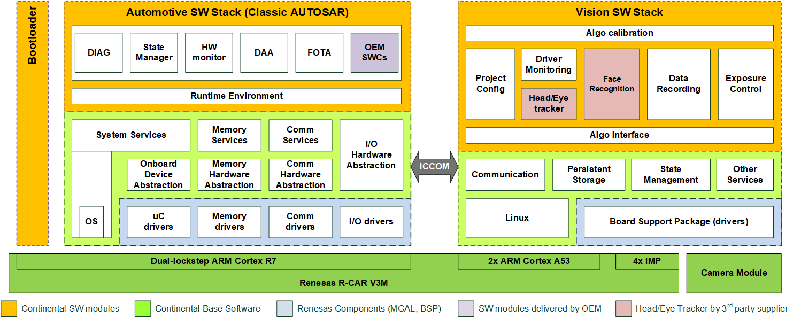
Project: ICP21 – Interior camera platform
Role: Scrum master, developer, Inventory Responsible, Jenkins maintainer
Programing Language: C (for bootloader booting time analysis, booting configuration and linux driver development, AUTOSAR), C++ (for application development), Python and Bash (for software build, Jenkins, Klocwork build process and maintaining)
Modules: Camera driver, ICCOM, Driver Monitoring, Image Fault Detection.
This is a small diagram to roughly describe my implementation for the ICCOM module base on what I remember: iccom.drawio - diagrams.net

Slide 4
Project: BMW Driver camera system
I wish that I can put something here, but it was long time ago and I couldn’t access to the project document anymore, so I cannot recall to roughly describe some significant implementations that I made for this project ☺
All I can tell is I worked on Diagnostics module and fixed bugs for this module. I contributed greatly on analysing, discussing, implementing and testing on NO_I2C_COMM Diagnostic trouble code.
Role: Developer
Programming language: C++ (For application development)
Module: Diagnostics

Slide 5
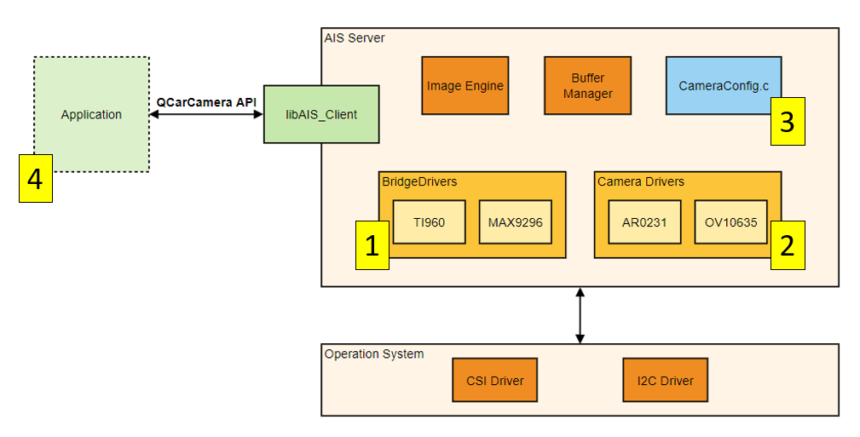
Innovation project – Interior camera platform
Role: Developer, Inventory Responsible
Programming Language: C (for QNX driver development), C++ (for application integration with new camera driver), Bash (to automate build process for personal usage), Python (to automate power source of the HW for remote access)
Modules: Camera driver, Camera integration
This diagram will describe better my implementation: Integrate_5MP_RGBIr_CHPC.drawio - diagrams.net

Slide 6
Small project: integrate Usb cam with dms on raspberry pi 4 board
The implementation that I made will be provided in this diagram: TobiiDemo.drawio - diagrams.net
Role: Developer
Programming language: C++ (application development), bitbake script and Cmake (software compilation)
Module: Camera Control.

Slide 7
Other skills
Communication: Be able to work independently and handle the communication with other stakeholders (scrum masters, integrators, HW engineers, HW FAE, POs, customers, etc.)
Team player: actively support teammates and give them guidance within my capability. Write documentations, provide ideas and automated scripts to help boost the team productivity.
Besides, I have experience in reading manuals, schematics, using oscilloscope to measure and test HW working conditions.

Slide 8
Thank you/Danke ☺

