Slide 1
Apis Add-on
Author | : | Apis team
Last update | : | March 9, 2018

Slide 2
AGENDA
Overview
Permission
Company data set
Apis data set
Request domain
Requirement domain
Test domain
Reporting domain
Delivery domain
Apis add-on status
Q&A

Slide 3
Overview
As Application Lifecycle Management (ALM) software, Apis allows you to manage the software development process. As an internal and collaborative tool, Apis uses multiple domains to convey the following: Request, Test, Reporting, Requirement, Delivery and Support.
Apis includes two data spaces namely Apis and Test data. The first contains two data sets: Apis and Company.
Apis data set: contains campaign definition, test scenarios, test input output contexts and reference data (test topic, test action category, requirement, request, eport…etc.)
Company data set: contains software products (product versions, product builds), test configuration (server/client configuration and the information of the company who conducts test....etc.)
Test data data space: contains reference data used for Input output data. The input output data for all steps defined in Apis data set come from this data space.

Slide 4
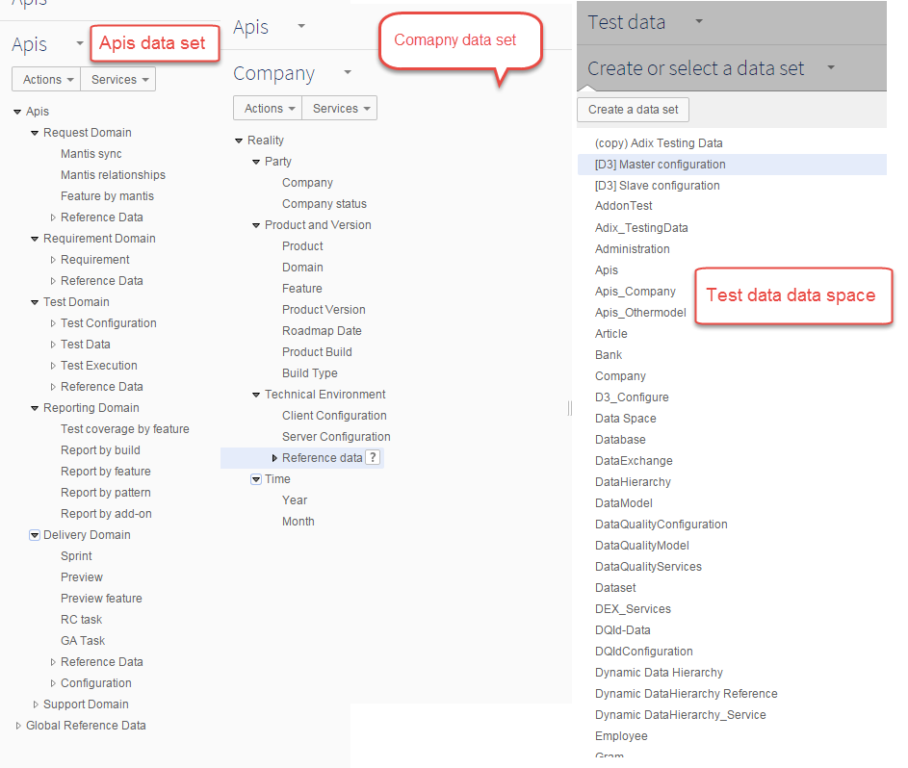
Overview

Slide 5
Overview
Requirement Domain
Define Requirement
For product, feature ? Applying for EBX version ? Validator?
Mantis
Log mantis
Request Domain
DEV team
TEST team
Test Domain
Sprint
Delivery Domain
Analyzing requirement
Creating Functional spec Creating Technical spec
Create some main test cases
Receive, analyzing requirement
Implement
Preview01, Preview 02, …
Create test cases Execute test cases
If it has any bug --> Log mantis
Release Candidate
Fix bug (if any)
Create test cases Execute test cases
If it has any bug --> Log mantis
General Availability
Fix bug (if any)
Create test cases Execute test cases
If it has any bug --> Log mantis
Notes:
10 min

Slide 6
Company data set
Reality
Company
Company status
Software Product and version
Product: the product on which test is applied
Domain
Feature
Product version: Business version of a product. E.g. 6.3.1
Roadmap date: Date on which a Product version is expected
Product build: Actual version of a product in a certain Built type. Eg.6.3.1 (666) RC 01 where 666 is an identifier of a source configuration management tool such as CVS, and RC the built type. 01 is the order of the product built, here it refers to the first RC
Build type: Type of product built. E.g. RC=Release Candidate, GA= General Availability, TEST
Technical Environment
Client configuration: Association between one browser and one operating system on which test can be executed.
Server configuration: Association between one browser, one operating system and one database
Browser
Operation system
Database

Slide 7
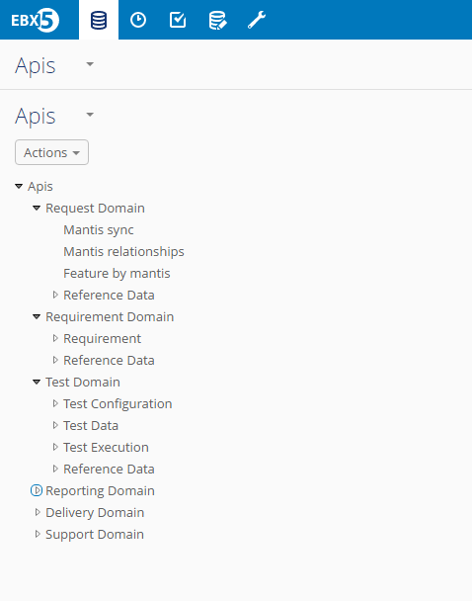
Apis data set

Slide 8
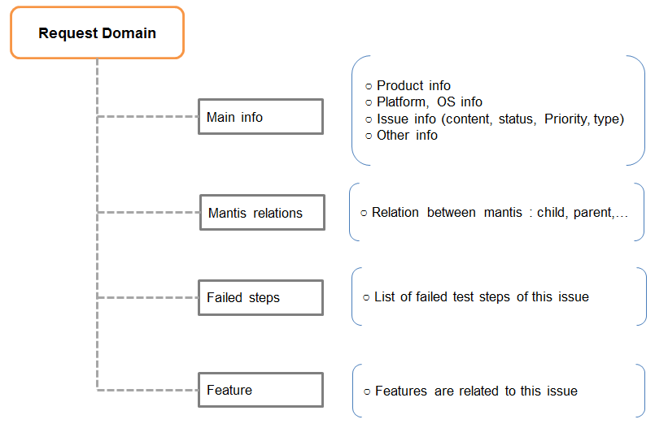
IV. Apis: REQUEST DOMAIN (Overview)
Requests — A request can take the form of a reported bug, an implemented feature change, or an analysis request created by the support, professional services and test team.
The values of the [Mantis Sync] table can be extracted and imported from Mantis bug tracker.
A record contains the following information:

Slide 9
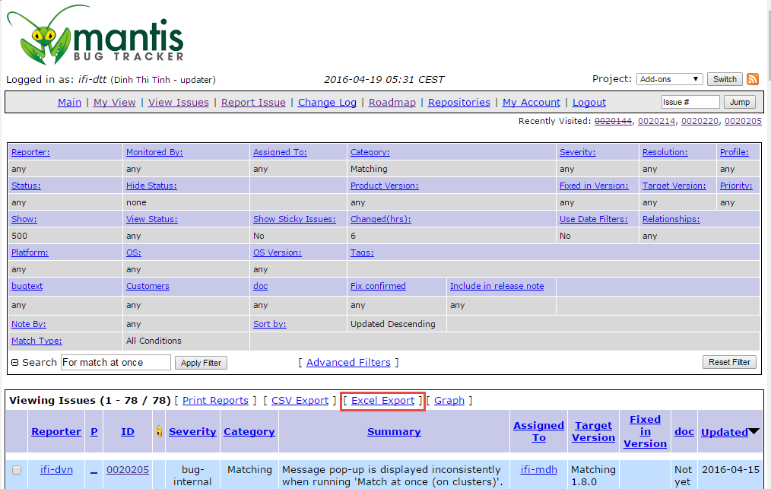
IV. Apis: REQUEST DOMAIN (Synchronize mantis)
1
Notes:
On ‘Mantis bug tracker’, filler all the mantises to be synchronized with Apis, then click on the ‘Excel Export’ button.

Slide 10
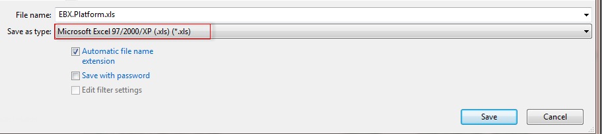
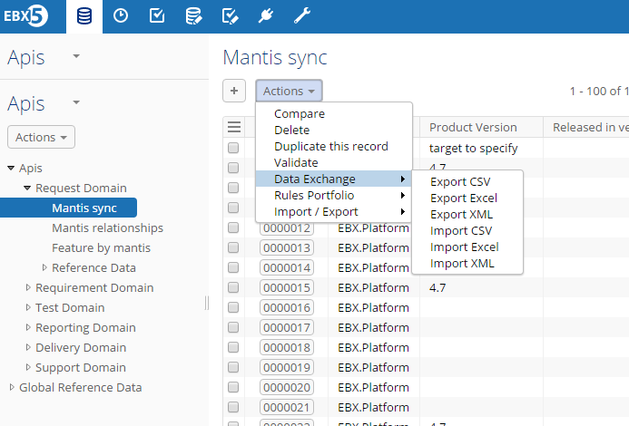
IV. Apis: REQUEST DOMAIN (Synchronize mantis)
1
2
Notes:
Open the exported file then save it as Microsoft Excel type.
Import the exported file into the [Mantis Sync] table in the Apis add-on by using the ‘Import Excel’ service of the Data Exchange add-on.

Slide 11
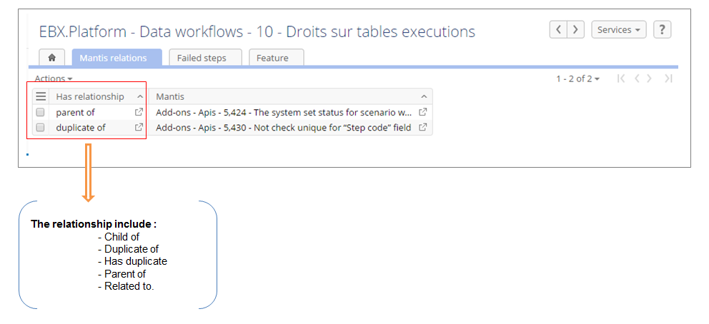
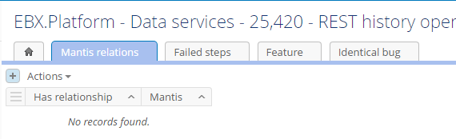
IV. Apis: REQUEST DOMAIN (Mantis relation)
1
2
Notes:
Users can create a relationship between this issue with other issues.
Click on the (+) button to create a new relationship.

Slide 12
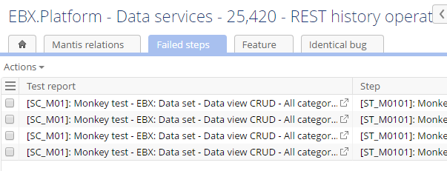
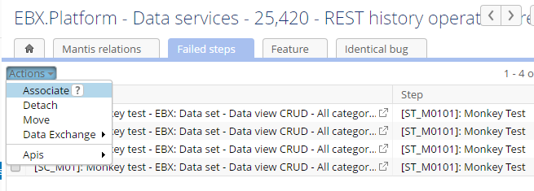
IV. Apis: REQUEST DOMAIN (Mantis relation)
1
2
Notes:
List of failed steps of the issue.
From the ‘Actions’ menu, select ’Associate’ to add more failed steps to the issue.

Slide 13
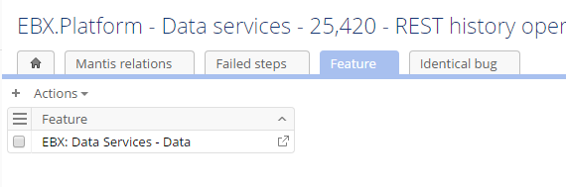
IV. Apis: REQUEST DOMAIN (Mantis relation)
2
1
Notes:
List of features related to the issue.
Click on the (+) button to add more features to the issue.

Slide 14
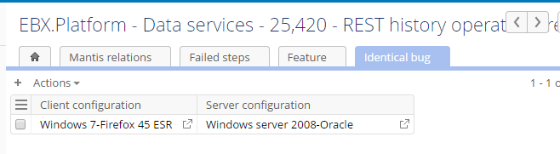
IV. Apis: REQUEST DOMAIN (Mantis relation)
2
1
Notes:
Define the environment where the issue is detected.
Click on the (+) button to define environment.

Slide 15
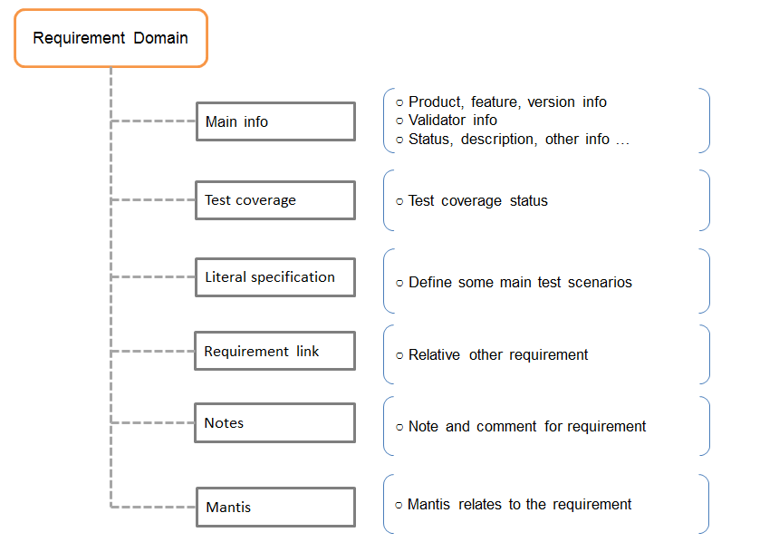
IV. Apis: REQUIREMENT DOMAIN (Overview)
Requirements — A requirement describes expected functionality deliverable for specific product versions.
Test requirement — informal description of expected feature details or behavior.
This test requirement is used to build literal specification test case.
Requirement sharing:
Once a requirement is created, other users can add contribution notes, then the requirement author can give feedback.

Slide 16
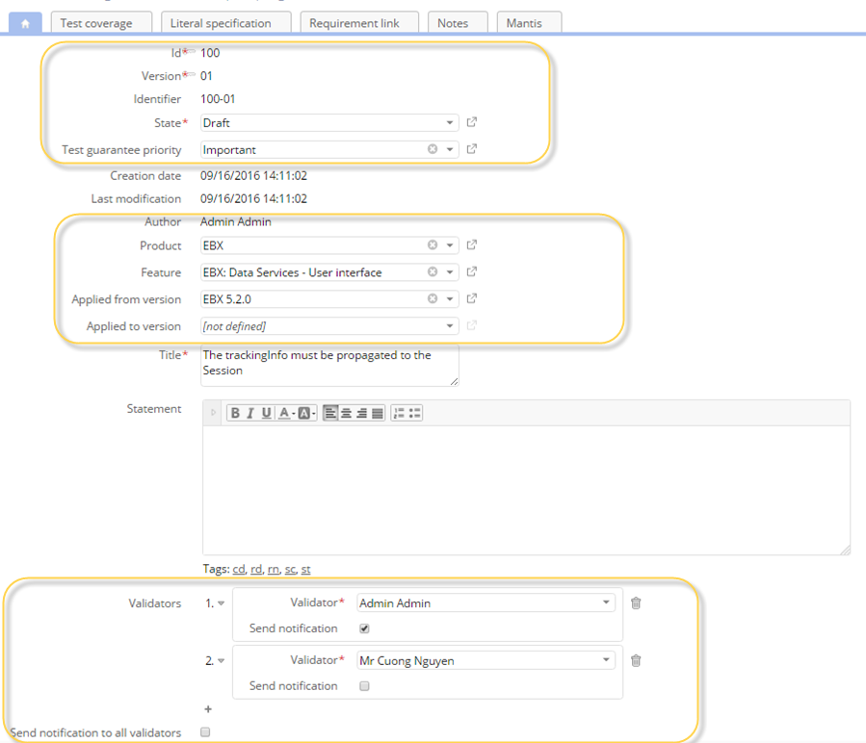
IV. Apis: REQUIREMENT DOMAIN (Main information)
1
2
3
4
Notes:
Id (This is a number to identify a requirement), Version (the number to indicate the version number of a requirement), Identifier (Identifier is the composition of id and version to completely identify a requirement with version information), Test guarantee priority (The priority to indicate the necessary of test for the requirement).
Author (The creator of requirement), Product (The product of software on which the requirement is defined), Feature (The feature on which the requirement describes ), Applied from version (The product version from which the requirement is applied), Applied to version (The product version to which the requirement is applied).
Short and detailed description of the requirement.
The people who are responsible for validating the requirement.

Slide 17
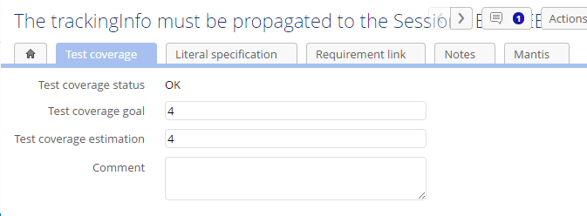
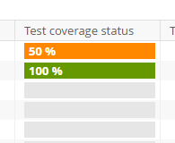
IV. Apis: REQUIREMENT DOMAIN (Main information)
1
2
Notes:
Test coverage status: 'OK' if test coverage estimation is equal to or greater than test coverage goal, otherwise status is 'KO'. 'Undefined' if test coverage goal or test coverage estimation are not defined or equals 0.
Status is filled by green, orange and grey for OK,KO, and Undefined respectively.

Slide 18
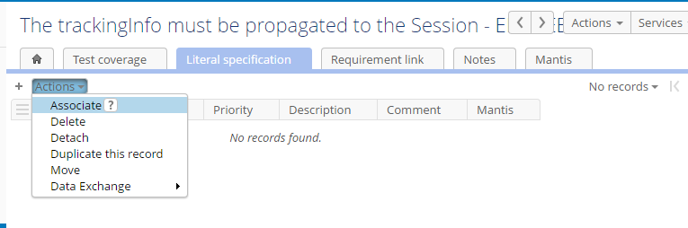
IV. Apis: REQUIREMENT DOMAIN (Requirement relation)
1
2
Notes:
The list of literal specifications relate to requirement.
Click on the (+) button or select ‘Associate’ from the ‘Actions’ menu to define more literal specification test cases.

Slide 19
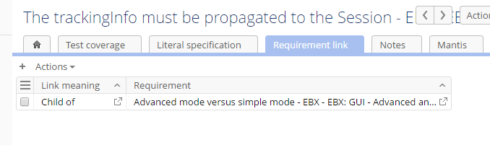
IV. Apis: REQUIREMENT DOMAIN (Requirement relation)
2
1
Notes:
The list of the other requirements relate to this requirement.
Click on the (+) button to define the relationship between this requirement with others.

Slide 20
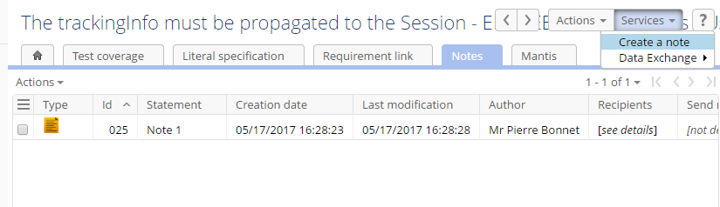
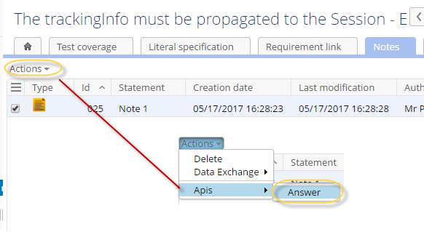
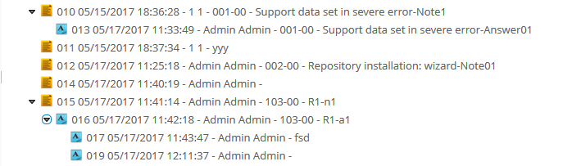
IV. Apis: REQUIREMENT DOMAIN (Requirement relation)
2
1
3
4
Notes:
Note is the means for requirement makers to add more information and enrich the requirements.
Run the ‘Create a note’ service from the ‘Services’ menu to create a note for the requirement.
Select the node, then run the ‘Answer’ service from the ‘Actions’ menu to create the answer note.
The display of note and answer note.

Slide 21
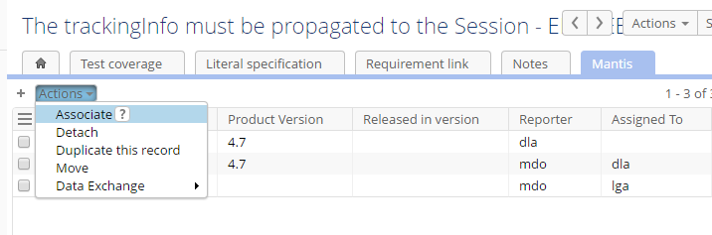
IV. Apis: REQUIREMENT DOMAIN (Requirement relation)
1
2
Notes:
The list of mantis relate to this requirement.
Select ‘Associate’ from the ‘Actions’ menu to add more Mantis to the requirement.

Slide 22
IV. Apis: TEST DOMAIN (Overview)
Test Domain — Working with tests requires management of all test related data including definitions and outcomes.
Define test configuration:
Define test objective (Campaign definition)
Define literal specification (Literal specification and detailed scenario)
Define case to test (Scenarios and detailed steps to do)
Define test environment such as systems and data bases
Define test data:
Define inputs and expected results (input/output data, input/ output context such as screen action, action category,... etc)
Manage test execution:
Specify test environments such as OS, test type,...etc
Store test results, occurred bugs (create reports for test cases to save test results, execution information such as execution time...)

Slide 23
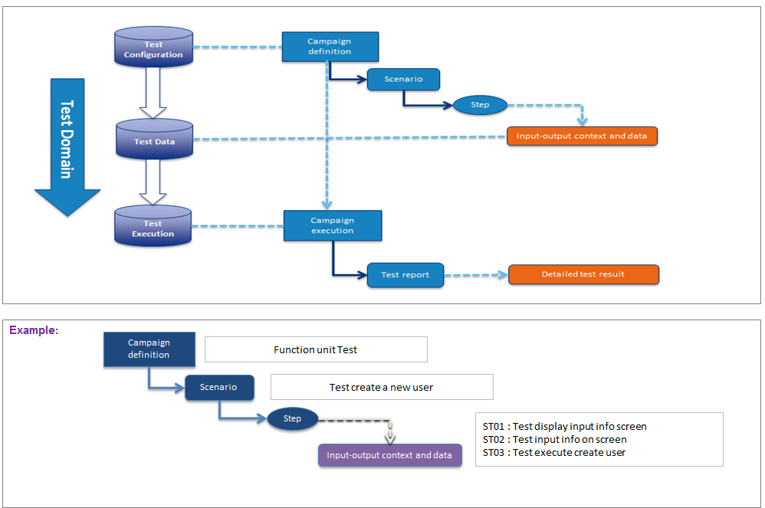
IV. Apis: TEST DOMAIN (Overview)

Slide 24
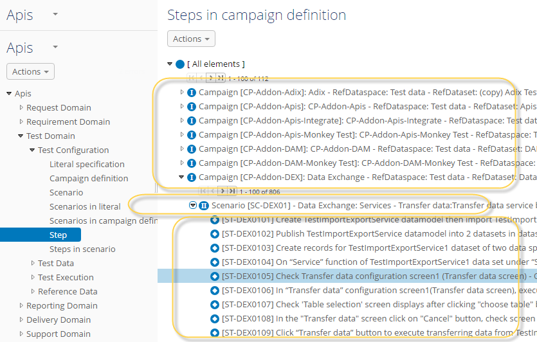
IV. Apis: TEST DOMAIN (Test configuration)
1
2
3
Notes:
The relation between campaign definition and scenario/ scenario and step on the hierarchy view.
Campaign definition.
Scenario.
Step.

Slide 25
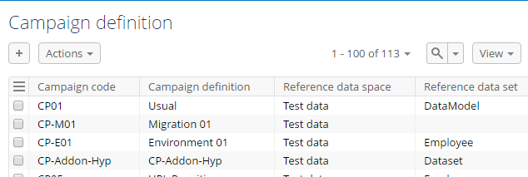
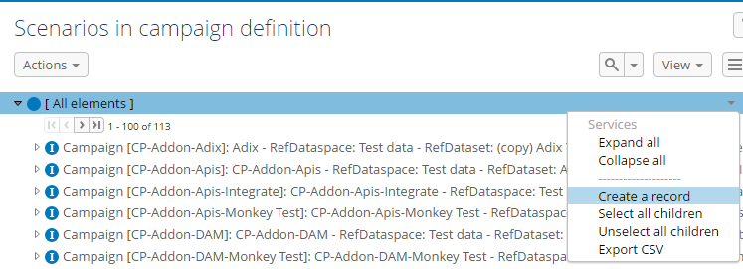
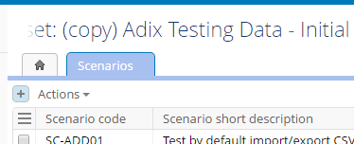
TEST DOMAIN (Test configuration)
1
2
3
Notes:
There are many ways to create a new campaign definition/ Literal specification/ Scenario/ Step/ their relations.
Click on the (+) button in the tabular view.
Run the ‘Create a record’ service from service menu of a node on the hierarchy view in Test domain.
Click on the (+) button from an association tab.
Constraints:
+ Code of a Campaign definition must start with ‘CP’.
+ Code of a Literal specification must start with ‘LS’.
+ Code of a Scenario must start with ‘SC’.
+ Code of a Step must start with ‘ST’.

Slide 26
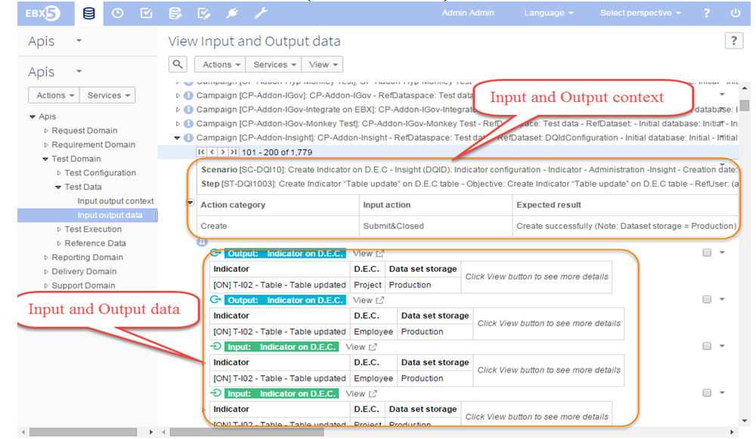
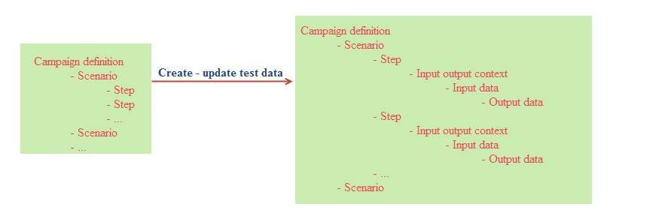
TEST DOMAIN (Test data)
2
1
Notes:
The display of test data in the hierarchy view.
There are three ways to create – update test data:
Create - update test data for all steps in a campaign definition: run the 'Create – update test data for selected campaign definition' service on the [Campaign definition] table.
Create – update test data for all steps in a scenario in a campaign definition: run the 'Create – update test data for selected scenario' service from a scenario node in the 'Scenarios in campaign definition' view on the [Scenario] table.
Create test data and new step in campaign definition simultaneously: run the 'Add new step' service from s scenario node in the 'Steps in campaign definition' view on the [Step] table.

Slide 27
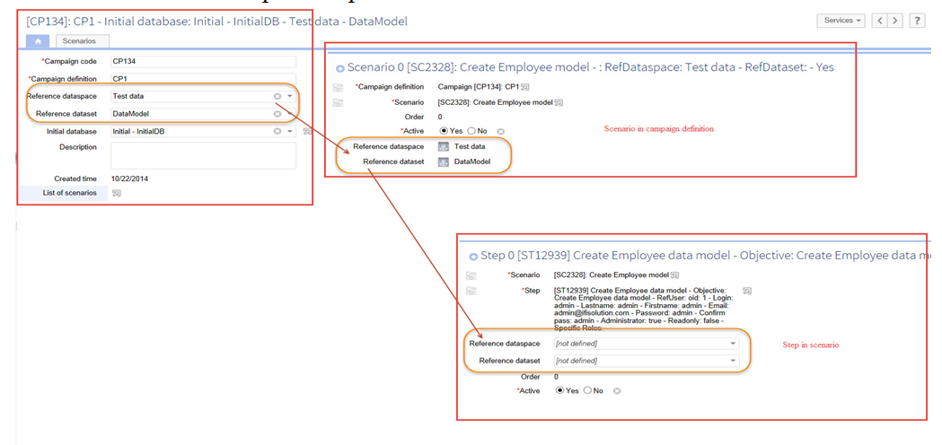
TEST DOMAIN (Test data)
2
1
3
Notes:
The input and output data of a context depend on the defined reference data space and data set.
If all campaigns use common reference data, users can define ‘Reference data space’ and ‘Reference data set’ in a campaign definition.
If all steps in a scenario in a campaign use common reference data, users can define ‘Reference data space’ and ‘Reference data set’ in a join record between the campaign and the scenario.
If not, users can define ‘Reference data space’ and ‘Reference data set’ in a join record between the scenario and the step.
Reference data in lower level will be inherited from higher level.

Slide 28
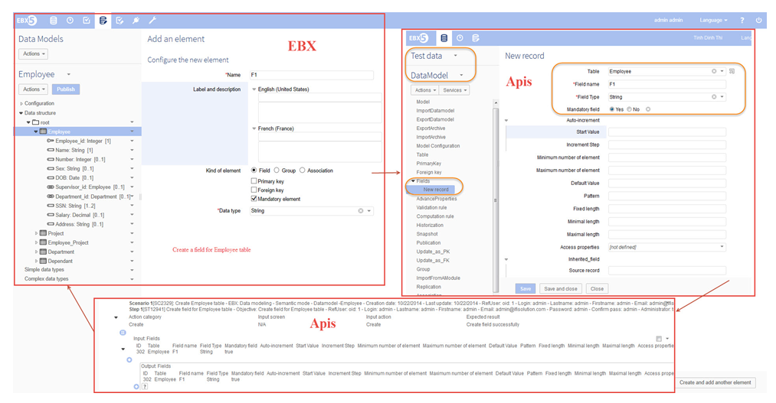
TEST DOMAIN (Test data)
1
2
2
Notes:
Define data set to store the data reference for test case in the Test data data space.
Example:
1. There is a test case: create a new field for Employee table.
2. To show all the information of a field in Apis, we must have a model containing all properties of the field, then publish it to the ‘Test data’ space.
3. Create a record containing all properties of the field in created data set in the ‘Test data’ space, then use that record for Input and Output data in Apis.

Slide 29
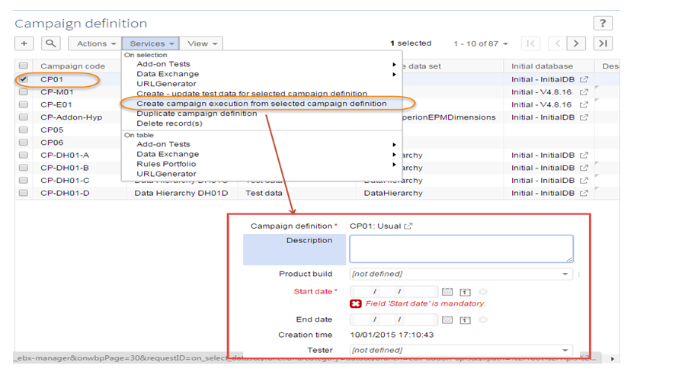
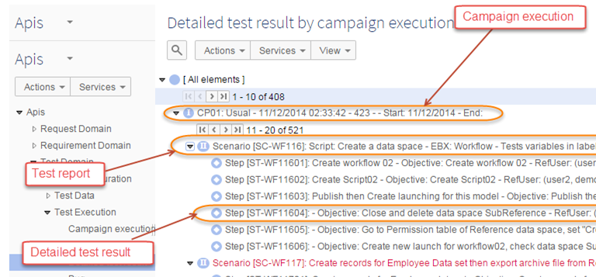
TEST DOMAIN (Manage test execution)
1
3
2
Notes:
Access the [Campaign definition] table, select a record then run the ‘Create campaign execution from selected campaign definition’ service.
Afterwards, a new campaign execution is opened.
The report at scenario and step level will be created after users run service to create campaign execution.

Slide 30
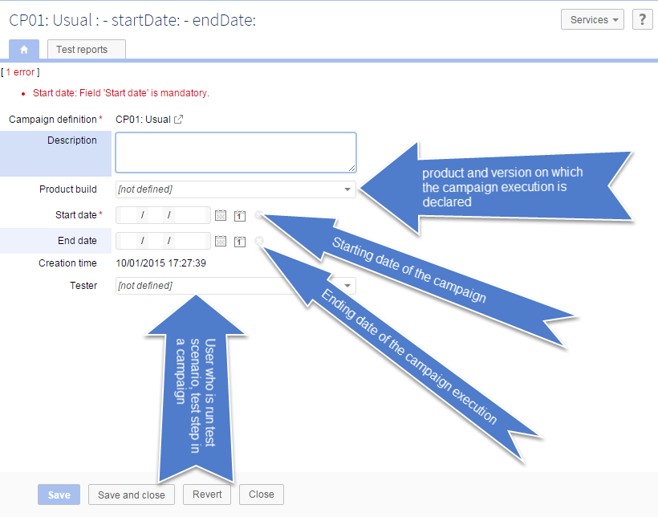
TEST DOMAIN (Manage test execution)
1
Notes:
A campaign execution is related to a campaign definition. It defines on which product and version the test campaign is achieved. A campaign definition can be performed several times on different versions and products. It is associated with start and end dates.

Slide 31
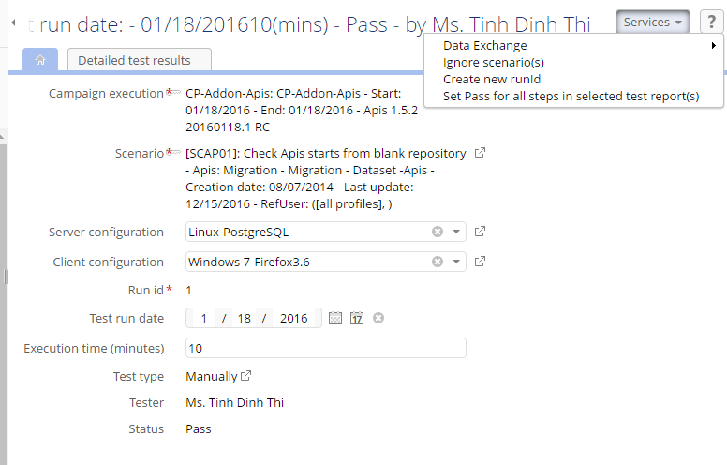
TEST DOMAIN (Manage test execution)
2
1
Notes:
A test report provides status of a test at the level of a scenario within a campaign execution. It is possible to define many statuses for a scenario when it is executed several times. Each outcome is then identified through an execution identifier.
Computation rule of test report status:
At least 1 step Fail → Scenario Fail.
At least 1 step N/A → Scenario N/A.
At least 1 step not defined → Scenario not defined.
Ignored step is not included in computing status of scenario.
All steps Pass –> Scenario Pass.
Run service from the [Services] menu to change status of the test report.

Slide 32
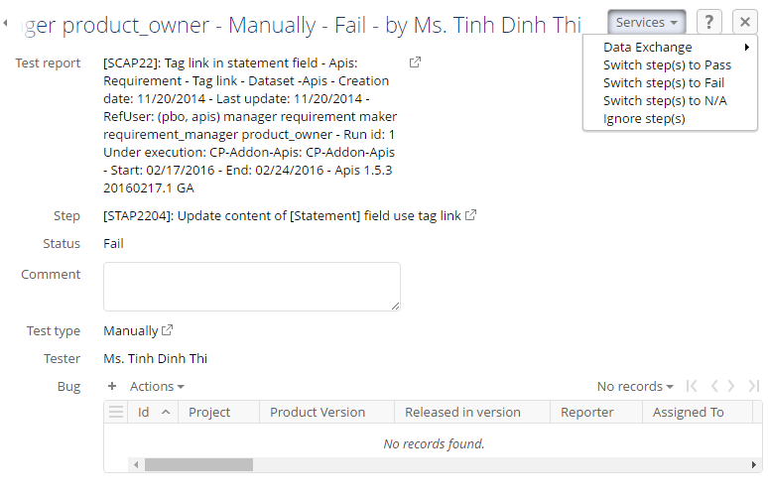
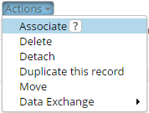
IV. Apis: TEST DOMAIN (Manage test execution)
1
2
3
4
Notes:
A detailed test result provides status of test at the level of a step within a scenario and a campaign execution.
Run service from the [Services] button to change the status of the detailed test result.
Status of the detailed test result: Pass, or Fail, or N/A, or Ignore.
‘Bug’ is available when the status is ‘Fail’.
Select ‘Associate’ from the ‘Actions’ menu to add Mantis to the failed step. (Value of the bug field is extracted from the ‘Mantis sync’ table in the Request domain).

Slide 33
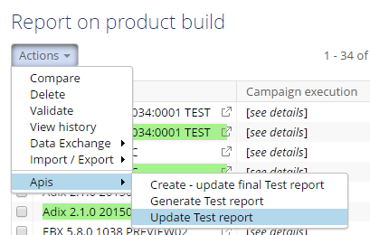
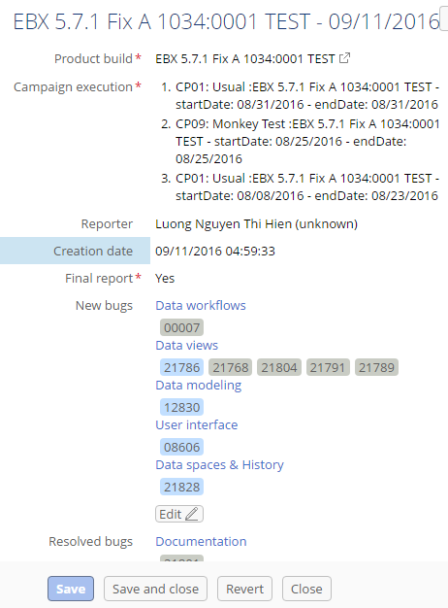
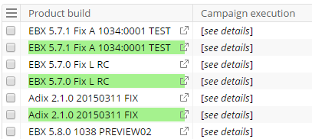
IV. Apis: TEST DOMAIN (Report on product build)
1
2
3
Notes:
The table to store report for an add-on or EBX build.
Services on the table:
Generate Test report.
Update Test report.
Create – update final Test report.
Information in a Test report.
In the tabular view, the final test report is displayed in green.

Slide 34
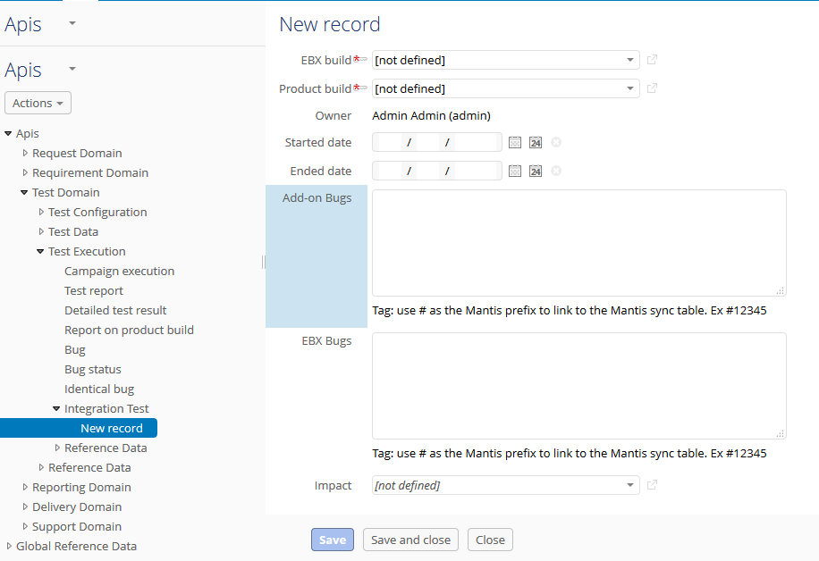
TEST DOMAIN (Integration test)
2
1
Notes:
Location: In the ‘Test Execution’ group of the ‘Test Domain’.
Contains some fields as follow: EBX build, Product build, Owner, Started date, Ended date, Add-on Bugs, EBX Bugs, and Impact.
Only those users belonging to the [Test manager], or [Addon test leader] can create, update, or delete records in the ‘Integration Test’ table.

Slide 35
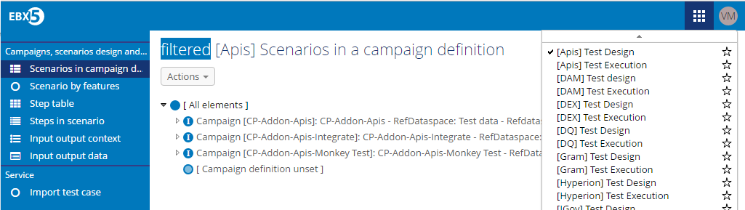
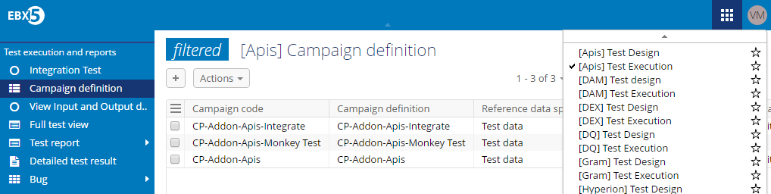
TEST DOMAIN (Perspective)
1
2
Notes:
Test design perspective (For Add-ons and EBX).
Test execution perspective (For Add-ons and EBX).

Slide 36
IV. Apis: REPORTING DOMAIN (Overview)
Reporting — Reports cover computation and creation for given indicators such as the number of bugs detected by feature, or per build.
The indicators in every report tables cannot be modified by the users, they are computed automatically at created or updated time instead.

Slide 37
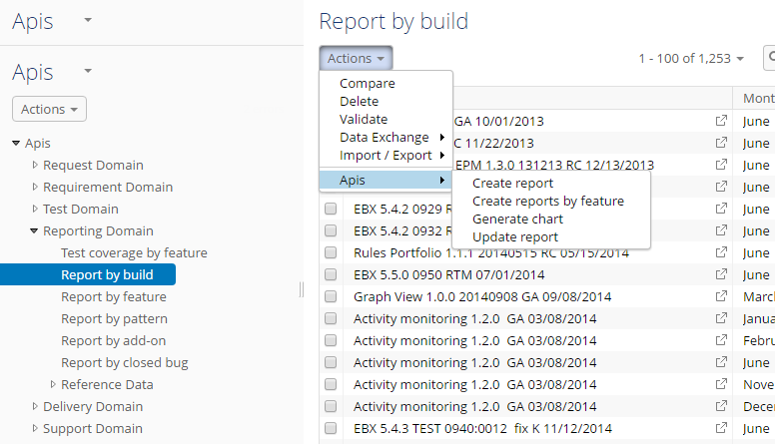
IV. Apis: REPORTING DOMAIN (Create/Update report/ Generate chart)
1
2
3
4
Notes:
Create report: (For all table except [Report by feature] table) Run the 'Create report' service under the [Services] menu → Select Year/ Month → Click [Submit].
Create report for the [Report by feature] table: Run the 'Create reports by feature' service under the [Services] menu on Selected 'Report by build' on the [Report by build] table.
Generate chart: (For all tables except [Test coverage by feature] and the [Report by closed bug] table.) Run the 'Generate chart' service under the [Services] button → Select Year/ Month → Click on the [Generate] button.
Update report: Select records -> Run the ‘Update report' service under the [Services] menu.

Slide 38
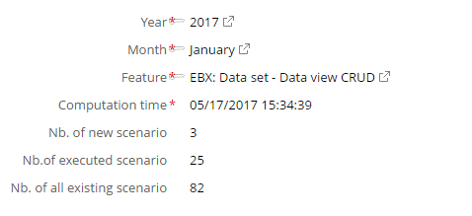
REPORTING DOMAIN (Test coverage by feature)
1
2
3
Notes:
Number of scenarios with underlying feature, month and year from ‘Scenarios by product feature’ view in the [Scenario] table.
Number of executed scenarios for current build with test run date in the current month/year under corresponding feature.
Number of scenarios under feature in the ‘Scenario by product feature’ [Scenario] table.

Slide 39
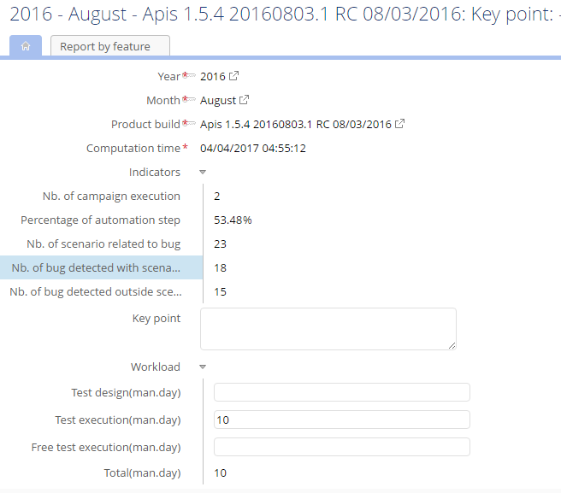
IV. Apis: REPORTING DOMAIN (Report by build)
1
2
3
4
5
Notes:
Number of campaigns executed underlying current build in the current year/month in execution build.
The percentage automation detailed test result with all executed steps in execution build.
Number of scenarios related to bug detected in the current build, this bug is detected in current time, it must be included in the scenario, the scenario must be referred in bug. Scenario of test report that related to bug must belong to a specific feature.
Number of bugs detected in the current year/month for found on the ‘Campaign execution and found bugs’ view of the current build. Notice the run date of test report must be long to a specific product feature.
Number of bugs detected in the current year/month found on the ‘Campaign execution and found bugs’ view under Monkey test campaign of the current build. Scenario of test report that related to bug must belong to a specific product feature.

Slide 40
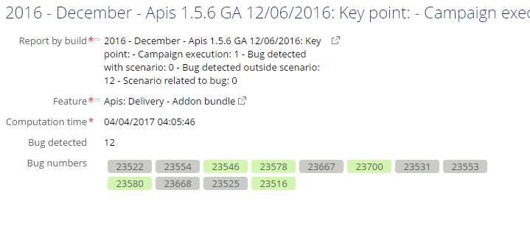
IV. Apis: REPORTING DOMAIN (Report by feature)
1
Notes:
Number of bugs under the current build of corresponding feature in campaign execution and found bugs view of Mantis sync table. Scenario of test report that related to bug must belong to a specific product feature.

Slide 41
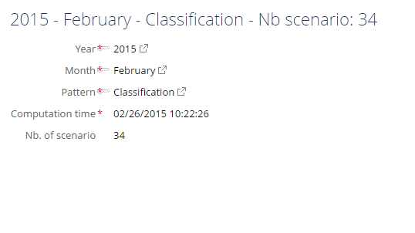
IV. Apis: REPORTING DOMAIN (Report by pattern)
1
Notes:
Number of scenarios whose creation dates match the current year and month found when searching on Scenario table with filter set to corresponding pattern. Scenario must belong to a specific EBX product feature.

Slide 42
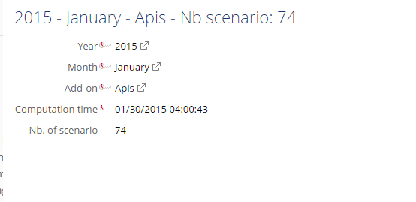
IV. Apis: REPORTING DOMAIN (Report by add-on)
1
Notes:
Number of scenarios under each add-on by ‘Select all children’ in Scenario table in ‘Scenarios by product feature’ view.

Slide 43
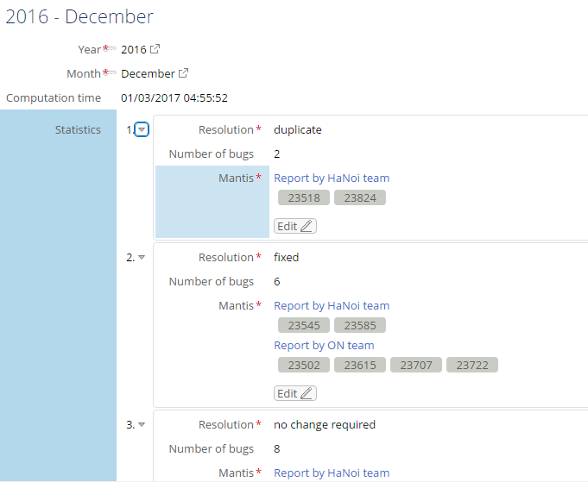
IV. Apis: REPORTING DOMAIN (Report by closed bug)
1
Notes:
Number of EBX Mantis which are closed in the current year/month with each specific resolution.

Slide 44

IV. Apis: DELIVERY DOMAIN (Overview)
Delivery — Delivery includes management of key milestones using a Sprint definition. You can associate delivery features with entries in the Mantis repository. Note that the Apis 'Delivery domain' does not manage data related to workloads and team assignments. The 'Delivery domain' contains the following main pieces of information:
Sprint contents and dates.
Graphical view of sprint timelines (road-maps).
Tracking of date changes.

Slide 45

IV. Apis: DELIVERY DOMAIN (Understanding sprint)
1
2
3
Notes:
A sprint defines a timebox for implementing software based on a well-identified backlog. Information used to describe a sprint includes, but is not limited to: the EBX5 version used and CVS tag, delivery dates, sprint content based on a list of features (Mantis ID) and sprint leader.
The example below shows a sprint related to the Insight add-on version 2.1.0. This is based on EBX5 5.8.0, for sprint releases.
Free description.
Computed automatically from Previews.
Previews in the Sprint.

Slide 46

IV. Apis: DELIVERY DOMAIN (Defining a Preview)
2
1
Notes:
A preview contains an increment of completed release features. During sprint execution, teams deliver one or more previews to avoid the "tunnel effect" that can occur over extended periods of time.
Features implemented in the Preview.
Preview testing includes User Acceptance Testing (UAT) and other formal acceptance testing methods. See the note below for further descriptions of these methods. Teams should deliver previews at the recommended three to four week increments. For sprints taking three months to complete, teams should plan on scheduling three previews before the RC.

Slide 47

IV. Apis: DELIVERY DOMAIN (Add-on bundle)
1
2
3
Notes:
To avoid releasing too many add-on versions, they are aggregated into 'Add-on bundle' groups. An 'Add-on bundle' release has its own version number, delivery date, and includes all existing add-ons with their latest versions.
The EBX version which add-on bundle is built with.
Defines the sprints for the add-on bundle. A sprint's GA date must be prior to the add-on build date. Additionally, there can be only one product version per add-on bundle.
Team project set content is automatically generated depending on the Add-ons.

Slide 48



DELIVERY DOMAIN
2
1
3
Notes:
Delete record(s): Deletes the sprint, its preview definition, preview content and tasks.
Export roadmap: Exporting information of sprints.
View roadmap: Displays the product roadmap for a specified time period.

Slide 49



DELIVERY DOMAIN
1
2
Notes:
View add-on bundles roadmap: Displays the roadmap for all add-on bundles.
Export team project set: Generates the team project set for the selected add-on bundle.

Slide 50
Apis add-on status
SDG:
- Apis 171 with ebx 581 fix B
Current:
- Apis 180 with EBX 5.8.1 fix E
- RC: March 21, 2018
- GA: March 30, 2-18

Slide 51
Q & A

Slide 52
End.

