Slide 1
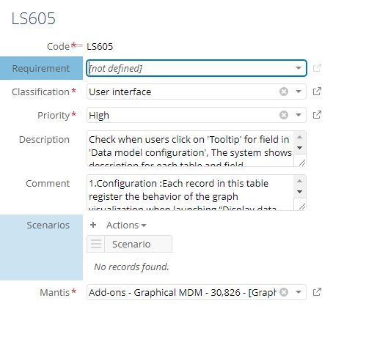
[31864]: [Test] Some fields should be added to indicate which literal specification test cases are designed for a Version delivery.
Overview:
In a specific literal specification test case, it’s unknown if it is designed for ‘Agile’ process or not and belongs to which sprint of a version delivery.

Slide 2
[31864]: [Test] Some fields should be added to indicate which literal specification test cases are designed for a Version delivery.
Analysis:
Some new fields will be added to the Literal specification table to specify that the literal specification test case belonging to ‘Agile’ process or not, and belonging to which sprint of a version delivery.
We need to create hierarchical views based on new added fields above respectively.

Slide 3
[31864]: [Test] Some fields should be added to indicate which literal specification test cases are designed for a Version delivery.
Solution:
[Add new fields] Fields “In version agile” and “Sprint” will be inserted into the Literal specification table.
Field | Label | Type | Description | Mandatory
inVersionAgile | In version agile | Boolean | To specify if literal specification test case is ‘Agile’ process or not | No
fkSprint | Sprint | String | Foreign Key Refer: /root/Apis/EngineeringDomain/Preview To specify literal specification test case belongs to which sprint. | No

Slide 4
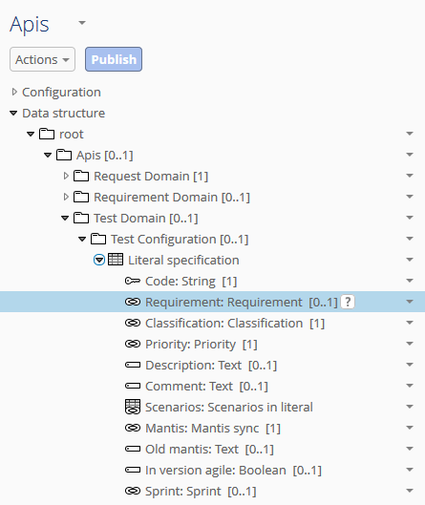
[31864]: [Test] Some fields should be added to indicate which literal specification test cases are designed for a Version delivery.
Solution:
[Add new fields] The fields are located right below ‘Old mantis’ field.

Slide 5
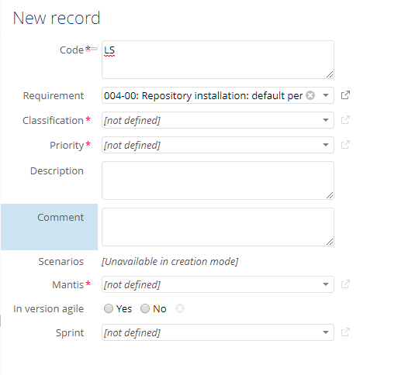
[31864]: [Test] Some fields should be added to indicate which literal specification test cases are designed for a Version delivery.
Solution:
[Add new fields]

Slide 6
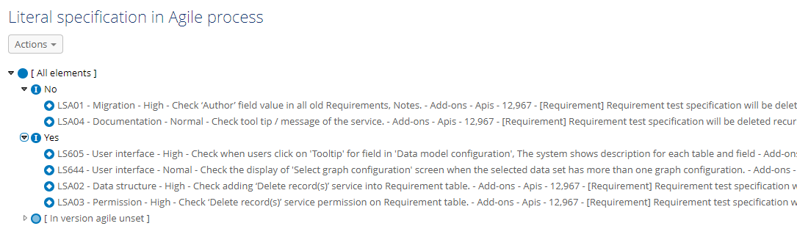
[31864]: [Test] Some fields should be added to indicate which literal specification test cases are designed for a Version delivery.
Solution :
[Create new hierarchical views]: the view is based on ‘In version agile’.

Slide 7
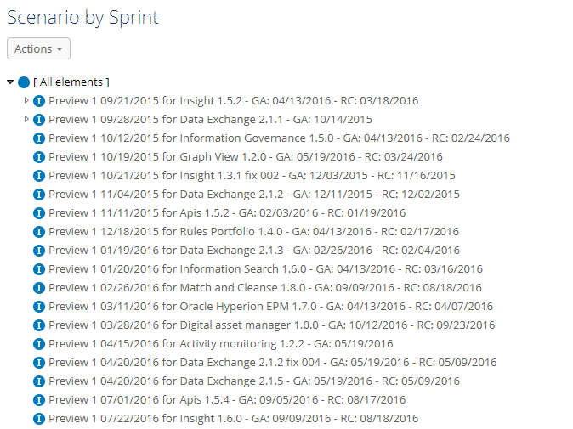
[31864]: [Test] Some fields should be added to indicate which literal specification test cases are designed for a Version delivery.
Solution:
[Create new hierarchical views]: the view is based on ‘Sprint’.

Slide 8
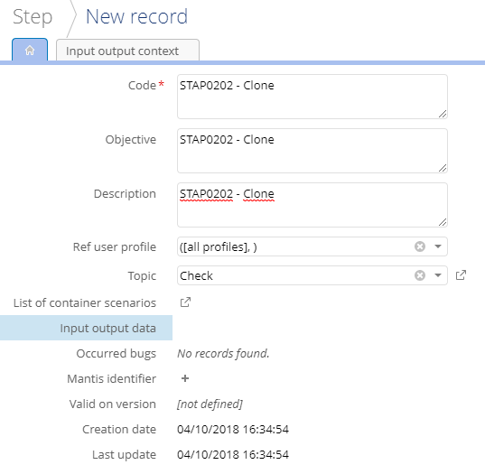
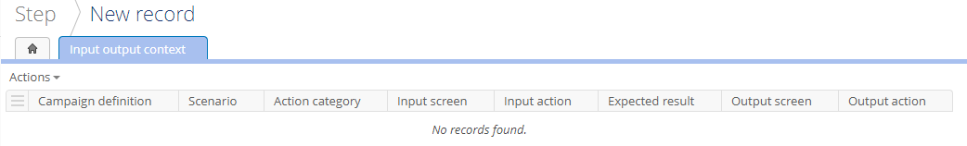
0031860: [Test] It should be possible to duplicate test data' along with 'Step' when duplicating a 'Step'.
Overview :
When a step is duplicated from another existing step, this cloned step’s input output data and input output context cannot be chosen.

Slide 9
0031860: [Test] It should be possible to duplicate test data' along with 'Step' when duplicating a 'Step'.
Analysis :
After user duplicate an existing step by using ‘Duplicate this record’ service of EBX, expected result is :
+ New step.
+ New input output context with the same context of the original step.
+ New input output data with the same data of original step.

Slide 10
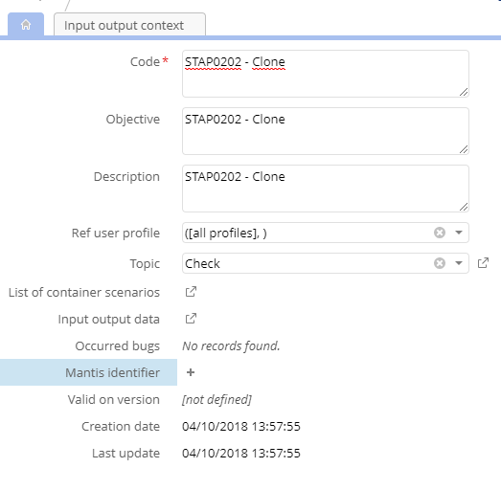
[31860]: [Test] It should be possible to duplicate test data' along with 'Step' when duplicating a 'Step'.
Solution :
When user duplicate an existing step by using ‘Duplicate this record’ service of EBX. It will create a new step. The new step has the same input output data and input output context as the original step.

Slide 11
[31860]: [Test] It should be possible to duplicate test data' along with 'Step' when duplicating a 'Step'.
Solution :
The context and data of the original step will not be linked to the duplicated step. This is to prevent any changes to the duplicated when the user modifies the context and data of the original step.

Slide 12
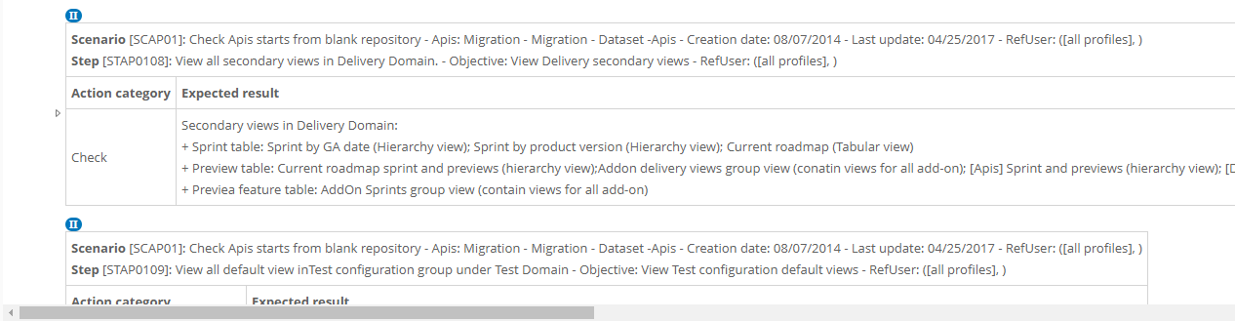
[31859]: [Test] The horizontal size of Input output context node should be decreased in the hierarchy view.
Overview :
In the hierarchical view on the Input output context and Input output data tables, horizontal scroll-bar appear when Scenario, Step, Expected result is long.

Slide 13
[31859]: [Test] The horizontal size of Input output context node should be decreased in the hierarchy view.
Solution :
In the hierarchy view on the Input output context and Input output data tables, the size of input output context node should be re-adjusted. Long Scenario, Step, Expected result will be displayed on multiple lines to remove horizontal scroll-bar.

Slide 14
[31857]: [Test] A new service showing the statistics of scenario by feature should be available on the Scenario table.
Overview :
For each product, testers will need to see statistics of scenarios by its main features.

Slide 15
[31857]: [Test] A new service showing the statistics of scenario by feature should be available on the Scenario table.
Analysis :
We need a new service to allow user to create statistics of scenarios by main feature in the “Scenario” table.

Slide 16
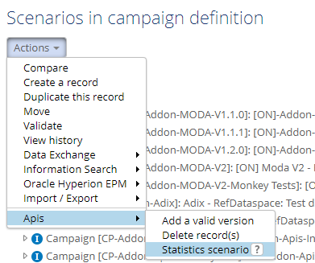
[31857]: [Test] A new service showing the statistics of scenario by feature should be available on the Scenario table.
Solution :
Create new “Statistics scenario” service in “scenario” table.
The service allows user to generate statistics of scenario by main feature and export report to xls file.
Permission: available for all users.

Slide 17
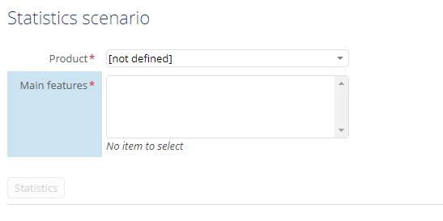
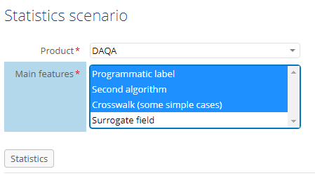
[31857]: [Test] A new service showing the statistics of scenario by feature should be available on the Scenario table.
Solution :
Create new “Statistics scenario” service in “scenario” table.
After running the service, a screen appears allowing users
to select product, features.
If user don't choose “Product” → “Main features”
will be empty -> “Statistics” button will not be enabled.
When user select an item on ‘Product’, list of main features
which have at least a scenario will be displayed
on ‘Main features’.
“Product build” empty
→ “Main features” empty → “Statistics” button disabled
Main features which have at least 1 scenario will be displayed.

Slide 18
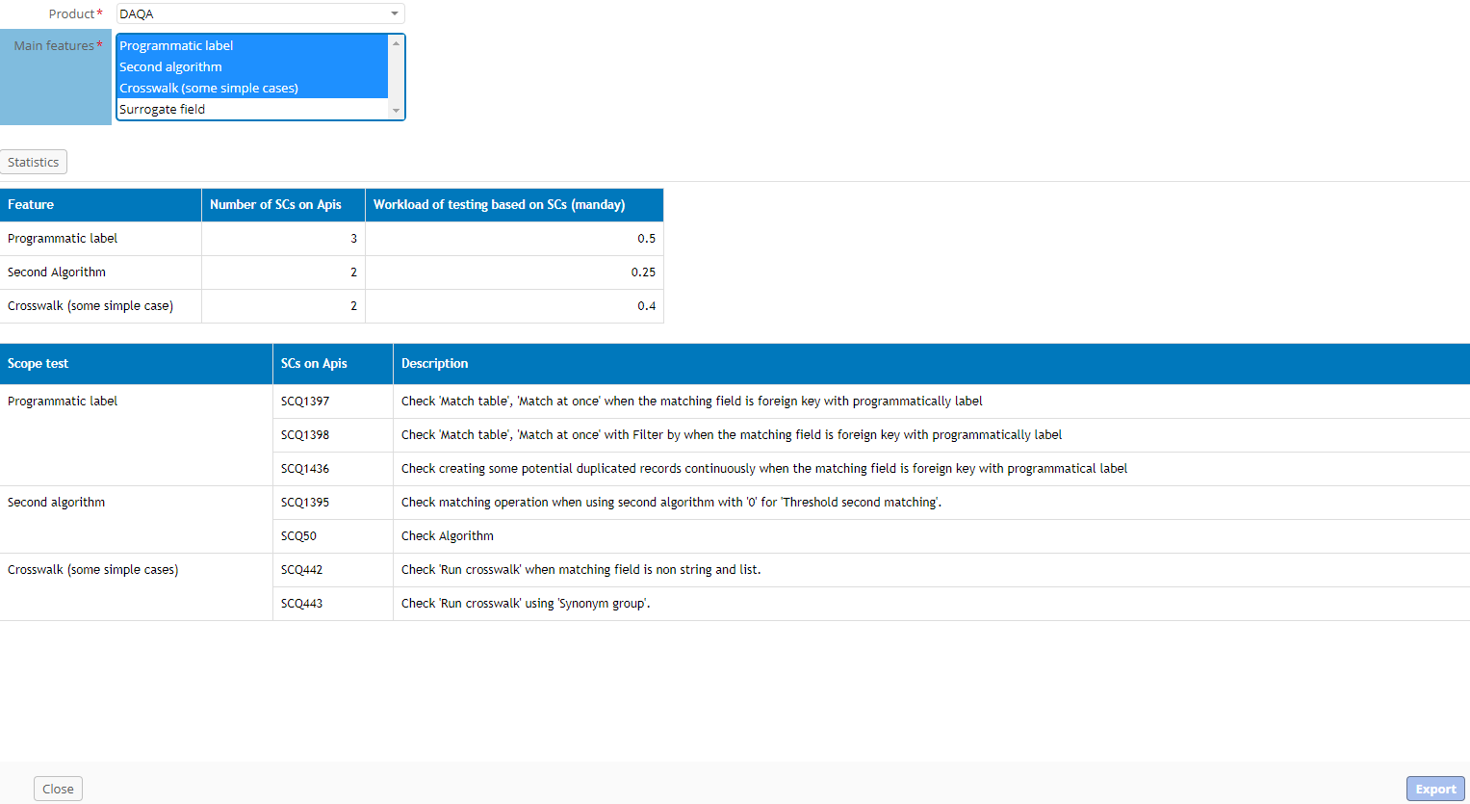
[31857]: [Test] A new service showing the statistics of scenario by feature should be available on the Scenario table.
Solution :
Create new “Statistics scenario” service in “scenario” table.
When user select items on ‘Main features’ and
click on ‘Statistics’ to generate the statistics of scenarios
by selected features.
Select items on ‘Main features’ and click on ‘Statistics’ to generate statistics
Scenario statistics generated by selected features.
‘Export’ button will be displayed.

Slide 19
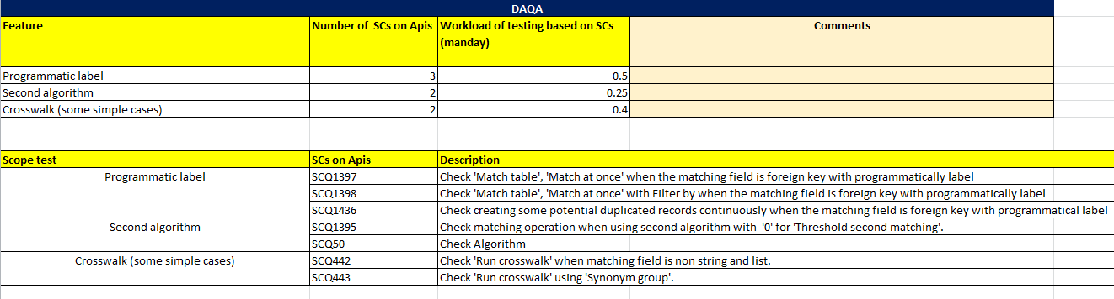
[31857]: [Test] A new service showing the statistics of scenario by feature should be available on the Scenario table.
Solution :
Create new “Statistics scenario” service in “scenario” table.
The report file:
Name: Prefix_Product name_Creation date (Prefix: “MDM Test case statistics”).
Extension: .xls
Example: MDM Test case statistics_DAQA _2018-04-12.xls.
The statistics file content as below:

Slide 20
[31855]: [Test] There should be a new option to indicate if the Scenario is 'Main case' or not.
Overview :
Not all scenarios in a campaign definition are main cases. If there is not enough time to do full-scale test, the tester will decide what scenario to test for a particular feature.

Slide 21
[31855]: [Test] There should be a new option to indicate if the Scenario is 'Main case' or not.
Analysis :
A field is added to ‘Scenario’ table to indicate that a certain scenario is main case or not.

Slide 22
[31855]: [Test] There should be a new option to indicate if the Scenario is 'Main case' or not.
Solution :
[Add new field] field ‘Main case’ is added to ‘Scenario’ table.
Field | Label | Type | Description | Mandatory
mainCase | Main case | Boolean | To specify if this scenario is main case or not | No

Slide 23
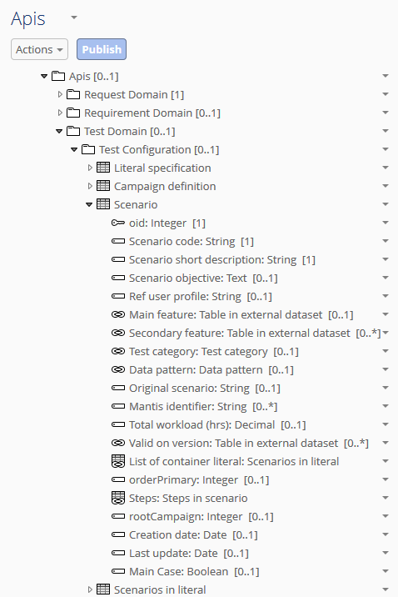
[31855]: [Test] There should be a new option to indicate if the Scenario is 'Main case' or not.
Solution :
[Add new field] field ‘Main case’ is right below ‘Last update’ field.

Slide 24
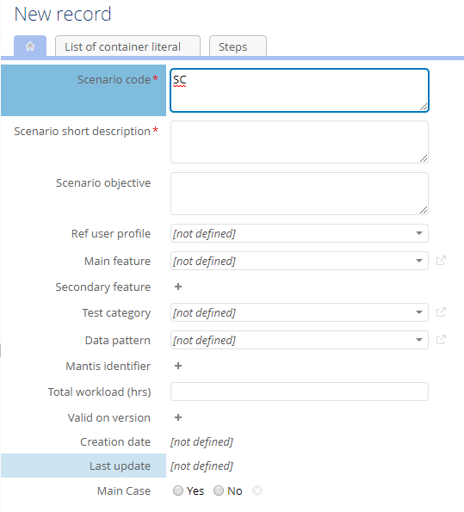
[31855]: [Test] There should be a new option to indicate if the Scenario is 'Main case' or not.
Solution :
[Add new field]

Slide 25
[31856]: [Test] The Scenario table should have a service to generate an Excel file which contains all 'Main case' scenarios of a Product.
Overview :
Not all scenarios in a campaign definition are main cases. If there is not enough time to do full-scale test, the tester will decide what scenario to test for a particular feature.

Slide 26
[31856]: [Test] The Scenario table should have a service to generate an Excel file which contains all 'Main case' scenarios of a Product.
Analysis :
A new service should be added to the ‘Scenario’ table to help the user get the list of main scenarios by product quickly.

Slide 27
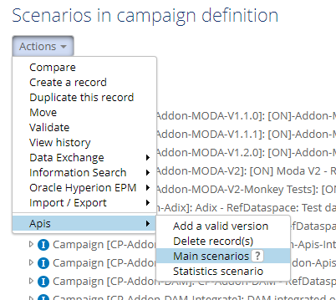
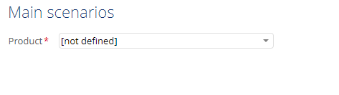
[31856]: [Test] The Scenario table should have a service to generate an Excel file which contains all 'Main case' scenarios of a Product.
Solution :
[Create new service] Create new “Main scenarios” service in “Scenario” table.
The service allows user to create a list of main scenarios and export this list to .xls file.
Permission: available for all users.
When user click on service ‘Main scenarios’,
a screen to be opened to allow user to select
a product.
a screen to be opened to allow user to select a product.

Slide 28
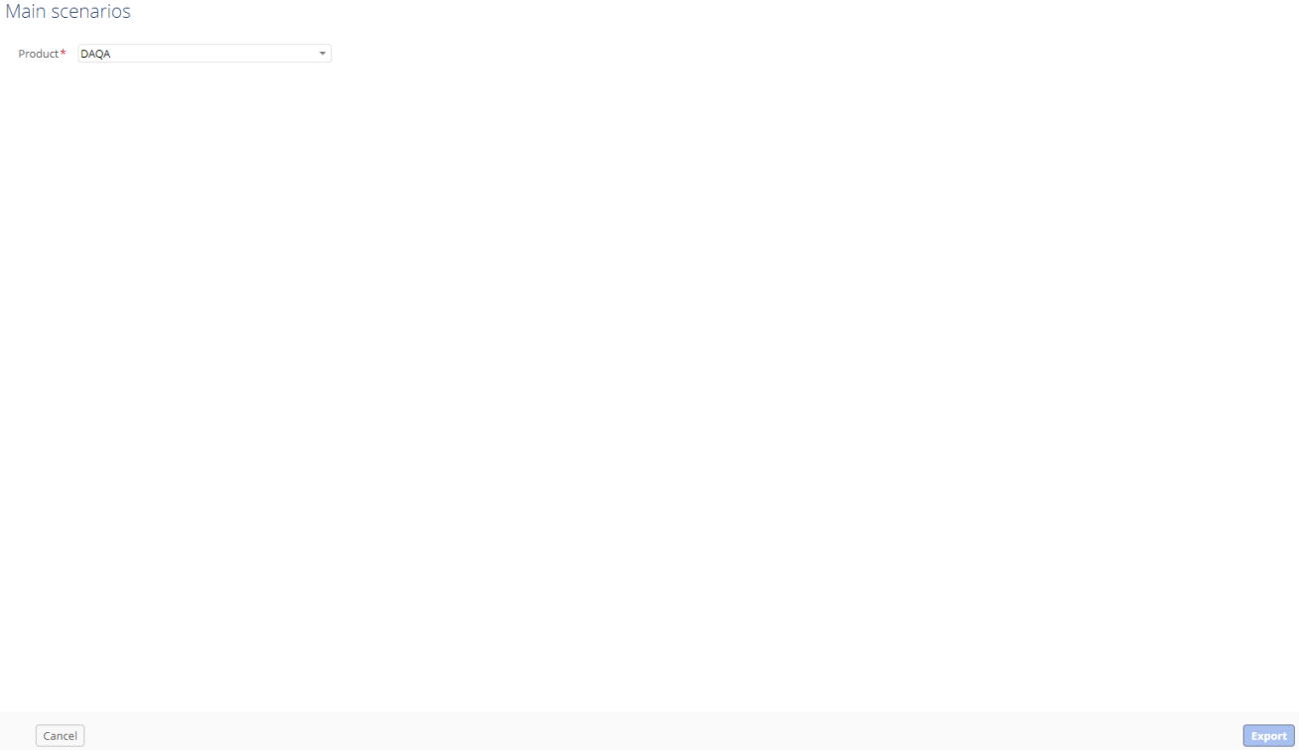
[31856]: [Test] The Scenario table should have a service to generate an Excel file which contains all 'Main case' scenarios of a Product.
Solution :
[Create new service] Create new “Main scenarios” service in “Scenario” table.
‘Export’ button is displayed after user select an item on ‘Product’.
When user click “Export” button → popup download will be displayed to allow user to download the .xls file.
‘Export’ button is displayed after user select an item on ‘Product’

Slide 29
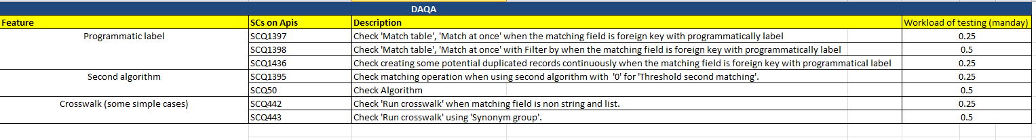
[31856]: [Test] The Scenario table should have a service to generate an Excel file which contains all 'Main case' scenarios of a Product.
Solution :
[Create new service] Create new “Main scenarios” service in “Scenario” table.
The report file:
- Name: Prefix_MainScenarios_Creation date (Prefix: “IS_MDM”).
Extension: .xls.
Example: IS_MDM_MainScenarios_2018-04-16.xls.
The report file content as below:

Slide 30
[31868]: [Perspective] There should be perspectives to manage requirement for each add-on and EBX.
Overview :
Currently, we only view all requirements for add-ons and EBX on the same table(table Requirement under Apis\Requirement Domain\Requirement).

Slide 31
[31868]: [Perspective] There should be perspectives to manage requirement for each add-on and EBX.
Analysis :
We need to add perspectives to manage requirement by product for each add-on and EBX.

Slide 32
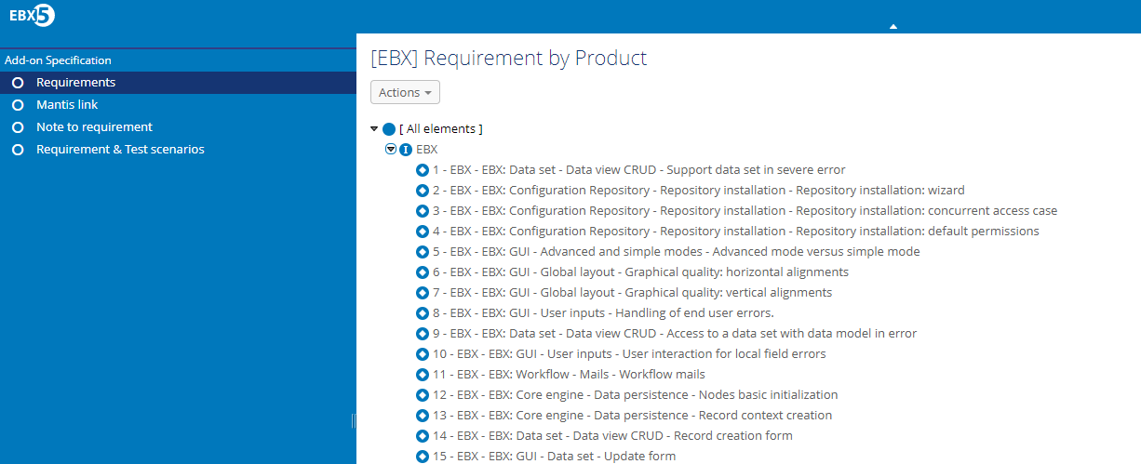
[31868]: [Perspective] There should be perspectives to manage requirement for each add-on and EBX.
Solution :
We create a new perspective for requirement of EBX as shown in picture below.
By the same way, we create other ones for requirement of add-ons.

Slide 33
[31867]: [Perspective] The EBX test execution perspective should include the 'Report on product build' item.
Overview :
we need a quick access to the ‘Report on product build’ table on EBX test execution perspective.

Slide 34
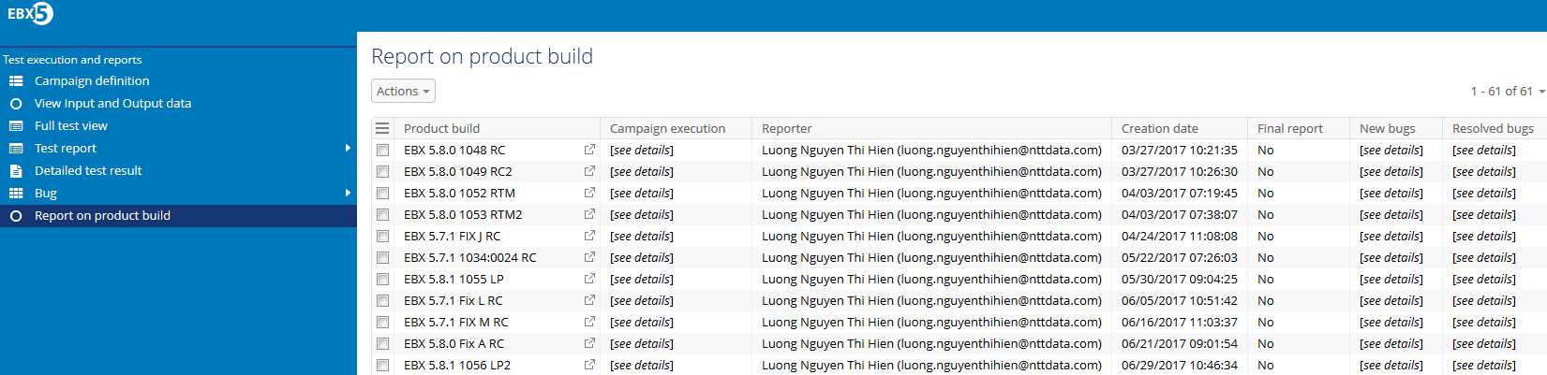
[31867]: [Perspective] The EBX test execution perspective should include the 'Report on product build' item.
Solution :
Add ‘Report on product build’ item into EBX test execution perspective.

Slide 35
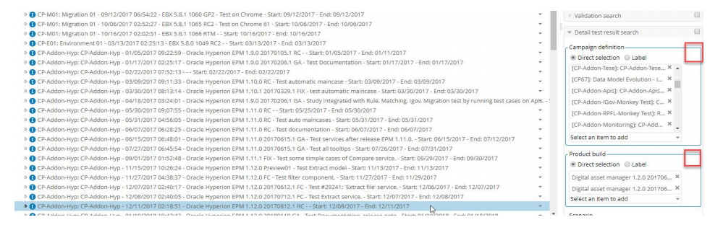
[31751]: [Test] There should be a 'Delete' icon at the border of each block.
Overview :
In the 'Detail test result search' block of the 'Detailed test result' table, there should be a 'Delete' icon at the border of each block:
Campaign definition.
Product build.
Scenario.
Test type (Test report).
Tester (Test report).

Slide 36
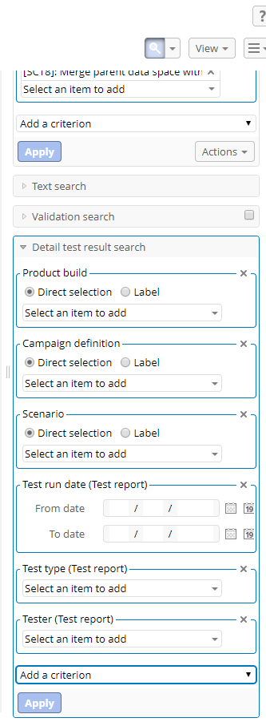
[31751]: [Test] There should be a 'Delete' icon at the border of each block.
Solution :
Add 'Delete' icon at the border of each block
(Campaign definition, Product build, Scenario, Test type, Tester).

Slide 37
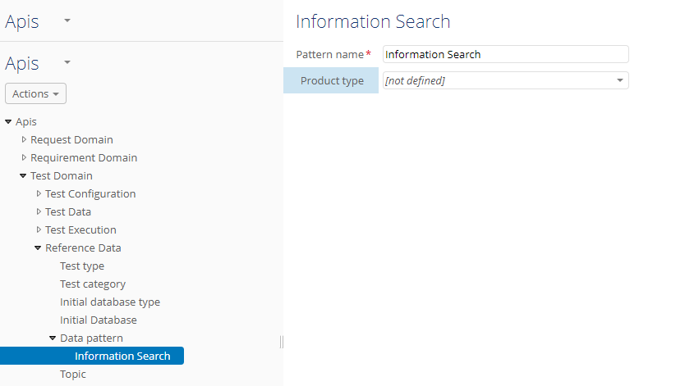
[32165]: [Test] The 'Product type' field in the 'Data pattern' table should be mandatory.
Overview :
In 'Test Domain'>'Reference Data'>'Data pattern', the 'Product type' field should be mandatory.

Slide 38
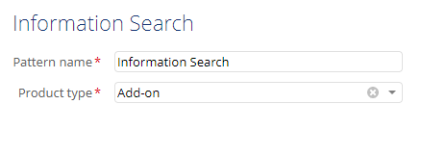
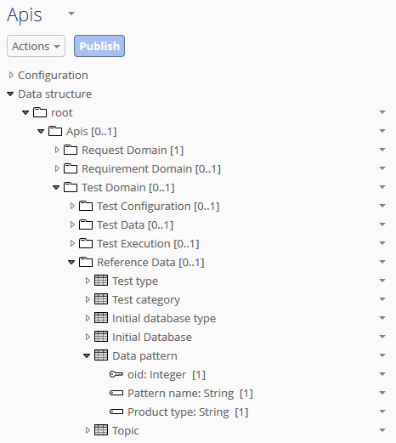
[32165]: [Test] The 'Product type' field in the 'Data pattern' table should be mandatory.
Solution :
We change the field ‘Product type’ to mandatory.

Slide 39
End

