Slide 1
APIS 1.9.0.
Functional Specification
Last update: April 09, 2018
Created by:
  - Apis team -
Information type: Restricted Confidential (MDM project)
Company name: IFI Solution
Information owner: Orchestra Networks

Slide 2
Table of contents
List of requirements in Sprint
APIS Specifications

Slide 3
APIS Sprint 1.9.0
List of requirements

Slide 4
List of requirements in Sprint
Evolution
Test Domain:
#31751: [Test] There should be a 'Delete' icon at the border of each block.
#31854: [Test] The 'Create a campaign execution from the selected campaign definition' service should be improved.
#31855: [Test] There should be a new option to indicate if the Scenario is 'Main case' or not.
#31856: [Test] The Scenario table should have a service to generate an Excel file which contains all 'Main case' scenarios of a Product.
#31857: [Test] A new service showing the statistics of scenario by feature should be available on the Scenario table.
#31858: [Test] A new multi-valued field should be added to the Input and output data table to store I.O data information.
#31859: [Test] The horizontal size of Input output context node should be decreased in the hierarchy view.
#31860: [Test] It should be possible to duplicate test data' along with 'Step' when duplicating a 'Step'.

Slide 5
List of requirements in Sprint
Evolution
Reporting Domain:
#31861: [Test] The 'Add new step' service needs rewriting.
#31864: [Test] Some fields should be added to indicate which literal specification test cases are designed for a Version delivery.
#32165: [Test] The 'Product type' field in the 'Data pattern' table should be mandatory.
#32166: [Test] The N/A value should be available EBX product type in the 'Data pattern' table.
Other:
#31867: [Perspective] The EBX test execution perspective should include the 'Report on product build' item.
#31868: [Perspective] There should be perspectives to manage requirement for each add-on and EBX.
#31869: [Perspective] Filtered tabular view by product should be applied when users access 'Mantis' item in 'Test execution' perspective.

Slide 6
List of requirements in Sprint
Bug-official
Delivery Domain:
#32183: [Delivery] An error occurs when users update a Version delivery with FIX version as Yes, empty RC date and Released state.

Slide 7
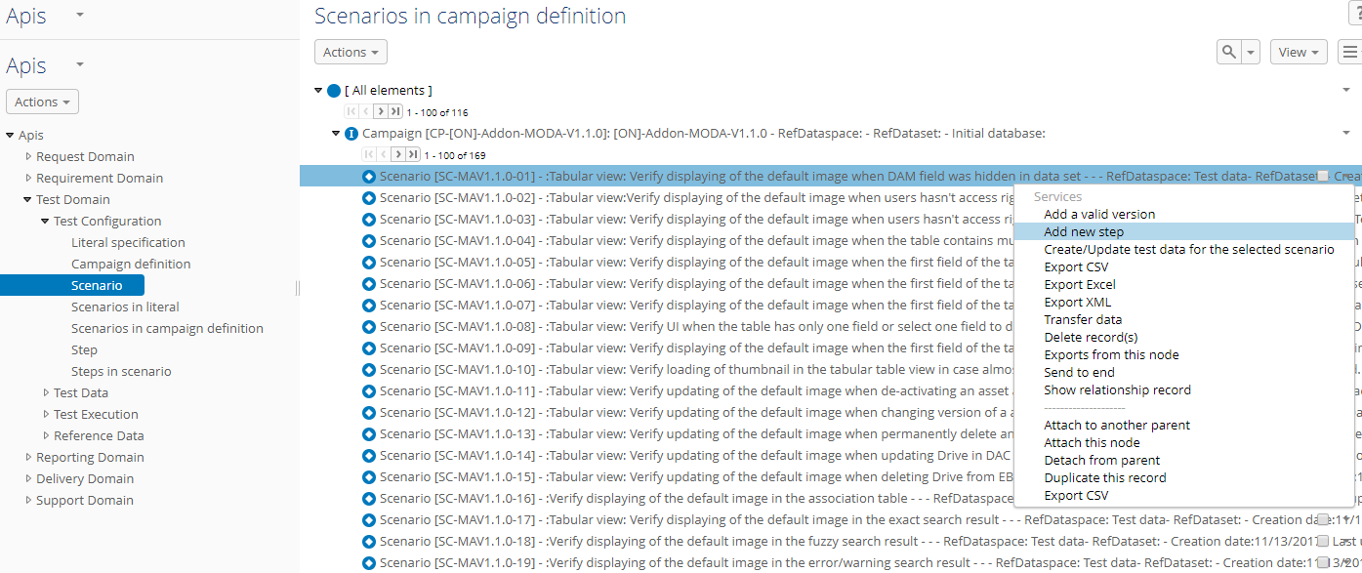
#31861: [Test] The 'Add new step' service needs rewriting.
Overview:
Currently, we have the ‘Add new step’ service. This service allows simultaneous create of step and it’s data. On our local environment, it words normally, but it fails on SDG. We have created the bug #30076 for EBX issue.
This service is important for us. So we need rewriting this service to it words normally on the SDG service.

Slide 8
#31861: [Test] The 'Add new step' service needs rewriting.
Analysis:
The business of the service will be not change. We will change technical to issue doesn't occur on SDG.

Slide 9
#31861: [Test] The 'Add new step' service needs rewriting.
Solution: N/A

Slide 10
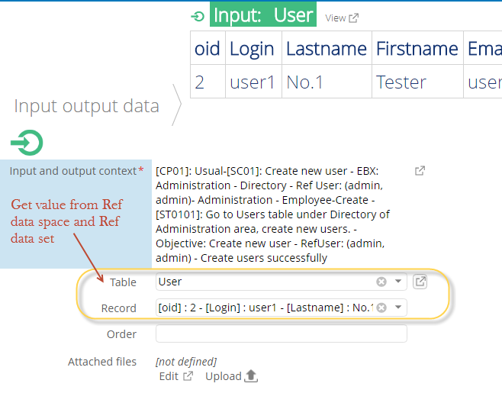
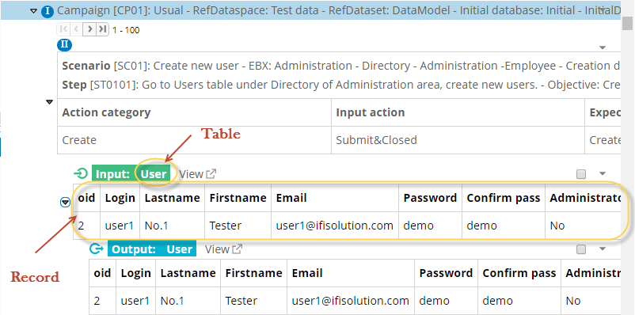
#31858: [Test] A new multi-valued field should be added to the Input and output data table to store I.O data information.
Overview:
Currently, users can enter data into the IO data table by reference to table and record in the ‘Test Data’ dataspace. But users spend more time doing it. So we need to another way do it.

Slide 11
#31858: [Test] A new multi-valued field should be added to the Input and output data table to store I.O data information.
Analysis:
We will add new field to allow users enter free text into this field.
So, users will have two solution to manage test data information:
- Solution 1: Use table and records as before
- Solution 2: Use new field and enter free text into the field.

Slide 12
#31858: [Test] A new multi-valued field should be added to the Input and output data table to store I.O data information.
Solution:
Create new filed named “Field value”, this field is multi-value and not mandatory.
Type | Table
Name | InputOutputData
Label | Input output data
Path | /root/Apis/TestDriving/TestData/InputOutputData
Field | Label | Type | Description | Multi-value | Is mandatory
… | … | … | … | … | …
fieldValue | Field value | Text | User can enter free text about test data into this field. | Yes | No

Slide 13
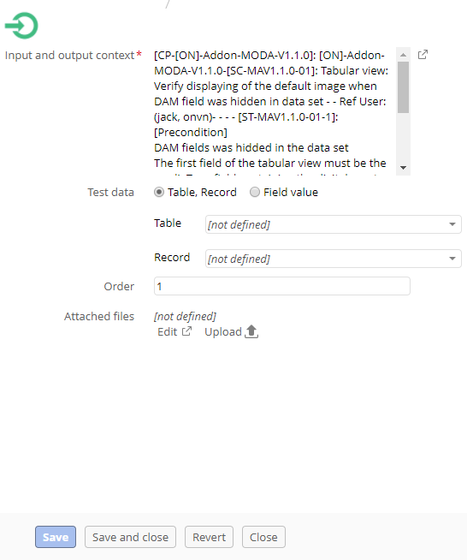
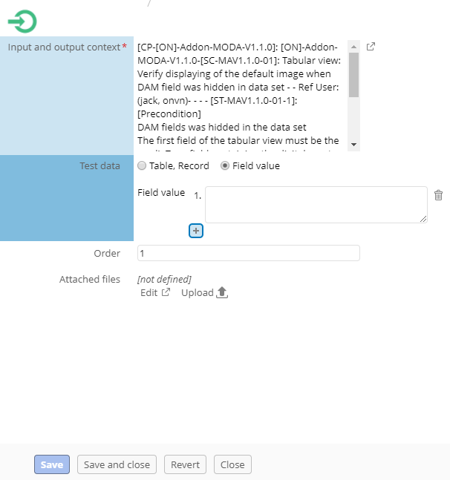
#31858: [Test] A new multi-valued field should be added to the Input and output data table to store I.O data information.
Solution:
Users can choose one of two solutions as the photo below:

Slide 14
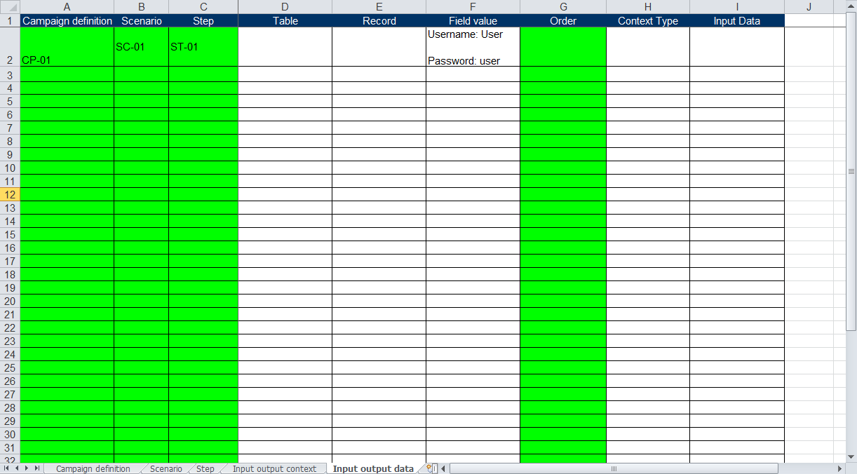
#31858: [Test] A new multi-valued field should be added to the Input and output data table to store I.O data information.
Solution:
Impacted service: Import test-case
In the template import test-case add new column named ‘Field value’ to import data for ‘Field value’ field in the IO data.
The ‘Field value’ field is multi-value, the data of the ‘Field value’ cell is separated by more than one break-line.

Slide 15
#31858: [Test] A new multi-valued field should be added to the Input and output data table to store I.O data information.
Solution:
Migrate data: Delete records in the ‘Test report’ table with status is ignored and it’s detailed test result.

Slide 16
#31854: [Test] The 'Create a campaign execution from the selected campaign definition' service should be improved.
Overview:
A campaign contains all scenarios of a product, and each build will only be tested by a certain scenario, because there will not be enough time to run the entire test scenarios.
For example, with a Preview, FC build, only those scenarios related to the new feature will be tested. There is no need to test the older scenarios. In this case, the test report created for non-test scenarios is not needed, we should remove it from the service run to create execution.

Slide 17
#31854: [Test] The 'Create a campaign execution from the selected campaign definition' service should be improved.
Analysis:
Before create a campaign execution, users need select scenario(s). An UI allow users select will show when run the ‘Create a campaign execution from the selected campaign definition’ service.
The confirmation message will show when users click on ‘Create campaign execution’ button.

Slide 18
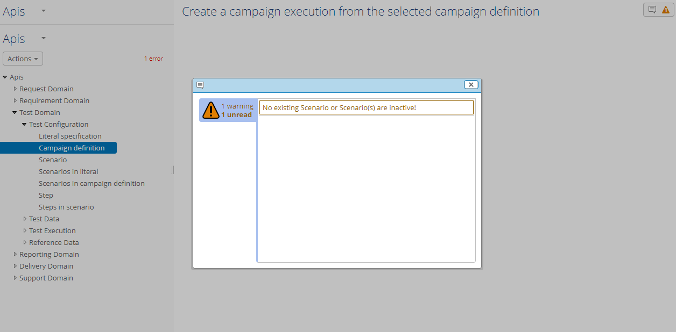
#31854: [Test] The 'Create a campaign execution from the selected campaign definition' service should be improved.
Solution:
Users selected a campaign definition and click on ‘Create a campaign execution from the selected campaign definition’ service.
If the selected campaign definition is not any active scenarios, The warning message will be displayed as photo below:

Slide 19
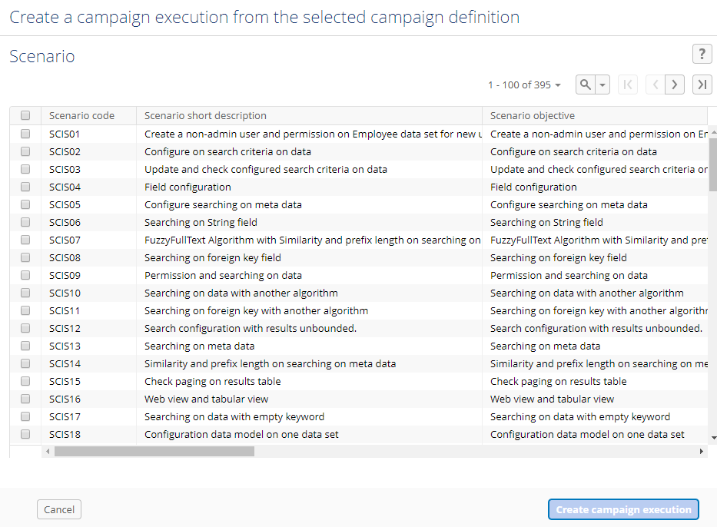
#31854: [Test] The 'Create a campaign execution from the selected campaign definition' service should be improved.
Solution:
If the selected campaign definition existed active scenarios, the screen will be displayed where users can selected target active scenario as photo below:
The active scenarios belong to the selected campaign definition

Slide 20
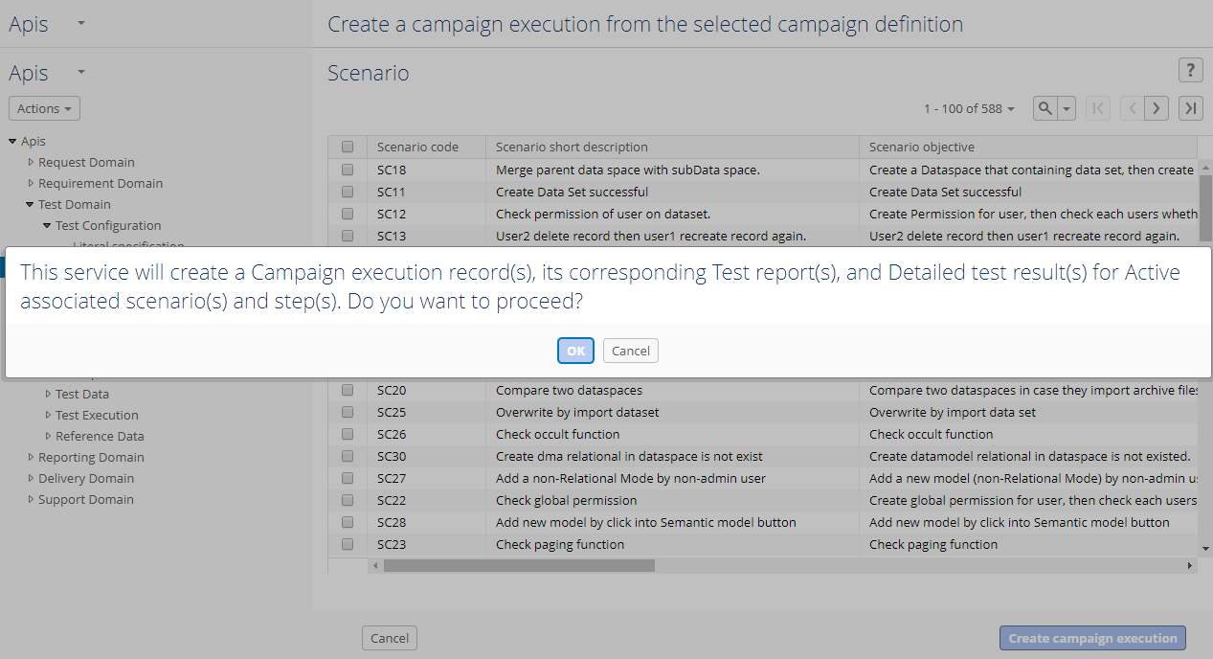
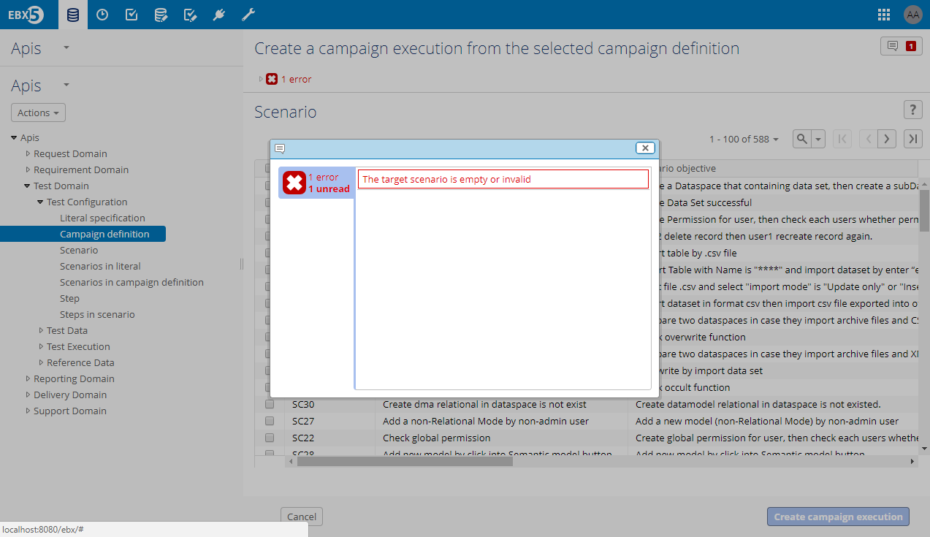
#31854: [Test] The 'Create a campaign execution from the selected campaign definition' service should be improved.
Solution:
When users click on ‘Create campaign execution’ button, the confirmation message will be showed as photo beside:
If Users cannot selected target scenario and click on ‘Create campaign execution’ button, the error message will be showed as beside:
Click on
No selected target scenario and click on ‘Create campaign execution’ button

Slide 21
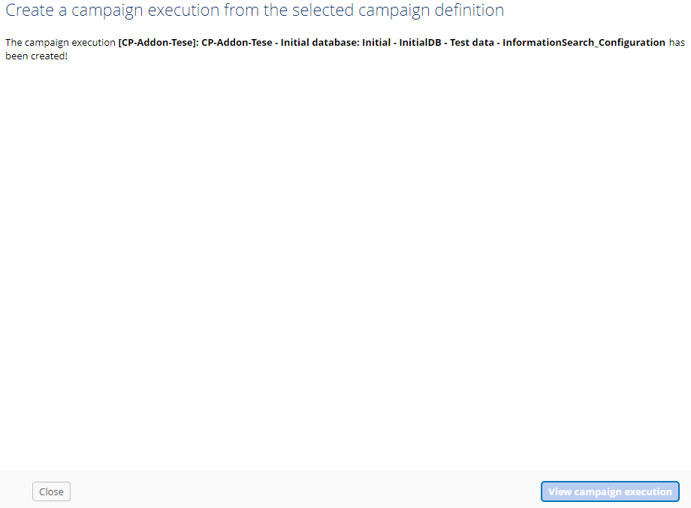
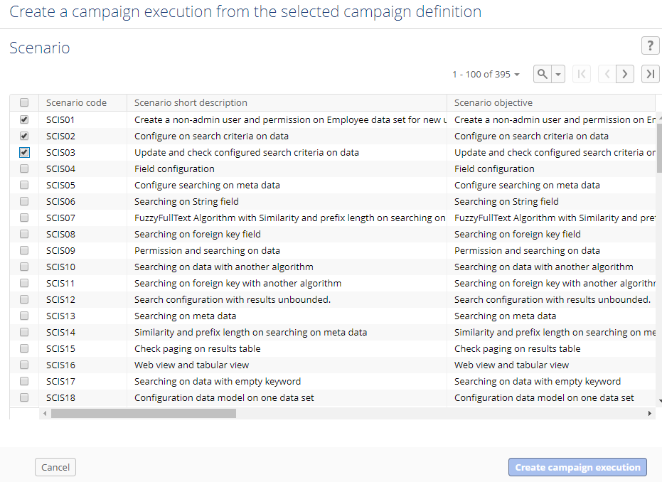
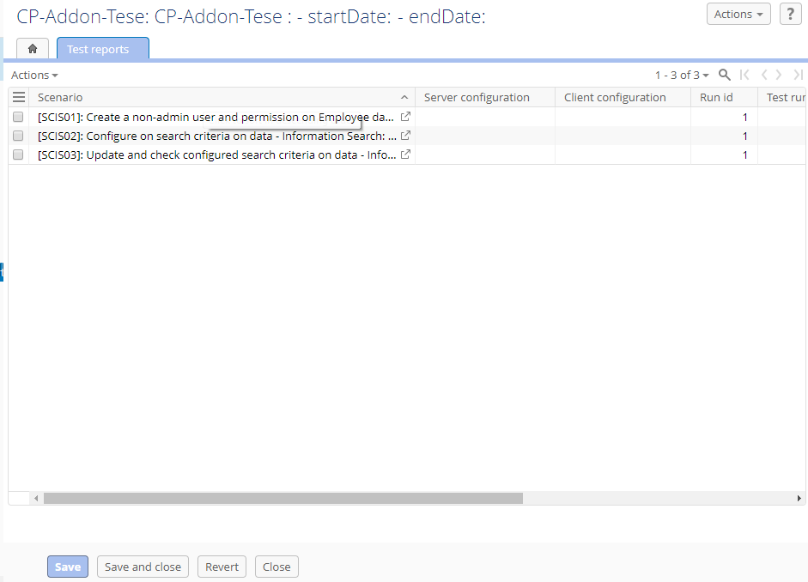
#31854: [Test] The 'Create a campaign execution from the selected campaign definition' service should be improved.
Solution:
Users select target active scenario and click on ‘Create campaign execution’ button, then one campaign execution created with the number of Test report corresponding to the selected scenarios.
Selected scenario and click on 'Create campaign execution' button
Click on
one campaign execution created with the number of Test report corresponding to the selected scenarios

Slide 22
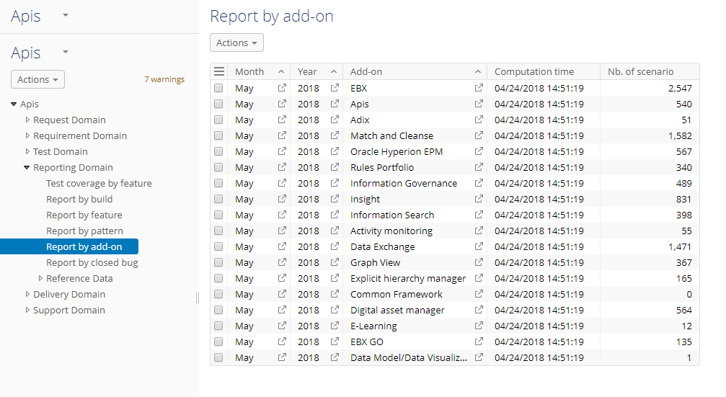
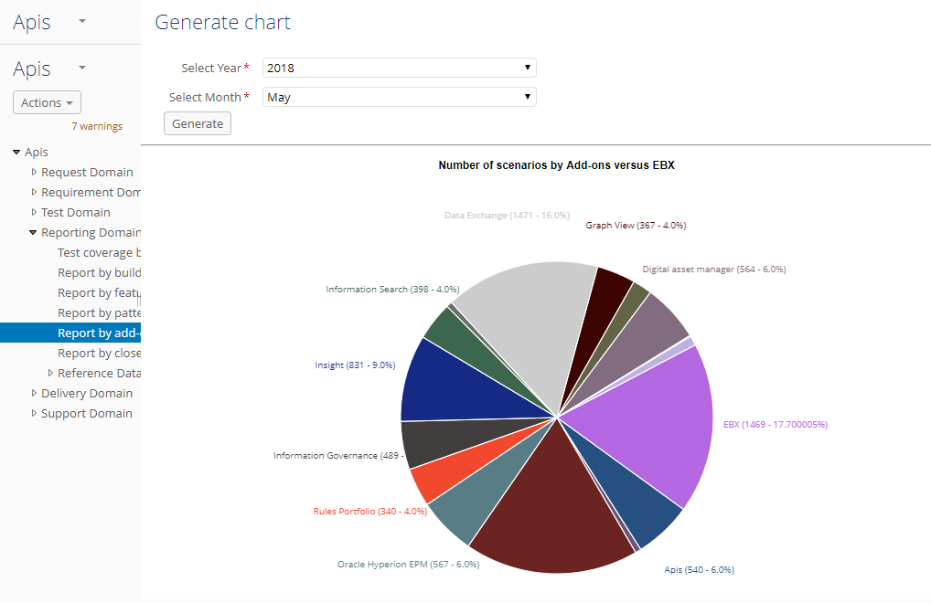
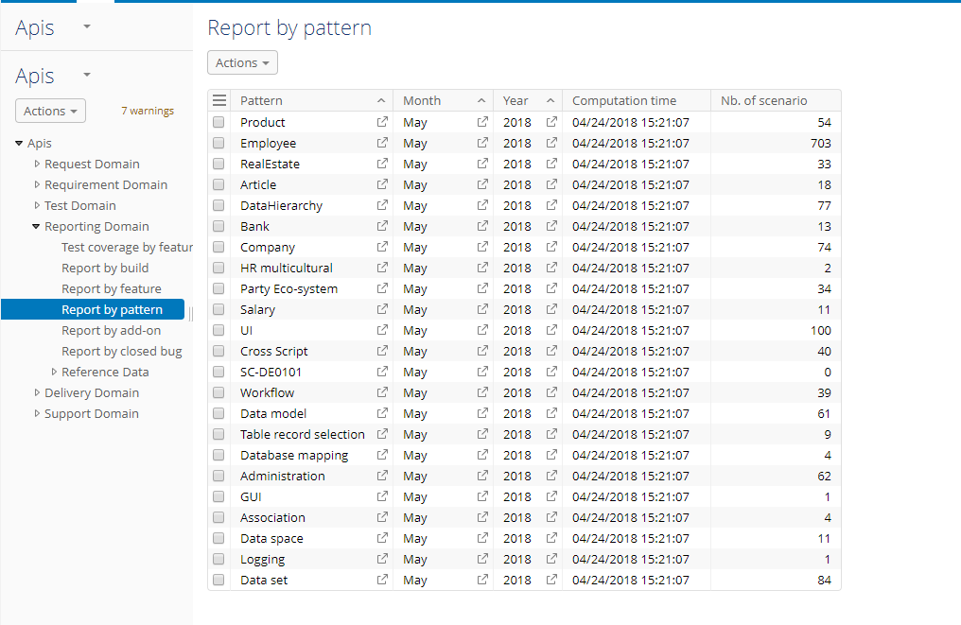
#32166: [Test] The N/A value should be available EBX product type in the 'Data pattern' table.
Overview:
In the ‘Report by add-on’ table, The number of SC by EBX product is 2,547 with year is 2018 and month is May. But in the screen of the generate chart, the number of SCs by EBX product is 1,469 that is the number of SCs by Pattern in the ‘Report by pattern’ with year is 2018 and month is May.
Currently, In the Scenario table, there are many records with the feature of EBX product, but not pattern.
Total is 1469

Slide 23
#32166: [Test] The N/A value should be available EBX product type in the 'Data pattern' table.
Analysis:
In the Scenario table, the records with feature of EBX product, users can update specific pattern.
We will create the N/A value of EBX product type in the ‘Data pattern’ table.

Slide 24
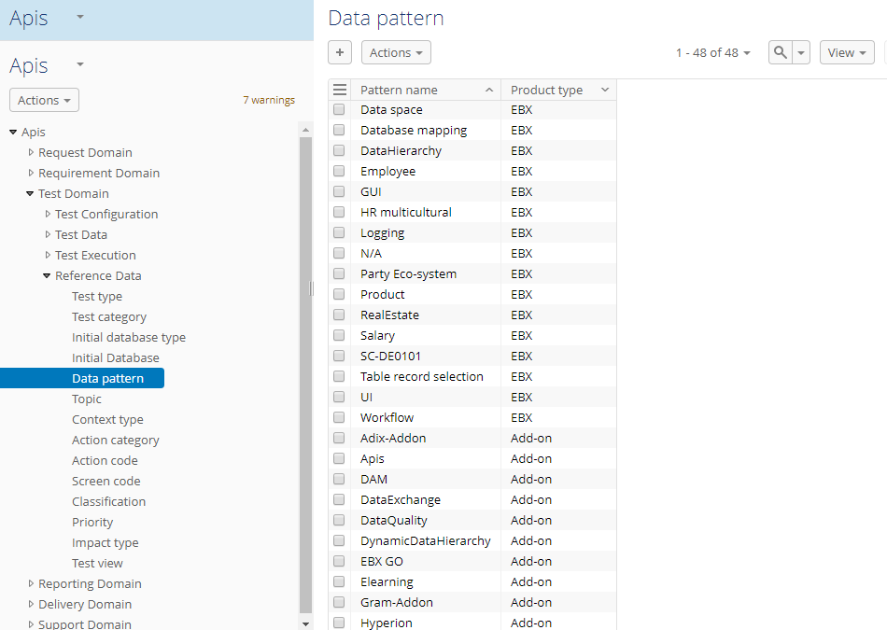
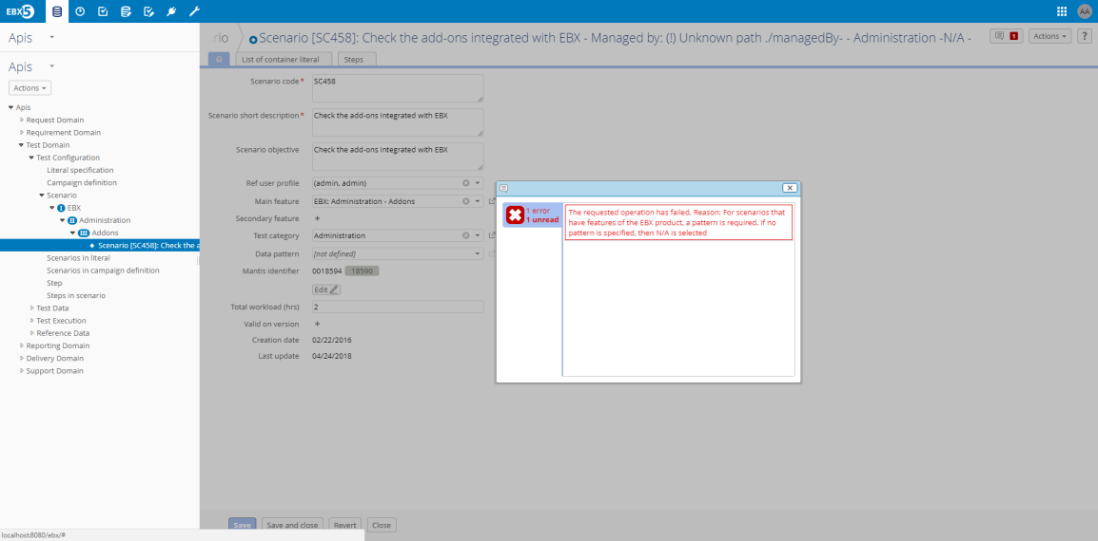
#32166: [Test] The N/A value should be available EBX product type in the 'Data pattern' table.
Solution:
Create new a record in the ‘Data pattern’ table as photo beside:
In the Scenario, when users create or update record, if the records have the feature of EBX product and the value of pattern field is not defined, a error message will be displayed to users know and update specific pattern as photo beside:
Create new the N/A value of EBX product type

Slide 25
#32166: [Test] The N/A value should be available EBX product type in the 'Data pattern' table.
Solution:
Migrate data: The old data, the records have the features of EBX product, if no pattern is specified, we will update the value of pattern field is N/A.

Slide 26
#31869: [Perspective] Filtered tabular view by product should be applied when users access 'Mantis' item in 'Test execution' perspective.
Overview:
Currently, when users access ‘Mantis sync’ table via ‘Test execution’ perspective. All record in ‘Mantis sync’ table will be displayed.
In each ‘Test execution’ perspective, users only need to display the records corresponding to specific product.

Slide 27
#31869: [Perspective] Filtered tabular view by product should be applied when users access 'Mantis' item in 'Test execution' perspective.
Analysis:
We create simple filtered table view by Product, EBX and call them in specific perspective.

Slide 28
#31869: [Perspective] Filtered tabular view by product should be applied when users access 'Mantis' item in 'Test execution' perspective.
Solution:
In the ‘Mantis sync’ table, we create 15 filtered tabular view as below:
  [EBX] Mantis sync: filtered with ‘EBX.Platform’ in Product field.
  [Apis] Mantis sync: filtered with ‘Apis’ in Category field.
  [DAM] Mantis sync: filtered with ‘DAM’ in Category field.
  [DEX] Mantis sync: filtered with ‘DEX’ in Category field.
  [DQ] Mantis sync: filtered with ‘Cleansing’ or ‘Matching’ in Category field.
  [Gram] Mantis sync: filtered with ‘Graphical MDM’ in Category field.
  [Hyperion] Mantis sync: filtered with ‘EPM’ in Category field.
  [IGov] Mantis sync: filtered with ‘Information Governance’ in Category field.
  [Insight] Mantis sync: filtered with ‘Insight’ in Category field.
  [MODA] Mantis sync: filtered with ‘EBX GO’ in Project field.
  [Mtdh] Mantis sync: filtered with ‘Meta DH’ in Category field.
  [Mtrn] Mantis sync: filtered with ‘Monitoring’ in Category field.
  [Rpfl] Mantis sync: filtered with ‘Portfolio’ in Category field.
  [Tese] Mantis sync: filtered with ‘Information Search’ in Category field.
  [Add-ons] Mantis sync: filtered with ‘Add-ons’ in Product field

Slide 29
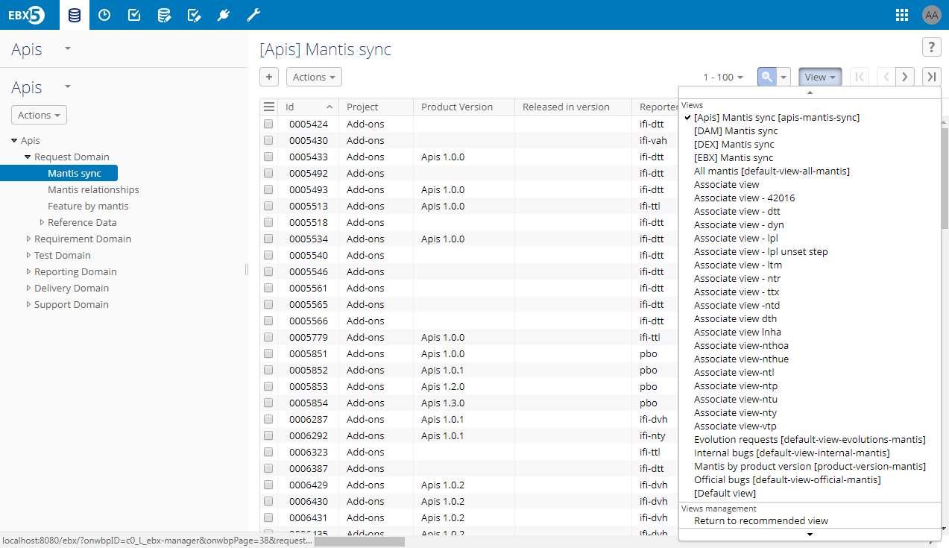
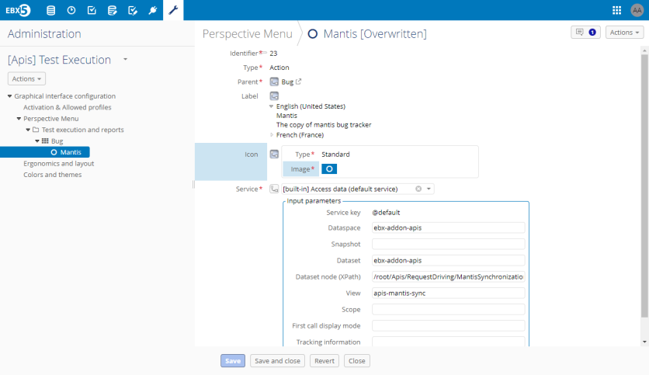
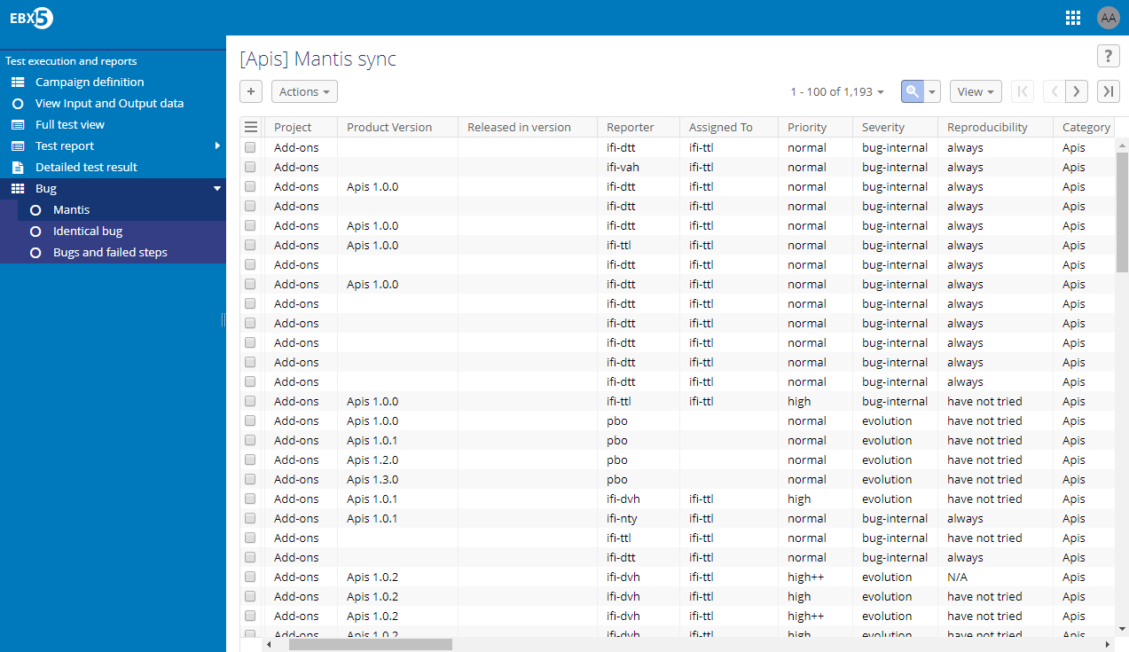
#31869: [Perspective] Filtered tabular view by product should be applied when users access 'Mantis' item in 'Test execution' perspective.
Solution:
Create new [Apis] Mantis sync view with key: apis-mantis-sync
Example, in the [Apis] Test Execution
whole records of Apis product

Slide 30
#32183: [Delivery] An error occurs when users update a Version delivery with FIX version as Yes, empty RC date and Released state.
Overview: N/A

Slide 31
#32183: [Delivery] An error occurs when users update a Version delivery with FIX version as Yes, empty RC date and Released state.
Analysis: N/A

Slide 32
#32183: [Delivery] An error occurs when users update a Version delivery with FIX version as Yes, empty RC date and Released state.
Solution: N/A

Slide 33
End

