Slide 1
From AI-Assisted Verification
to Security Defect Discovery
Case study: formally verifying Signal's Sparse Post-Quantum Ratchet (SPQR) in Lean 4
Rust → Aeneas → Lean 4 · 246 spec files · 63 defects (D1–D63)
October 2026

Slide 2
Seminar Structure (45 min)
01
The Challenge: Can We Trust Software?
5 min
02
What Is Formal Verification?
8 min
03
How AI Assists Formal Verification
10 min
04
From Verification to Security Defect Discovery
15 min
05
Lessons, Limitations, and Takeaways
7 min

Slide 3
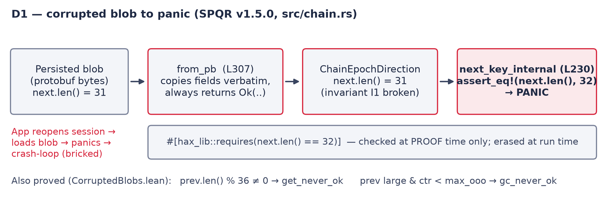
D1: From Corrupted Blob to Panic
Nothing between the blob and the assert re-checks next.len(); the hax contract is verified only at proof time.

Slide 4
02
Testing vs. Formal Verification
8 minutes
Testing
Formal verification
▸ Runs the program on chosen inputs
▸ 40 000 forged messages: 0 panics
▸ Shows presence of bugs, never absence
▸ Missed every blob-path defect (D1, D19, D23 ...)
▸ States a property for ALL inputs and proves it
▸ 246 Lean spec files, 0 sorry
▸ Every theorem names its hypotheses
▸ A hypothesis the Rust never checks = a defect
Signal's own tests and hax/F* proofs passed. The 63 defects were found by asking what each proof had to assume.

Slide 5
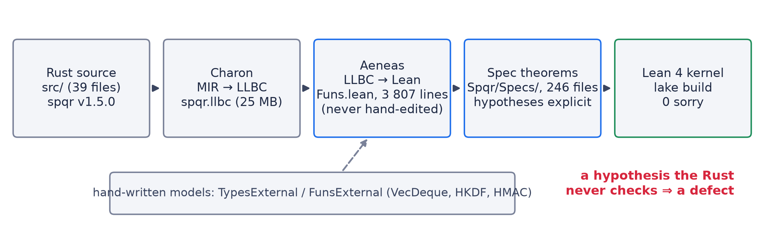
The Verification Pipeline
Funs.lean is generated and trusted. The hand-written external models (dashed) are where an unsound model (D59) silently weakens proofs.

Slide 6
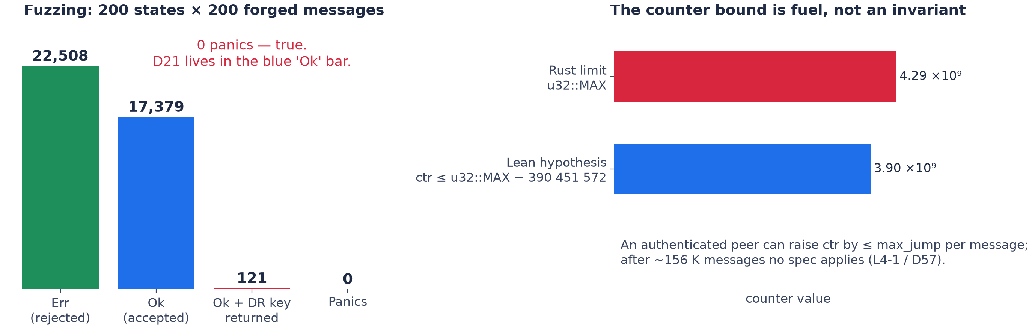
What Fuzzing Showed — and Didn't
Left: nothing panics, yet D21 lives on the accepted (blue) path. Right: the Lean counter bound is a hypothesis a peer can exceed after ~156 K messages.

Slide 7
04
The Project: Signal's SPQR, Re-verified in Lean 4
15 minutes
What
Sparse Post-Quantum Ratchet: the ML-KEM layer of Signal's Triple Ratchet (Rust crate spqr v1.5.0)
Upstream
Signal verifies it with hax → F*
Ours
Independent re-verification: Rust → Aeneas → Lean 4, 246 spec theorems
Result
63 defects (D1–D63), each backed by a Lean proof or a runnable Rust counterexample
Three root-cause patterns
Authenticate after persist
from_pb copies without validating
assume! erased at run time
D16 D21 D22 D35 D36 D62
D1 D11–D14 D18 D19 D23 ... D61
D2 D3 D5 D8 D9 D25 D29 D37 D56 D57

Slide 8
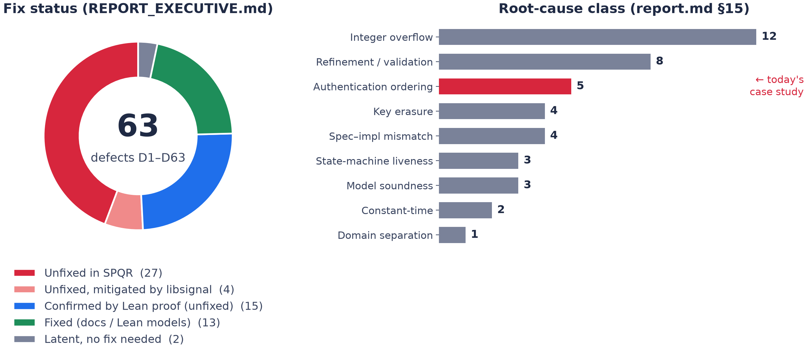
63 Defects at a Glance
Left: fix status. Right: root-cause class — overflow and missing validation dominate by count; authentication ordering (red) is today's case study.

Slide 9
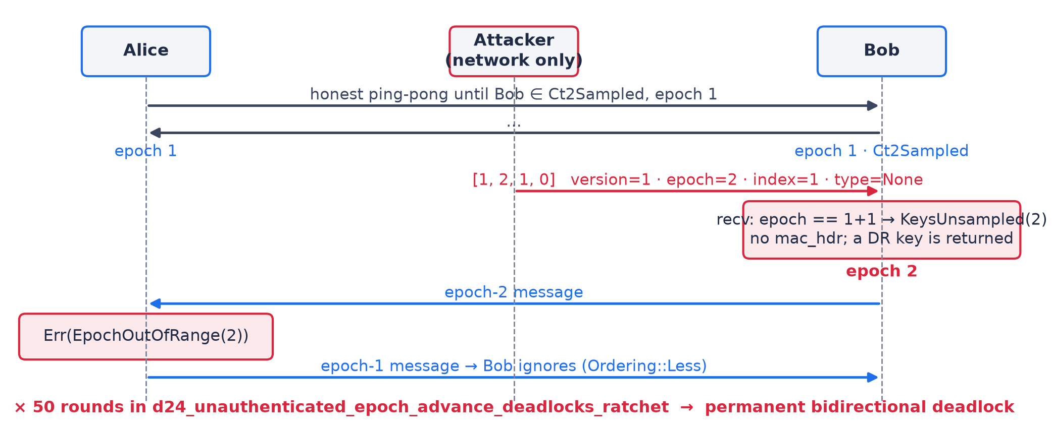
D21 as a Sequence Diagram
One unauthenticated 4-byte message moves Bob to epoch 2. Alice rejects all of Bob's messages; Bob ignores all of Alice's. Permanent deadlock.

Slide 10
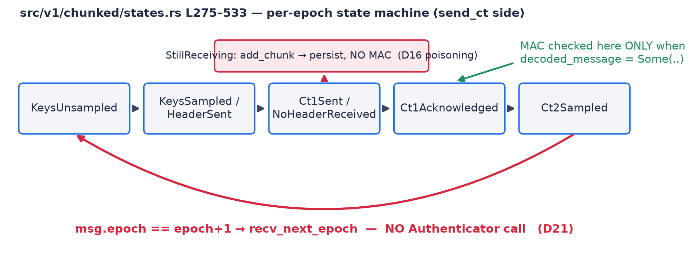
Where the MAC Is — and Isn't — Checked
Green: the only edges that call the MAC. Red: edges that persist state with no Authenticator call. D21 is the red back-edge.

Slide 11
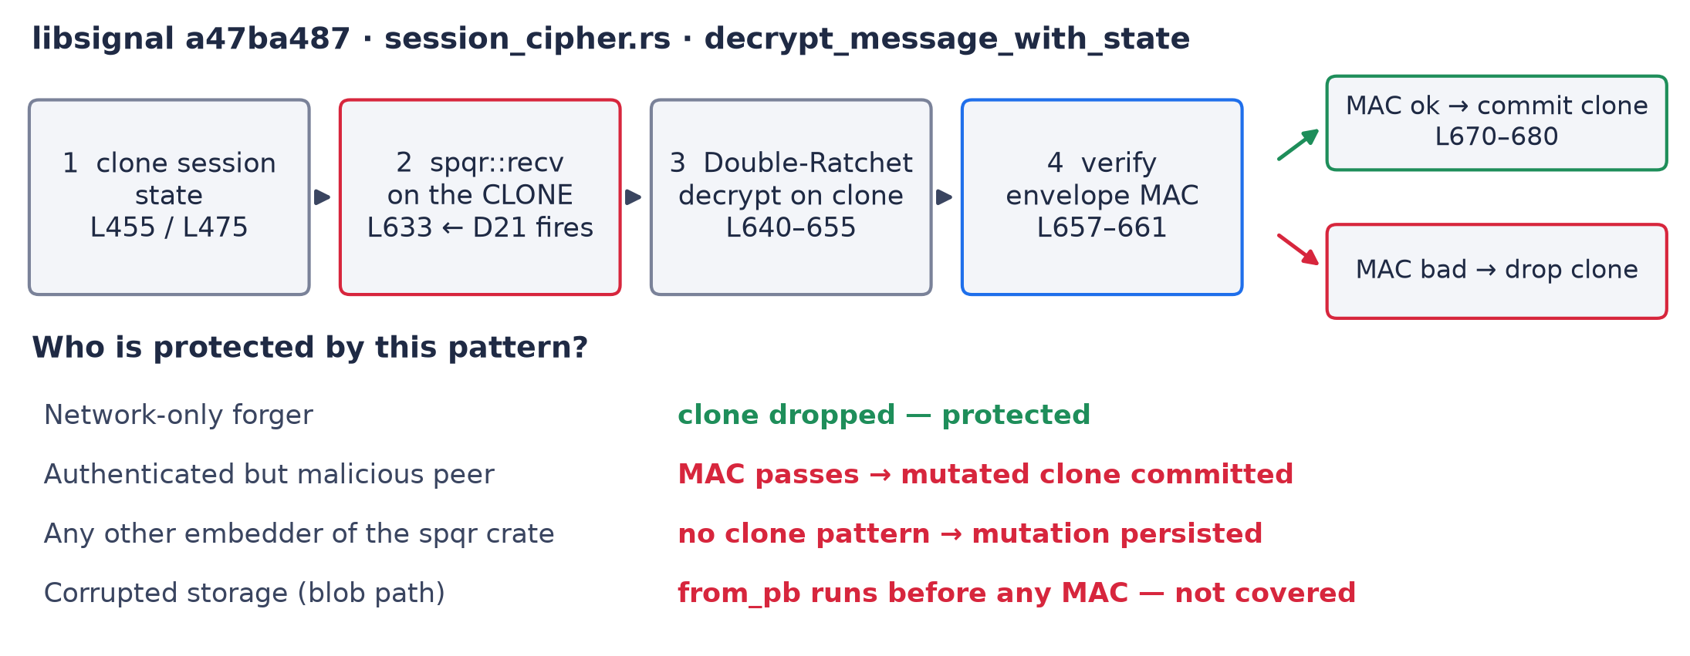
Why Signal Is Safe From D21 — and Who Isn't
libsignal runs spqr::recv on a clone and commits only after the MAC passes. The protection lives outside SPQR; peers, other embedders and storage bypass it.

Slide 12
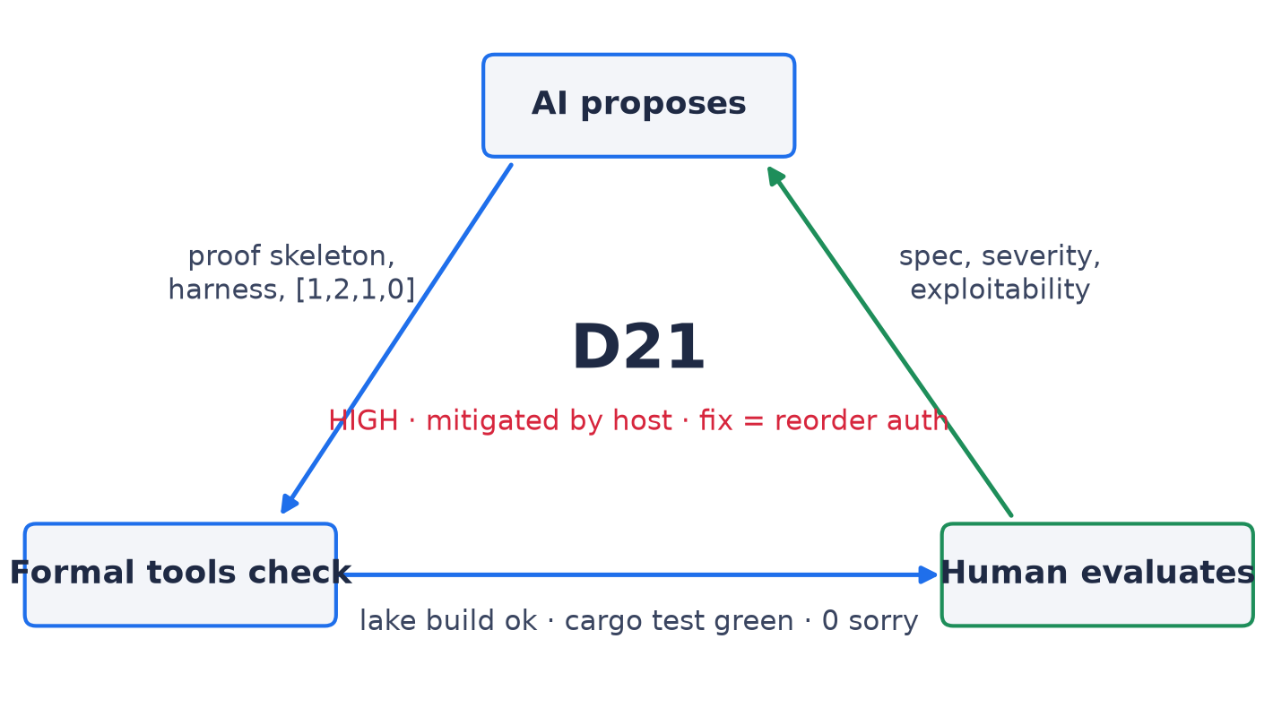
Three Roles, One Defect
No arrow is skippable: the forged bytes came from AI, the deadlock proof from cargo/Lean, the exploitability verdict from reading libsignal.

Slide 13
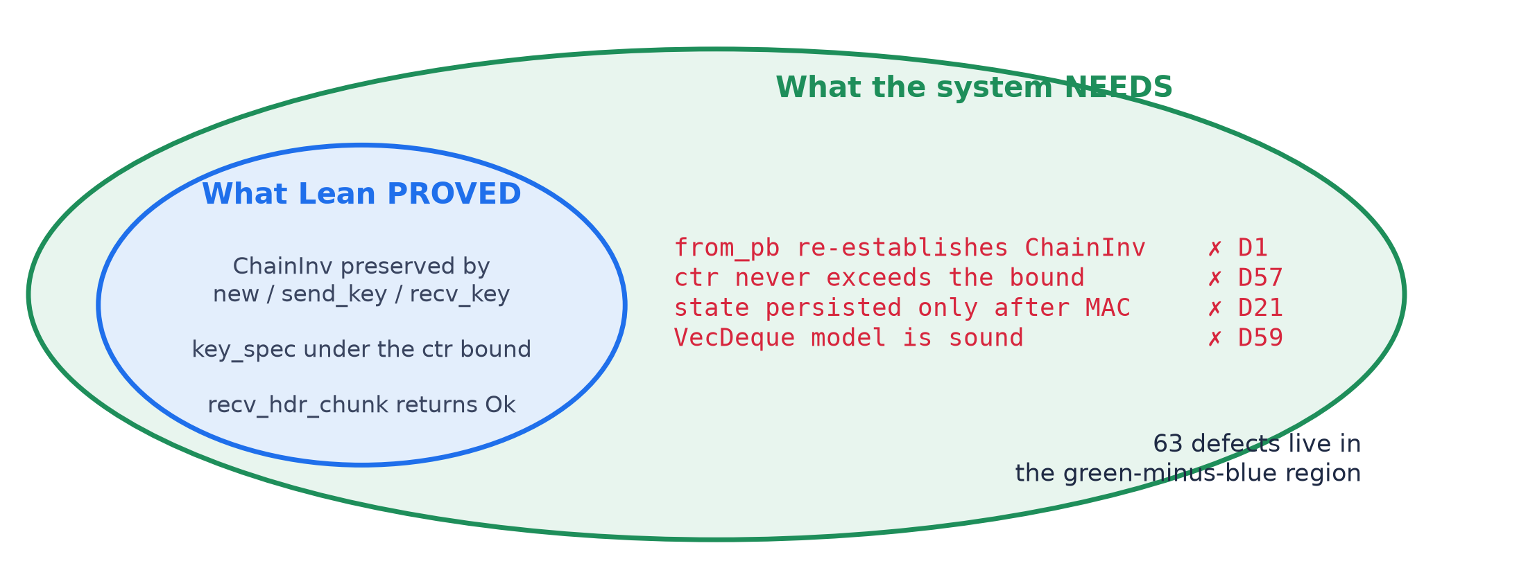
Why a Proof Is Not a Security Guarantee
Everything in the blue ellipse is machine-checked. Every defect is a true statement about the green region that no theorem mentioned.

Slide 14
Key Message
Even a Lean proof accepted by the kernel establishes only
the formal proposition under its stated assumptions.
It does not, by itself, establish that the specification captures
every security requirement of the real-world system.
SPQR: 246 spec files, 0 sorry, ChainInv proved — and still 63 defects,
found precisely by asking what each proof had to assume.

Slide 15
Thank You
Questions & Discussion
docs/report.md · docs/listDefects.md · docs/classificationBug.md · docs/bugSecurityRemote.md
Spqr/Specs/Bugs/ProtocolDoS.lean · Spqr/Specs/Bugs/CorruptedBlobs.lean · docs/protocol_driver_counterexamples.rs.txt

