Slide 1
45-MINUTE SEMINAR
From AI-Assisted Verification
to Security Defect Discovery
How AI can help us reason about software—and find what can go wrong
Case study: formally verifying Signal's Sparse Post-Quantum Ratchet (SPQR) in Lean 4 · Rust → Aeneas → Lean 4 · 246 spec files · 63 defects
Speaker: Hoàng Le Trường
Friday, October 16, 2026 · 3:00 PM
Artificial Intelligence
Formal Verification
Software Security

Slide 2
Today’s Roadmap
1 minute
01
Can We Trust Software?
5 minutes · Why software failures matter — and one real one (D1)
02
What Is Formal Verification?
8 minutes · Testing, specifications, proofs, and the SPQR pipeline
03
How AI Assists Verification
10 minutes · AI-generated proofs, their limits, and what fuzzing missed
04
Security Defect Discovery
15 minutes · The SPQR case study: 63 defects, one deadlock (D21)
05
Lessons and Takeaways
7 minutes · What a proof can and cannot guarantee
From AI-Assisted Verification to Security Defect Discovery
2 / 23

Slide 3
Can We Trust Software?
Part 1 · 5 minutes
A program can pass every test we try—and still contain a bug.
Consider a simple program that checks whether a user is authorized to perform an operation.
Example: A simple authorization check
if user_is_authorized:
perform_operation()
else:
reject_request()
• Ordinary cases behave correctly.
• Invalid inputs may follow an unexpected path.
• An attacker may deliberately search for an unusual sequence of operations.
• A rare failure can have a serious security impact.
Question: Is checking this condition enough to guarantee that the operation is secure?
Testing finds failures in selected executions. Formal verification reasons about stated properties of program behavior.
From AI-Assisted Verification to Security Defect Discovery
3 / 23

Slide 4
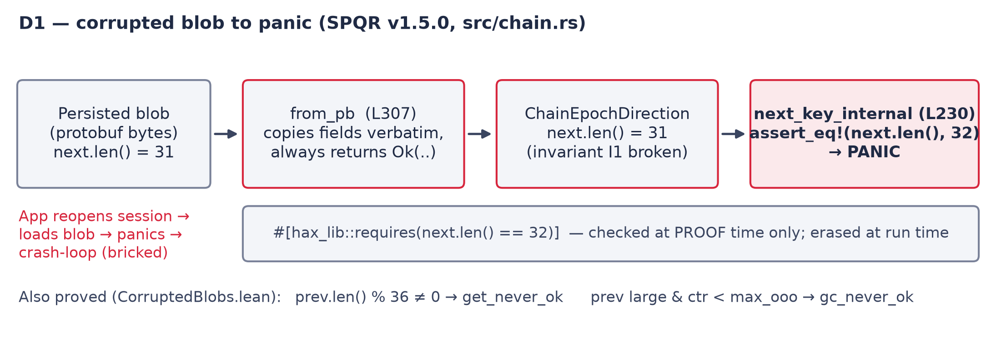
A Real One: D1 — From Corrupted Blob to Panic
Part 1 · SPQR evidence
Signal's SPQR passed its own tests and hax/F* proofs. Yet nothing between a stored blob and the assert re-checks next.len(); the hax contract is verified only at proof time, so a corrupted blob panics at run time.
From AI-Assisted Verification to Security Defect Discovery
4 / 23

Slide 5
Testing vs. Formal Verification
Part 2 · 8 minutes
Testing
Formal Verification
What does the program do on these inputs?
Can we prove a stated property under explicit assumptions?
• Run the program on selected inputs and observe behavior.
• Shows the presence of bugs, never their absence.
• SPQR: 40 000 forged messages → 0 panics.
• Missed every blob-path defect (D1, D19, D23 …).
• State a property for ALL inputs and prove it in a model.
• Every theorem names its hypotheses.
• SPQR: 246 Lean spec files, 0 sorry.
• A hypothesis the Rust never checks = a defect.
A tiny example
For f(a, b) = a + b we want: ∀ a, b ∈ ℕ, f(a, b) = a + b.
Testing can evaluate selected pairs. A formal proof establishes the property for every pair — provided the implementation and statement are correctly formalized.
Testing samples executions; formal verification establishes specified properties within a model. The 63 SPQR defects came from asking what each proof had to assume.
From AI-Assisted Verification to Security Defect Discovery
5 / 23

Slide 6
Specification, Implementation, and Proof
Part 2 · 3 minutes
1. Specification — What should happen?
A precise statement of the intended behavior.
Example: An unauthenticated message must not advance the session state.
2. Implementation — What does the code do?
The actual instructions, conditions, state transitions, and message-handling logic.
3. Proof — Why is the property true?
A formal argument that the implementation satisfies the specification under stated assumptions.
Important question: What if the specification itself is wrong or incomplete?
A proof may be mathematically valid while the system still fails to satisfy its real-world security requirements.
From AI-Assisted Verification to Security Defect Discovery
6 / 23

Slide 7
What Is Lean, and Why Use It?
Part 2 · 2 minutes
Lean is an interactive theorem prover and programming language.
A tiny Lean example
theorem add_zero (n : Nat) : n + 0 = n := by
rfl
It allows us to:
• Express mathematical definitions and theorems precisely.
• Construct proofs using tactics and reusable lemmas.
• Encode properties of programs and mathematical structures.
• Check proof terms with Lean's trusted kernel.
This theorem states that adding zero to a natural number leaves it unchanged.
• Nat represents natural numbers.
• theorem introduces a proposition to prove.
• by starts the proof.
• rfl proves the equality by definitional reduction.
The important idea: Lean checks whether the proof establishes the stated proposition — nothing more.
From AI-Assisted Verification to Security Defect Discovery
7 / 23

Slide 8
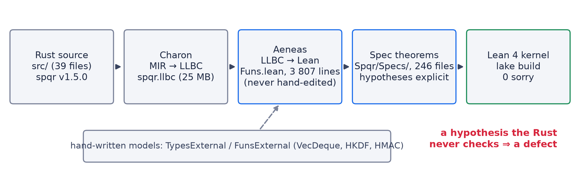
The SPQR Verification Pipeline: Rust → Aeneas → Lean 4
Part 2 · SPQR evidence
Funs.lean is generated from the Rust by Aeneas and trusted. The hand-written external models (dashed) are where an unsound model (D59) silently weakens every proof that depends on it.
From AI-Assisted Verification to Security Defect Discovery
8 / 23

Slide 9
How AI Assists Formal Verification
Part 3 · 10 minutes
1. Explain
2. Suggest
Explain unfamiliar code, definitions, and proof goals in natural language.
Recommend useful lemmas, tactics, and proof strategies.
3. Generate
4. Explore
Draft Lean code, candidate proofs — and candidate counterexamples.
Try alternative proof approaches and investigate why a proof gets stuck.
In SPQR, AI drafted spec theorems, proposed the forged-message bytes, and summarized state transitions — Lean and cargo checked them.
From AI-Assisted Verification to Security Defect Discovery
9 / 23

Slide 10
Why AI-Generated Proofs Need Checking
Part 3 · 3 minutes
Failure 1: Invalid Proof
Failure 2: Wrong Property
AI generates code that does not compile or does not prove the goal.
The proof establishes a weaker property than the one needed for security.
Failure 3: Missing Assumptions
Failure 4: False Confidence
The formal model omits relevant system behavior or environmental conditions.
A successful proof is interpreted as a guarantee that the whole system is secure.
AI output → Lean checks the proof → Humans check the specification and assumptions.
From AI-Assisted Verification to Security Defect Discovery
10 / 23

Slide 11
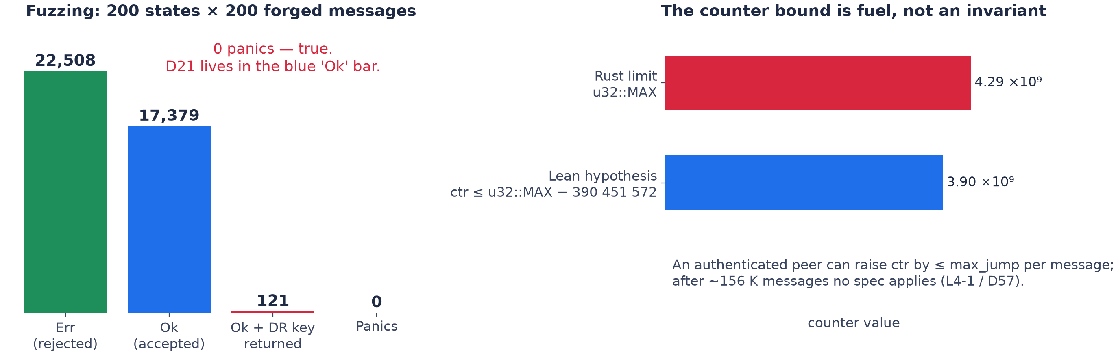
What Fuzzing Showed — and Didn't
Part 3 · SPQR evidence
Left: an AI-built harness fires 40 000 forged messages and nothing panics — yet D21 lives on the accepted (blue) path. Right: the Lean counter bound is a hypothesis a peer can exceed after ~156 K messages. Both checks passed; neither asked the right question.
From AI-Assisted Verification to Security Defect Discovery
11 / 23

Slide 12
The Project: Signal's SPQR, Re-verified in Lean 4
Part 4 · 15 minutes
What
Sparse Post-Quantum Ratchet: the ML-KEM layer of Signal's Triple Ratchet (Rust crate spqr v1.5.0)
Upstream
Signal verifies it with hax → F*
Ours
Independent re-verification: Rust → Aeneas → Lean 4, 246 spec theorems, 0 sorry
Result
63 defects (D1–D63), each backed by a Lean proof or a runnable Rust counterexample
Three root-cause patterns
Authenticate after persist
from_pb copies without validating
assume! erased at run time
D16 D21 D22 D35 D36 D62
D1 D11–D14 D18 D19 D23 … D61
D2 D3 D5 D8 D9 D25 D29 D37 D56 D57
From AI-Assisted Verification to Security Defect Discovery
12 / 23

Slide 13
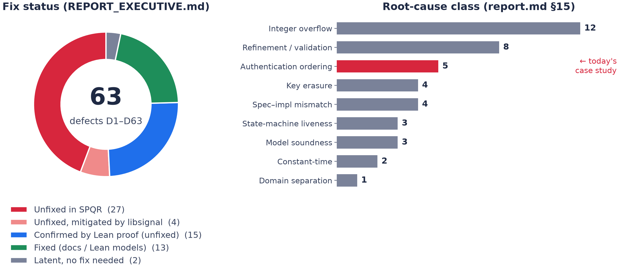
63 Defects at a Glance
Part 4 · SPQR evidence
Left: fix status. Right: root-cause class — overflow and missing validation dominate by count; authentication ordering (red) is today's case study.
From AI-Assisted Verification to Security Defect Discovery
13 / 23

Slide 14
Case Study: When a Protocol Accepts the Wrong Message
Part 4 · D21
Security goal: An unauthenticated control message must not cause an unauthorized state transition.
Intended behavior
What SPQR recv actually does (D21)
1. Receive a control message.
2. Verify the required authentication conditions.
3. Validate the message's meaning and context.
4. Apply the state transition only if all required checks succeed.
1. Receive a control message.
2. Advance the protocol state (epoch, keys) and persist it.
3. Verify authentication.
4. Reject the message if authentication fails — state already changed.
The key question
What happens if the message is rejected after the protocol state has already changed?
From AI-Assisted Verification to Security Defect Discovery
14 / 23

Slide 15
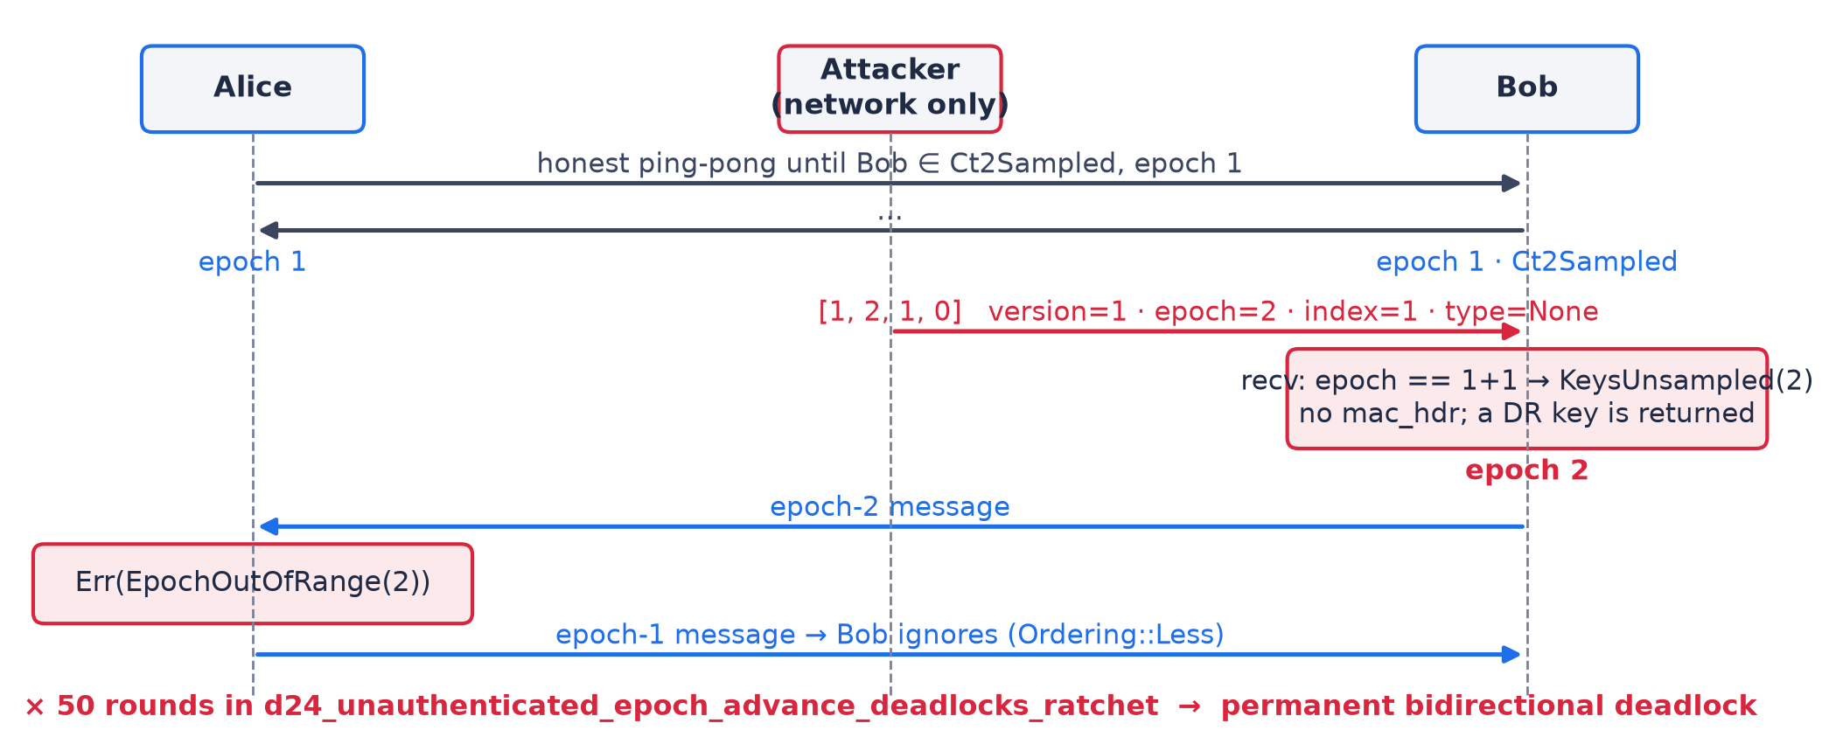
D21 as a Sequence Diagram
Part 4 · SPQR evidence
One unauthenticated 4-byte message moves Bob to epoch 2. Alice rejects all of Bob's messages; Bob ignores all of Alice's. Permanent deadlock — the answer to the key question.
From AI-Assisted Verification to Security Defect Discovery
15 / 23

Slide 16
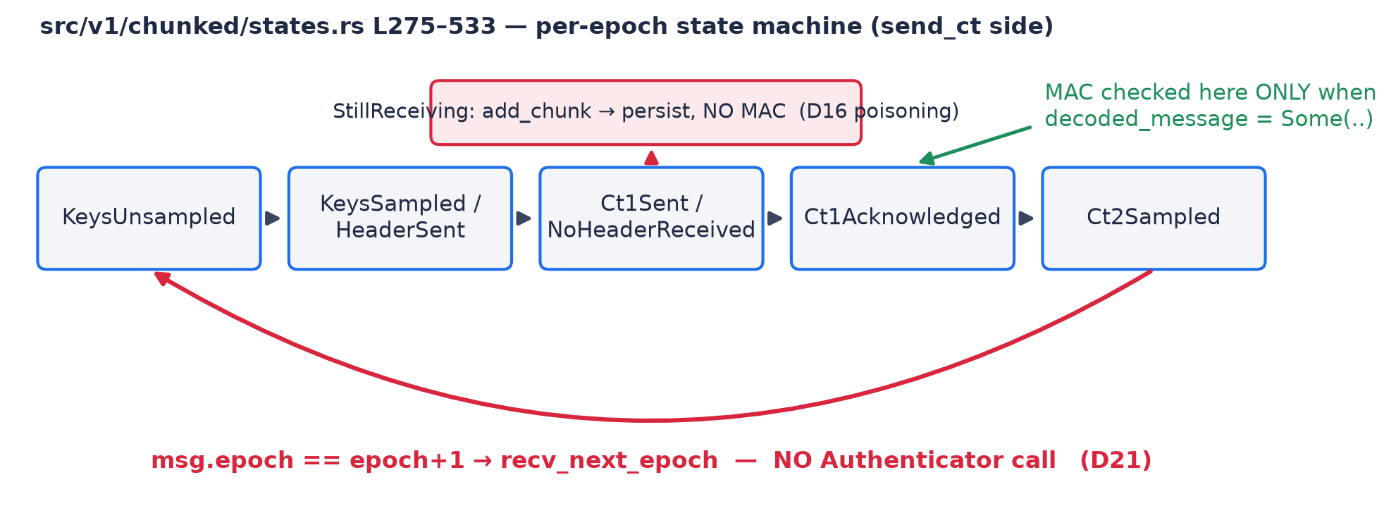
Where the MAC Is — and Isn't — Checked
Part 4 · SPQR evidence
Green: the only edges that call the MAC. Red: edges that persist state with no Authenticator call. D21 is the red back-edge; the same pattern explains D16, D22, D35, D36 and D62.
From AI-Assisted Verification to Security Defect Discovery
16 / 23

Slide 17
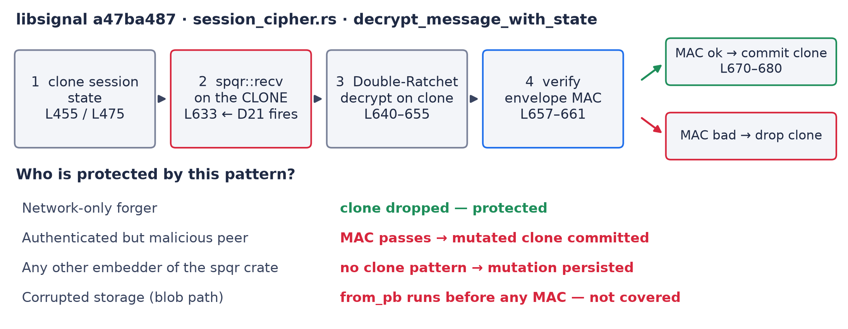
Why Signal Is Safe From D21 — and Who Isn't
Part 4 · exploitability
libsignal runs spqr::recv on a clone and commits only after the MAC passes. The protection lives outside SPQR; peers, other embedders and storage bypass it. Exploitability is a judgment about the whole system, not the crate.
From AI-Assisted Verification to Security Defect Discovery
17 / 23

Slide 18
From Code Reading to a Validated Defect
Part 4 · workflow
Step 1 — Inspect
Step 2 — Hypothesize
Step 3 — Construct
Step 4 — Validate
AI summarizes control flow, message handling, and state transitions.
Identify a suspicious ordering, missing condition, or inconsistency with the security requirements.
Propose a message sequence, execution trace, or counterexample that could violate the property.
Reproduce the behavior and check it against implementation, model, tests, or formal properties.
→
→
→
D21: AI read recv and flagged that the epoch advances before the MAC check.
Hypothesis: an unauthenticated message can move a peer to a new epoch.
AI proposed the 4-byte forged message.
cargo test reproduces the deadlock; Lean proves it in ProtocolDoS.lean.
Report a defect only when the evidence is strong enough. Two agents agreeing is not evidence.
From AI-Assisted Verification to Security Defect Discovery
18 / 23

Slide 19
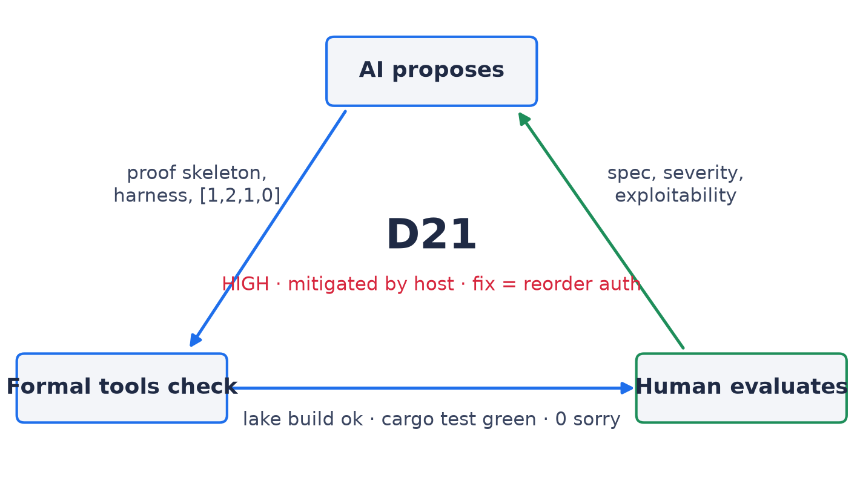
Three Complementary Roles, One Defect
Part 4 · method
No arrow is skippable: the forged bytes came from AI, the deadlock proof from cargo/Lean, the exploitability verdict from reading libsignal.
AI proposes · Formal tools check · Humans evaluate specification quality, exploitability, and impact.
From AI-Assisted Verification to Security Defect Discovery
19 / 23

Slide 20
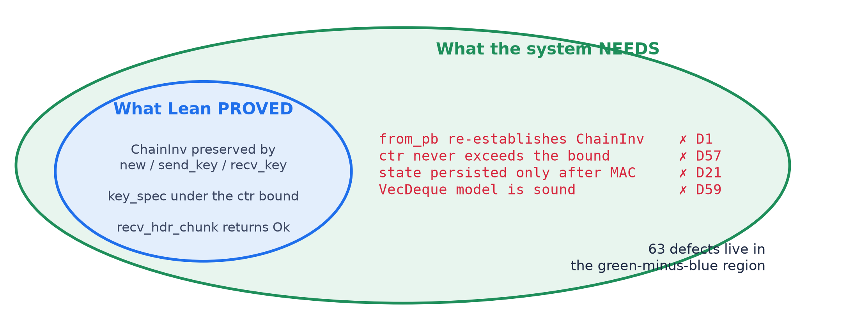
Why a Proof Is Not a Security Guarantee
Part 5 · 7 minutes
Everything in the blue ellipse is machine-checked. Every one of the 63 defects is a true statement about the green region that no theorem mentioned.
From AI-Assisted Verification to Security Defect Discovery
20 / 23

Slide 21
Key Message
Part 5
Even a Lean proof accepted by the kernel establishes only
the formal proposition under its stated assumptions.
It does not, by itself, establish that the specification captures
every security requirement of the real-world system.
SPQR: 246 spec files, 0 sorry, ChainInv proved — and still 63 defects,
found precisely by asking what each proof had to assume.
From AI-Assisted Verification to Security Defect Discovery
21 / 23

Slide 22
Lessons, Limitations, and Takeaways
Part 5
Five takeaways
Questions for discussion
1. Testing is useful, but incomplete. 40 000 fuzzed messages missed D21.
2. Formal verification gives precise guarantees — relative to the specification and its assumptions.
3. AI accelerates exploration: drafting specs, proofs, harnesses, and counterexamples.
4. Proof does not equal security. A valid proof may establish a property that is too weak or incomplete.
5. Human judgment remains essential: the libsignal clone-and-commit verdict came from reading code, not a prover.
• If an AI-generated proof is accepted by Lean, what exactly have we established?
• Can a perfectly verified program still be insecure?
• Where should human judgment remain in an AI-assisted workflow?
Final message: Use AI to explore more possibilities — and use verification to check the claims.
From AI-Assisted Verification to Security Defect Discovery
22 / 23

Slide 23
Thank You
Questions & Discussion
docs/report.md · docs/listDefects.md · docs/classificationBug.md · docs/bugSecurityRemote.md
Spqr/Specs/Bugs/ProtocolDoS.lean · Spqr/Specs/Bugs/CorruptedBlobs.lean · docs/protocol_driver_counterexamples.rs.txt

