Slide 1


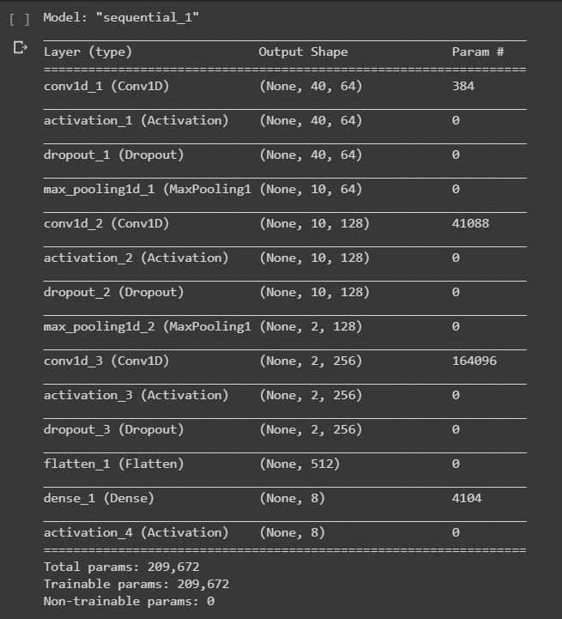
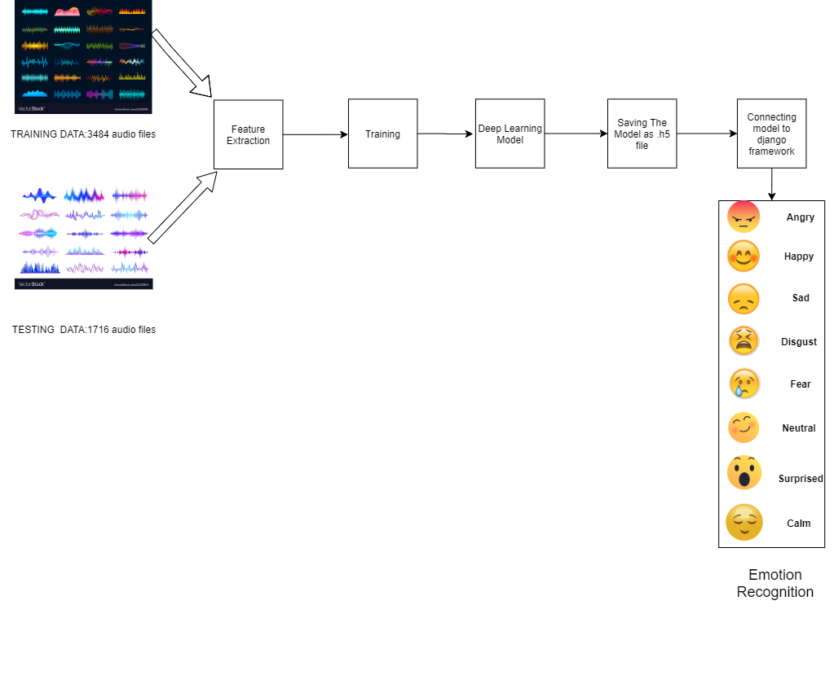
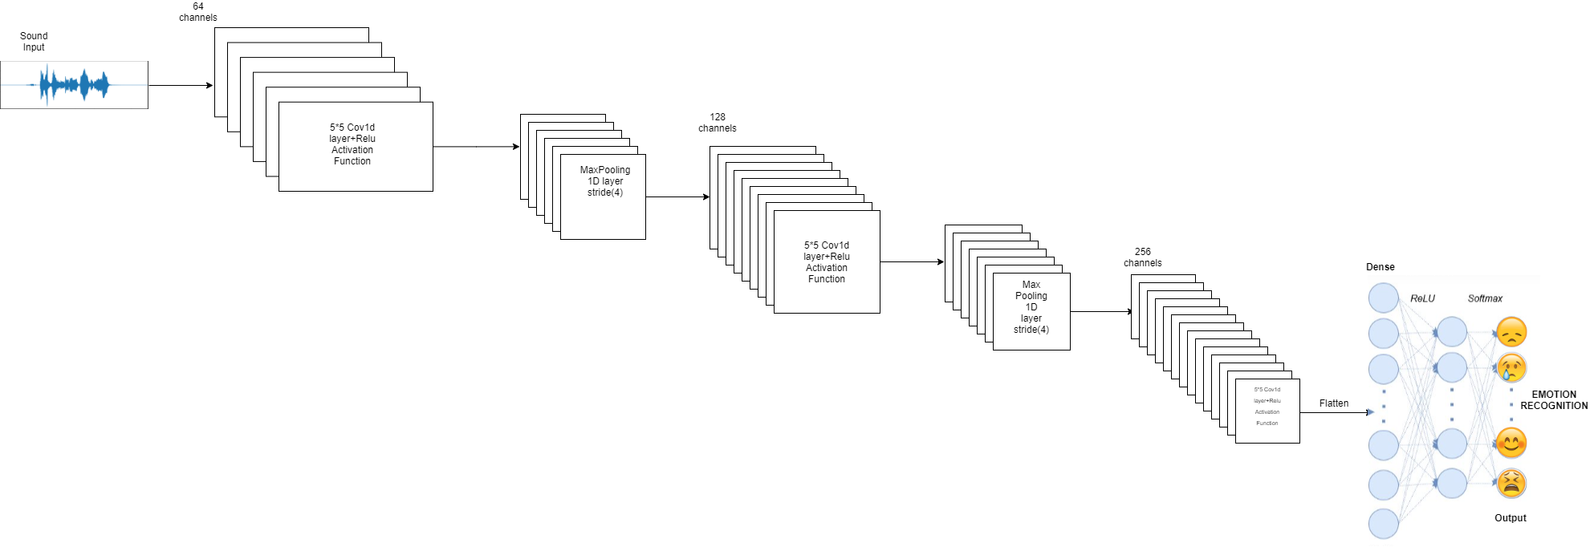

[Speech Emotion Recognition
using Deep learning]
[Abhay Gupta, Aditya Karmokar,
Khadija Mohamad Haneefa, Chennaboina Hemantha Lakshmi]
[Mentor-Dr. Shivani Goel]
Abstract
to obtain a large value in case of activation by applying this function as a good choice
to represent hidden units.
We have run the process described once more
by changing the kernel size. Following, we have
applied another dropout and then flatten the output
to make it compatible with the next layers. Finally,
we applied one Dense layer (fully connected layer)
with a soft max activation function, varying the output
Size from 640 elements to 8 and estimating the
probability distribution of each of the classes properly
encoded(0=Neutral; 1= Calm; 2= Happy; Sad=3;
Angry=4; Fearful= 5; Disgust=6; Surprised=7).
2. A multilayer perceptron (MLP) is a class of feedforward artificial neural network (ANN).MLP utilizes a supervised learning technique called back propagation for training. Its multiple layers and non-linear activation distinguish MLP from a linear perceptron. It can distinguish data that is not linearly separable. A multilayer perceptron (MLP) is a class of feedforward artificial neural network (ANN).MLP utilizes a supervised learning technique called back propagation for training. Its multiple layers and non-linear activation distinguish MLP from a linear perceptron. It can distinguish data that is not linearly separable.
A.SYSTEM DESIGN FLOWCHART
3.“Support Vector Machine” (SVM) is a supervised machine learning algorithm which can be used for both classification or regression challenges. However, it is mostly used in classification problems. In the SVM algorithm, we plot each data item as a point in n-dimensional space (where n is the number of features you have) with the value of each feature being the value of a particular coordinate. Data can be scaled before applying to an SVM classifier to avoid attributes in greater numeric ranges while processing it. Scaling also serves the purpose of avoiding some numerical difficulties during the calculation.
For this task, the dataset is built using 5252 samples from:
Ryerson Audio-Visual Database of Emotional Speech and Song (RAVDESS) dataset
Toronto emotional speech set (TESS) dataset
B.CNN LAYER DESCRIPTION
TABLE II:F1-SCORES FOR EACH CLASS
COMPARED TO THE BASELINES(SVM,MLP)
AND THE STATE OF ART
In this work, we presented an architecture based on deep neural networks for the classification of emotions using audio recordings from the Ryerson Audio-Visual Database of Emotional Speech and Song (RAVDESS) and Toronto emotional speech set (TESS). The model has been trained to classify seven different emotions (neutral, calm, happy, sad, angry, fearful, disgust, surprised) and obtained an overall F1 score of 0.85 with the best performances on the Happy class (0.90) and worst on the calm class (0.77). To obtain such a result, we extracted the MFCC features (spectrum of-a-spectrum) from the audio files used for the training.
[1] LOGAN, B., ET AL. Mel frequency cepstral coefficients for music modeling
ISMIR(2000), vol. 270, pp. 1–11. [2] MUDA, L., BEGAM, M., AND ELAMVAZUTHI, I. Voice recognition algorithms using mel frequency cepstral coefficient (mfcc) and dynamic time warping (dtw) techniques. arXiv preprint arXiv:1003.4083 (2010).
The aim of the project is about the detection of the emotions elicited by the speaker while talking. As an example, speech produced in a state of fear, anger, or joy becomes loud and fast, with a higher and wider range in pitch, whereas emotions such as sadness or tiredness generate slow and low-pitched speech. Detection of human emotions through voice-pattern and speech-pattern analysis has many applications such as better assisting human-machine interactions. In particular, we are presenting a classification model of emotion elicited by speeches based on deep neural networks (CNNs),SVM,MLP Classification based on acoustic features such as Mel Frequency Cepstral Coefficient (MFCC).The model has been trained to classify eight different emotions (neutral, calm, happy, sad, angry, fearful, disgust, surprise). Our evaluation shows that the proposed approach yields accuracies of 86%, 84% and 82% using CNN, MLP Classifier and SVM Classifiers, respectively, for 8 emotions using Ryerson Audio-Visual Database of Emotional Speech and Song (RAVDESS) dataset and Toronto Emotional Speech Set (TESS) Dataset.
Introduction
Human communication through the spoken language is the base for
Information exchange and it is the main aspect of the society since the first human settlements. In the same way, emotions go back to a primordial instinct prior to the spoken language that we know today and that can be considered as the first natural communication strategies. It also finds use in numerous practical applications in various fields like Business Process Outsourcing (BPO) Centre and Call Centre to detect the emotion useful for identifying the happiness of the customer. In the Proposed Model it is shown how each of us expresses more than one basic emotion at a time but our opinion is that is extremely difficult, both for the speaker and for the listener, to be able to recognize which and in what percentage of the emotions are mixed. In this regard it was decided to create a model that aims to identify only the emotion that has a greater value in the audio track. Different approaches have been tried to have a machine classify feelings like computer vision or text analytics. In this work, our goal is to use pure audio data considering Mel-frequency Cepstral Coefficients[1] (from now on MFCC).Speech is one of the most fundamental abilities of humans, that allow us to bond with each other, express ourselves and more importantly gives us a sense of existence. It is one of the key factors for mental and physical well-being. Owing to the fact that emotions may define how we behave and perceive the situations we are going through, speech made by a speaker conveys its linguistic meaning as well as the feeling with which the speech is delivered.
Proposed Method
The classification model of emotion recognition here proposed is based on a deep learning strategy based on convolutional neural networks (CNN), Support Vector machine (SVM) classifier, MLP Classifier. The key idea is considering the MFCC commonly referred to as the ”spectrum of a spectrum”, as the only feature to train the model. MFCC is a different interpretation of the Mel-frequency cepstrum (MFC), and it has been demonstrated to be the state of the art of sound formalization in automatic speech recognition task [2]. The MFC coefficients have mainly been used as the consequence of their capability to represent the amplitude spectrum of the sound wave in a compact vectorial form. As described in [1], the audio file is divided into frames, usually using a fixed window size, in order to obtain statistically stationary waves. The amplitude spectrum is normalized with a reduction of the ”Mel” frequency scale. This operation is performed for empathizing the frequency more meaningful for a significant reconstruction of the wave as the human auditory system can perceive. For each audio file,40 features have been extracted. The feature has been generated by converting each audio file to a floating-point time series. Then, an MFCC sequence has been created from the timeseries.
CLASS | MLP | SVM | CNN
SAD | 0.68 | 0.82 | 0.80
ANGRY | 0.68 | 0.91 | 0.89
HAPPY | 0.74 | 0.84 | 0.90
DISGUST | 0.68 | 0.81 | 0.81
SURPRISE | 0.53 | 0.87 | 0.88
NEUTRAL | - | 0.93 | 0.88
CALM | 0.85 | 0.64 | 0.77
FEAR | 0.79 | 0.81 | 0.88
Conclusions
Experimental Results and Discussion
The deep neural network(CNN) designed for the classification task is reported operationally in Fig. 1. The network is able to work on vectors of 40 features for each audio file provided as input. The 40 values represent the compact numerical form of the audio frame of 2s length. Consequently, we provide as input a of size < number of training files > x 40 x 1 on which we performed one round of a 1D CNN with a ReLu activation function, dropout of 20% and a max-pooling function 2 x 2.
The rectified linear unit (ReLu) can be formalized as g(z) = max{0, z},and it allows us
References
Team No. - 21

