Slide 1


Speech Emotion Recognition
Team (21) Members Mentor:
Abhay Gupta Shivani Goel
Aditya Karmokar
Khadija Mohamad Haneefa
Chennaboina Hemantha Lakshmi

Slide 2
Introduction
Emotions are important part of understanding human interactions. Research is going into finding methods that can at the very least mimic human ability to recognise emotions displayed in the form of facial expressions, changes in tone while speaking, etc. Speech Emotion Recognition (SER) is one of such fields. Using deep learning and machine learning algorithms, we aim to design an automatic emotion recognition system.

Slide 3
Dataset Used
1440 speech files
1012 song files
recordings of 24 professional actors (Male & Female)
Emotions including neutral, calm, happy, sad, angry, fearful, surprise, and disgust.
2800 Audio files
set of 200 target words
Two actresses (ages 26, 64)
Seven emotions including anger, disgust, fear, happiness, pleasant surprise, sadness, and neutral
The dataset is built using 5252 samples from:
Ryerson Audio-Visual Database of Emotional Speech and Song (RAVDESS) dataset [1][2]
Toronto emotional speech set (TESS) dataset [3]
RAVDESS
TESS

Slide 4
Methodology / Model Used
The classification model proposed based on
machine learning
deep learning strategy.
The project tested 3 models:
convolutional neural networks (CNN),
support vector machine (SVM) classifier,
MLP classifier.
Feature extracted: Mel-frequency cepstral coefficients (MFCC) [4]
Table 1. shows classes the model wants to predict
 | emotion
0 | Neutral
1 | Calm
2 | Happy
3 | Sad
4 | Angry
5 | Fearful
6 | Disgust
7 | Surprised
Table 1. Emotions to be classified

Slide 5



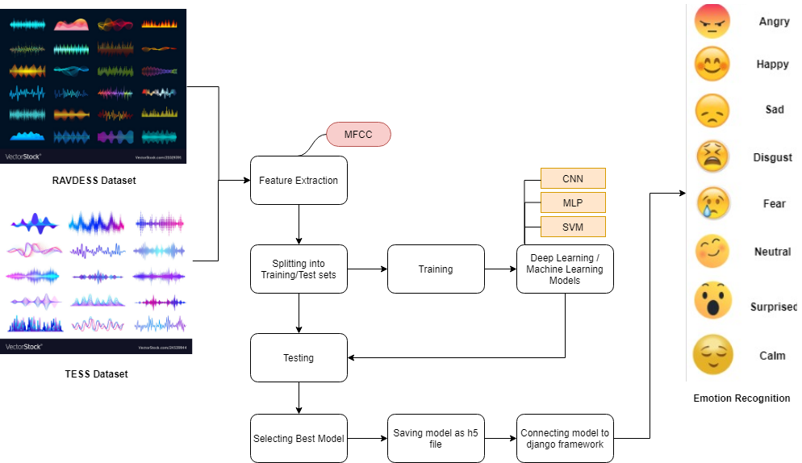


System Architecture
System Design Flowchart
Fig 1. SER system design flowchart

Slide 6
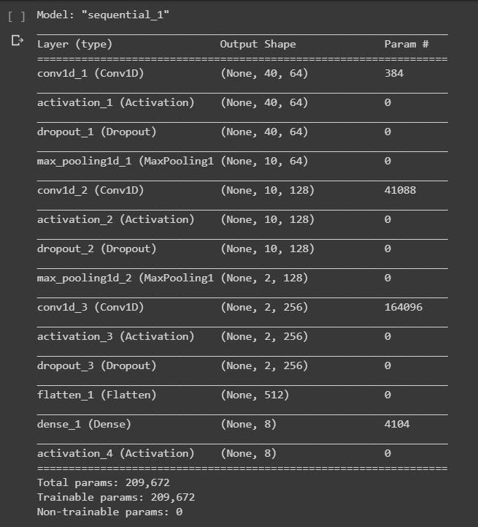
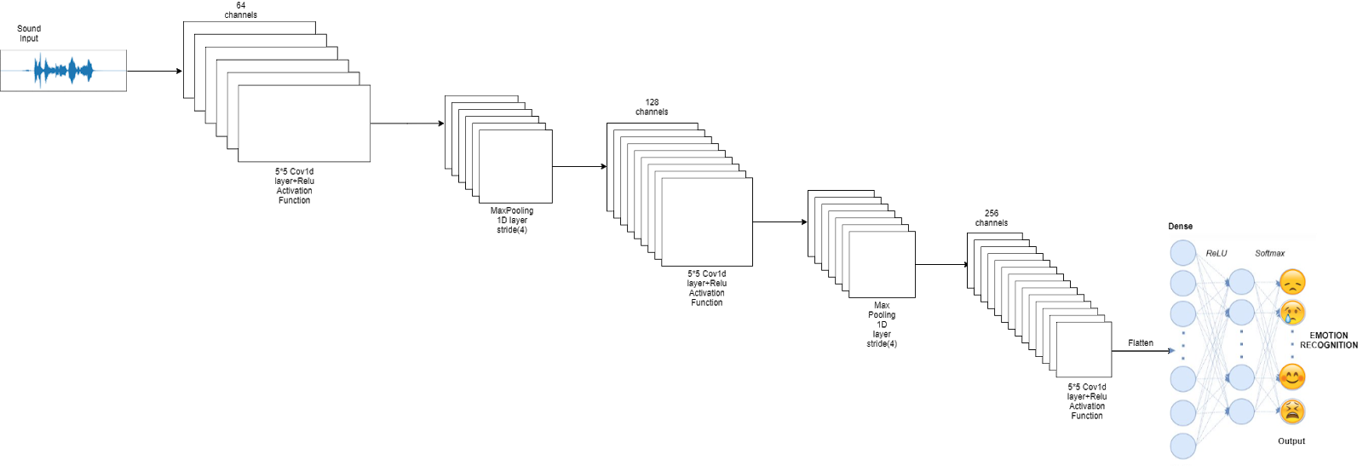
CNN Layer Description

Slide 7

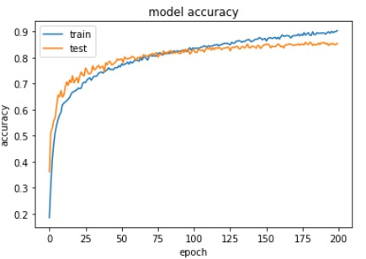
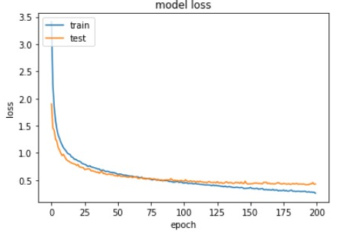
Results Achieved
CLASS | MLP | SVM | CNN
SAD | 0.81 | 0.82 | 0.80
ANGRY | 0.89 | 0.91 | 0.89
HAPPY | 0.82 | 0.84 | 0.90
DISGUST | 0.80 | 0.81 | 0.81
SURPRISE | 0.80 | 0.87 | 0.88
NEUTRAL | 0.89 | 0.93 | 0.88
CALM | 0.75 | 0.64 | 0.77
FEAR | 0.84 | 0.81 | 0.88
MLP Classifier achieved an F1 score of 0.83 over the 8 classes.
Final choice - deep learning model that obtained an F1 score of 0.86
SVM classifier achieved an F1 score of 0.82.
Fig 4. Accuracy vs. Epochs.
CNN model accuracy graph
Table 2: F1-score for each class compared to the baselines (SVM, MLP) and the state of art.
Obtained an overall F1 score of 0.85
Best - on Happy class (0.90)
Worst - on calm class (0.77).
Fig 5. Loss vs. Epochs.
CNN model loss graph

Slide 8
Conclusions
Approaches based on deep neural networks are an excellent basis for solving the task.
Model is general enough to work in a real application context correctly
Combining the two datasets, RAVDESS & TESS, increased accuracy
Removed audio collected from video files from RAVDESS dataset as it caused overfitting
Further Improvement: More data can be collected to increase model accuracy and performance on all emotion classes. Can improve the model further by predicting emotions on real time data. Also can incorporate other learning mechanisms to compute the percentage of emotions for audio with mixed emotion.

Slide 9
References
[1] Livingstone SR, Russo FA (2018) The Ryerson Audio-Visual Database of Emotional Speech and Song (RAVDESS): A dynamic, multimodal set of facial and vocal expressions in North American English. PLoS ONE 13(5): e0196391. https://doi.org/10.1371/journal.pone.0196391.
[2] https://zenodo.org/record/1188976
[3] TESS https://www.kaggle.com/ejlok1/toronto-emotional-speech-set-tess
[4] LOGAN, B., ET AL. Mel frequency cepstral coefficients for music modeling. In ISMIR (2000), vol. 270, pp. 1–11.

Slide 10
Thank You

