Slide 1


vOCS3.0 System
Overview

Slide 2
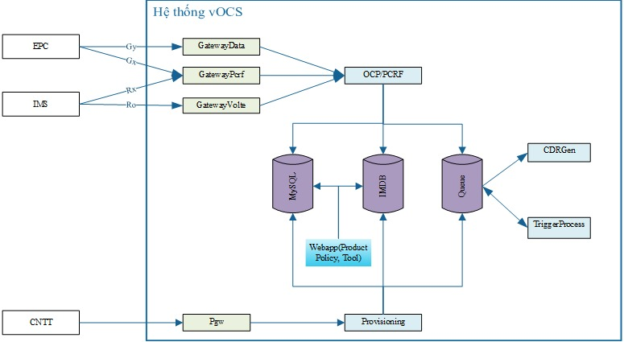
vOCS3.0 System

Slide 3
Technology
Big Data: Aerospike, Kafka
RDBMS: MySQL
Platform:
- Java (Gateway, Charging & Rating)
3rd party software:
- Database: Aerospike, Apache

Slide 4
Flow Data

Slide 5
Flow PCRF

Slide 6
Flow Volte

