Slide 1

Project Requirement
Project Name: Sign-Language-Detection
We want to build a detector using camera to capture and exactly identify/classify sign language

Slide 2

EDA (Exploratory Data Analysis)
- Dataset we used: ASL (American Sign Language) Dataset
- The number of classes/labels in dataset: 29 (26 alphabet characters, nothing, space and del)
- The number of images which each label has: 3000
The dataset is not imbalance

Slide 3
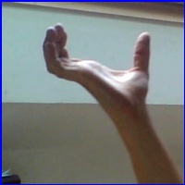

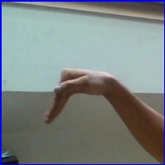

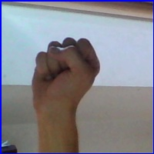
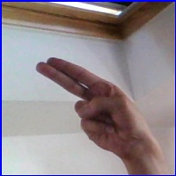
Some Pictures In Our Dataset
Label: Space
Label: Nothing
Label: Del
Label: W
Label: S
Label: H

Slide 4
Model Selection
- Custom CNN (we can control the number of conv layers and pool layers as well as other parameters of these layers)
- MobileNetV2 (it helps reduce computations needed and has high accuracy as well as good performance)

Slide 5
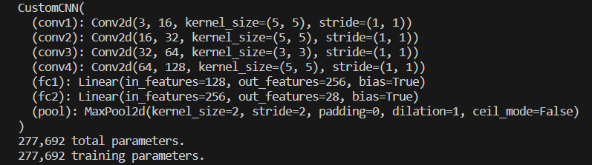
Our Custom CNN Architecture

Slide 6
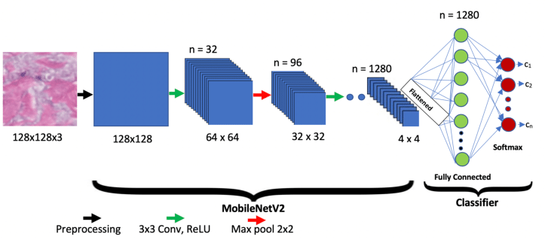
MobileNetV2 Architecture

Slide 7
Member Task List
Preprocess data and create csv file from the data
Make the custom CNN model, also implement pretrained MobileNetV2
Train, Validate and Test those 2 models
Test using camera of the device

Slide 8

Project Plan
- Preprocess data and change it to csv file (done)
- Make the custom CNN model, also implement pretrained MobileNetV2
(done)
- Train, Validate and Test those 2 models (done)
- Test using camera (unfinished, expected done within this week)

