Slide 1
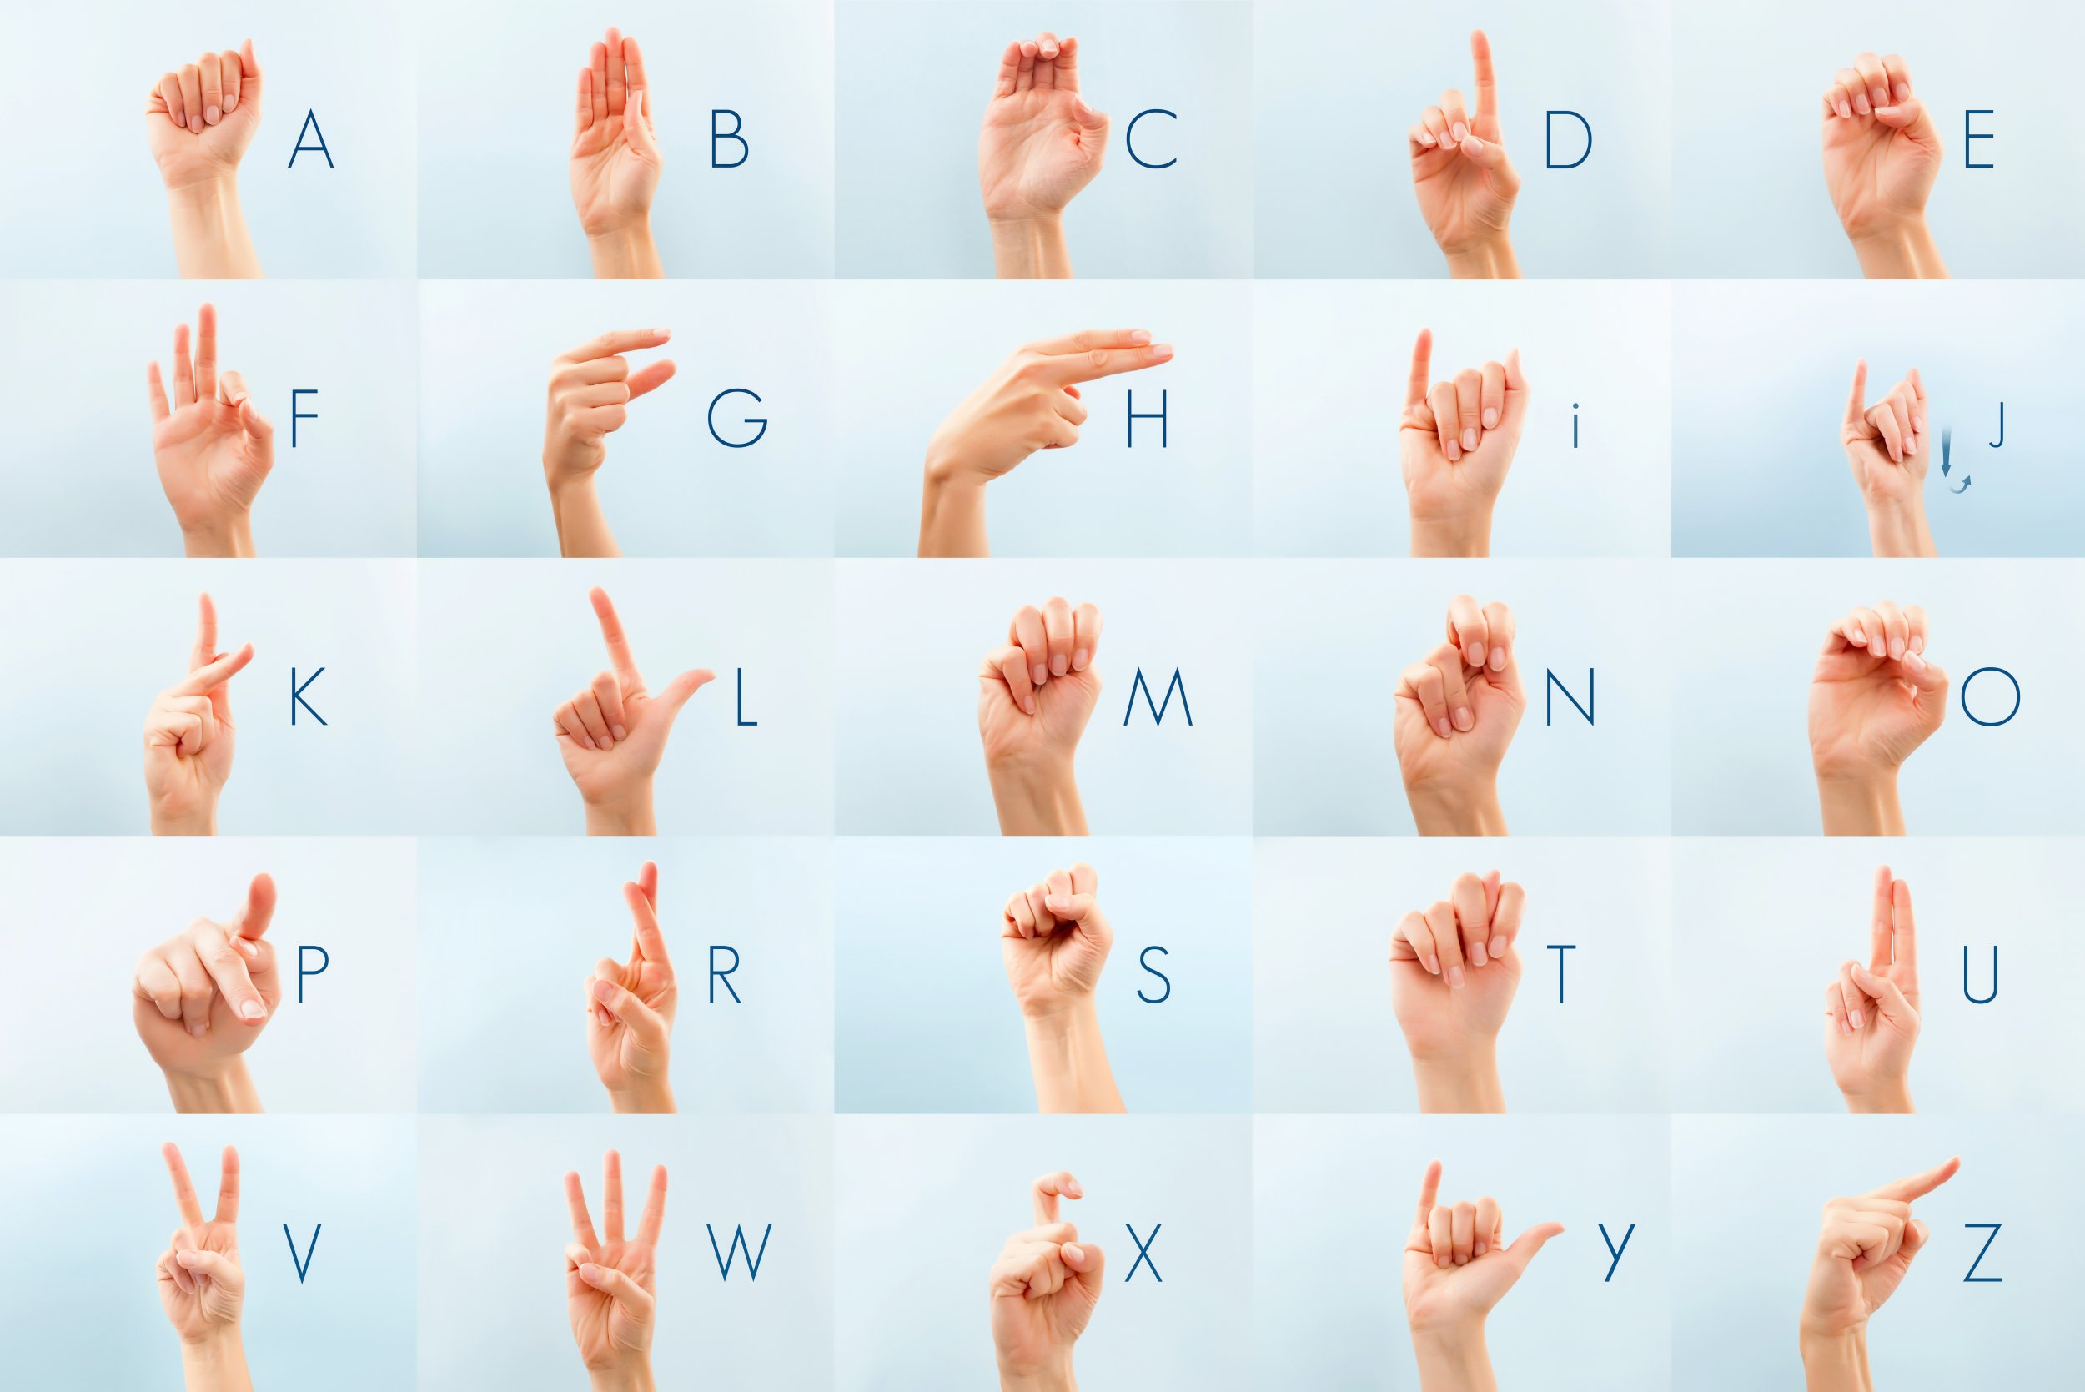
Project Requirement
Project Name: Sign-Language-Detection
We want to build a detector using camera to capture and exactly identify/classify sign language

Slide 2
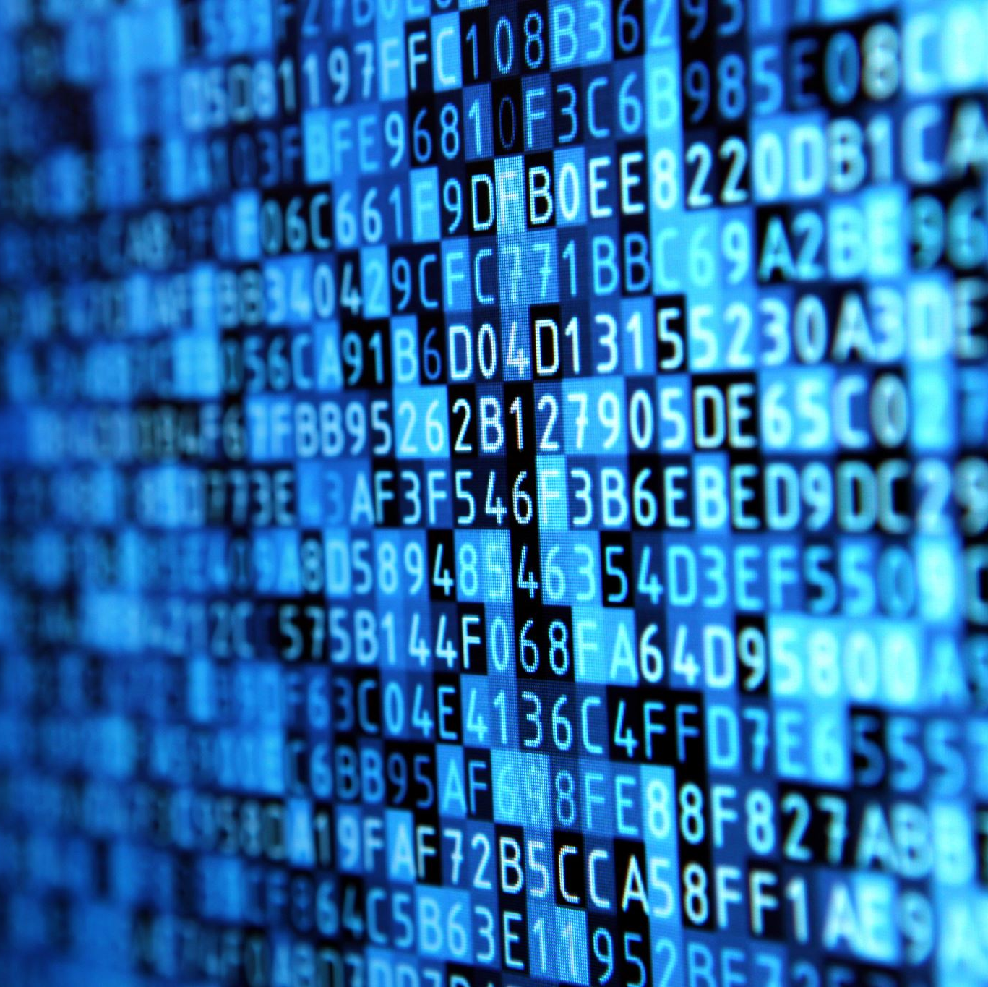
EDA (Exploratory Data Analysis)
- Dataset we used: ASL (American Sign Language) Dataset
The number of classes/labels in training set: 29 (26 alphabet characters, nothing, space and del)
The number of classes/labels in testing set: 28 (26 alphabet characters, nothing, space)
The number of images which each label has in training set: 3000
The dataset is not imbalance

Slide 3
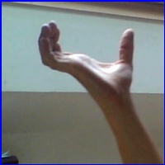

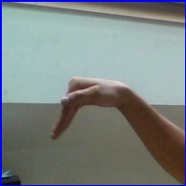

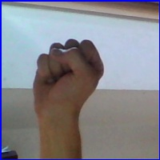
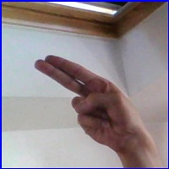
Some Pictures In Our Dataset
Label: Space
Label: Nothing
Label: Del
Label: W
Label: S
Label: H

Slide 4
Model Selection
- Custom CNN (we can control the number of conv layers and pool layers as well as other parameters of these layers)
- 27 Pretrained Models (we quickly fit and get the performance of 27 CNN pretrained models within 5 epoch to choose the best model out of them to train and test)

Slide 5
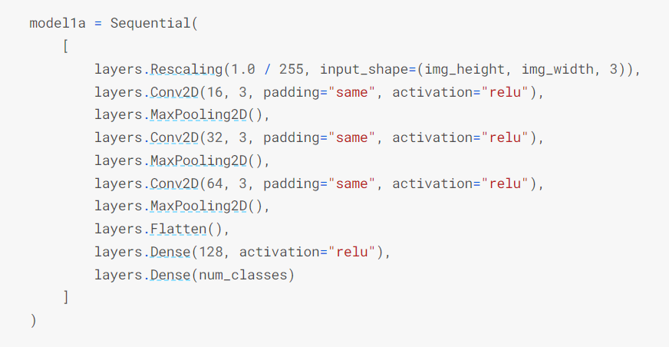
Our Custom CNN Model’s Architecture

Slide 6
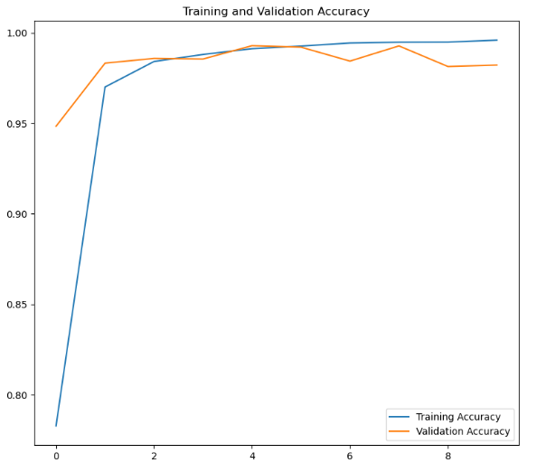
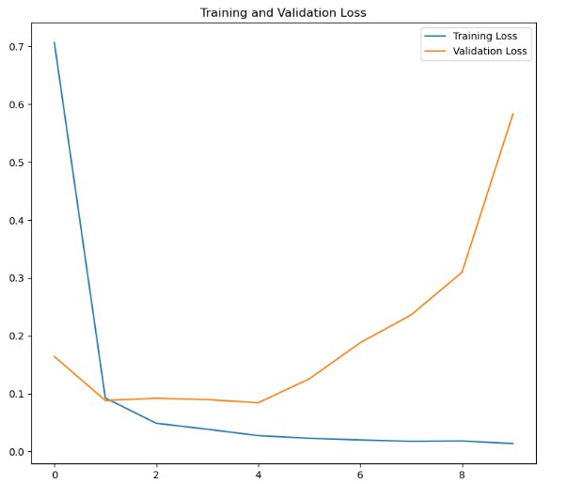
Accuracy (Best 99.59% On Train Set And 99.29% On Validation Set) And Loss (Best 0.0138 On Train Set And 0.0843 On Validation Set) Of Custom CNN Model (Without Data Augementation)

Slide 7
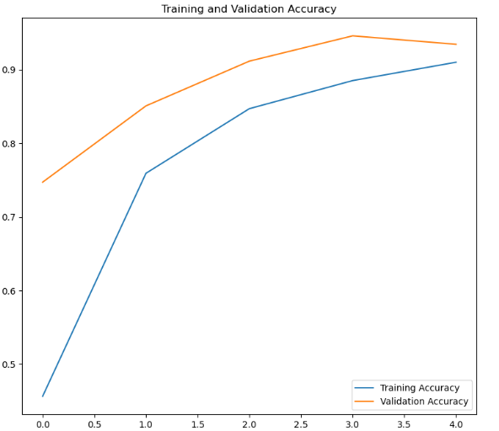
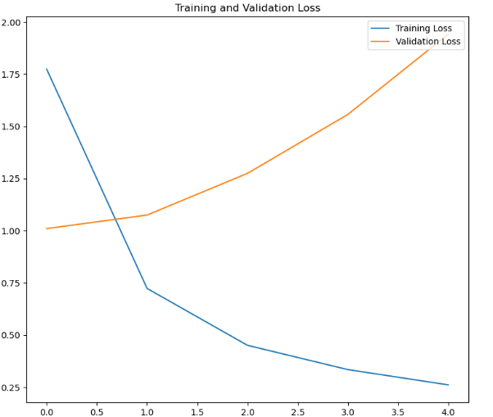
Accuracy (Best 91.00% On Train Set And 94.58% On Validation Set) And Loss (Best 0.2612 On Train Set And 1.0750 On Validation Set) Of Custom CNN Model (With Data Augementation)

Slide 8
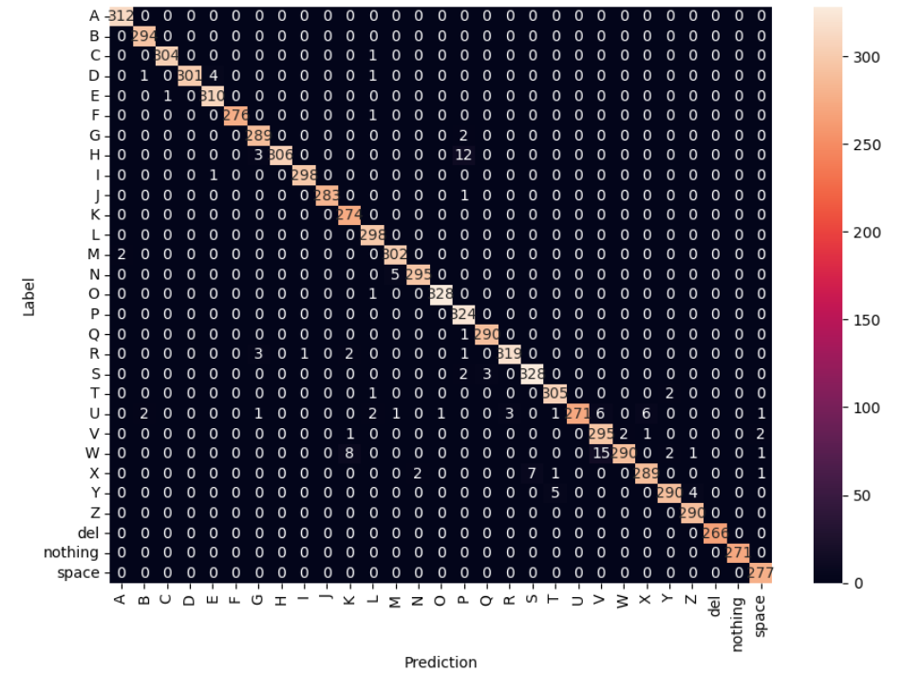
Confusion Matrix Of Custom CNN Model (129/8700 false predicted images – 98.52% test accuracy, without Data Augmentation)

Slide 9
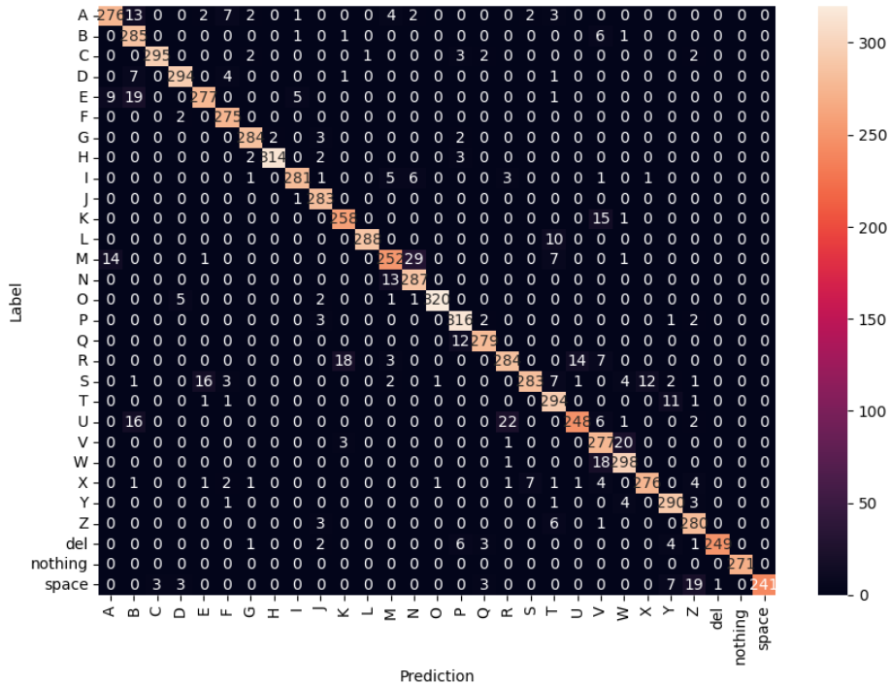
Confusion Matrix Of Custom CNN Model (549/8700 false predicted images – 93.69% test accuracy, with Data Augmentation)

Slide 10
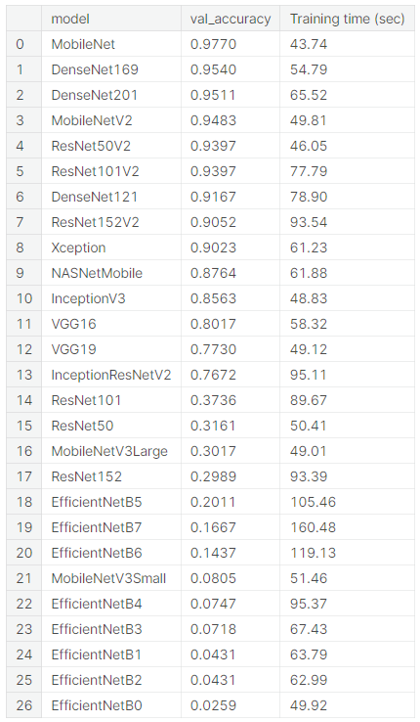
Benchmark For 27 Pretrained Models (5 epochs, without Data Augmentation)
From this table, we choose the best model to train and test which is MobileNet model with highest validation accuracy and fastest training time

Slide 11
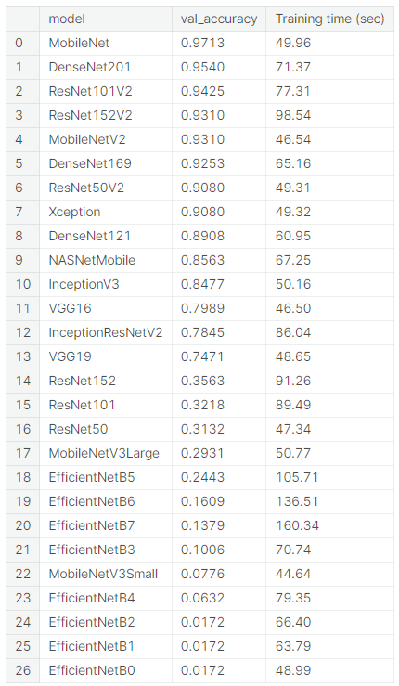
Benchmark For 27 Pretrained Models (5 epochs, with Data Augmentation)
From this table, we choose the best model to train and test which is MobileNet model with highest validation accuracy and fast enough training time

Slide 12
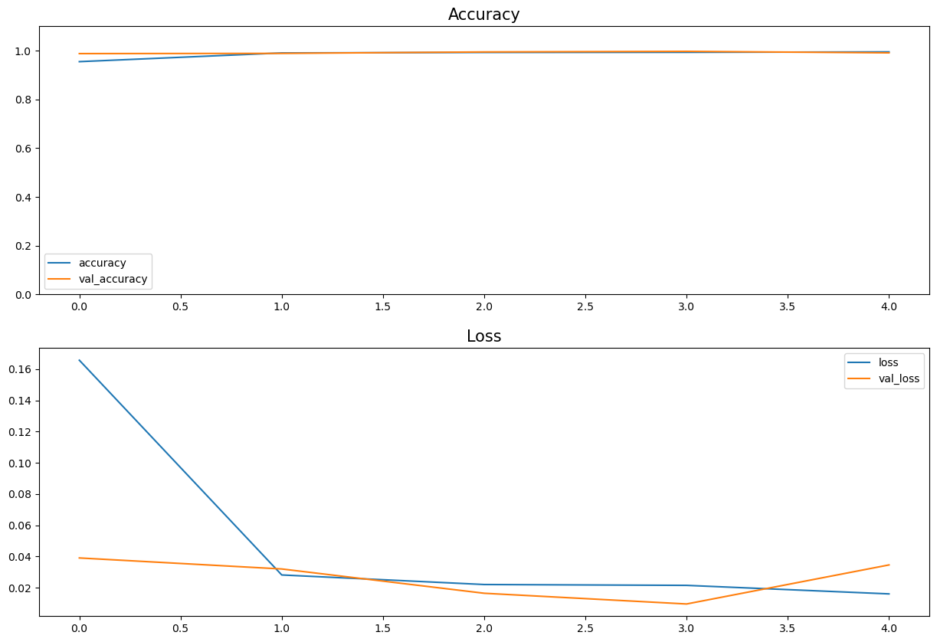
Accuracy And Loss Of Best Pretrained Model (Without Data Augmentation)

Slide 13
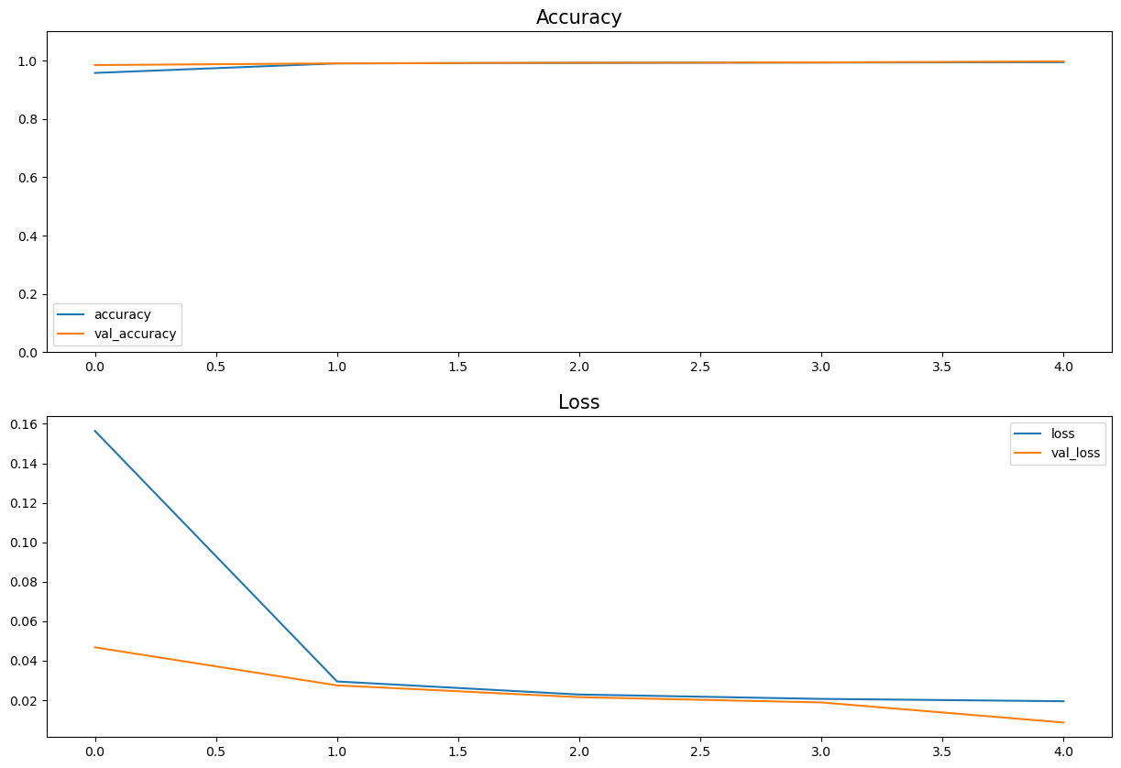
Accuracy And Loss Of Best Pretrained Model (With Data Augmentation)

Slide 14
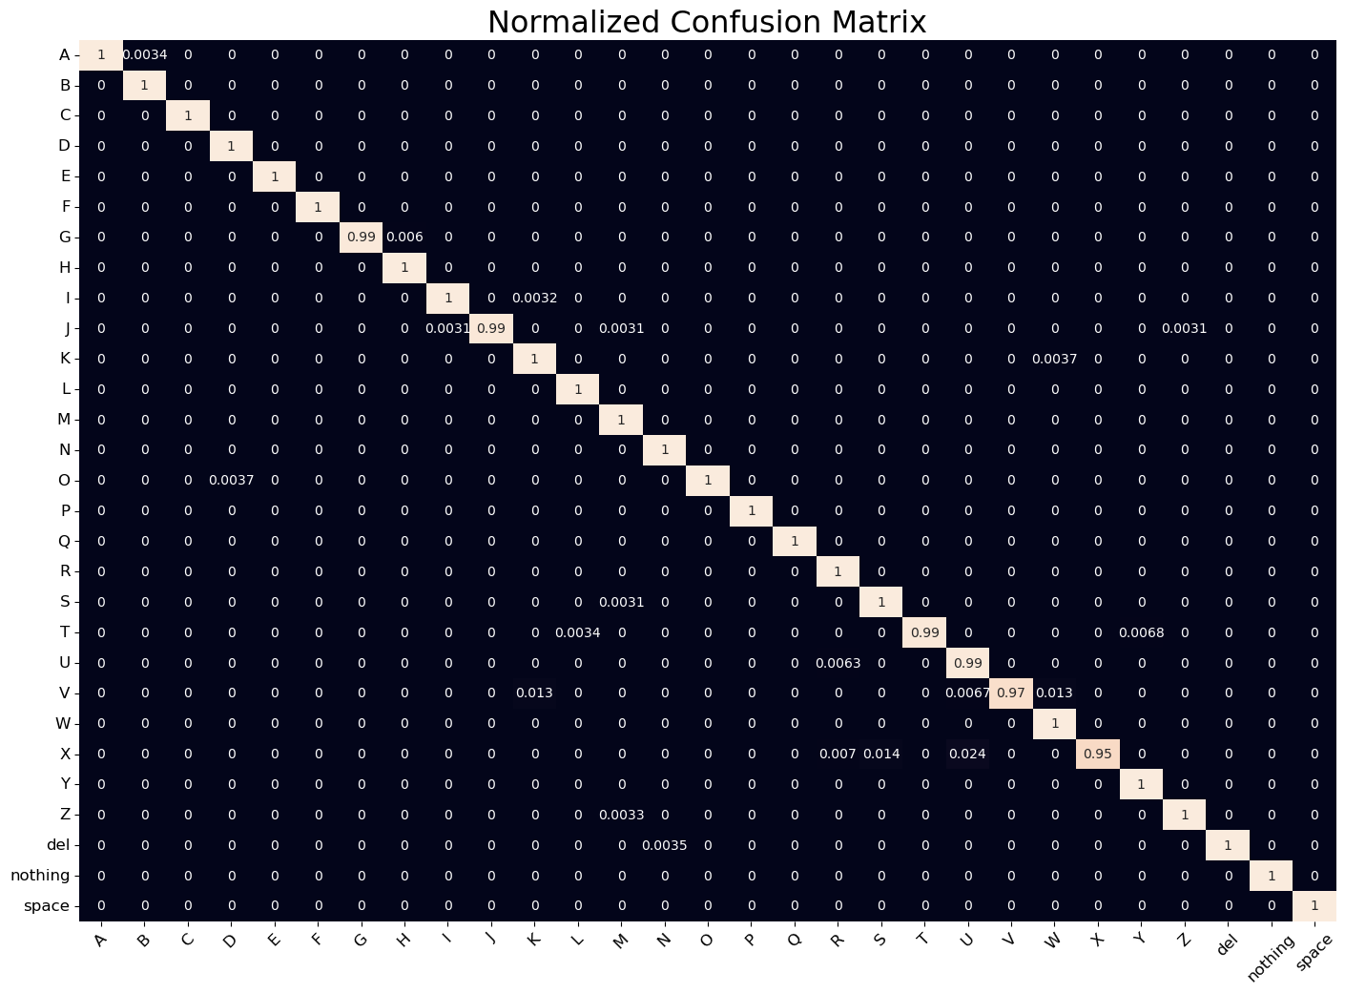
Confusion Matrix Of Best Pretrained Model (18/8700 false predicted images – 99.54% test accuracy, without Data Augmentation)

Slide 15
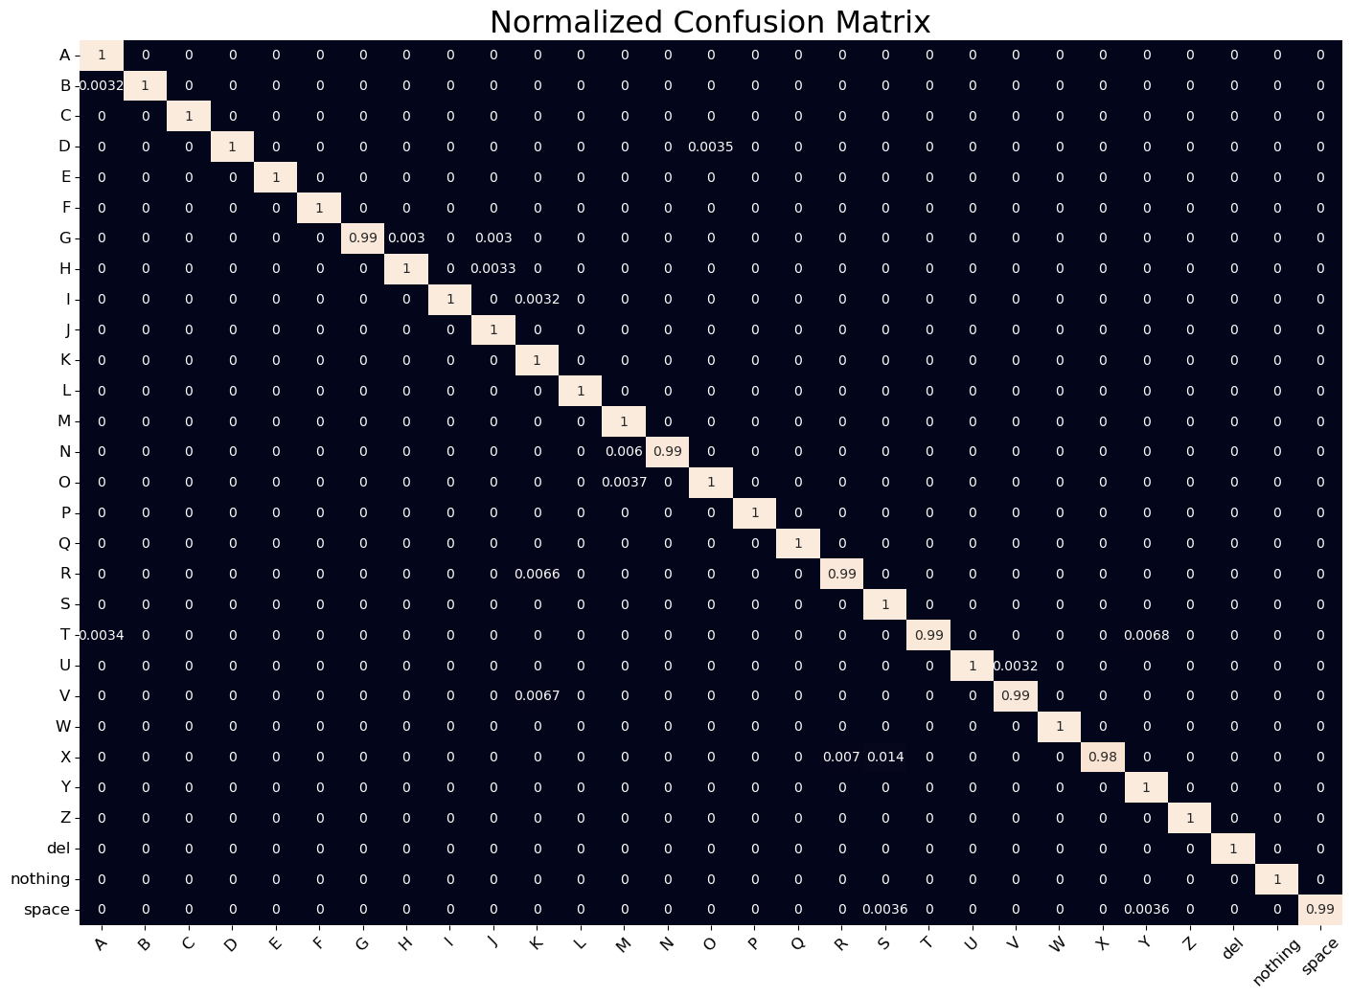
Confusion Matrix Of Best Pretrained Model (18/8700 false predicted images – 99.71% test accuracy, with Data Augmentation)

Slide 16
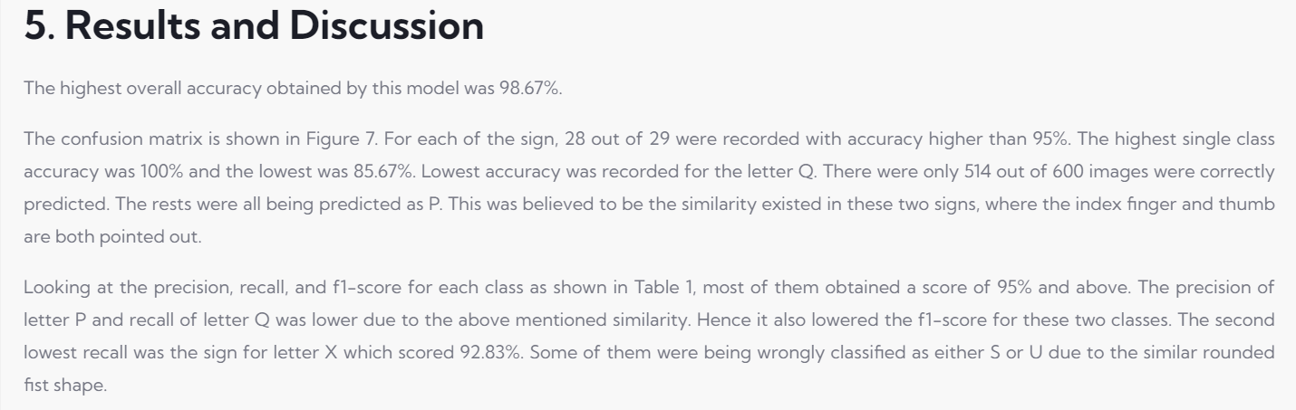
Paper We Have Read For Reference
https://www.astesj.com/v05/i06/p57/#1654275331162-05e1d788-1e6f

Slide 17




Task List
Preprocess data using ImageDataGenerator (create a dataframe from filepath and labels of the pictures, Data Augmentation, generate batches of images to train, split train set (80%), test set (20%) and validation set (10% of the remaining train set)
Plot some random images, create CustomCNN model (or import 27 pretrained models for transfer learning) and compile these models (for pretrained models we quickly fit them using 5% of our dataset within 5 epoch to choose one best model for training and testing later)
Fit the CustomCNN model, the best pretrained model obtained from step 2, plot accuracy and loss of these two models and test them using test set, create and print out the confusion matrix between prediction labels and true test labels
Print out some random images with their true and prediction labels , test using camera of the device and choosing the model for application

