Slide 1

Overlapping Chromosome Segmentation
R&D Team
11/03/2023

Slide 2
agenda
1
Overall
2
sas
3
as
*proposal version
R&D Team

Slide 3
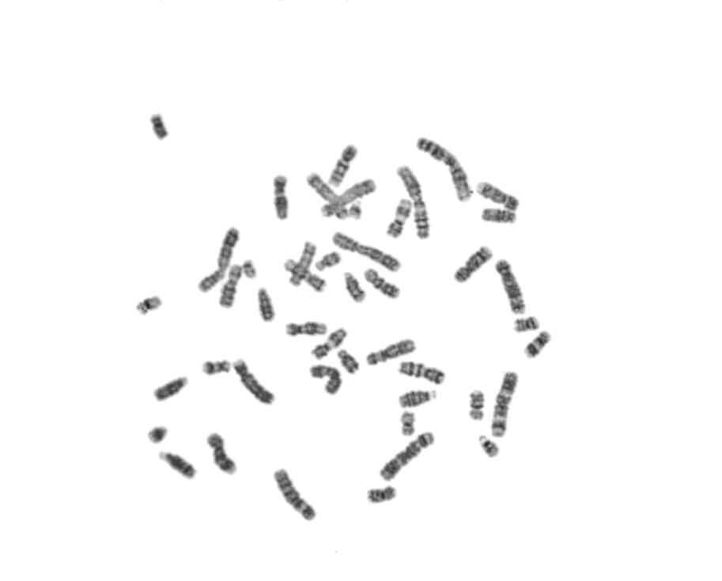

Overall
The diagram below illustrates the processing flow in brief:
R&D Team
‹#›

Slide 4
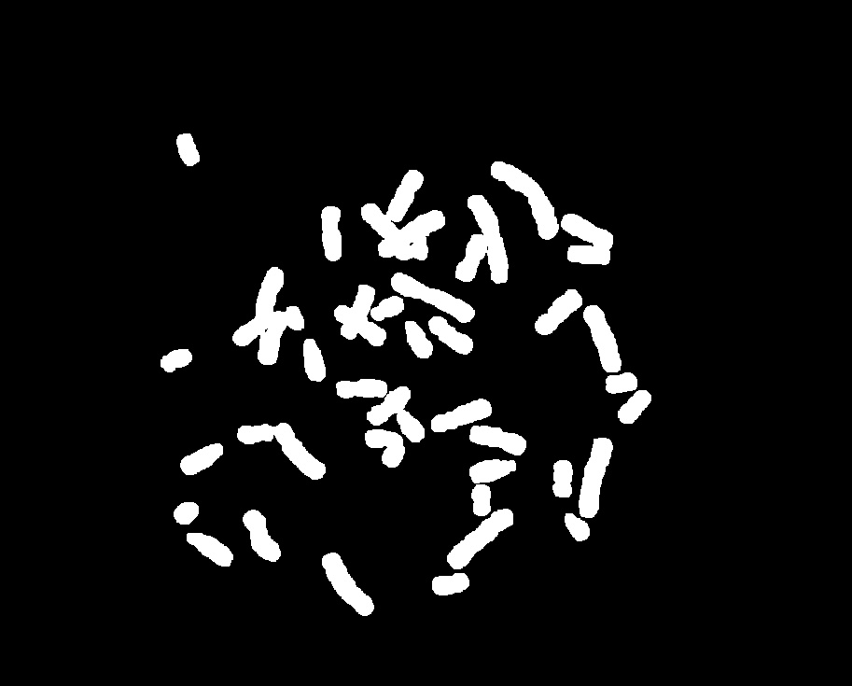
Overall
The diagram below illustrates the processing flow in brief:
R&D Team
‹#›

Slide 5
Overall
The diagram below illustrates the processing flow in brief:
R&D Team
‹#›

Slide 6
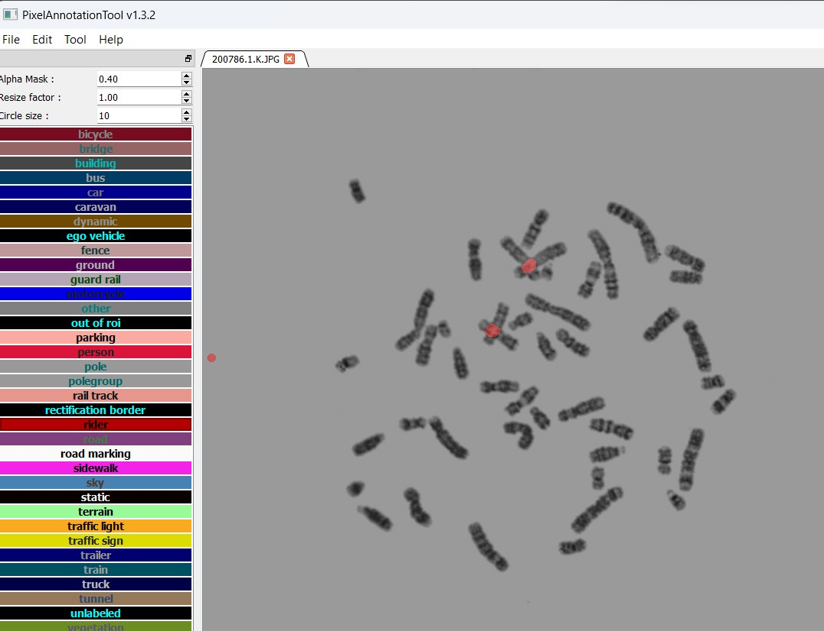
Overall
R&D Team
‹#›

Slide 7
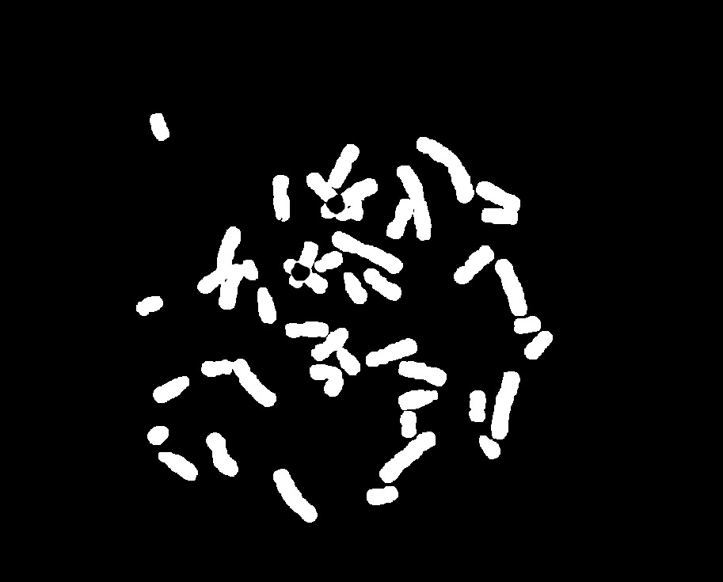

Overall
R&D Team
‹#›

