Slide 1
Contain:
1. Overview 2. Question 3. Sorting

Slide 2
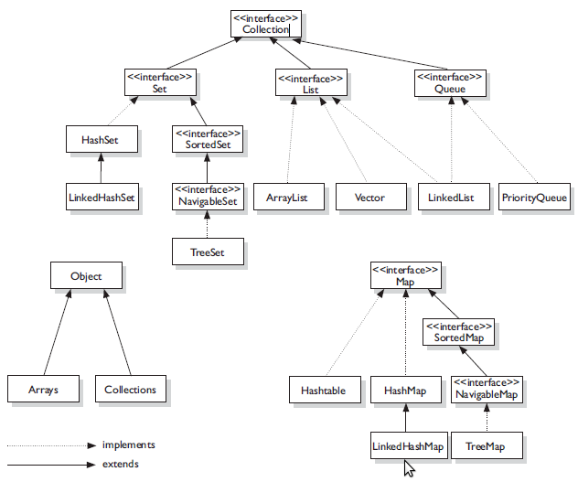
Overview

Slide 3
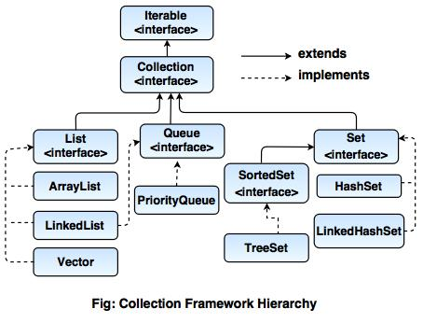
Overview

Slide 4
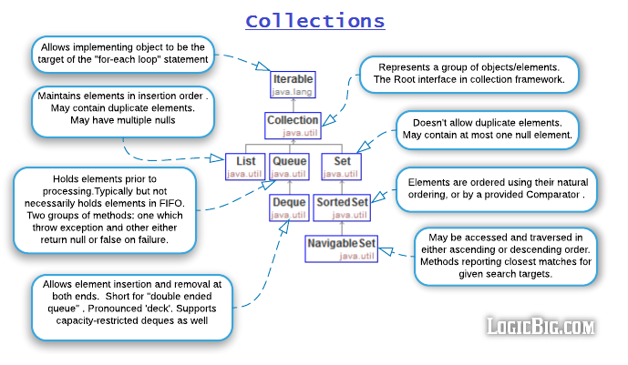
Overview

Slide 5
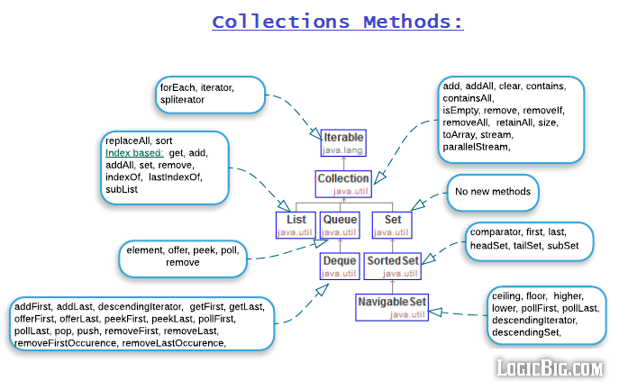
Overview

Slide 6
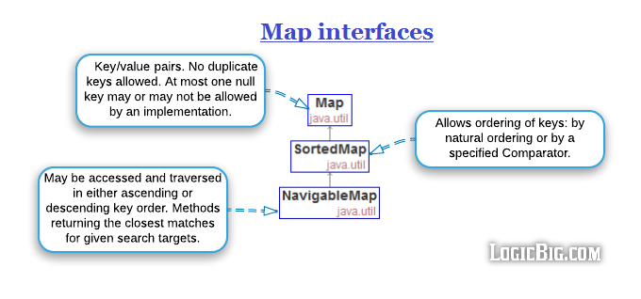
Overview

Slide 7
HashSet, TreeSet, LinkedHashSet
Thứ tự của các phần tử:
HashSet: các phần tử được thêm vào ko đc sắp xếp
LinkedHashSet: Các phần tử được lưu trữ đúng như thứ tự chúng được chèn vào.
TreeSet: TreeSet sắp xếp thứ tự các phần tử theo bộ so sánh được cung cấp (Comparator)
Phần tử Null
HashSet: cho phép tối đa một phần tử null.
LinkedHashSet: cho phép tối đa một phần tử null
TreeSet: không cho phép chứa phần tử null

Slide 8
What are the basic interfaces of Java Collections Framework?
Collection is the root of the collection hierarchy. A collection represents a group of objects known as its elements. The Java platform doesn’t provide any direct implementations of this interface.
Set is a collection that cannot contain duplicate elements. This interface models the mathematical set abstraction and is used to represent sets, such as the deck of cards.
List is an ordered collection and can contain duplicate elements. You can access any element from it’s index. List is more like array with dynamic length.
A Map is an object that maps keys to values. A map cannot contain duplicate keys: Each key can map to at most one value.
Some other interfaces are Queue, Dequeue, Iterator, SortedSet, SortedMap and ListIterator.

Slide 9
How HashMap works in Java?
HashMap stores key-value pair in Map.Entry static nested class implementation. HashMap works on hashing algorithm and uses hashCode() and equals() method in put and get methods.
When we call put method by passing key-value pair, HashMap uses Key hashCode() with hashing to find out the index to store the key-value pair. The Entry is stored in the LinkedList, so if there are already existing entry, it uses equals() method to check if the passed key already exists, if yes it overwrites the value else it creates a new entry and store this key-value Entry.
When we call get method by passing Key, again it uses the hashCode() to find the index in the array and then use equals() method to find the correct Entry and return it’s value. Below image will explain these detail clearly.

Slide 10
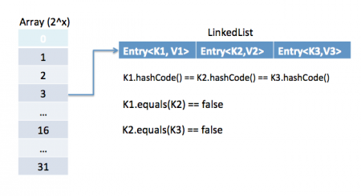
How HashMap works in Java?
Link:
https://viblo.asia/p/hashmap-hoat-dong-nhu-the-nao-trong-java-lPXzgalYRAg

Slide 11
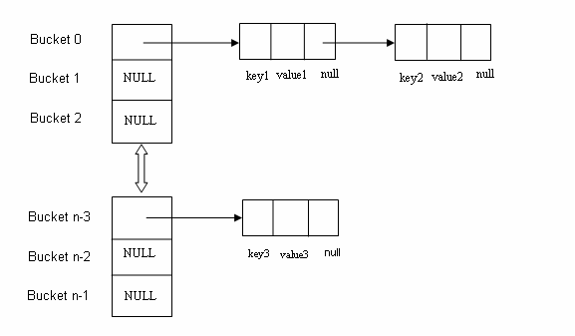
How HashMap works in Java?
Nói vắn tắt, sẽ có ba trường hợp sảy ra khi put cái gì đó vào HashMap:
hashCode() được gọi và tính ra hash value, nếu hash value này không tồn tại trong hash table. thì insert Entry vào một bucket mới.
equals() được gọi khi hash value tồn tại, nếu trả về true tức là đã có key tồn tại trong HashMap, ghi đè Entry cũ bằng Entry mới trên Linked List ở bucket của Entry cũ.
equals() trả về false thêm một phần tử vào đằng sau Linked List ở bucket tương ứng với hash value.

Slide 12
EnumMap
EnumMap is one of the specialized implementation of Map interface for use with enum type keys, introduced in Java 1.5 with enumeration type. All of the keys in an enum map must come from a single enum type that is specified, explicitly or implicitly, when the map is created. Enum maps are represented internally as arrays. This representation is extremely compact and efficient. Programmer often use HashMap to store enum type, because they are unaware about this little gem. Enum constants are unique and have predefined length, you can't create new enum at runtime. It allows java designer to make highly optimized EmumMap. Enum maps are maintained in the natural order of their keys (the order in which the enum constants are declared)

Slide 13
EnumMap
Features:
Java EnumMap inherits AbstractMap class.
All keys of each EnumMap instance must be keys of a single enum type.
Java EnumMap does not permits null key, but permits multiple null values.
Enum maps are maintained in the natural order of their keys as the order in which the enum constants are declared).
Iterators returned by the collection views are weakly consistent: they will never throw ConcurrentModificationException and they may or may not show the effects of any modifications to the map that occur while the iteration is in progress.
Java EnumMap is not synchronized.
Java EnumMap is not thread-safe. You can make thread-safe by doing Collections.synchronizedMap(new EnumMap<EnumKey, V>(...));
Java EnumMap implementation provides constant-time performance for the basic operations (like get, and put)
Java EnumMap performance is better than HashMap

Slide 14
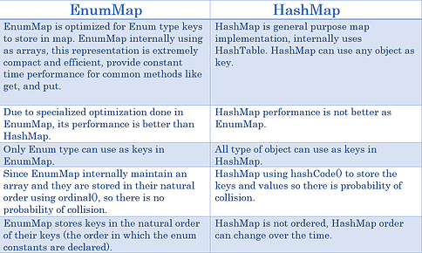
EnumMap vs HashMap

Slide 15
What is the importance of hashCode() and equals() methods?
HashMap uses Key object hashCode() and equals() method to determine the index to put the key-value pair. These methods are also used when we try to get value from HashMap. If these methods are not implemented correctly, two different Key’s might produce same hashCode() and equals() output and in that case rather than storing it at different location, HashMap will consider them same and overwrite them.
Similarly all the collection classes that doesn’t store duplicate data use hashCode() and equals() to find duplicates, so it’s very important to implement them correctly. The implementation of equals() and hashCode() should follow these rules.
If o1.equals(o2), then o1.hashCode() == o2.hashCode() should always be true.
If o1.hashCode() == o2.hashCode is true, it doesn’t mean that o1.equals(o2) will be true.

Slide 16
What is difference between HashMap and Hashtable?
HashMap and Hashtable both implements Map interface and looks similar, however there are following difference between HashMap and Hashtable.
HashMap allows null key and values whereas Hashtable doesn’t allow null key and values.
Hashtable is synchronized but HashMap is not synchronized. So HashMap is better for single threaded environment, Hashtable is suitable for multi-threaded environment.
LinkedHashMap was introduced in Java 1.4 as a subclass of HashMap, so incase you want iteration order, you can easily switch from HashMap to LinkedHashMap but that is not the case with Hashtable whose iteration order is unpredictable.
HashMap provides Set of keys to iterate and hence it’s fail-fast but Hashtable provides Enumeration of keys that doesn’t support this feature.
Hashtable is considered to be legacy class and if you are looking for modifications of Map while iterating, you should use ConcurrentHashMap.

Slide 17
How to decide between HashMap and TreeMap?
For inserting, deleting, and locating elements in a Map, the HashMap offers the best alternative. If, however, you need to traverse the keys in a sorted order, then TreeMap is your better alternative. Depending upon the size of your collection, it may be faster to add elements to a HashMap, then convert the map to a TreeMap for sorted key traversal.

Slide 18
Array vs ArrayList?
Arrays can contain primitive or Objects whereas ArrayList can contain only Objects.
Arrays are fixed size whereas ArrayList size is dynamic.
Arrays doesn’t provide a lot of features like ArrayList, such as addAll, removeAll, iterator etc.
Although ArrayList is the obvious choice when we work on list, there are few times when array are good to use.
If the size of list is fixed and mostly used to store and traverse them.
For list of primitive data types, although Collections use autoboxing to reduce the coding effort but still it makes them slow when working on fixed size primitive data types.
If you are working on fixed multi-dimensional situation, using [][] is far more easier than List<List<>>

Slide 19
ArrayList vs LinkedList?
ArrayList and LinkedList both implement List interface but there are some differences between them.
ArrayList is an index based data structure backed by Array, so it provides random access to it’s elements with performance as O(1) but LinkedList stores data as list of nodes where every node is linked to it’s previous and next node. So even though there is a method to get the element using index, internally it traverse from start to reach at the index node and then return the element, so performance is O(n) that is slower than ArrayList.
Insertion, addition or removal of an element is faster in LinkedList compared to ArrayList because there is no concept of resizing array or updating index when element is added in middle.
LinkedList consumes more memory than ArrayList because every node in LinkedList stores reference of previous and next elements.

Slide 20
Comparable vs Comparator?
Java provides Comparable interface which should be implemented by any custom class if we want to use Arrays or Collections sorting methods. Comparable interface has compareTo(T obj) method which is used by sorting methods. We should override this method in such a way that it returns a negative integer, zero, or a positive integer if “this” object is less than, equal to, or greater than the object passed as argument.
But, in most real life scenarios, we want sorting based on different parameters. For example, as a CEO, I would like to sort the employees based on Salary, an HR would like to sort them based on the age. This is the situation where we need to use Comparator interface because Comparable.compareTo(Object o) method implementation can sort based on one field only and we can’t chose the field on which we want to sort the Object.
Comparator interface compare(Object o1, Object o2) method need to be implemented that takes two Object argument, it should be implemented in such a way that it returns negative int if first argument is less than the second one and returns zero if they are equal and positive int if first argument is greater than second one.

Slide 21
Comparable vs Comparator?
Comparable and Comparator interfaces are used to sort collection or array of objects.
Comparable interface is used to provide the natural sorting of objects and we can use it to provide sorting based on single logic.
Comparator interface is used to provide different algorithms for sorting and we can chose the comparator we want to use to sort the given collection of objects.

Slide 22
Best Links
https://viblo.asia/p/java-collections-sap-xep-collections-naQZRgvdlvx
https://viblo.asia/p/gioi-thieu-ve-collection-trong-java-aWj53268l6m
https://viblo.asia/p/hashmap-hoat-dong-nhu-the-nao-trong-java-lPXzgalYRAg
https://viblo.asia/p/how-and-when-override-equals-and-hashcode-1Je5EYvy5nL
https://viblo.asia/p/deep-dive-into-hashing-hashmap-in-android-MVpeKBxwGKd
https://viblo.asia/p/sap-xep-trong-java-8-63vKjaLM52R

Slide 23
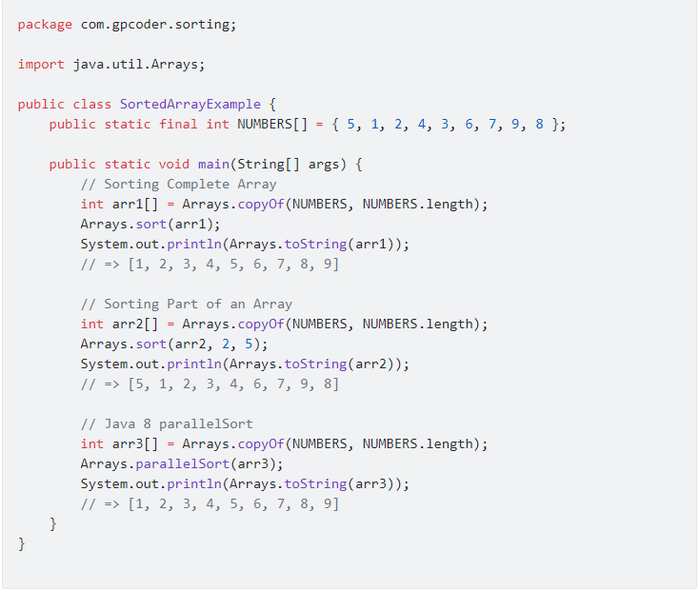
Sort Array

Slide 24
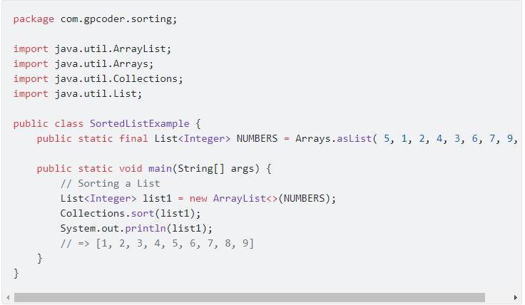
Sort List

Slide 25
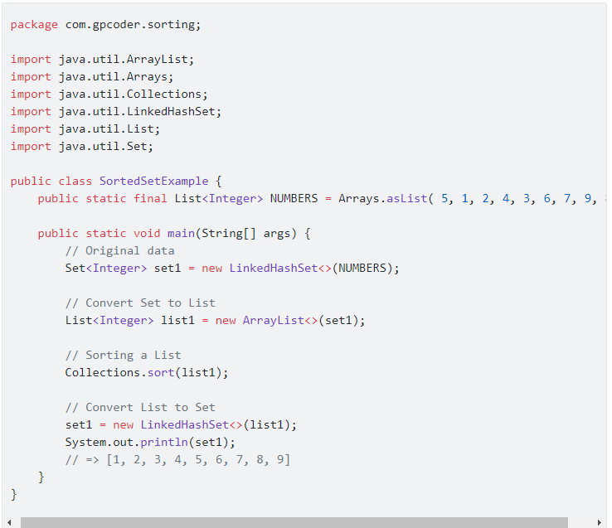
Sort Set
Chúng ta phải sử dụng LinkedHashSet để có thể giữ được thứ tự các phần tử trong một tập hợp.
Lớp tiện ích Collections chỉ hỗ trợ sắp xếp các phần tử trong một List. Do đó, để có thể sắp xếp được một Set chúng ta cần chuyển một Set qua một List, sau đó thực hiện sắp xếp danh sách này và cuối cùng thực hiện chuyển List về Set.

Slide 26
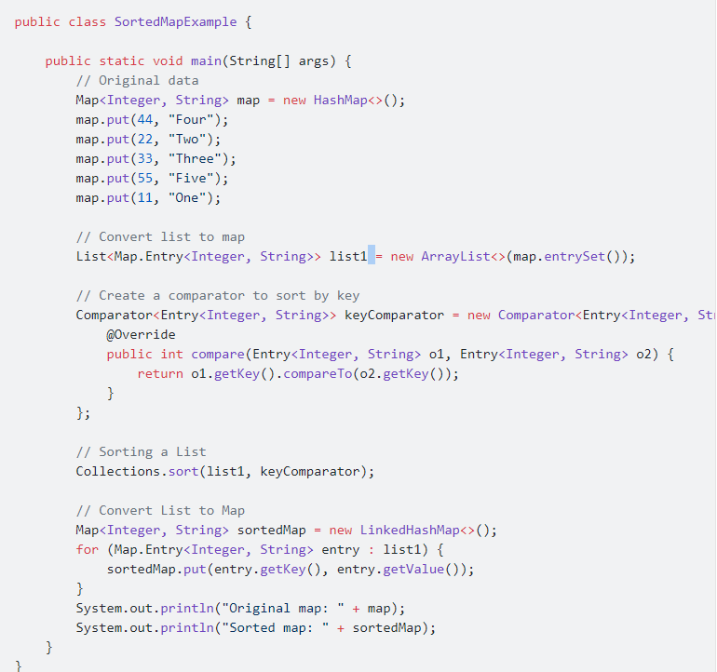
Sort Map: by Key
Lớp tiện ích Collections chỉ hỗ trợ sắp xếp các phần tử trong một List. Do đó, để có thể sắp xếp được một Map chúng ta cần chuyển một Map qua một List, sau đó thực hiện sắp xếp danh sách này và cuối cùng thực hiện chuyển List về Map.

Slide 27
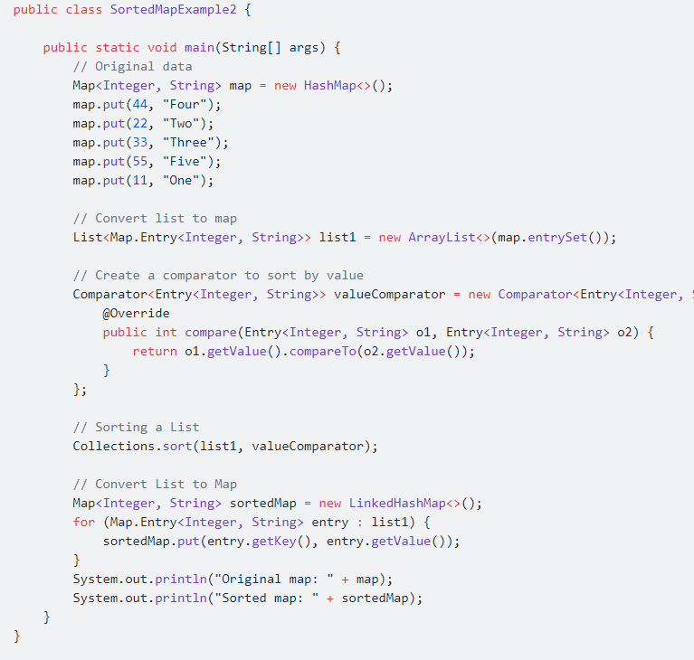
Sort Map: by Value
Tương tự như sắp xếp theo Key, chúng ta chỉ việc viết lại phương thức Comparator so sánh theo value:

