Slide 1

Predict Costs of Parts using Machine Learning Approaches
Khanh Truong
August 2019

Slide 2
Content
Content
Abstract
Model Setup
Multiple Linear Regression
Algorithm
Performance
Random Forest
Algorithm
Performance
Neural Network
Algorithm
Performance
Comparison
Labor
Material
Total
Degree of Confidence
Data Preprocessing
Missing Value
Categorical variable
Redundant variables
Summary
Data Preprocessing
Machine Learning Modeling
Degree of Confidence
Keep track by content bar
This presentation is bottom-up organized, i.e. “result-oriented”.
It’s always easier for readers to start from results …

Slide 3


Abstract
Degree of Confidence on Test sample.xlsx
Machine learning models
Content
Abstract
Model Setup
Multiple Linear Regression
Algorithm
Performance
Random Forest
Algorithm
Performance
Neural Network
Algorithm
Performance
Comparison
Labor
Material
Total
Degree of Confidence
Data Preprocessing
Missing Value
Categorical variable
Redundant variables
Summary
partNumber | Cost | Predicted Cost | Confidence
x00001 | 79.9 | 94.0 | 0.85
x00002 | 80.0 | 94.0 | 0.85
x00003 | 75.1 | 89.9 | 0.84
x00004 | 75.1 | 89.9 | 0.84
… | … | … | …
Models
Costs
Multiple Linear Regression
Random Forest
Neural Network
Labor Cost
Material Cost
Total Cost
Average: 90%
On average, our Labor Cost prediction is €3.6 or 7.4% different from the true value.
Tools:
Python in Jupyter Notebook
Machine learning packages:
Scikit-learn
Statsmodels
Visualization packages:
Matplotlib
Seaborn
Ipywidgets
On average, our Material Cost prediction is €3.5 or 7.7% different from the true value.
On average, our Total Cost prediction is €5.6 or 6.3% different from the true value.

Slide 4


Model Setup
Data
Evaluate performance
Content
Abstract
Model Setup
Multiple Linear Regression
Algorithm
Performance
Random Forest
Algorithm
Performance
Neural Network
Algorithm
Performance
Comparison
Labor
Material
Total
Degree of Confidence
Data Preprocessing
Missing Value
Categorical variable
Redundant variables
Summary
Data
Reference sample.xlsx
Training Set
Test samples.xlsx
Test Set
80%
Models will be assessed on test set:
20%
Absolute Error = $\left|Predicted−True\right|$
Absolute Percentage Error =$\left|\frac{Predicted−True}{True}\right|$
Training Set
Multiple Regression
(1)
(2)
|(1) - (2)|
|(1) - (2)| / (2)
Part Number | Length | Width | Labor Cost
t0001 | 200 | 146 | €49
t0004 | 182 | 120 | €20
… | … | … | …
t0728 | 195 | 98 | €38
Predicted Labor Cost
€120
€45
…
€32
True Labor Cost
€129
€52
…
€30
Absolute Error
€9
€7
…
€2
Absolute Percentage Error
7%
13%
…
7%
Random Forest
Neural Network
Average: €8
95th Percentile: €23
Average: 11%
95th Percentile: 28%
Test Set
Part Number | Length | Width | Labor Cost
t0002 | 390 | 262 | ?
t0003 | 278 | 198 | ?
… | … | … | …
t0719 | 93 | 134 | ?
Predicted Labor Cost
€120
€45
…
€32
Neural Network
Compare these metrics to determine which model is better

Slide 5
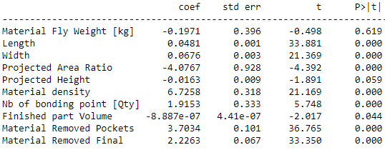
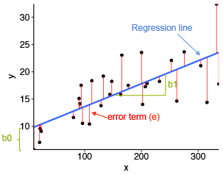
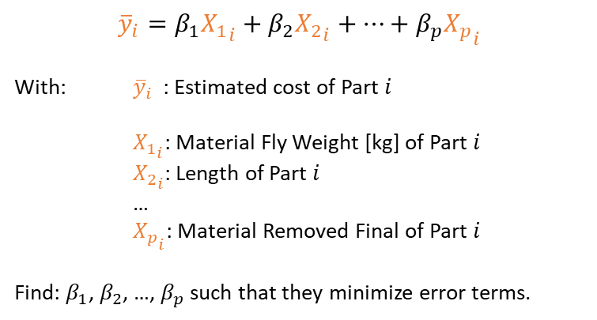
Multiple Linear Regression
Algorithm
Model
Coefficient Table
Labor cost
Content
Abstract
Model Setup
Multiple Linear Regression
Algorithm
Performance
Random Forest
Algorithm
Performance
Neural Network
Algorithm
Performance
Comparison
Labor
Material
Total
Degree of Confidence
Data Preprocessing
Missing Value
Categorical variable
Redundant variables
Summary
$${\overline{y}}_{i}=β_{1}{X_{1}}_{i}+β_{2}{X_{2}}_{i}+⋯+β_{p}{X_{p}}_{i}$$
With: ${\overline{y}}_{i}$ : Estimated cost of Part $i$
${X_{1}}_{i}$: Material Fly Weight [kg] of Part $i$
${X_{2}}_{i}$: Length of Part $i$
…
${X_{p}}_{i}$: Material Removed Final of Part $i$
Find: $β_{1}$, $β_{2}$, …, $β_{p}$ such that they minimize error terms.
$${\overline{labor cost}}_{i}=−0.197{X_{1}}_{i}+0.048{X_{2}}_{i}+⋯+2.226{X_{10}}_{i}$$
For the other two costs:
$${\overline{material cost}}_{i}=11.589{X_{1}}_{i}+0.012{X_{2}}_{i}+⋯+4.172{X_{10}}_{i}$$
$${\overline{total cost}}_{i}=11.392{X_{1}}_{i}+0.061{X_{2}}_{i}+⋯+6.398{X_{10}}_{i}$$

Slide 6
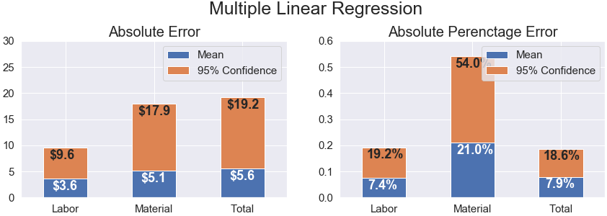
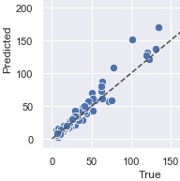
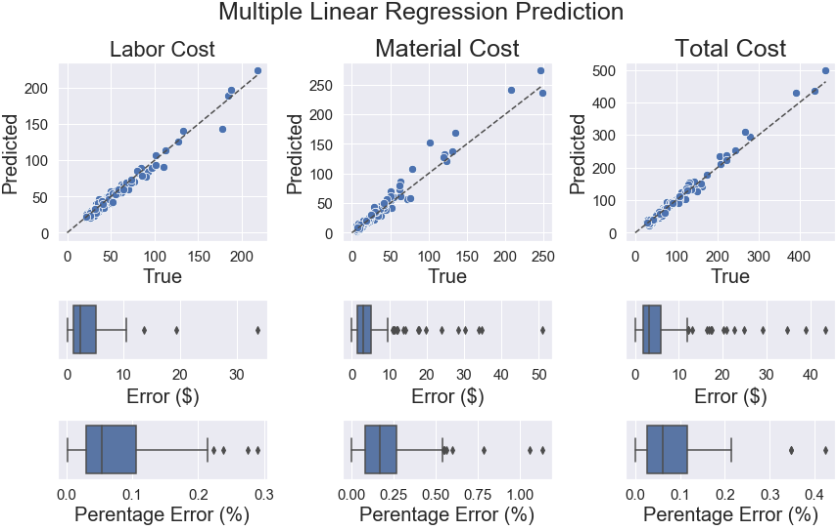
Multiple Linear Regression
Performance
Prediction
Summary
Content
Abstract
Model Setup
Multiple Linear Regression
Algorithm
Performance
Random Forest
Algorithm
Performance
Neural Network
Algorithm
Performance
Comparison
Labor
Material
Total
Degree of Confidence
Data Preprocessing
Missing Value
Categorical variable
Redundant variables
Summary
Part t0185:
True Material Cost: €101
Prediction: €151
=> Over-predicted
Error: €50
Percentage Error: 50%
On average, predicted Labor Cost of a part from Multiple Linear Regression will be €3.6 different from the true value.
Moreover, it’s 95% of confidence that this error will be less than €9.6.
On average, predicted Labor Cost of a part from Multiple Linear Regression will be 7.4% different from the true value.
Moreover, , it’s 95% of confidence that this error will be less than 19.2%.

Slide 7

Random Forest
Algorithm
Tree
Forest
Content
Abstract
Model Setup
Multiple Linear Regression
Algorithm
Performance
Random Forest
Algorithm
Performance
Neural Network
Algorithm
Performance
Comparison
Labor
Material
Total
Degree of Confidence
Data Preprocessing
Missing Value
Categorical variable
Redundant variables
Summary
Width: 150
Length: 200
Projected Area Ratio: 0.9
Width
< 100
Projected Area Ratio
< 0.56
Length
< 210
R4
R3
R2
R1
Input
Yes
No
Forest
Tree 1
Tree 2
…
Tree n
Yes
No
Yes
No
Parts | Total Cost
t0002 | €36
t0011 | €40
t0015 | €49
……….
t0738 | €29
Parts | Total Cost
t0001 | €40
t0009 | €19
t0012 | €20
……….
t0737 | €45
Parts | Total Cost
t0006 | €32
t0008 | €38
t0012 | €41
……….
t0736 | €50
Parts | Total Cost
t0004 | €31
t0013 | €40
t0019 | €29
……….
t0735 | €30
€31
€34
…
€28
Average = €27
Average = €30
Average = €32
Average = €28
Average
Input
Tree
Out put
€32
Projected Area Ratio: 0.9
Length: 200
Width: 150
Out put
€33

Slide 8
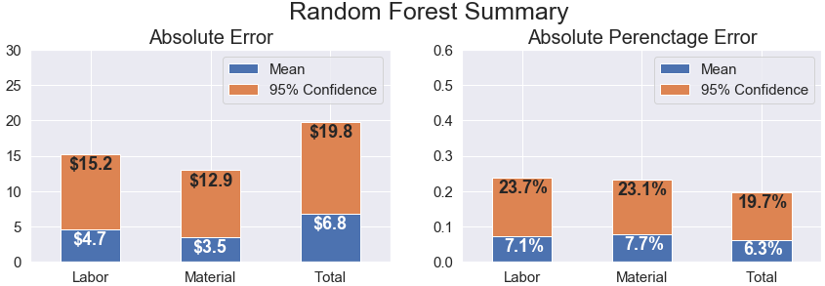
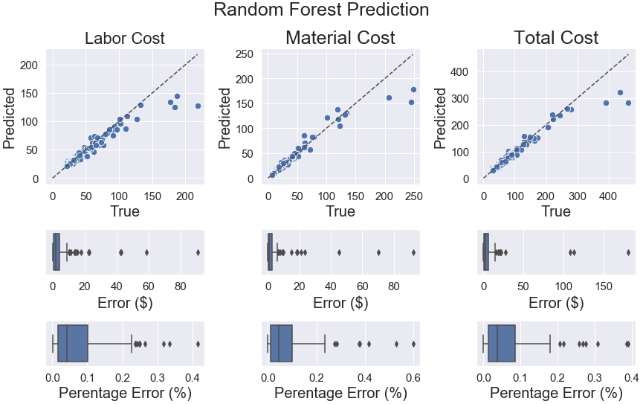
Random Forest
Performance
Prediction
Summary
Content
Abstract
Model Setup
Multiple Linear Regression
Algorithm
Performance
Random Forest
Algorithm
Performance
Neural Network
Algorithm
Performance
Comparison
Labor
Material
Total
Degree of Confidence
Data Preprocessing
Missing Value
Categorical variable
Redundant variables
Summary
Random Forest does well on Parts whose Total Costs are less than €200.
On average, predicted Material Cost of a part from Random Forest will be €3.5 different from the true Material Cost.
Moreover, 95% of confidence that this error will be less than €12.9.
Most of the Total Cost errors are less than 10%
On average, predicted Material Cost of a part from Random Forest will be 7.7% different from the true Material Cost.
Moreover, 95% of confidence that this error will be less than 23.1%.

Slide 9
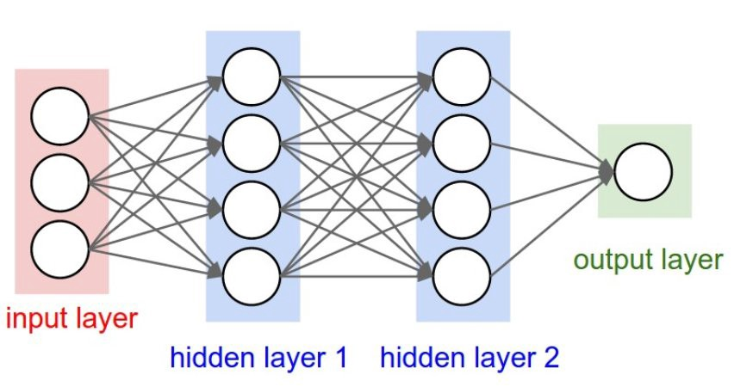


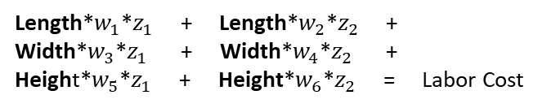









Neural Network
Algorithm
Multiple Linear Regression
Extend Neural Network
Content
Abstract
Model Setup
Multiple Linear Regression
Algorithm
Performance
Random Forest
Algorithm
Performance
Neural Network
Algorithm
Performance
Comparison
Labor
Material
Total
Degree of Confidence
Data Preprocessing
Missing Value
Categorical variable
Redundant variables
Summary
Length
$$β_{1}$$
Labor Cost
Length
Width
$$β_{2}$$
Labor Cost
Width
$$β_{3}$$
Height
Height
Length*$β_{1}$ + Width*$β_{2}$ + Height*$β_{3}$ = Labor Cost
Neural Network
Black Box
Length
$$w_{1}$$
hidden layer
Length
Labor Cost
$$w_{2}$$
$$z_{1}$$
Width
$$w_{3}$$
Width
Labor Cost
Height
$$w_{4}$$
$$w_{5}$$
$$z_{2}$$
$$w_{6}$$
Height
“Neural network is a black-box”, i.e. it does not give any insight on the form of f(X)=y
Length*$w_{1}$*$z_{1}$ + Length*$w_{2}$*$z_{2}$ +
Width*$w_{3}$*$z_{1}$ + Width*$w_{4}$*$z_{2}$ +
Height*$w_{5}$*$z_{1}$ + Height*$w_{6}$*$z_{2}$ = Labor Cost

Slide 10
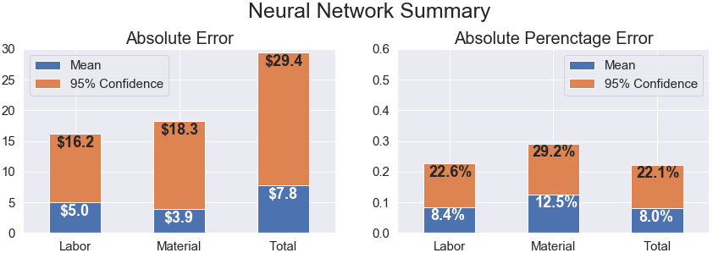
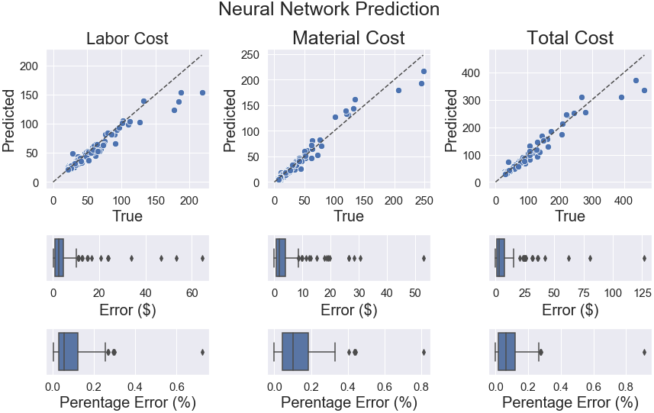
Neural Network
Performance
Prediction
Summary
Content
Abstract
Model Setup
Multiple Linear Regression
Algorithm
Performance
Random Forest
Algorithm
Performance
Neural Network
Algorithm
Performance
Comparison
Labor
Material
Total
Degree of Confidence
Data Preprocessing
Missing Value
Categorical variable
Redundant variables
Summary
Similar to Random Forest, Neural Network performs well when Total Cost is less than €200.
On average, predicted Total Cost of a part from Neural Network will be €7.8 different from the true Total Cost.
Moreover, 95% of confidence that this error will be less than €29.4.
However, it seems that Neural Network commits larger errors than the other two methods.
On average, predicted Total Cost of a part from Neural Network will be 8.0% different from the true Total Cost.
Moreover, 95% of confidence that this error will be less than 22.1%.

Slide 11
Comparison
Labor Cost
Absolute
Percentage
Error
Content
Abstract
Model Setup
Multiple Linear Regression
Algorithm
Performance
Random Forest
Algorithm
Performance
Neural Network
Algorithm
Performance
Comparison
Labor
Material
Total
Degree of Confidence
Data Preprocessing
Missing Value
Categorical variable
Redundant variables
Summary
Absolute Error
Lowest Absolute Error
Lowest Absolute
Percentage
Error
The winner model:
Labor:
Multiple Linear Regression
Material:
Random Forest
Total:
Multiple Linear Regression
The winner model:
Labor:
Multiple Linear Regression
Material:
Random Forest
Total:
Multiple Linear Regression

Slide 12
Comparison
Material Cost
Absolute
Percentage
Error
Content
Abstract
Model Setup
Multiple Linear Regression
Algorithm
Performance
Random Forest
Algorithm
Performance
Neural Network
Algorithm
Performance
Comparison
Labor
Material
Total
Degree of Confidence
Data Preprocessing
Missing Value
Categorical variable
Redundant variables
Summary
Absolute Error
The winner model:
Labor:
Multiple Linear Regression
Material:
Random Forest
Total:
Multiple Linear Regression
The winner model:
Labor:
Multiple Linear Regression
Material:
Random Forest
Total:
Multiple Linear Regression
Lowest Absolute Error
Lowest Absolute
Percentage
Error

Slide 13
Comparison
Total Cost
Absolute
Percentage
Error
Content
Abstract
Model Setup
Multiple Linear Regression
Algorithm
Performance
Random Forest
Algorithm
Performance
Neural Network
Algorithm
Performance
Comparison
Labor
Material
Total
Degree of Confidence
Data Preprocessing
Missing Value
Categorical variable
Redundant variables
Summary
Absolute Error
Lowest Absolute Error
The winner model:
Labor:
Multiple Linear Regression
Material:
Random Forest
Total:
Multiple Linear Regression
The winner model:
Labor:
Multiple Linear Regression
Material:
Random Forest
Total:
Random Forest
Lowest Absolute
Percentage
Error

Slide 14
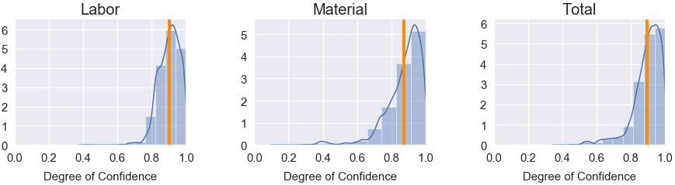
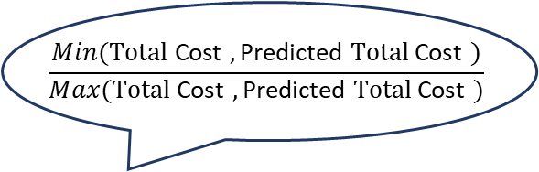
Degree of Confidence
$$\frac{Min(\text{Total} \text{Cost} ,\text{Predicted} \text{Total} \text{Cost} )}{Max(\text{Total} \text{Cost} ,\text{Predicted} \text{Total} \text{Cost} )}$$
Content
Abstract
Model Setup
Multiple Linear Regression
Algorithm
Performance
Random Forest
Algorithm
Performance
Neural Network
Algorithm
Performance
Comparison
Labor
Material
Total
Degree of Confidence
Data Preprocessing
Missing Value
Categorical variable
Redundant variables
Summary
From Test sample.xlsx
From Machine Learning models
partNumber | Total Cost | Predicted Total Cost | Confidence
x00001 | 79.9 | 94.0 | 0.85
x00002 | 80.0 | 94.0 | 0.85
x00003 | 75.1 | 89.9 | 0.84
x00004 | 75.1 | 89.9 | 0.84
… | … | … | ...
Average degree of confidence in Test sample.xlsx is about 90%.
Mean = 90.1%
Mean = 87.6%
Mean = 89.6%

Slide 15
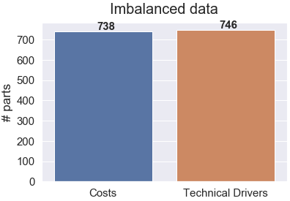
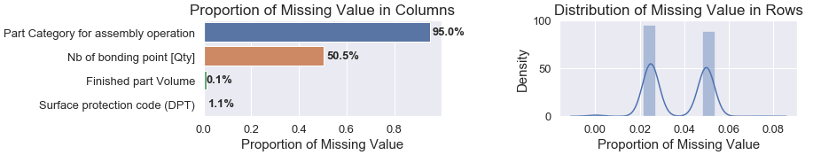
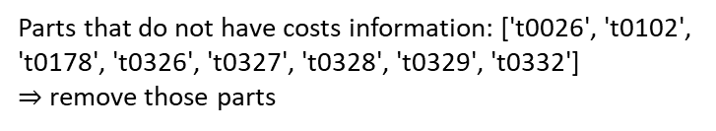
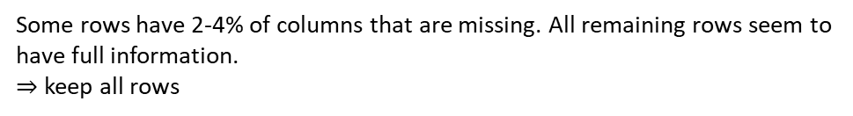
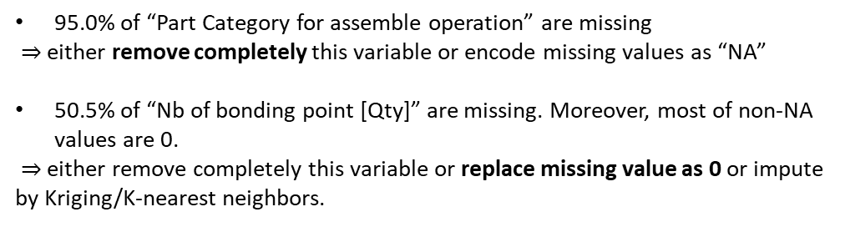
Data Preprocessing
Missing value
Imbalanced data
Missing value in columns
Content
Abstract
Model Setup
Multiple Linear Regression
Algorithm
Performance
Random Forest
Algorithm
Performance
Neural Network
Algorithm
Performance
Comparison
Labor
Material
Total
Degree of Confidence
Data Preprocessing
Missing Value
Categorical variable
Redundant variables
Summary
95.0% of “Part Category for assemble operation” are missing
$⇒$ either remove completely this variable or encode missing values as “NA”
50.5% of “Nb of bonding point [Qty]” are missing. Moreover, most of non-NA values are 0.
$⇒$ either remove completely this variable or replace missing value as 0 or impute by Kriging/K-nearest neighbors.
Parts that do not have costs information: ['t0026', 't0102', 't0178', 't0326', 't0327', 't0328', 't0329', 't0332']
$⇒$ remove those parts
Labor Cost Proportion
Missing value in rows
% Labor Cost in Total
Mean | 67.9%
Std | 9.2%
min | 33.6%
25% | 63.4%
50% | 70.2%
75% | 75.1%
max | 85.4%
Some rows have 2-4% of columns that are missing. All remaining rows seem to have full information.
$⇒$ keep all rows

Slide 16
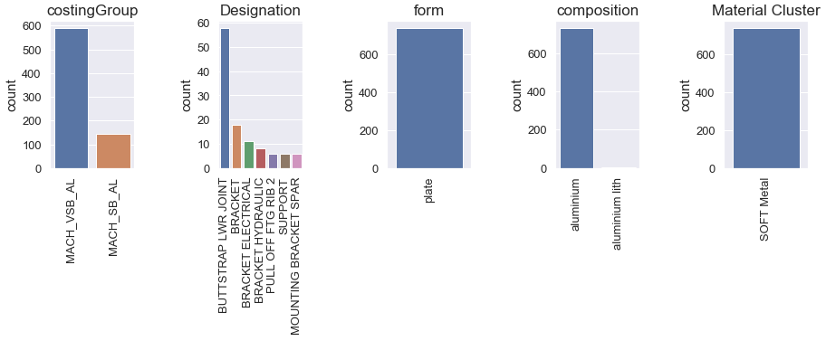
Data Preprocessing
Categorical variables
Content
Abstract
Model Setup
Multiple Linear Regression
Algorithm
Performance
Random Forest
Algorithm
Performance
Neural Network
Algorithm
Performance
Comparison
Labor
Material
Total
Degree of Confidence
Data Preprocessing
Missing Value
Categorical variable
Redundant variables
Summary
Categorical variables either concentrate on only one class or distribute into too many classes.
$⇒$ not useful for statistical modeling.

Slide 17
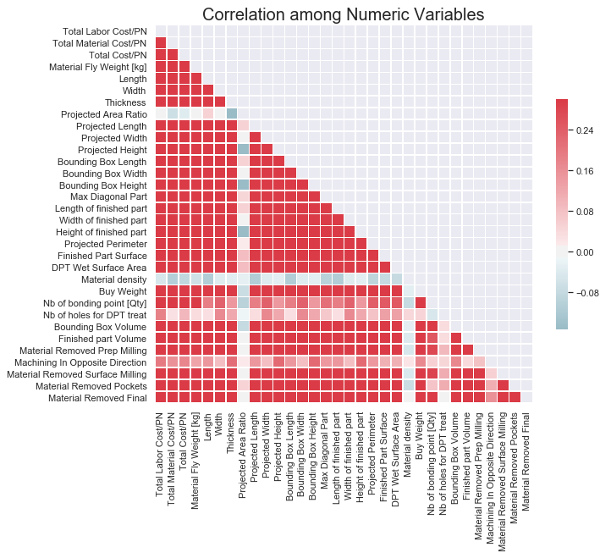
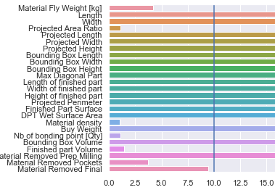
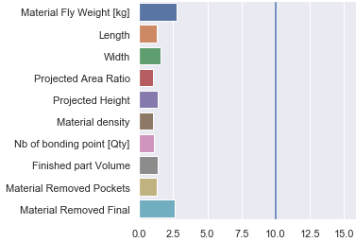
Data Preprocessing
Redundant variables
Before
Content
Abstract
Model Setup
Multiple Linear Regression
Algorithm
Performance
Random Forest
Algorithm
Performance
Neural Network
Algorithm
Performance
Comparison
Labor
Material
Total
Degree of Confidence
Data Preprocessing
Missing Value
Categorical variable
Redundant variables
Summary
Most of the variables are pairwise positive correlated. This may indicate redundant variables in the data.
“Projected Area Ratio” and “Material density” have (weak) negative correlation with other variables.
Many variables
are redundant
After
After
10 variables remain
after cleaning
Correlation matrix
Multicollinearity

Slide 18

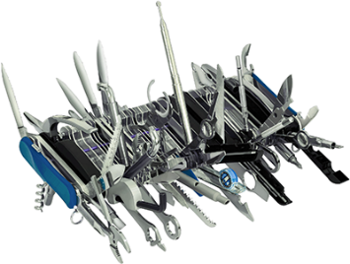
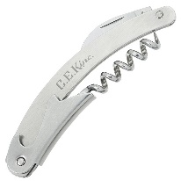




Summary
Average degree of confidence in Test sample.xlsx is about 90%.
Comments
Content
Abstract
Model Setup
Multiple Linear Regression
Algorithm
Performance
Random Forest
Algorithm
Performance
Neural Network
Algorithm
Performance
Comparison
Labor
Material
Total
Degree of Confidence
Data Preprocessing
Missing Value
Categorical variable
Redundant variables
Summary
Data is always not perfect.
Interpolation missing value and data preparation are essential before building models.
Not all Technical Drivers are useful.
Using more Technical Drivers in models does not necessarily result to better prediction.
Labor cost has different characteristics from Material cost.
A mixture of different machine learning models will be ideal.
Models
Labor:
Multiple Linear Regression
Material:
Random Forest
Total:
Multiple Linear Regression
Random Forest
V.S.
Suggestions
Understand better every technical driver.
Split model to a specific range of costs, e.g. Random Forest does well on Parts whose Total costs are less than €200.
Develop Graphical user interface (GUI) to ease the interactive with the model.

Slide 19
Predict Costs of Parts using Machine Learning Approaches
Khanh Truong
August 2019

