Slide 1

Material Classification
A combination of deep feature and handcrafted features
SVTH: Trương Phúc Anh – 14520040
GVHD: Lê Đình Duy, Mai Tiến Dũng
Computer Vision

Slide 2
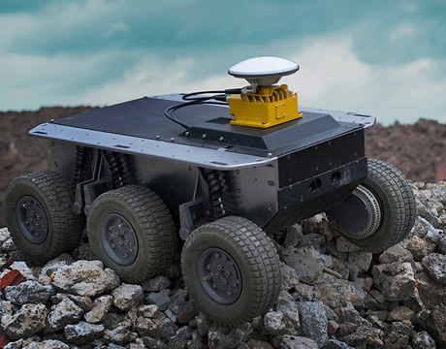
Contents
1
Introduction
2
Related works
3
Methods
4
Experiments
5
Evaluations
6
Future works
Figure 1. Material classification has been used in Robot Navigation

Slide 3
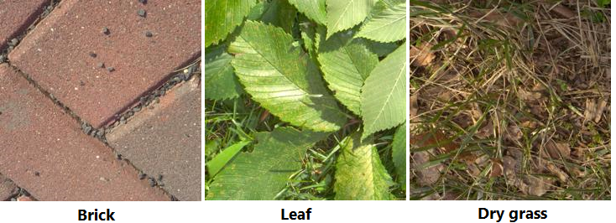
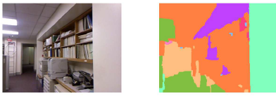
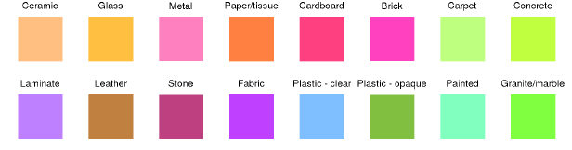
Introduction
What is material classification?
The main goal is providing the detail of material information in an image.
In simple words, given an image I, the computer need to find out what material its surface is made of (such as metal, plastic, stone, brick, glass, wood, etc.).
A higher level, the computer even need to know exactly what material class for every single pixel in the image.

Slide 4
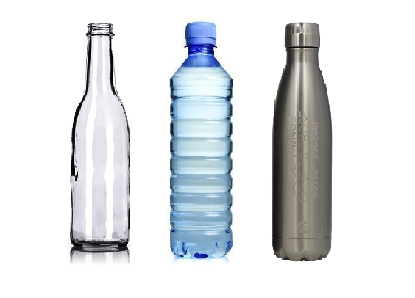
Introduction
Why do we need material classification?
Material of surfaces contribute valuable information for computer to understand and interact with the world (just like human).
It is one of significant keys for improving scene understanding in Computer Vision [1].
Being used in variety of applications in real world such as Advanced Driver-Assistance Systems [2], Robotic Manipulation [3], Robotic Navigation [4], etc.
Figure 1. Bottles with similar shape are made of different materials which decides its physical properties and could be extremely useful information in various situations.

Slide 5
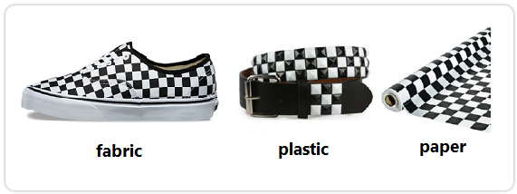
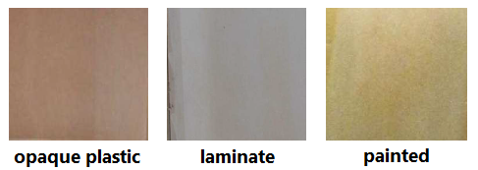
Introduction
Challenges
Surface texture, geometry variants.
Similar texture patterns, shape with different materials.
Lighting conditions.
Clutter.
Combining them.
Figure 1. Surfaces with similar texture
Figure 2. Samples from Open-Surfaces

Slide 6
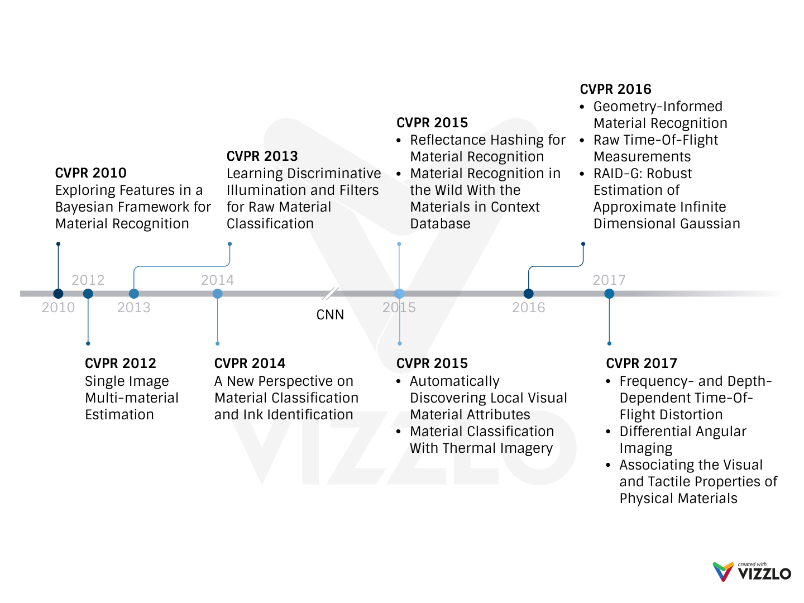
Related Works - CVPR Milestone
Notes:
After we transfer Deep Neural Networks for Computer Vision tasks, A lot of research about this task have been published with extremely accurate (almost like human)

Slide 7
Related Works – Some Datasets
Name | Samples | Classes | Views | Illumination | In scene | Scene image | Camera parameters | Year
CUReT | 61 | 61 | 205 | 205 | No | No | No | 1999
KTH-TIPS | 11 | 11 | 27 | 3 | No | No | No | 2004
UBO2014 | 84 | 7 | 151 | 151 | No | No | No | 2014
Reflectance | 190 | 19 | 3 | 3 | No | No | Yes | 2015
4D Light-field | 1200 | 12 | 1 | 1 | Yes | No | No | 2016
NISAR | 100 | 100 | 9 | 12 | No | No | No | 2016
GTOS | 606 | 40 | 19 | 4 | Yes | Yes | Yes | 2016
Table 1. Some publicly available BRDF material datasets [5].
Notes:
One again, we see that, DNNs and CNNs affect on the datasets. It becomes more and more challenge with lager-scale (trends in CVRP)

Slide 8
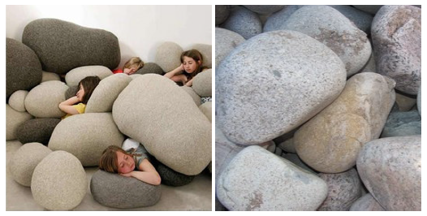
Methods
Main idea
Previous image-based methods often reply on object classification to predict material.
It’s easy to be fooled by similar objects maded of different materials.
To not only avoid these miss-classification samples, but also inherit the success of previous object classification architectures, we combine:
Deep features from a success pre-trained CNN for object classification.
Handcrafted features represent for geometry and textures information of object.
Figure 1. While the main object in both scenes can be considered
as ”stone” it is obvious that their material is different

Slide 9
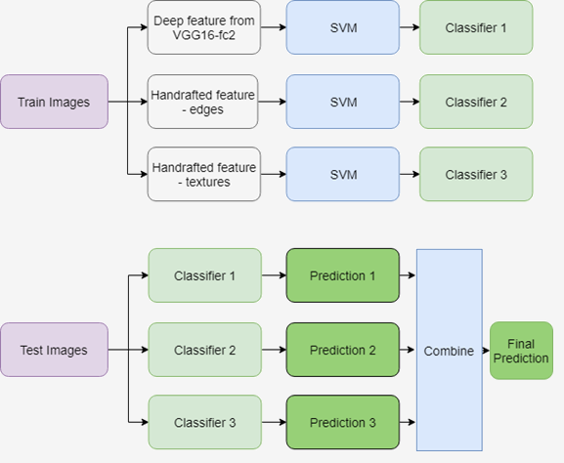
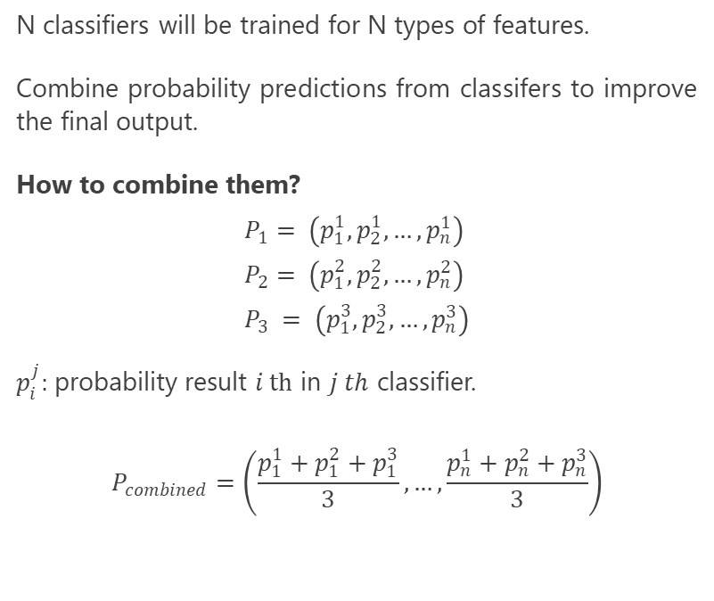
Methods
Post-fusion
N classifiers will be trained for N types of features.
Combine probability predictions from classifers to improve the final output.
How to combine them?
$$P_{1}= \left(p_{1}^{1}, p_{2}^{1}, …, p_{n}^{1}\right)$$
$$P_{2}= \left(p_{1}^{2}, p_{2}^{2}, …, p_{n}^{2}\right)$$
$$P_{3} = \left(p_{1}^{3}, p_{2}^{3}, …, p_{n}^{3}\right)$$
$p_{i}^{j}:$probability result $i th$ in $j th$ classifier.
$$P_{combined}=\left(\frac{p_{1}^{1}+p_{1}^{2}+p_{1}^{3}}{3}, …,\frac{p_{n}^{1}+p_{n}^{2}+p_{n}^{3}}{3}\right)$$
Figure 1. Post-fusion architecture

Slide 10
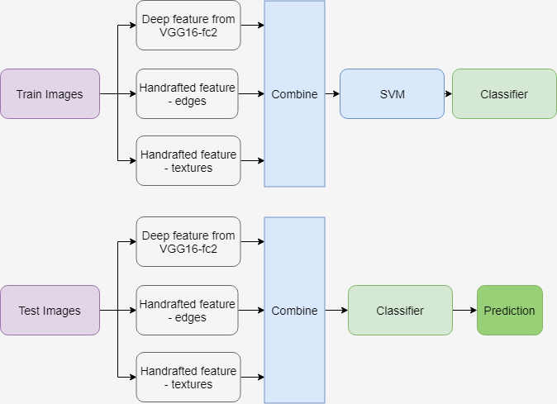
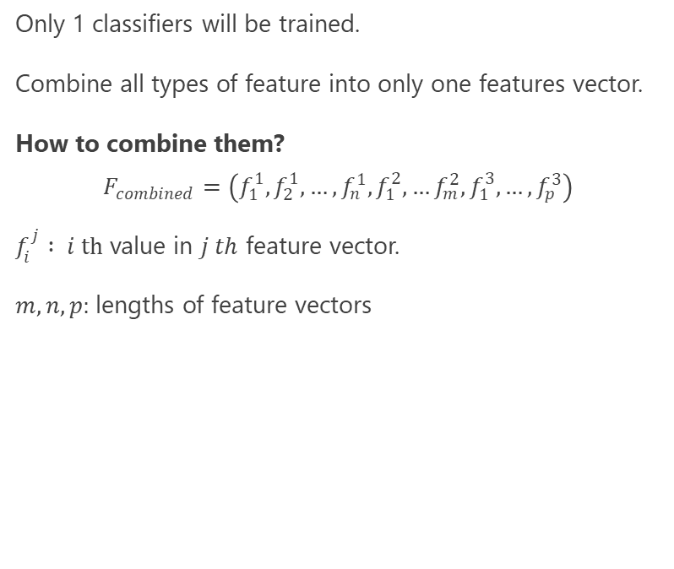
Methods
Pre-fusion
Only 1 classifiers will be trained.
Combine all types of feature into only one features vector.
How to combine them?
$$F_{combined}=\left(f_{1}^{1}, f_{2}^{1}, …,f_{n}^{1}, f_{1}^{2},…f_{m}^{2}, f_{1}^{3},…,f_{p}^{3}\right)$$
$f_{i}^{j}$ $: i th$ value in $j th$ feature vector.
$m, n, p:$lengths of feature vectors
Figure 1. Pre-fusion architecture

Slide 11
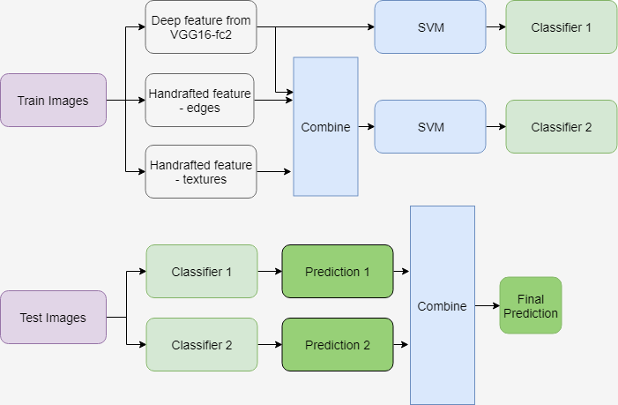
Methods
Full-fusion
Mixed of pre-fusion and post-fusion
2 classifiers will be trained.
One for deep feature
One for combined all features
Figure 1. Full-fusion architecture

Slide 12
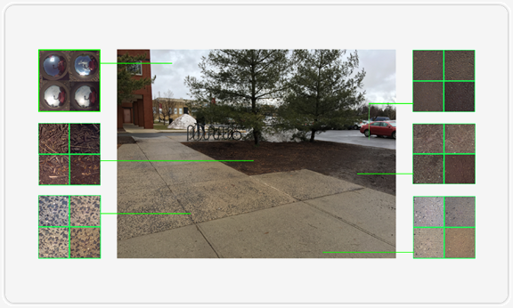
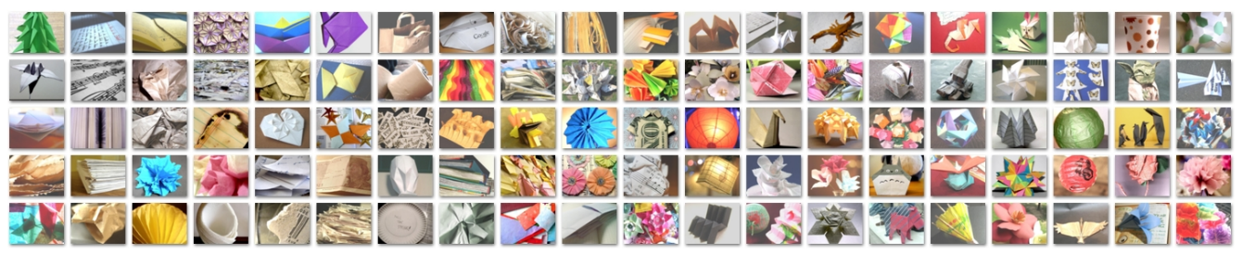
Experiments
Datasets
Ground Terrain in Outdoor Scenes (GTOS)
Newest dataset (2017)
34000+ images, 40 classes
Collected in different weather, lighting conditions.
Flicker Material Dataset (FMD)
Most common dataset (2009)
1000 images, 10 classes
Various lighting conditions, context, color, etc.
Figure 1. Outdoor scene surfaces imaged example from GTOS
Figure 1. Examples from FMD dataset

Slide 13
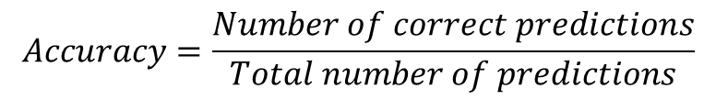
Experiments
Evaluation measure:
In particular, for both dataset, evaluation uses average classification accuracy.
$$Accuracy=\frac{Number of correct predictions}{Total number of predictions}$$

Slide 14
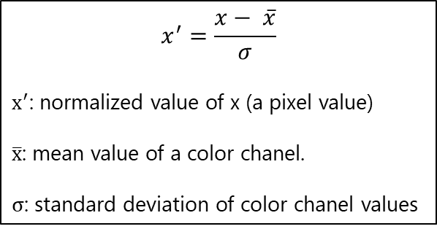
Experiments
Trainning process:
$$x^{′}=\frac{x− \overline{x}}{σ}$$
$x^{′}$: normalized value of x (a pixel value)
$\overline{x}$: mean value of a color chanel.
$σ$: standard deviation of color chanel values
Train-test splits:
70% - 30% on GTOS
80% - 20% on FMD
Data (images) preprocessing:
Crop size (224 x 224)
Standardization: subtracting a per color channel mean and normalizing for unit variance
Equation 1. Data (image) standardization
Notes:
Since the range of values of raw data varies widely, in some machine learning algorithms, objective functions will not work properly without normalization. For example, the majority of classifiers calculate the distance between two points by the Euclidean distance. If one of the features has a broad range of values, the distance will be governed by this particular feature. Therefore, the range of all features should be normalized so that each feature contributes approximately proportionately to the final distance.
Another reason why feature scaling is applied is that gradient descent converges much faster with feature scaling than without it

Slide 15
Evaluation
Method | Deep feature | Deep + edges | Deep + edges + texture
Post-fusion | 75 ± 1.8 | 75.5 ± 3.0 | 76.3 ± 1.9
Pre-fusion | 75 ± 1.8 | 77.8 ± 2.5 | 79.5 ± 2.5
Full-fusion | 75 ± 1.8 | 78.9 ± 2.2 | 82.2 ± 2.3
Figure 1. Classification result on GTOS dataset

Slide 16
Evaluation
Method | Deep feature | Deep + edges | Deep + edges + texture
Post-fusion | 74.2 ± 1.4 | 75.1 ± 2.2 | 76.3 ± 1.7
Pre-fusion | 74.2 ± 1.4 | 75.3 ± 1.5 | 76.3 ± 1.7
Full-fusion | 74.2 ± 1.4 | 75.5 ± 1.2 | 77.2 ± 0.9
Figure 1. Classification result on FMD dataset

Slide 17
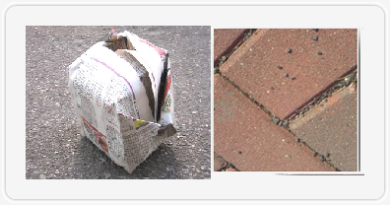
Evaluation
Figure 1. Image from FMD (left) has an object on a background (street), it makes textures information no longer effective. Image from GTOS (right) has only one surface, so textures information would work better.

Slide 18
Evaluation
Method | GTOS | FMD
DAIN | 81.2 ± 1.7
Reflectance |  | 65.5
SIFT IFV+fc7 |  | 69.6 ± 0.3
Ours | 82.2 ± 2.3 | 77.2 ± 0.9
Figure 1. Compare with other methods on same datasets

Slide 19
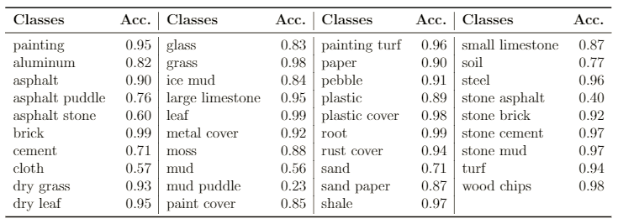
Evaluation
Table 1. Accuracy per class on GTOS dataset

Slide 20
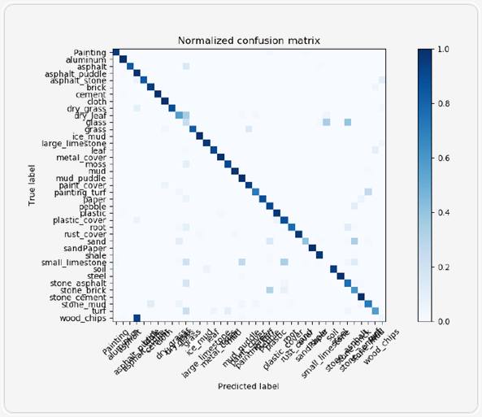
Evaluation
Figure 1. Normalized confusion matrix on GTOS dataset

Slide 21
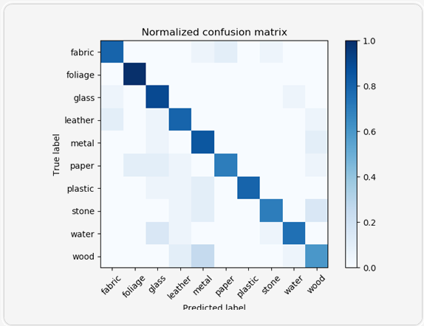
Evaluation
Figure 1. Normalized confusion matrix on FMD dataset

Slide 22
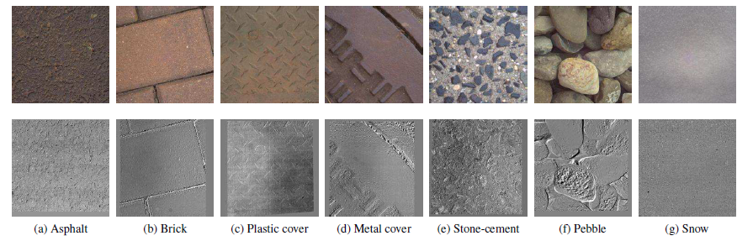
Future works
Build a full-fusion network (CNN), to:
Reduce computational and storage costs
Reduce training time (by reduce number of layers of the network)
Flexible with new data.
Change combining methods:
Combine with weights to determine the priority of features (with one is more important) instead of using vector concatenation
Use another information from image:
Multiple view point information with differential angular images (subtract an image of a sample for another image of this sample in different view point).
Figure 1. Examples of Differential Angular Images

Slide 23
References
[1] Corbett-Davies, Sam. "Real-World Material Recognition for Scene Understanding."
[2] NVIDIA, ADVANCED DRIVER ASSISTANCE SYSTEMS. [Online]. Available: https://www.nvidia.com/en-us/self-driving-cars/adas/
[3] M. W. Spong, S. Hutchinson, and M. Vidyasagar, Robot modeling and control. Wiley New York, 2006, vol. 3.
[4] J.-H. Kim, E. T. Matson, H. Myung, and P. Xu, Robot Intelligence Technology and Applications 2012: An Edition of the Presented Papers from the 1st International Conference on Robot Intelligence Technology and Applications. Springer Science & Business Media, 2013, vol. 208.
[5] Xue, Jia, et al. "Differential angular imaging for material recognition." arXiv preprint arXiv:1612.02372 (2016).

Slide 24

More questions about this task?
For more detail please email me at 14520040@gm.uit.edu.vn.
Look for more information about the data set
Interested in my work, you can find it here
Give feedback about this work
Notes:
In Slide Show mode, select the arrows to visit links.

Slide 25
Thank you for watching
Don’t read this line, this is just a subtitle. :p
Computer My Vision

