Slide 1

Material Classification
An overview.
Computer Vision

Slide 2
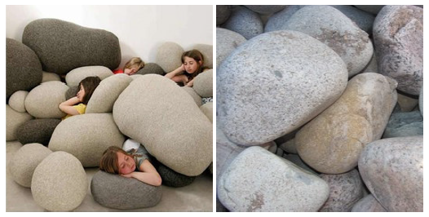
Contents
1
Introduction.
2
Related works.
3
Datasets.
4
My current work.
5
What next?
Figure 1. While the main object in both scenes can be considered
as ”stone” it is obvious that their material is different
6
Questions.

Slide 3
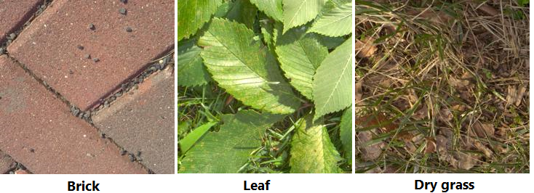
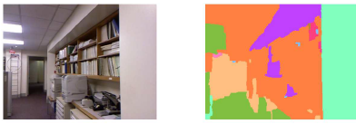
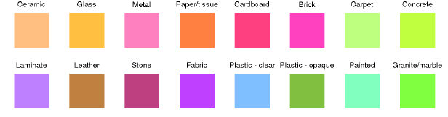
Introduction
What is material classification?
The main goal is providing the detail of material information in an image.
In simple words, given an image I, the computer need to find out what material it is made of (such as metal, plastic, stone, brick, glass, wood, etc.).
A higher level, the computer even need to know exactly what material class for every single pixel in I.

Slide 4
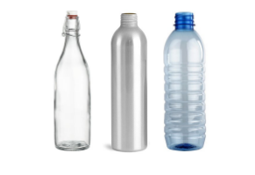
Introduction
Why do we need material classification?
Material of surfaces contribute valuable information for computer to understand and interact with the world (just like human).
It is one of significant keys for improving scene understanding in Computer Vision [1].
Being used in variety of applications in real world such as Advanced Driver-Assistance Systems [2], Robotic Manipulation [3], Robotic Navigation [4], etc.
Figure 1. Bottles with similar shapes, are made of different materials which decides its physical properties, which could be extremely useful information in various situations.

Slide 5
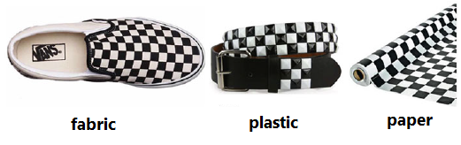
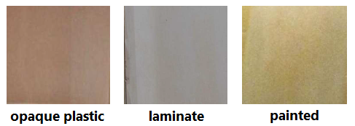
Introduction
Challenges
Surface texture, geometry variants.
Similar texture patterns, shape with different materials.
Lighting conditions.
Clutter.
Combining them.
Figure 1. Surfaces with similar texture
Figure 2. Samples from OpenSurfaces

Slide 6
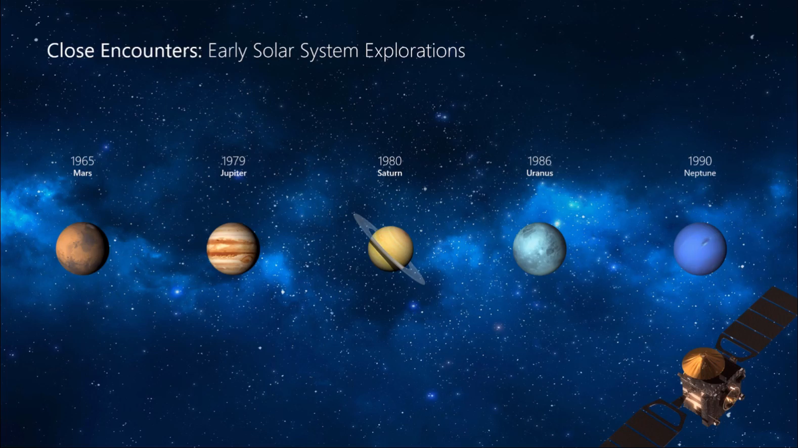
Related Works
Morph makes smooth animations and object movements in your presentation. You use two similar slides to perform the animation, but it looks to your audience like the action happens on one slide.
Play the video on the right to see a quick example.
Morph is a subscription-only feature. If you have an Office 365 subscription, you can try it yourself with the steps on the next slide.

Slide 7
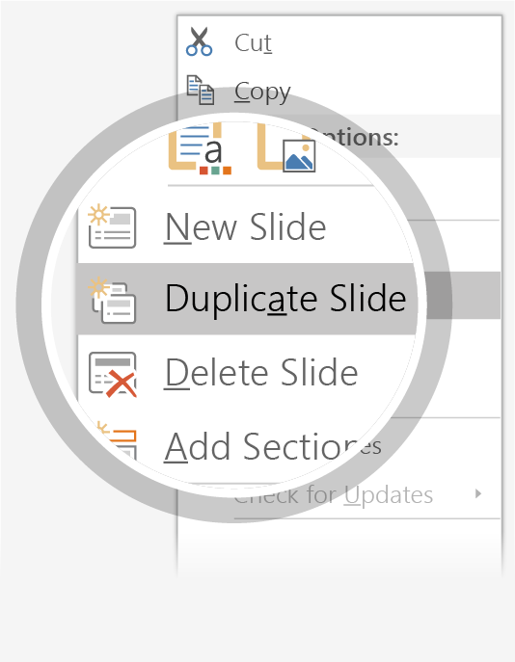
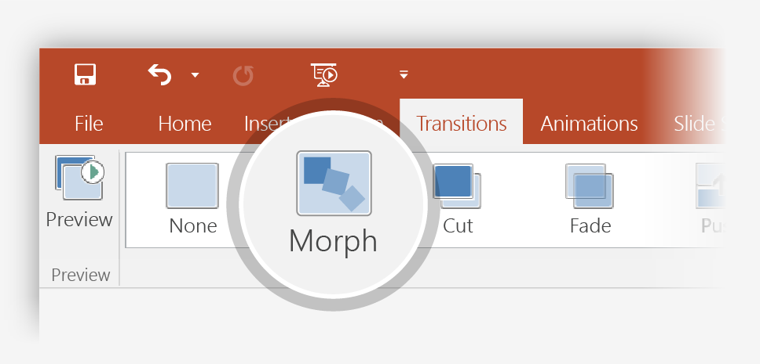

Setting up Morph
Try it yourself with these two simple “planets”:
1
Duplicate this slide: Right-click the slide thumbnail and select Duplicate Slide.
2
In the second of these two identical slides, change the shapes on the right in some way (move, resize, change color), then go to Transitions > Morph.
3
Return to the first of the two slides and press Slide Show button and then select Play to see your circle morph!
Hint: Effect Options gives you even more options for Morph.

Slide 8
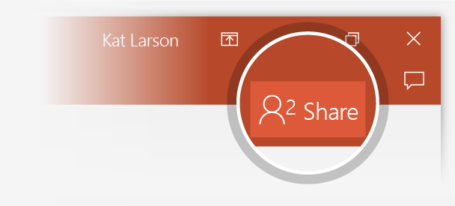
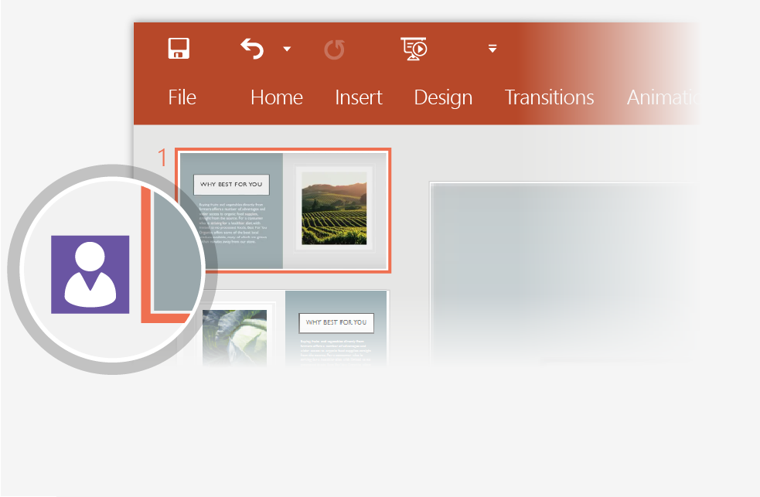
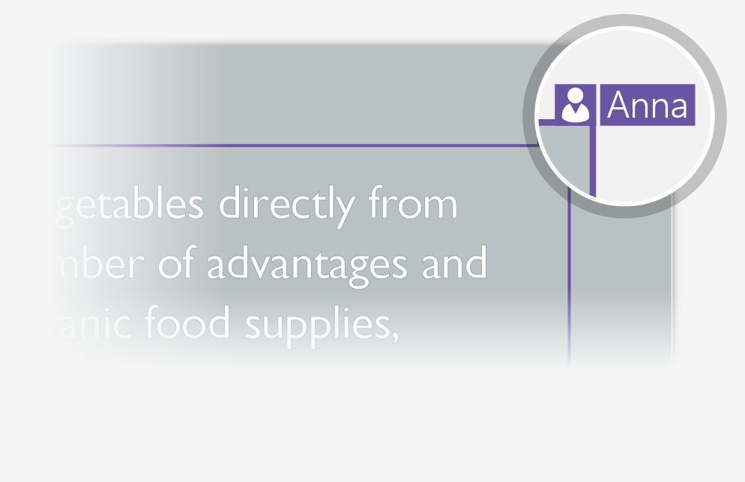
Working together in real time
When you share your presentation with others, you’ll see them working with you at the same time. How it works:
1
Select Share from above the ribbon, or by using short-key Alt-YU, to invite people to work with you (You can save to the cloud at this point.)
2
When other people are in the presentation, a marker shows who is on which slide…
3
…and the part of the slide they're editing.

Slide 9


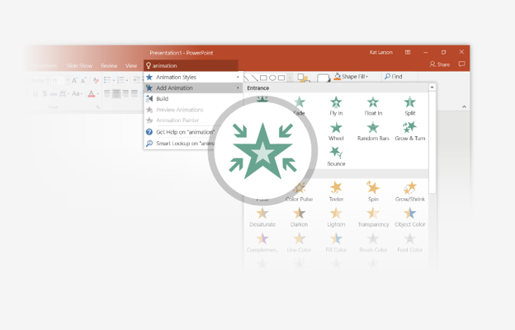
You’re an expert with Tell Me
The Tell Me box finds the right command when you need it, so you can save time and focus on your work. Try it:
SELECT ME
1
Select the Robot picture on the right.
2
Type animation in the Tell Me box, and then choose Add Animation.
3
Choose an animation effect, like Zoom, and watch what happens.

Slide 10
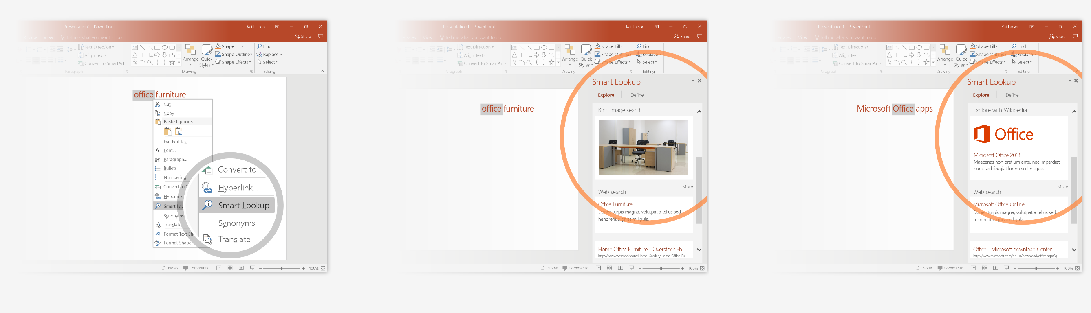
Explore without leaving your slides
Smart Lookup brings research directly in to PowerPoint. Try it:
1
Right-click in the word office in the following phrase: office furniture
2
Choose Smart Lookup, and notice that results are contextual for that phrase, not Microsoft Office apps.
3
Just for fun, try Smart Lookup again by right-clicking in the word Office in Step 2.

Slide 11
References
[1] Corbett-Davies, Sam. "Real-World Material Recognition for Scene Understanding."
[2] NVIDIA, ADVANCED DRIVER ASSISTANCE SYSTEMS. [Online]. Available: https://www.nvidia.com/en-us/self-driving-cars/adas/
[3] M. W. Spong, S. Hutchinson, and M. Vidyasagar, Robot modeling and control. Wiley New York, 2006, vol. 3.
[4] J.-H. Kim, E. T. Matson, H. Myung, and P. Xu, Robot Intelligence Technology and Applications 2012: An Edition of the Presented Papers from the 1st International Conference on Robot Intelligence Technology and Applications. Springer Science & Business Media, 2013, vol. 208.

Slide 12

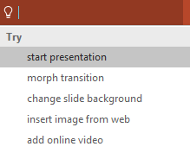

More questions about PowerPoint?
Select the Tell Me button and type what you want to know.
Visit the PowerPoint team blog
Go to free PowerPoint training
Give feedback about this tour
SELECT THE ARROW WHEN IN SLIDE SHOW MODE
Notes:
In Slide Show mode, select the arrows to visit links.

