Slide 1

Material Classification
An overview.
Computer Vision

Slide 2
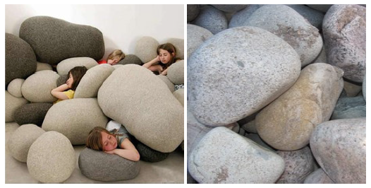
Contents
1
Introduction.
2
Related works.
3
Datasets.
4
My current work.
5
What’s next?
Figure 1. While the main object in both scenes can be considered
as ”stone” it is obvious that their material is different
6
Questions.

Slide 3
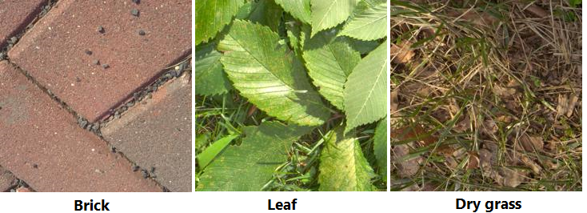
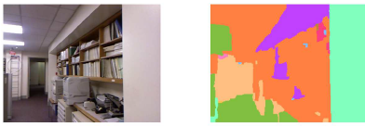
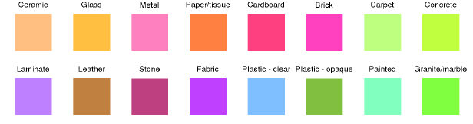
Introduction
What is material classification?
The main goal is providing the detail of material information in an image.
In simple words, given an image I, the computer need to find out what material its surface is made of (such as metal, plastic, stone, brick, glass, wood, etc.).
A higher level, the computer even need to know exactly what material class for every single pixel in the image.

Slide 4
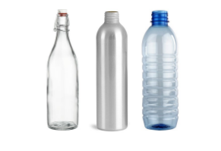
Introduction
Why do we need material classification?
Material of surfaces contribute valuable information for computer to understand and interact with the world (just like human).
It is one of significant keys for improving scene understanding in Computer Vision [1].
Being used in variety of applications in real world such as Advanced Driver-Assistance Systems [2], Robotic Manipulation [3], Robotic Navigation [4], etc.
Figure 1. Bottles with similar shapes, are made of different materials which decides its physical properties, which could be extremely useful information in various situations.

Slide 5
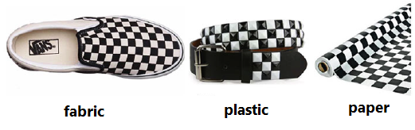
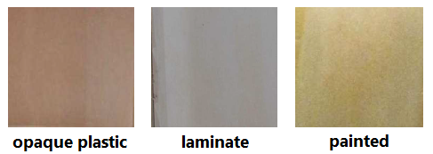
Introduction
Challenges
Surface texture, geometry variants.
Similar texture patterns, shape with different materials.
Lighting conditions.
Clutter.
Combining them.
Figure 1. Surfaces with similar texture
Figure 2. Samples from Open-Surfaces

Slide 6
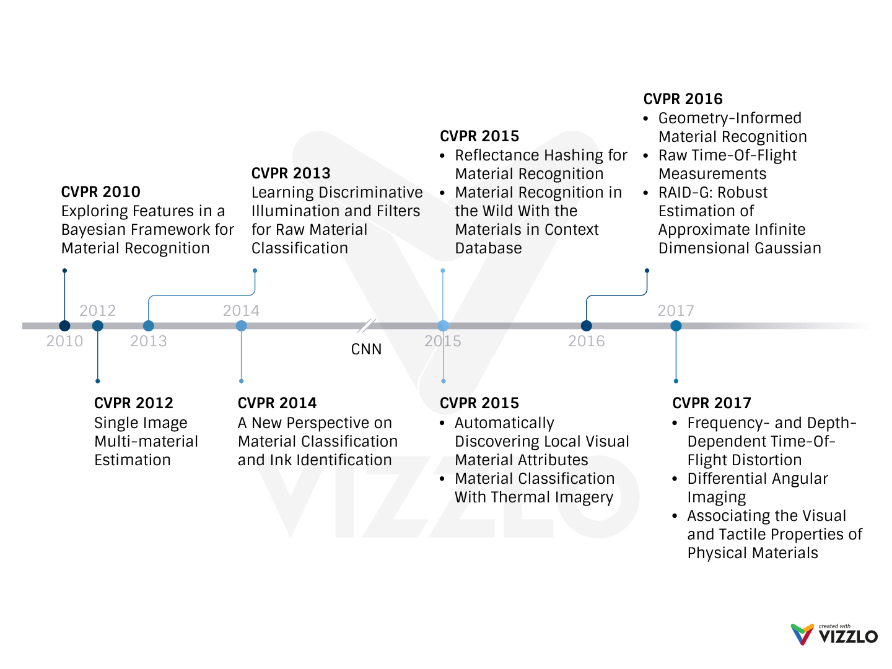
Related Works - CVPR Milestone
Notes:
After we transfer Deep Neural Networks for Computer Vision tasks, A lot of research about this task have been published with extremely accurate (almost like human)

Slide 7
Datasets
Name | Samples | Classes | Views | Illumination | In scene | Scene image | Camera parameters | Year
CUReT | 61 | 61 | 205 | 205 | No | No | No | 1999
KTH-TIPS | 11 | 11 | 27 | 3 | No | No | No | 2004
UBO2014 | 84 | 7 | 151 | 151 | No | No | No | 2014
Reflectance | 190 | 19 | 3 | 3 | No | No | Yes | 2015
4D Light-field | 1200 | 12 | 1 | 1 | Yes | No | No | 2016
NISAR | 100 | 100 | 9 | 12 | No | No | No | 2016
GTOS | 606 | 40 | 19 | 4 | Yes | Yes | Yes | 2016
Table 1. Some publicly available BRDF material datasets [5]. Note that the 4D Light-field dataset is captured by the Lytro Illum light field camera.
Notes:
One again, we see that, DNNs and CNNs affect on the datasets. It becomes more and more challenge with lager-scale (trends in CVRP)

Slide 8
My current work

Slide 9
What’s next?

Slide 10
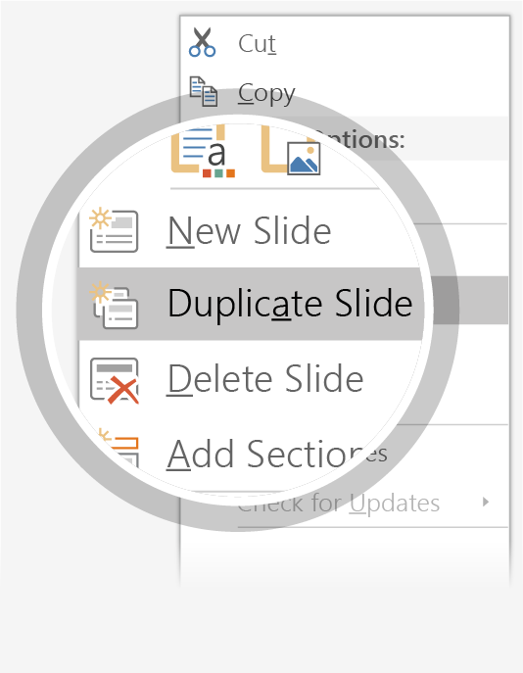
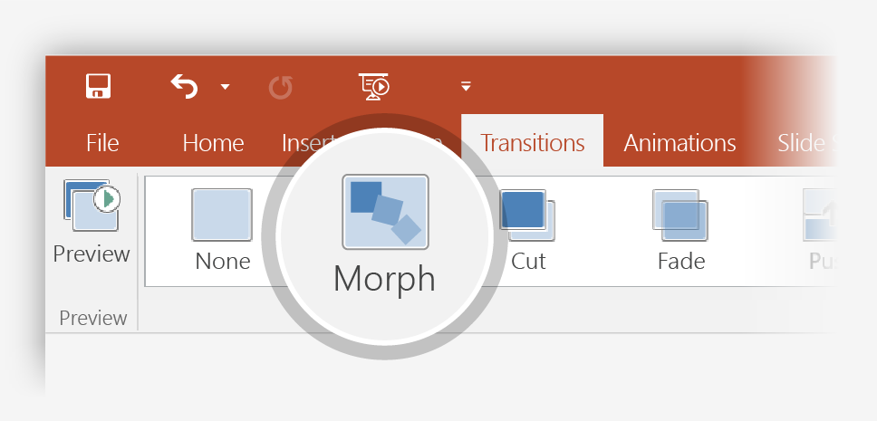

Setting up Morph
Try it yourself with these two simple “planets”:
1
Duplicate this slide: Right-click the slide thumbnail and select Duplicate Slide.
2
In the second of these two identical slides, change the shapes on the right in some way (move, resize, change color), then go to Transitions > Morph.
3
Return to the first of the two slides and press Slide Show button and then select Play to see your circle morph!
Hint: Effect Options gives you even more options for Morph.

Slide 11
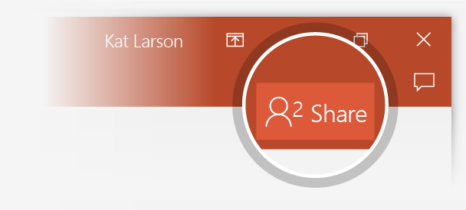
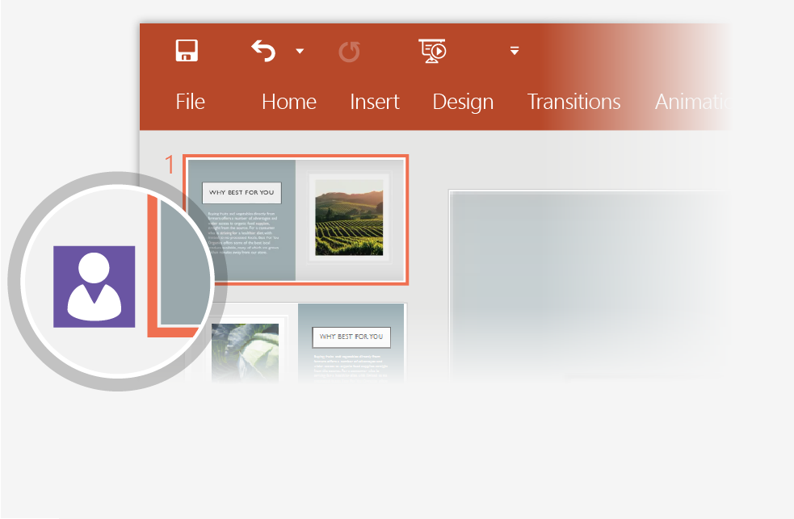
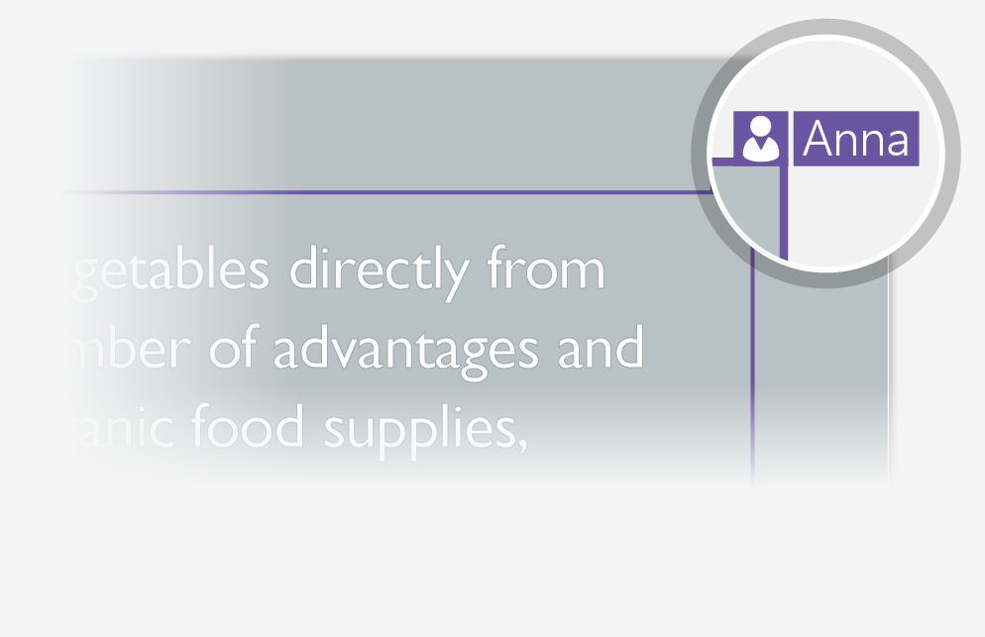
Working together in real time
When you share your presentation with others, you’ll see them working with you at the same time. How it works:
1
Select Share from above the ribbon, or by using short-key Alt-YU, to invite people to work with you (You can save to the cloud at this point.)
2
When other people are in the presentation, a marker shows who is on which slide…
3
…and the part of the slide they're editing.

Slide 12


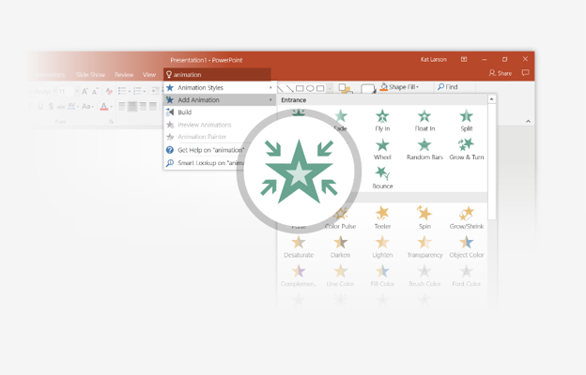
You’re an expert with Tell Me
The Tell Me box finds the right command when you need it, so you can save time and focus on your work. Try it:
SELECT ME
1
Select the Robot picture on the right.
2
Type animation in the Tell Me box, and then choose Add Animation.
3
Choose an animation effect, like Zoom, and watch what happens.

Slide 13
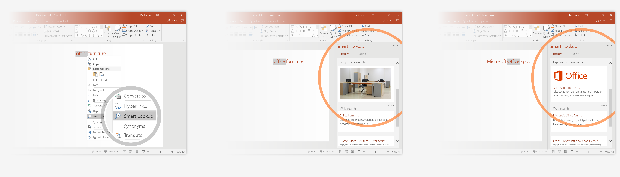
Explore without leaving your slides
Smart Lookup brings research directly in to PowerPoint. Try it:
1
Right-click in the word office in the following phrase: office furniture
2
Choose Smart Lookup, and notice that results are contextual for that phrase, not Microsoft Office apps.
3
Just for fun, try Smart Lookup again by right-clicking in the word Office in Step 2.

Slide 14
References
[1] Corbett-Davies, Sam. "Real-World Material Recognition for Scene Understanding."
[2] NVIDIA, ADVANCED DRIVER ASSISTANCE SYSTEMS. [Online]. Available: https://www.nvidia.com/en-us/self-driving-cars/adas/
[3] M. W. Spong, S. Hutchinson, and M. Vidyasagar, Robot modeling and control. Wiley New York, 2006, vol. 3.
[4] J.-H. Kim, E. T. Matson, H. Myung, and P. Xu, Robot Intelligence Technology and Applications 2012: An Edition of the Presented Papers from the 1st International Conference on Robot Intelligence Technology and Applications. Springer Science & Business Media, 2013, vol. 208.
[5] Xue, Jia, et al. "Differential angular imaging for material recognition." arXiv preprint arXiv:1612.02372 (2016).

Slide 15
More questions about this task?
Notes:
In Slide Show mode, select the arrows to visit links.

Slide 16
Thank you for watching
Don’t read this line, this is just a subtitle. :p
Computer My Vision

