Slide 1

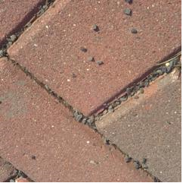
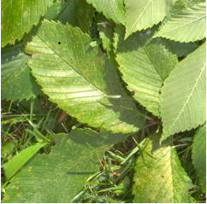
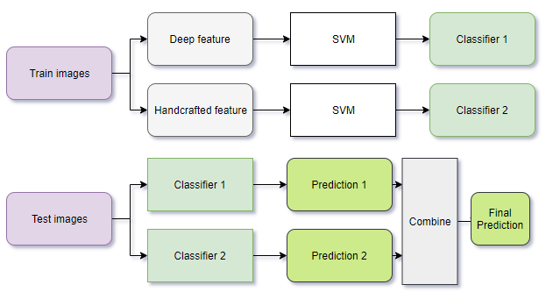
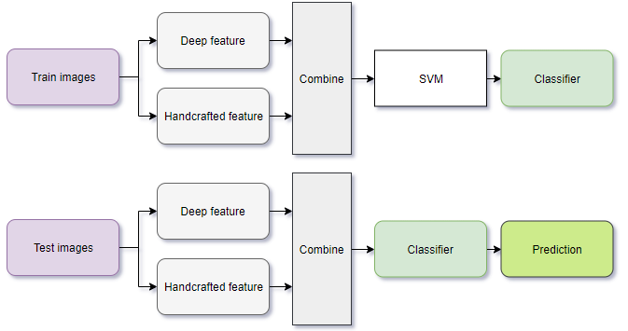
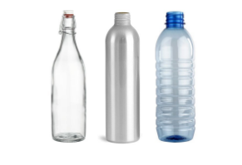
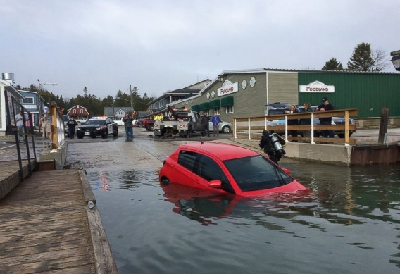
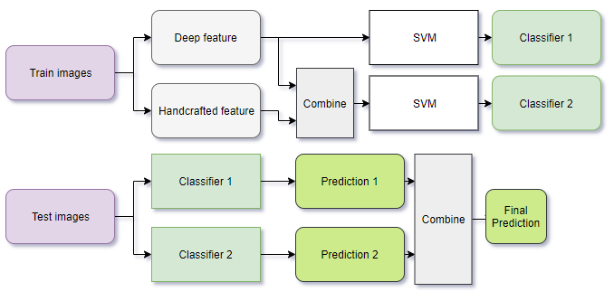
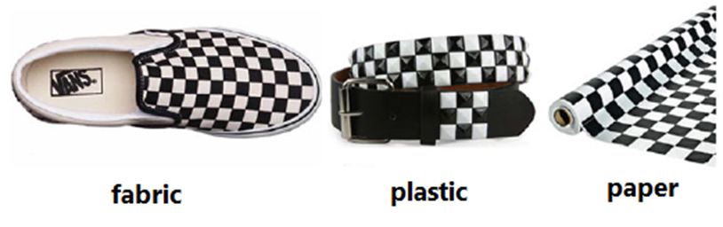
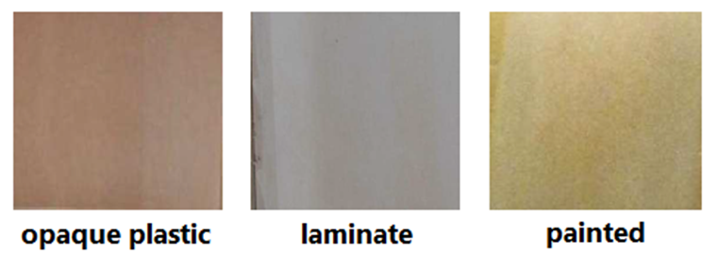




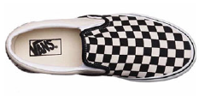










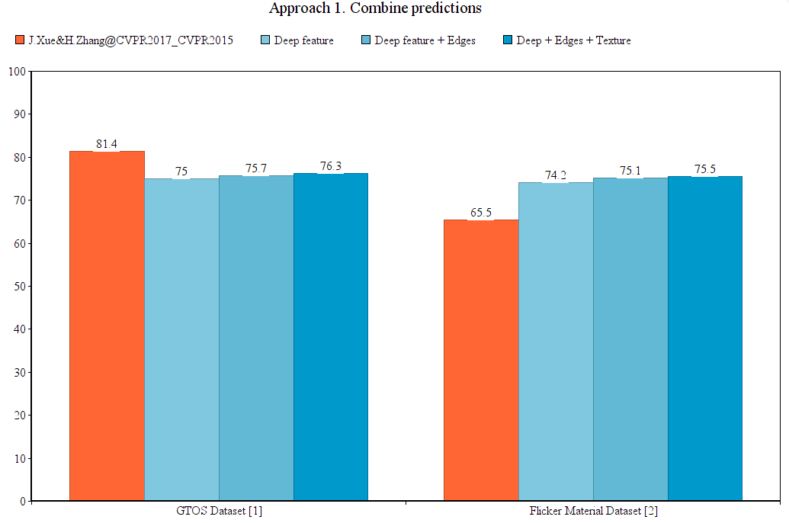
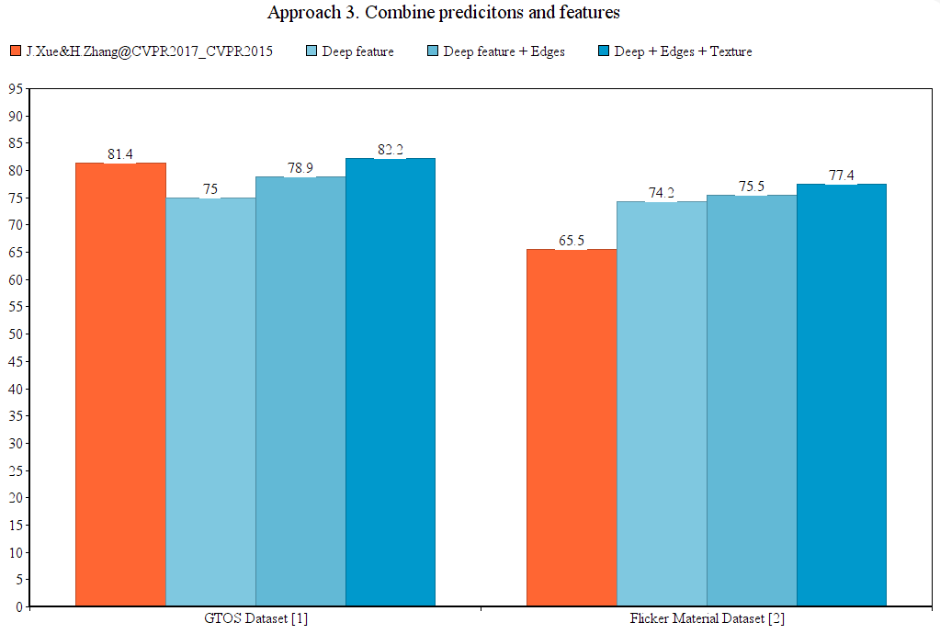
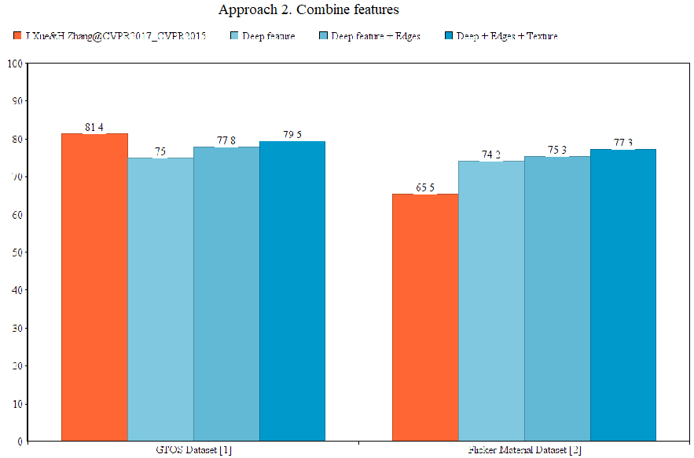
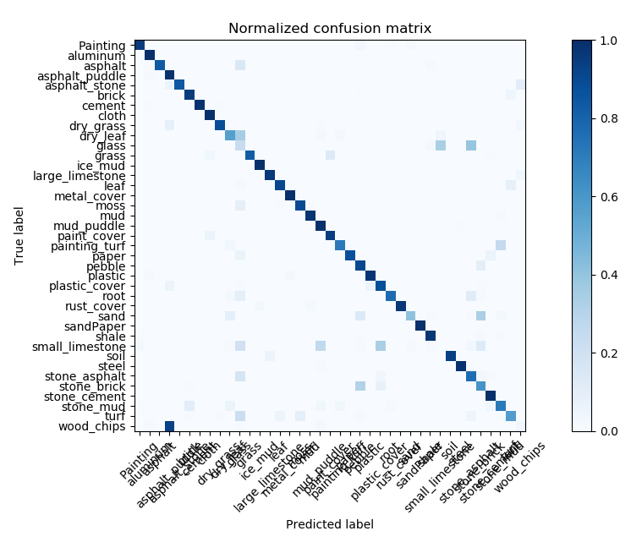


Deep feature and handcrafted feature - A combination for
Material Classification
Anh-Truong Phuc, Tien-Dung Mai, Duy-Dinh Le
University of Information Technology
Introduction
Approaches
What is it ?
Answer the question “Which material is this object made of?”.
Brick
Leaves
Why do we need it ?
Material is a valuable information for computer to understand and interact with the world.
Which bottle should we use to store hot water?
Auto-car: “Sorry. I don’t know it is water”.
1. Combine predictions
2. Combine features
Only one single image for guessing material - really challenge.
Event for human!
3. Combine predictions & features
Cool! Look similar texture
but it is not too hard.
Now. Can use guess which
material are they?
How it works
Main idea
We consider that deep feature extracted from a CNN can represent for the way human think and learn.
Combine it with a suitable handcrafted feature would improve the prediction.
Sometime, human is right ...
“Easy! Look at its shape.
It must be a shoe.”
Original image
Classifier 0
Fabric 90%
Deep feature
P0
features
Fabric 49%
Angular
Classifier 1
“Similar with …”
Plastic 51%
Handcrafted f1
P1
Final prediction
Sobel-Feldman edges
Classifier 2
P2
Sometime, computer is right ...
Handcrafted f2
“Easy! Look at its shape.
It must be a shoe.”
Wood 60%
More handcrafted features
Classifier i
Painted 40%
Handcrafted fi
P3
features
Wood 30%
“Suitable” example: I can recognize type of material base on its shape so I choose angular and edges as additional information.
“Similar with …”
Painted 70%
Results
So, why don’t we combine it?
Approach 1.
Combine predictions
Approach 3.
Combine predictions & features
Fabric 90%
Plastic 10%
Fabric 141 %
Fabric 49%
Plastic 61 %
Approach 2.
Combine features
Confusion matrix on GTOS dataset best result
Plastic 51%
Wood 60%
Painted 40%
Painted 130%
References
Wood 30%
Wood 70%
[1] ]Xue, Jia, et al. "Differential angular imaging for material recognition."IEEE Conference on Computer Vision and Pattern Recognition (CVPR Vol. 5. 2017.
[2] ]H. Zhang, K. Dana, and K. Nishino. Reflectance hashing for material recognition. IEEE Conference on Computer Vision and Pattern Recognition, p 371–380, 2015.
Painted 70%

