Slide 1

Material Classification
An overview.
Trương Phúc Anh– 14520040
Computer Vision

Slide 2
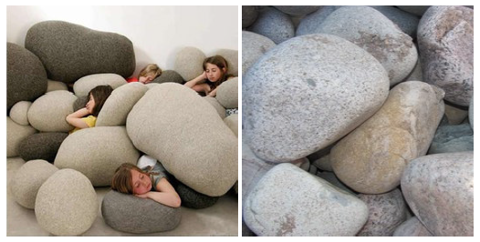
Contents
1
Introduction.
2
Related works.
3
Datasets.
4
My current work.
5
What’s next?
Figure 1. While the main object in both scenes can be considered
as ”stone” it is obvious that their material is different
6
Questions.

Slide 3
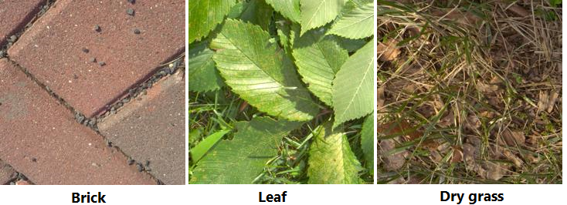
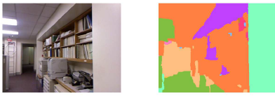
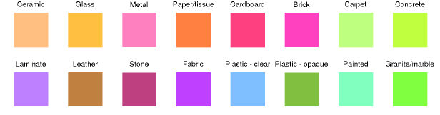
Introduction
What is material classification?
The main goal is providing the detail of material information in an image.
In simple words, given an image I, the computer need to find out what material its surface is made of (such as metal, plastic, stone, brick, glass, wood, etc.).
A higher level, the computer even need to know exactly what material class for every single pixel in the image.

Slide 4
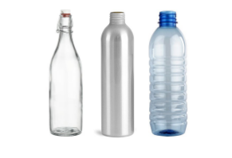
Introduction
Why do we need material classification?
Material of surfaces contribute valuable information for computer to understand and interact with the world (just like human).
It is one of significant keys for improving scene understanding in Computer Vision [1].
Being used in variety of applications in real world such as Advanced Driver-Assistance Systems [2], Robotic Manipulation [3], Robotic Navigation [4], etc.
Figure 1. Bottles with similar shape are made are made of different materials which decides its physical properties and could be extremely useful information in various situation.

Slide 5
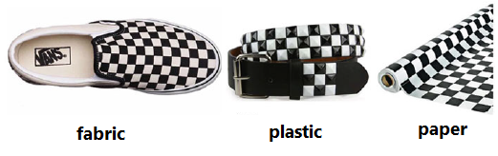
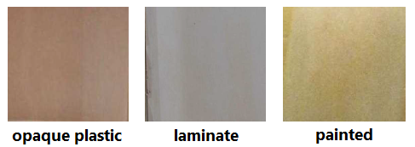
Introduction
Challenges
Surface texture, geometry variants.
Similar texture patterns, shape with different materials.
Lighting conditions.
Clutter.
Combining them.
Figure 1. Surfaces with similar texture
Figure 2. Samples from Open-Surfaces

Slide 6
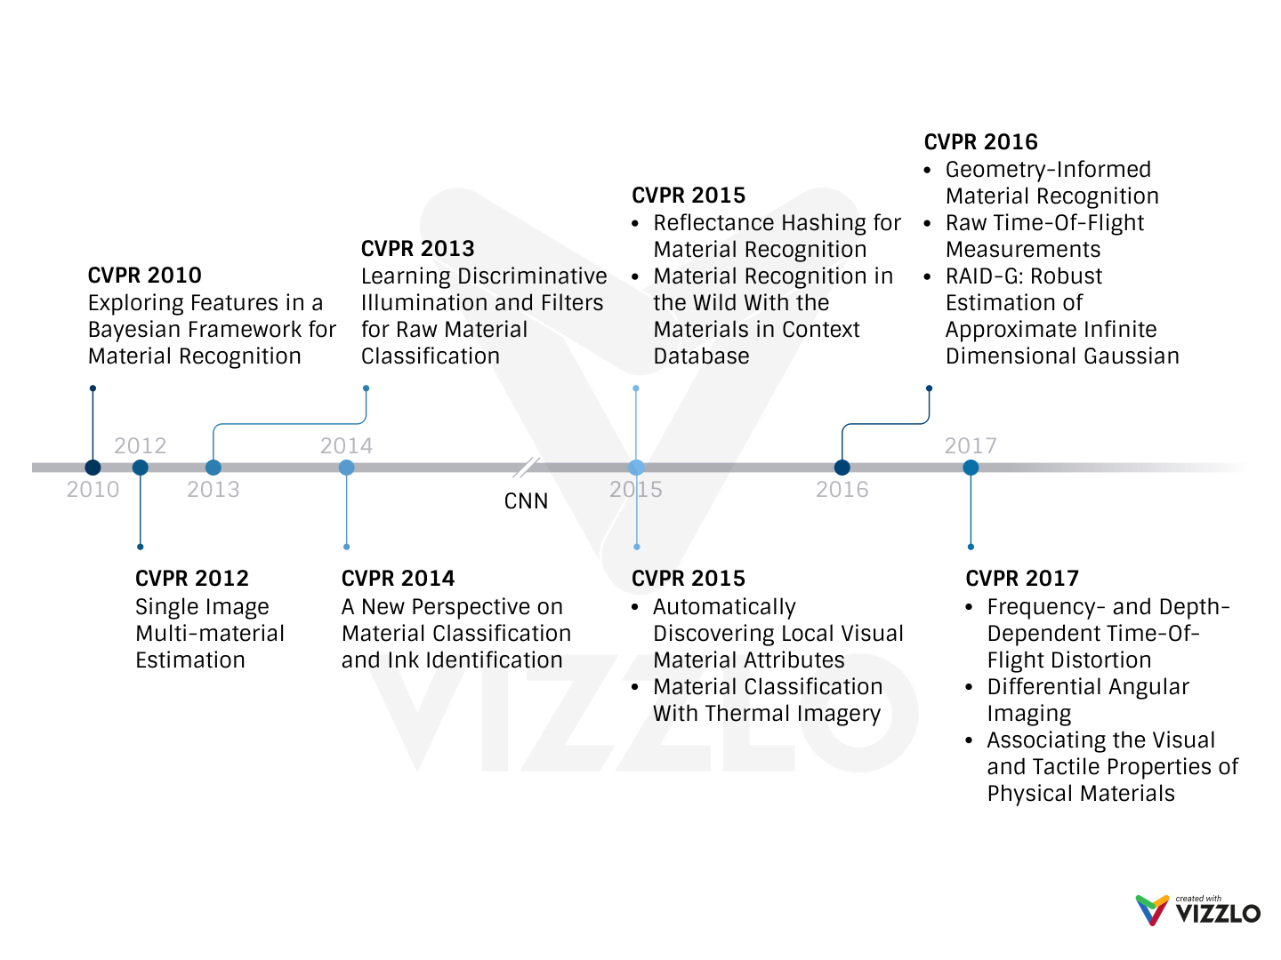
Related Works - CVPR Milestone
Notes:
After we transfer Deep Neural Networks for Computer Vision tasks, A lot of research about this task have been published with extremely accurate (almost like human)

Slide 7
Datasets
Name | Samples | Classes | Views | Illumination | In scene | Scene image | Camera parameters | Year
CUReT | 61 | 61 | 205 | 205 | No | No | No | 1999
KTH-TIPS | 11 | 11 | 27 | 3 | No | No | No | 2004
UBO2014 | 84 | 7 | 151 | 151 | No | No | No | 2014
Reflectance | 190 | 19 | 3 | 3 | No | No | Yes | 2015
4D Light-field | 1200 | 12 | 1 | 1 | Yes | No | No | 2016
NISAR | 100 | 100 | 9 | 12 | No | No | No | 2016
GTOS | 606 | 40 | 19 | 4 | Yes | Yes | Yes | 2016
Table 1. Some publicly available BRDF material datasets [5]. Note that the 4D Light-field dataset is captured by the Lytro Illum light field camera.
Notes:
One again, we see that, DNNs and CNNs affect on the datasets. It becomes more and more challenge with lager-scale (trends in CVRP)

Slide 8
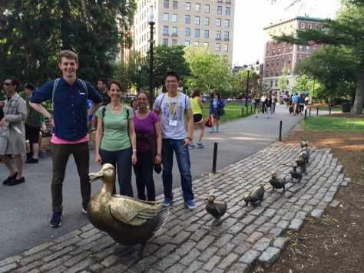

My current work
The paper I choose to work on
Name Differential Angular Imaging for Material Recognition (DAIN)
Dataset GTOS (Ground Terrain in Outdoor Scenes).
Authors Jia Xue, Hang Zhang, Kristin Dana, Ko Nishino from Computer Vision Lab, Rutgers University - New Jersey (USA).
Website http://eceweb1.rutgers.edu/vision/index.html
SELECT ME

Slide 9
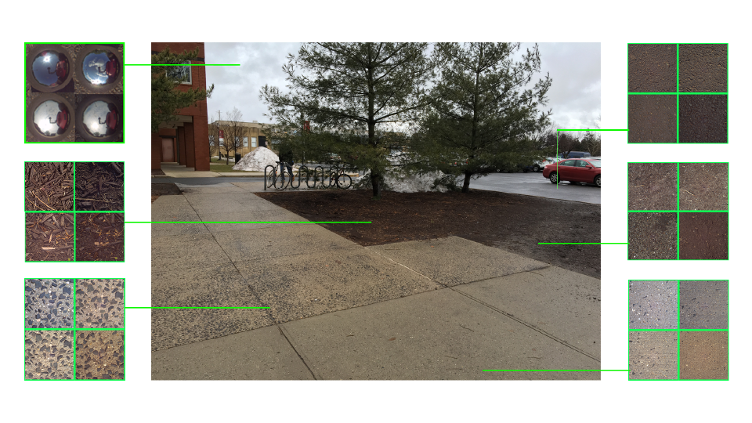
My current work
Why do I choose this paper?
Newest paper about material classification published in CVPR2017.
Work with a new dataset (GTOS - published 2016) – large scale, high quality. Coming soon, GTIS (Ground Terrain in Indoor Scenes) – more challenges.
Best result compare with the state of art algorithms on the same dataset.
The key idea of solution in this paper is not complex so I can moving on.
Published source code. You can download it here https://github.com/mrxue1993/DAIN
Figure 1. An image from GTOS dataset
SELECT ME

Slide 10
My current work
Architecture | Accuracy
FV+CNN | 75.4%
FV-N+CNN+N(3D) | 58.3%
MVCNN | 78.1%
Multi-view DAIN (3D filter), pooling | 81.4%
Table 1. Comparison Multi-view DAIN with the state of art algorithms on GTOS dataset [5].

Slide 11
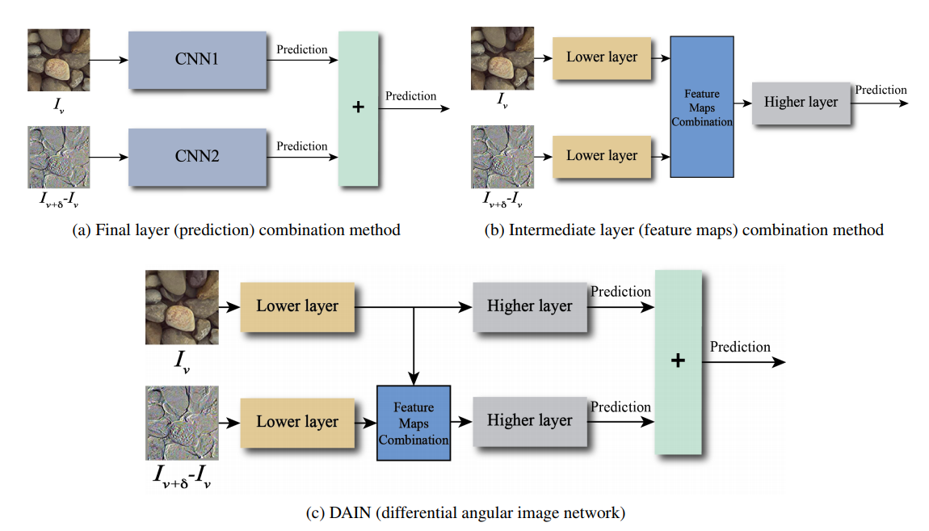
My current work

Slide 12
My current work
Baseline with VGG16(layer fc2) - SVM
Extract VGG16-fc2 with Keras framework (using Tensorflow as backend).
Train with SVM (from scikit-learn python package) with my custom parameters.
Test on 5 different train-test set (same as the original paper).
Train-test set | Accuracy
001 | 73.17%
002 | 77.01%
003 | 77.79%
004 | 81.24%
005 | 80.44%
Average | 77.93%
Table 1. VGG-16(fc2) – SVM result on GTOS

Slide 13
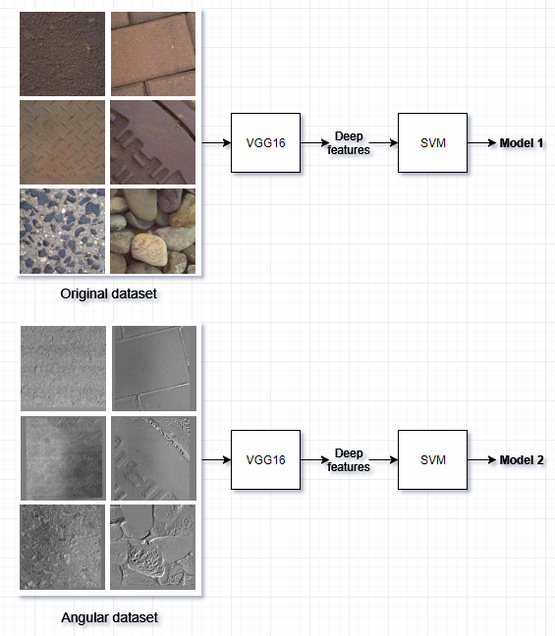
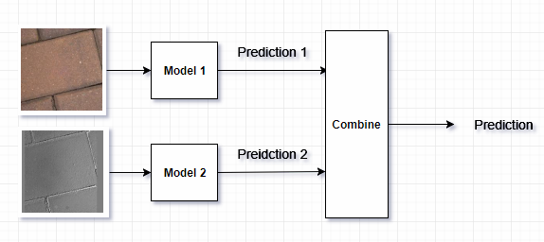
My approaches
1
Prediction combined with SVM instead of combining final layer of CNN

Slide 14
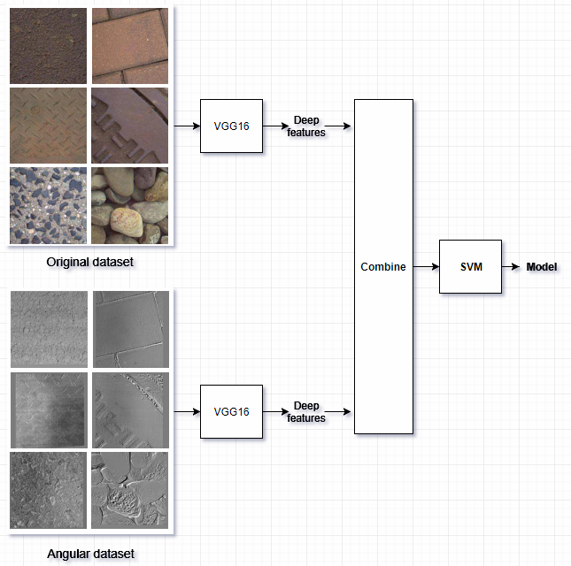
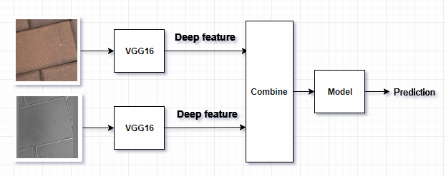
My approaches
2
Feature combined with SVM instead of combining intermedia layer of CNN

Slide 15
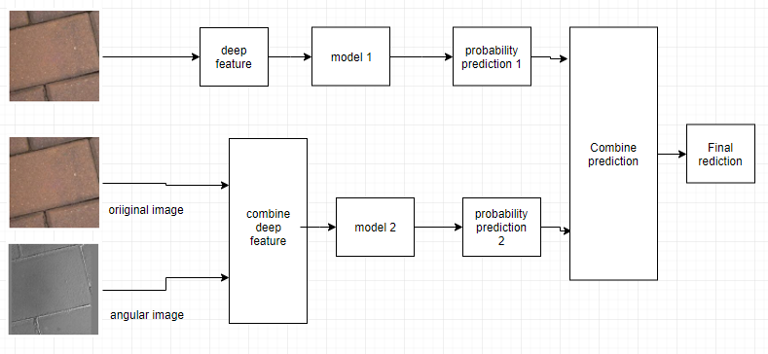
My approaches
3
Combine both features and prediction

Slide 16
My current results
Method | Accuracy
Combine feature (original image+ edges information) | 77.85% ± 2.75%
Combine feature (original image+ edges information) and combine prediction | 78.75% ± 2.56%
Combine feature (original image+ edges information + texture information) | 78.88% ± 2.57%
Combine feature (original image+ edges information + texture information) and combine prediction | 82.2% ± 2.21%
Table 1. Some result on my current work. DAIN’s result is 81.4%

Slide 17
References
[1] Corbett-Davies, Sam. "Real-World Material Recognition for Scene Understanding."
[2] NVIDIA, ADVANCED DRIVER ASSISTANCE SYSTEMS. [Online]. Available: https://www.nvidia.com/en-us/self-driving-cars/adas/
[3] M. W. Spong, S. Hutchinson, and M. Vidyasagar, Robot modeling and control. Wiley New York, 2006, vol. 3.
[4] J.-H. Kim, E. T. Matson, H. Myung, and P. Xu, Robot Intelligence Technology and Applications 2012: An Edition of the Presented Papers from the 1st International Conference on Robot Intelligence Technology and Applications. Springer Science & Business Media, 2013, vol. 208.
[5] Xue, Jia, et al. "Differential angular imaging for material recognition." arXiv preprint arXiv:1612.02372 (2016).

Slide 18

More questions about this task?
For more detail please email me at 14520040@gm.uit.edu.vn.
Look for more information about the data set
Interested in my work, you can find it here
Give feedback about this work
Notes:
In Slide Show mode, select the arrows to visit links.

Slide 19
Thank you for watching
Don’t read this line, this is just a subtitle. :p
Computer My Vision

