Slide 1

Material Classification using Deep Learning
A combination of deep feature and handcrafted features
SVTH: Trương Phúc Anh – 14520040
GVHD: TS.Lê Đình Duy, ThS.Mai Tiến Dũng
Computer Vision

Slide 2
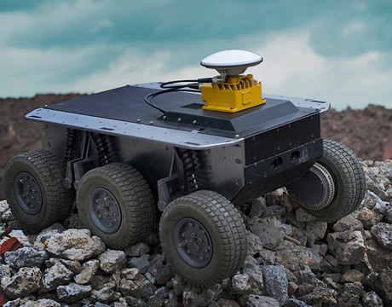
Contents
1
Introduction
2
Related works
3
Methods
4
Experiments
5
Evaluations
6
Future works
Figure 1. Material classification has been used in Robot Navigation [1]

Slide 3
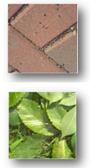
Introduction
What is material classification?
The main goal is providing material information in an image.
Given an image I, the computer need to find out what material its surface is made of (such as metal, plastic, stone, brick, glass, wood, etc.).
Input: An image of a surface or an object
Output: The material of this image
Brick
Classifier
Leaf
Figure 2. Material classification example

Slide 4
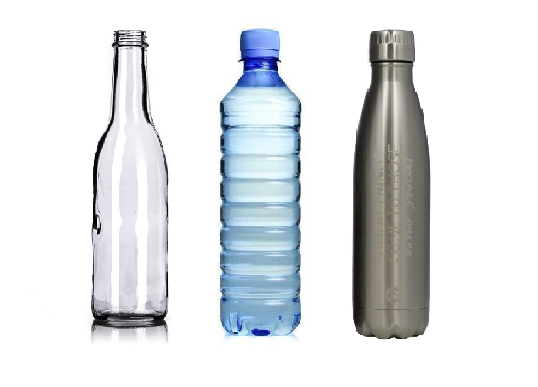
Introduction
Why do we need material classification?
Valuable information
One of significant keys for improving scene understanding in Computer Vision.
Being used in variety of applications in real world (Advanced Driver-Assistance Systems, Robotic Manipulation, Robotic Navigation, etc. [1] [2])
Figure 3. Bottles with similar shape are made of different materials which decides its physical properties and could be extremely useful information in various situations.

Slide 5
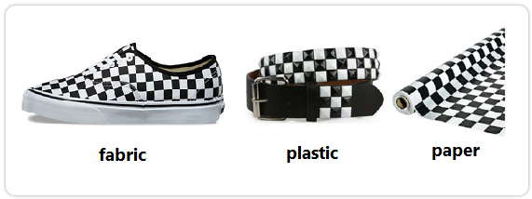
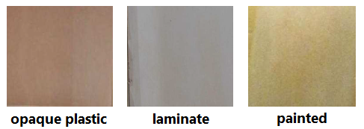
Introduction
Challenges
Surface texture, geometry variants.
Similar texture patterns, shape with different materials.
Lighting conditions.
Clutter.
Combining them.
Figure 4. Surfaces with similar texture [3]
Figure 5. Samples from Open-Surfaces [4]

Slide 6
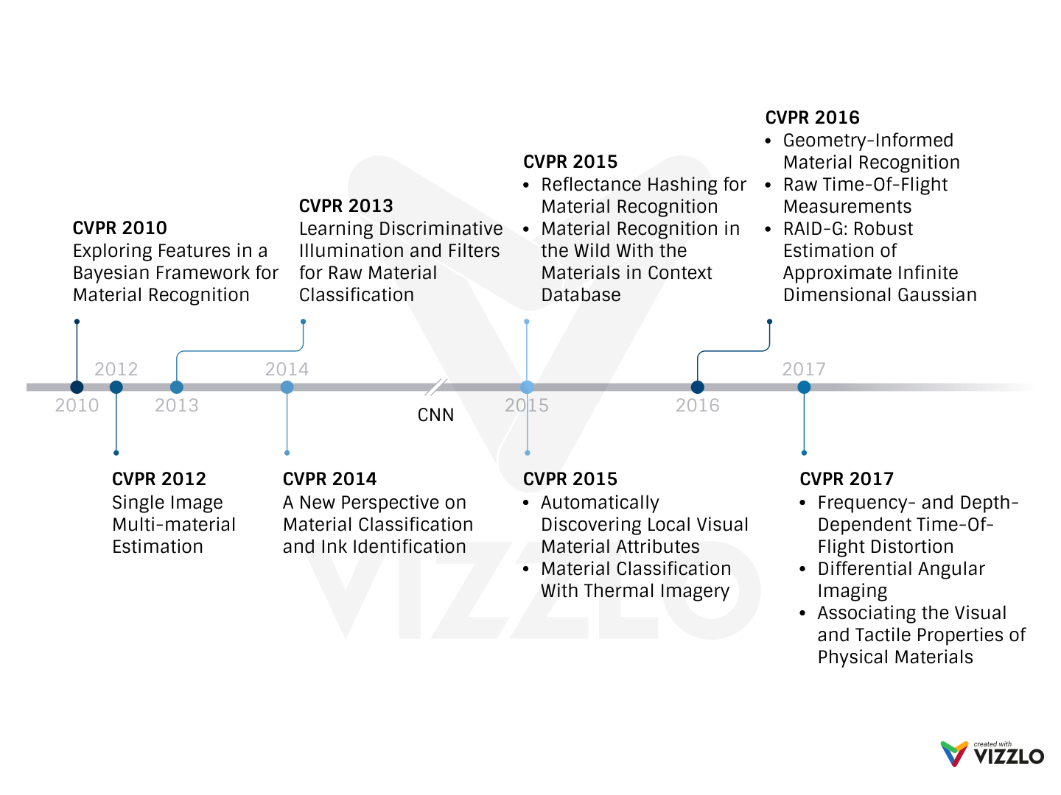
Related Works - CVPR Milestone
Notes:
After we transfer Deep Neural Networks for Computer Vision tasks, A lot of research about this task have been published with extremely accurate (almost like human)

Slide 7
Related Works – Some Datasets
Name | Samples | Classes | Views | Illumination | In scene | Scene image | Camera parameters | Year
CUReT | 61 | 61 | 205 | 205 | No | No | No | 1999
KTH-TIPS | 11 | 11 | 27 | 3 | No | No | No | 2004
UBO2014 | 84 | 7 | 151 | 151 | No | No | No | 2014
Reflectance | 190 | 19 | 3 | 3 | No | No | Yes | 2015
4D Light-field | 1200 | 12 | 1 | 1 | Yes | No | No | 2016
NISAR | 100 | 100 | 9 | 12 | No | No | No | 2016
GTOS | 606 | 40 | 19 | 4 | Yes | Yes | Yes | 2017
Table 1. Some publicly available material datasets. [5]
Notes:
One again, we see that, DNNs and CNNs affect on the datasets. It becomes more and more challenge with lager-scale (trends in CVRP)

Slide 8
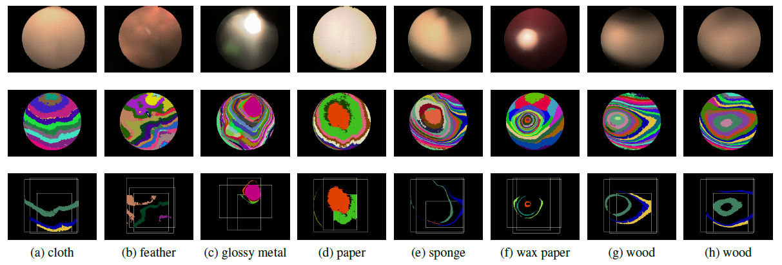
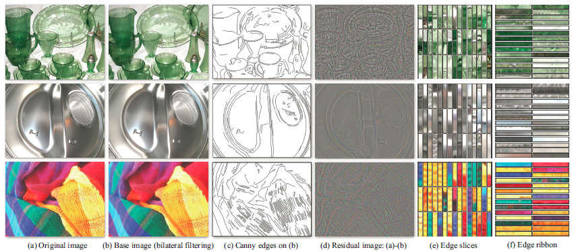
Related Works
Lab-based methods
Image-based methods
Using image and other physical properties (elasticity, water permeation, optic response, etc.). [9] [10]
Using 2D color image only. [11] [12]
High performance
Lack of information, often based on object classification
Requires special equipment to build
Easy to build
Notes:
One again, we see that, DNNs and CNNs affect on the datasets. It becomes more and more challenge with lager-scale (trends in CVRP)

Slide 9
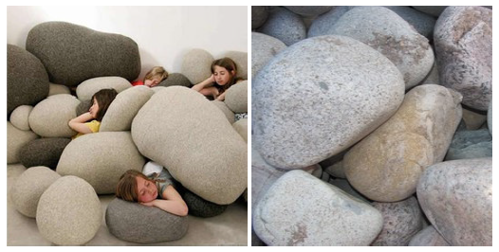
Methods
Main idea
Previous image-based methods often reply on object classification to predict material.
It’s easy to be fooled by similar objects maded of different materials.
To not only avoid these miss-classification samples, but also inherit the success of previous object classification architectures, we combine:
Deep features from a success pre-trained CNN for object classification.
Handcrafted features represent for geometry and textures information of object.
Figure 6. While the main object in both scenes can be considered as ”stone” it is obvious that their material is different

Slide 10
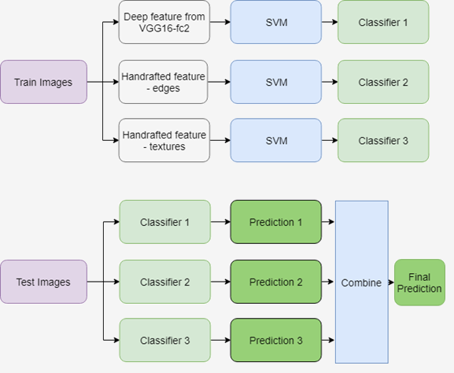
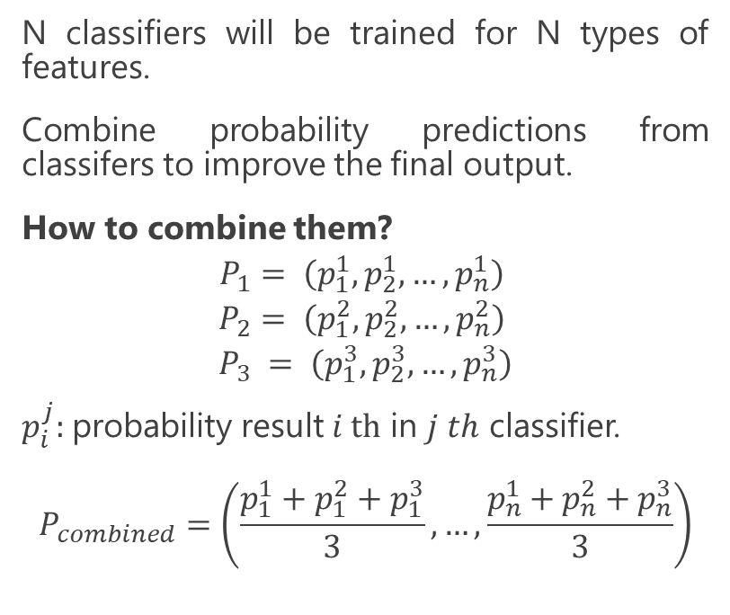
Methods
Post-fusion
N classifiers will be trained for N types of features.
Combine probability predictions from classifers to improve the final output.
How to combine them?
$$P_{1}= \left(p_{1}^{1}, p_{2}^{1}, …, p_{n}^{1}\right)$$
$$P_{2}= \left(p_{1}^{2}, p_{2}^{2}, …, p_{n}^{2}\right)$$
$$P_{3} = \left(p_{1}^{3}, p_{2}^{3}, …, p_{n}^{3}\right)$$
$p_{i}^{j}:$probability result $i th$ in $j th$ classifier.
$$P_{combined}=\left(\frac{p_{1}^{1}+p_{1}^{2}+p_{1}^{3}}{3}, …,\frac{p_{n}^{1}+p_{n}^{2}+p_{n}^{3}}{3}\right)$$
Figure 7. Post-fusion architecture

Slide 11
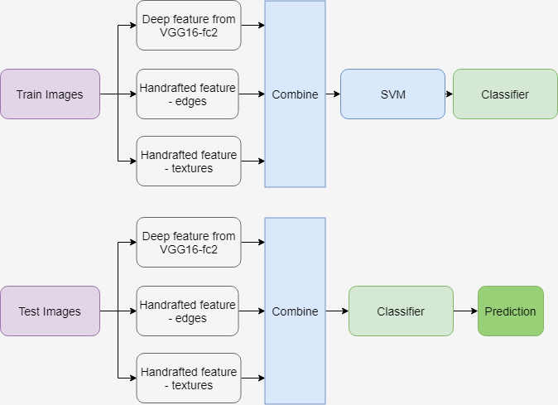
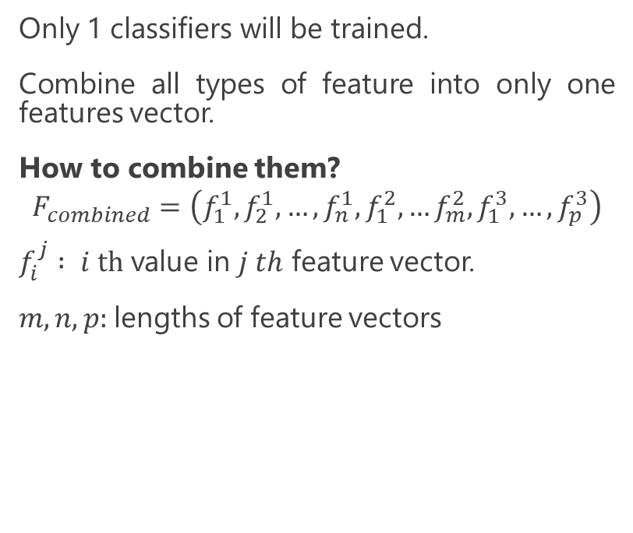
Methods
Pre-fusion
Only 1 classifiers will be trained.
Combine all types of feature into only one features vector.
How to combine them?
$$F_{combined}=\left(f_{1}^{1}, f_{2}^{1}, …,f_{n}^{1}, f_{1}^{2},…f_{m}^{2}, f_{1}^{3},…,f_{p}^{3}\right)$$
$f_{i}^{j}$ $: i th$ value in $j th$ feature vector.
$m, n, p:$lengths of feature vectors
Figure 8. Pre-fusion architecture

Slide 12
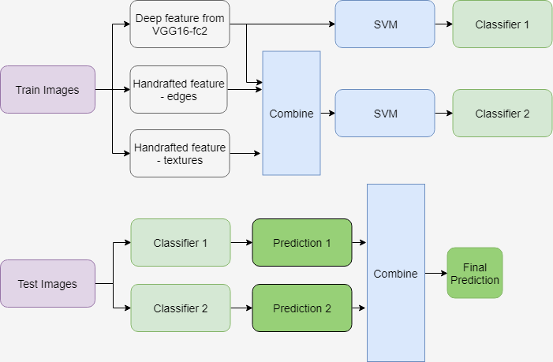
Methods
Full-fusion
Mixed of pre-fusion and post-fusion
2 classifiers will be trained.
One for deep feature
One for combined all features
Figure 9. Full-fusion architecture

Slide 13
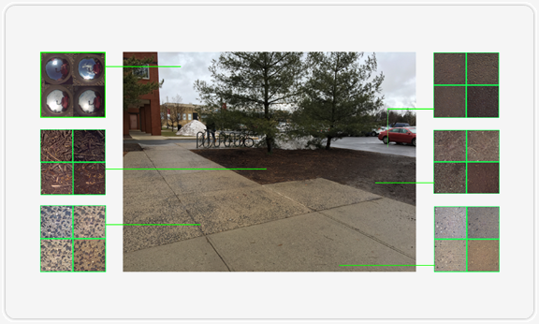
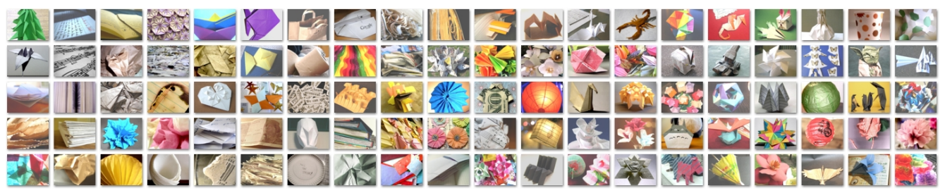
Experiments
Datasets
Ground Terrain in Outdoor Scenes (GTOS)
Newest material dataset (2017)
34000+ images, 40 classes
Collected in different weather, lighting conditions.
Flicker Material Dataset (FMD)
Most common material dataset (2009)
1000 images, 10 classes
Various lighting conditions, context, color, etc.
Figure 10. Outdoor scene surfaces imaged from GTOS [5]
Figure 11. Examples from FMD dataset [3]

Slide 14
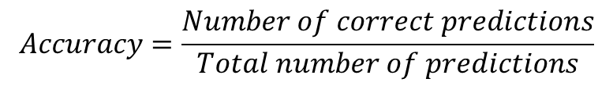
Experiments
Evaluation measure
In particular, for both dataset, evaluation uses mean classification accuracy. Accuracies from different train – test split will be averaged.
Mean accuracy has been used in many previous researches. [5] [6] [7] [8]
$$Accuracy=\frac{Number of correct predictions}{Total number of predictions}$$

Slide 15
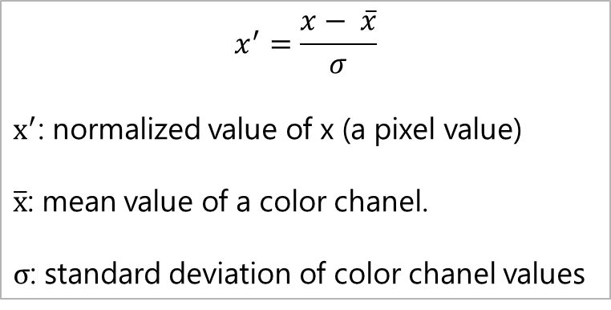
Experiments
Trainning process:
Train-test splits:
70% - 30% on GTOS
80% - 20% on FMD
Data (images) preprocessing:
Crop size (224 x 224)
Standardization: subtracting a per color channel mean and normalizing for unit variance
Feature extraction:
Deep feature: VGG16 – layer ‘fc2’
Handcrafted features: Canny edges + Local range + Local entropy texture
$$x^{′}=\frac{x− \overline{x}}{σ}$$
$x^{′}$: normalized value of x (a pixel value)
$\overline{x}$: mean value of a color chanel.
$σ$: standard deviation of color chanel values
Equation 1. Data (image) standardization
Notes:
Since the range of values of raw data varies widely, in some machine learning algorithms, objective functions will not work properly without normalization. For example, the majority of classifiers calculate the distance between two points by the Euclidean distance. If one of the features has a broad range of values, the distance will be governed by this particular feature. Therefore, the range of all features should be normalized so that each feature contributes approximately proportionately to the final distance.
Another reason why feature scaling is applied is that gradient descent converges much faster with feature scaling than without it

Slide 16
Evaluation
Method | Deep feature | Deep + edges | Deep + edges + texture
Post-fusion | 75 ± 1.8 | 75.5 ± 3.0 | 76.3 ± 1.9
Pre-fusion | 75 ± 1.8 | 77.8 ± 2.5 | 79.5 ± 2.5
Full-fusion | 75 ± 1.8 | 78.9 ± 2.2 | 82.2 ± 2.3
Table 2. Classification result on GTOS dataset (%)

Slide 17
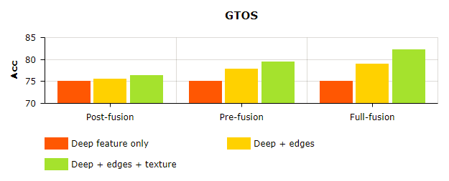
Evaluation
Figure 12. Result on GTOS dataset

Slide 18
Evaluation
Method | Deep feature | Deep + edges | Deep + edges + texture
Post-fusion | 74.2 ± 1.4 | 75.1 ± 2.2 | 76.3 ± 1.7
Pre-fusion | 74.2 ± 1.4 | 75.3 ± 1.5 | 76.3 ± 1.7
Full-fusion | 74.2 ± 1.4 | 75.5 ± 1.2 | 77.2 ± 0.9
Table 3. Classification result on FMD dataset (%)

Slide 19
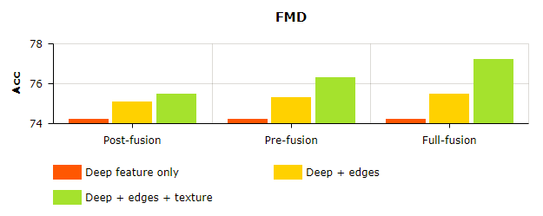
Evaluation
Figure 13. Result on FMD dataset

Slide 20
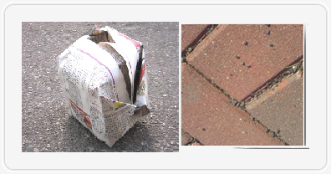
Evaluation
Figure 14. Image from FMD (left) has an object on a background (street), it makes textures information no longer effective. Image from GTOS (right) has only one surface, so textures information would work better.

Slide 21
Evaluation
Method | GTOS | FMD
DAIN [5] | 81.2 ± 1.7
Reflectance [6] |  | 65.5
SIFT IFV+fc7 [7] |  | 69.6 ± 0.3
Ours | 82.2 ± 2.3 | 77.2 ± 0.9
Table 4. Compare with other methods on same datasets

Slide 22
Evaluation
Class | Acc (%) | Class | Acc (%) | Class | Acc (%) | Class | Acc (%)
Painting | 95 | Glass | 83 | Painting turf | 96 | Small limestone | 37
Aluminum | 82 | Grass | 98 | Paper | 90 | Soil | 77
Asphalt | 90 | Ice mud | 84 | Pebble | 91 | Steel | 96
Asphalt puddle | 76 | Large limestone | 95 | Plastic | 89 | Stone asphalt | 40
Asphalt stone | 60 | Leaf | 99 | Plastic cover | 98 | Stone brick | 92
Brick | 99 | Metal cover | 92 | Root | 99 | Stone cement | 97
Cement | 71 | Moss | 88 | Rust cover | 94 | Stone mud | 97
Cloth | 57 | Mud | 56 | Sand | 71 | Turf | 94
Dry grass | 93 | Mud puddle | 98 | Sand paper | 87 | Wood chips | 23
Dry leaf | 95 | Paint cover | 85 | Shale | 97
Table 5. Accuracy per class on GTOS dataset

Slide 23
Evaluation
Class | Acc (%) | Class | Acc (%)
fabric | 75 | paper | 55
foliage | 70 | plastic | 70
glass | 95 | stone | 65
leather | 90 | water | 80
metal | 65 | wood | 85
Table 6. Accuracy per class on FMD dataset

Slide 24
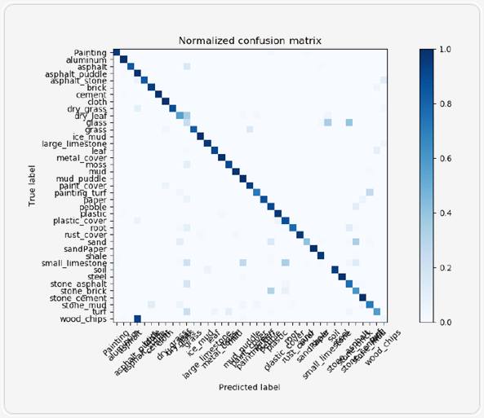
Evaluation
Figure 15. Normalized confusion matrix on GTOS dataset

Slide 25
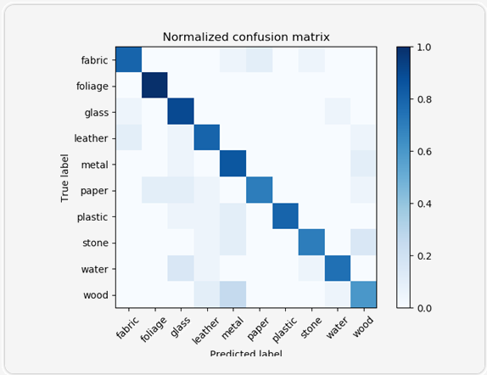
Evaluation
Figure 16. Normalized confusion matrix on FMD dataset

Slide 26
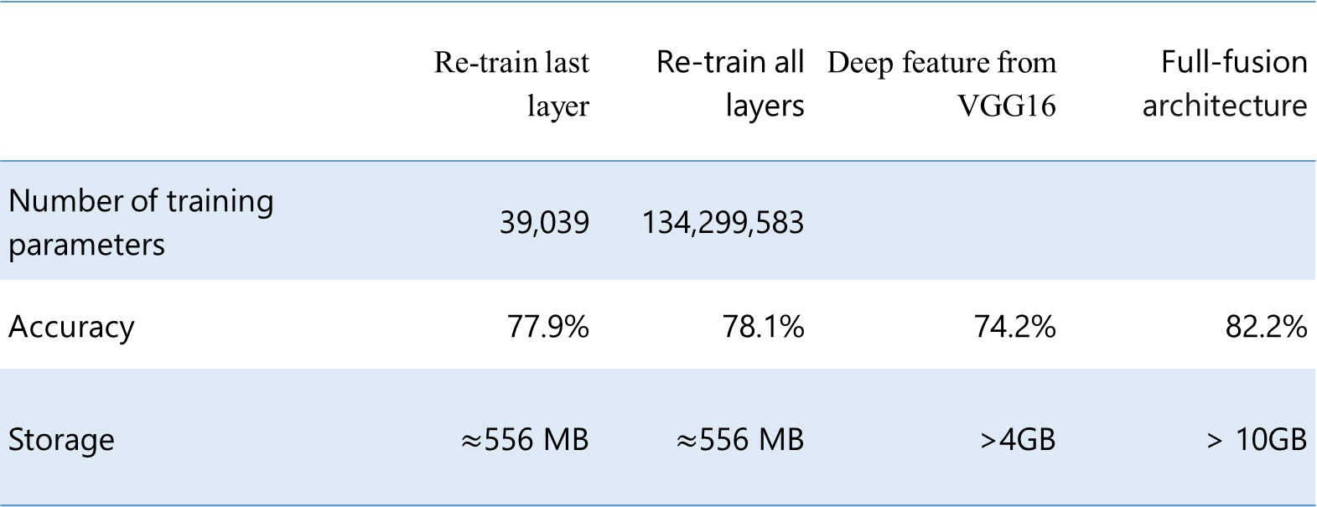
Evaluation
 | Re-train last layer | Re-train all layers | Deep feature from VGG16 | Full-fusion architecture
Number of training parameters | 39,039 | 134,299,583
Accuracy | 77.9% | 78.1% | 74.2% | 82.2%
Storage | $≈$556 MB | $≈$556 MB | >4GB | > 10GB
Table 7. VGG-16 fine-tuning result on GTOS

Slide 27

Evaluation
 | Re-train last layer | Re-train all layers | Deep feature from VGG16 | Full-fusion architecture
Number of training parameters | 39,039 | 134,299,583
Accuracy | 75.3% | 75.2% | 75% | 77.2%
Storage | $≈$556 MB | $≈$556 MB | > 1GB | > 2GB
Table 8. VGG-16 fine-tuning result on FMD

Slide 28
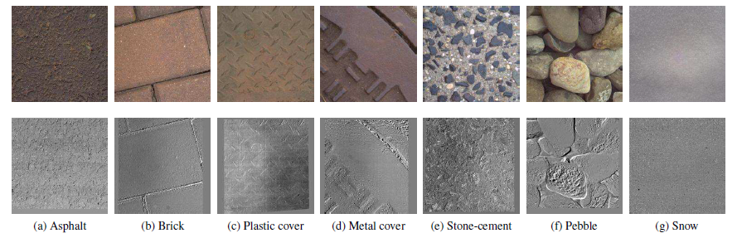
Future works
Build a full-fusion network (CNN), to:
Reduce computational and storage costs
Reduce training time (by reduce number of layers of the network)
Flexible with new data.
Change combining methods:
Combine with weights to determine the priority of features (with one is more important) instead of using vector concatenation
Use another information from image:
Multiple view point information with differential angular images (subtract an image of a sample for another image of this sample in different view point).
Figure 17. Examples of Differential Angular Images [5]

Slide 29
References
[1] Na, Y.-K. a. Oh and Se-Young, "Hybrid control for autonomous mobile robot navigation using neural network based behavior modules and environment classification," Autonomous Robots, vol. 15, pp. 193--206, 2003.
[2] Saadat, M. a. Nan and Ping, "Industrial applications of automatic manipulation of flexible materials," Industrial Robot: An International Journal, vol. 29, pp. 434--442, 2002.
[3] L. Sharan, R. Rosenholtz and E. Adelson, "Material perception: What can you see in a brief glance?," Journal of Vision, vol. 9, pp. 784-784, 2009.
[4] A. Davis, K. L. Bouman, J. G. Chen, M. Rubinstein, F. Durand and W. T. Freeman, "Visual vibrometry: Estimating material properties from small motion in video," in Proceedings of the IEEE Conference on Computer Vision and Pattern Recognition, 2015.
[5] J. Xue, H. Zhang, K. Dana and K. Nishino, "Differential angular imaging for material recognition," in IEEE Conference on Computer Vision and Pattern Recognition (CVPR), 2017.
[6] H. Zhang, K. Dana and K. Nishino, "Reflectance hashing for material recognition," in Computer Vision and Pattern Recognition (CVPR), 2015 IEEE Conference on, 2015.

Slide 30
References
[7] S. Bell, P. Upchurch, N. Snavely and K. Bala, "Material recognition in the wild with the materials in context database (supplemental material)," in Computer Vision and Pattern Recognition (CVPR), 2015.
[8] P. Saponaro, S. Sorensen, A. Kolagunda and C. Kambhamettu, "Material classification with thermal imagery.," in CVPR, 2015.
[9] A. Davis, K. L. Bouman, J. G. Chen, M. Rubinstein, F. Durand and W. T. Freeman, "Visual vibrometry: Estimating material properties from small motion in video," in Proceedings of the IEEE Conference on Computer Vision and Pattern Recognition, 2015.
[10] P. Saponaro, S. Sorensen, A. Kolagunda and C. Kambhamettu, "Material classification with thermal imagery.," in CVPR, 2015
[11] C. Liu, L. Sharan, E. H. Adelson and R. Rosenholtz, "Exploring features in a bayesian framework for material recognition," in Computer Vision and Pattern Recognition (CVPR), 2010 IEEE Conference on, 2010.
[12] D. Hu, L. Bo and X. Ren, "Toward Robust Material Recognition for Everyday Objects.," in BMVC, 2011.

Slide 31

More questions about this task?
For more detail please email me at 14520040@gm.uit.edu.vn.
Look for more information about the data set
Interested in my work, you can find it here
Give feedback about this work
Notes:
In Slide Show mode, select the arrows to visit links.

Slide 32
Thank you
Computer Vision

