Slide 1






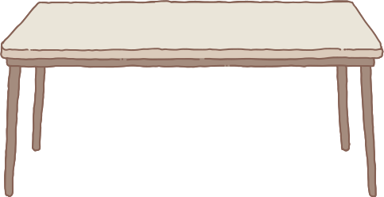

Presented by Group 8
FINAL REPORT
Customer segmentation with FRM and K - means
Subject: Data analysis with R/python
Teacher: Nguyen Phat Dat
1

Slide 2

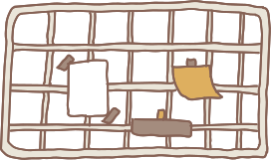

Members:
❁ Trần Đức Duy - K194050694
❁ Phạm Thành Đạt – K194111601
❁ Huỳnh Nhật Hào – K194111603
❁ Lương Trường Phước - K194111624
❁ Trương Thành Sang – K184060799
2

Slide 3
Main Content
Product overview and introduction
Approach
EDA
4. Data analysis
Experiment
6. Conclusion
3

Slide 4


Product overview and introduction
4

Slide 5
Project overview
This research combines the
quantitative value of RFM attributes and the K-means algorithm.
Objectives and scopes
❁ Object: the study was conducted through an empirical method on a dataset with 52761 transactions of service group stores, with 5 customer segments.
❁ Scope:
Time scopes: 1/1/2021 - 31/3/2022
Space scopes: transactions of service company.
5

Slide 6
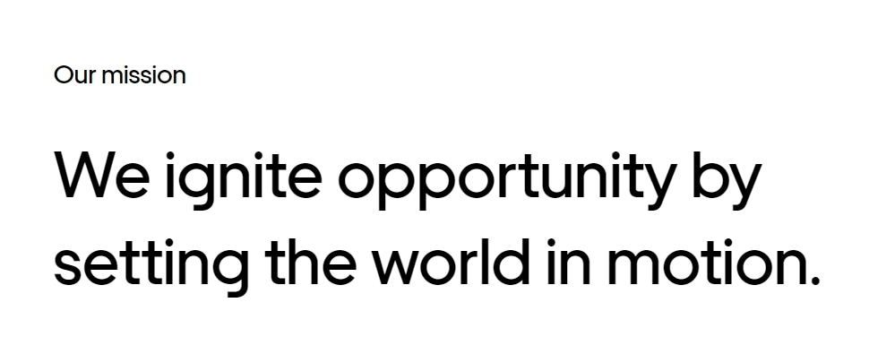
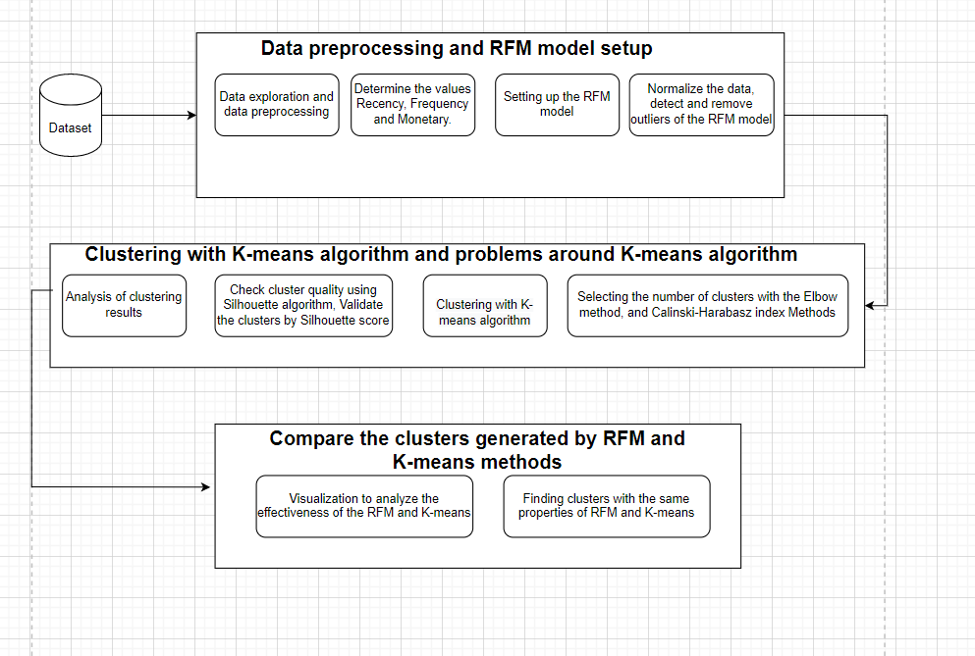
Research methods and procedures
6

Slide 7
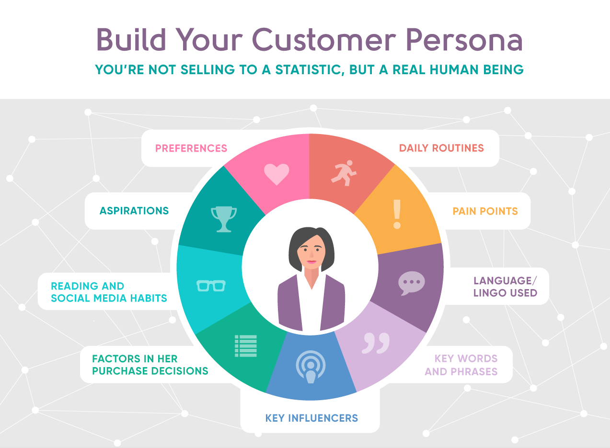
Introduction
7

Slide 8
Literature review
Keymart (2001) show that RFM model.
Schijns and Schroeder (1996) from the point of view of consumer behavior.
Jiang and Tuzhilin (2009) presents a direct clustering approach that clusters the customer not based on computed statistics.
…
8

Slide 9

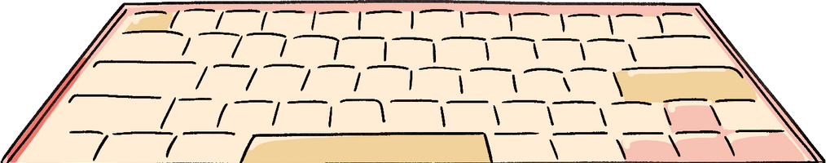
Approach
9

Slide 10

RFM analysis
RFM analysis is a customer segmentation technique. RFM includes 3 main indicators:
❁ ❁ ❁ ❁ ❁ ❁ ❁ ❁ ❁ ❁ ❁ ❁ ❁ ❁ ❁ ❁
❁ Recency (R) : Last transaction time.
❁ Frequency (F): frequency of customer purchases.
❁ Monetary value (M) : total amount spent by the customer.
10
Notes:
quản lí như thêm, sửa, xóa bài viết, cài đặt trang web…

Slide 11
K-means clustering
➤ K-means is a simple clustering algorithm of unsupervised learning.
➤ K-means is used to solve clustering problems
11

Slide 12
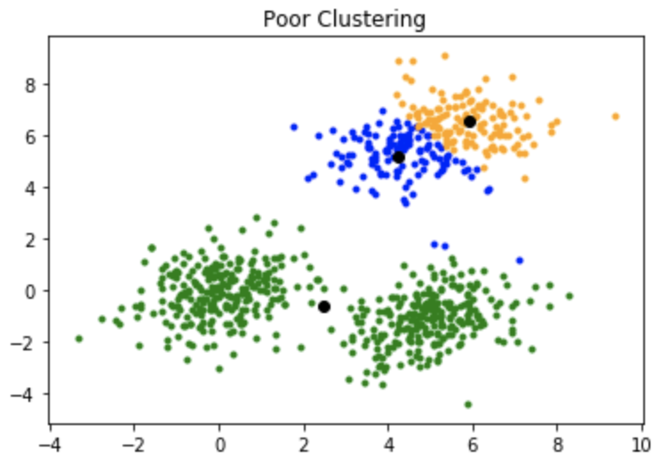
K-means++
➤ The K-means algorithm has the disadvantage that it is sensitive to initializing or mean points.
To overcome the above disadvantage, we use K-mean ++
12

Slide 13
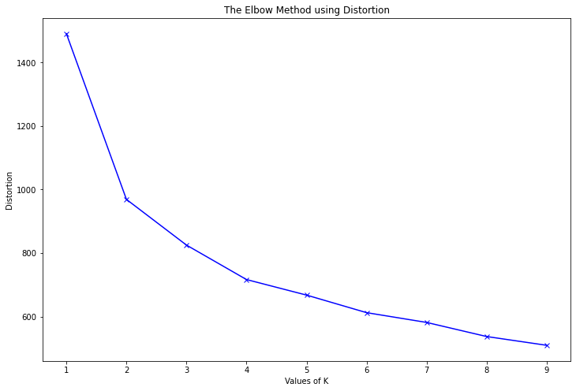
Elbow method
➤ To determine the number of clusters in the K-means alogorithm.
13

Slide 14
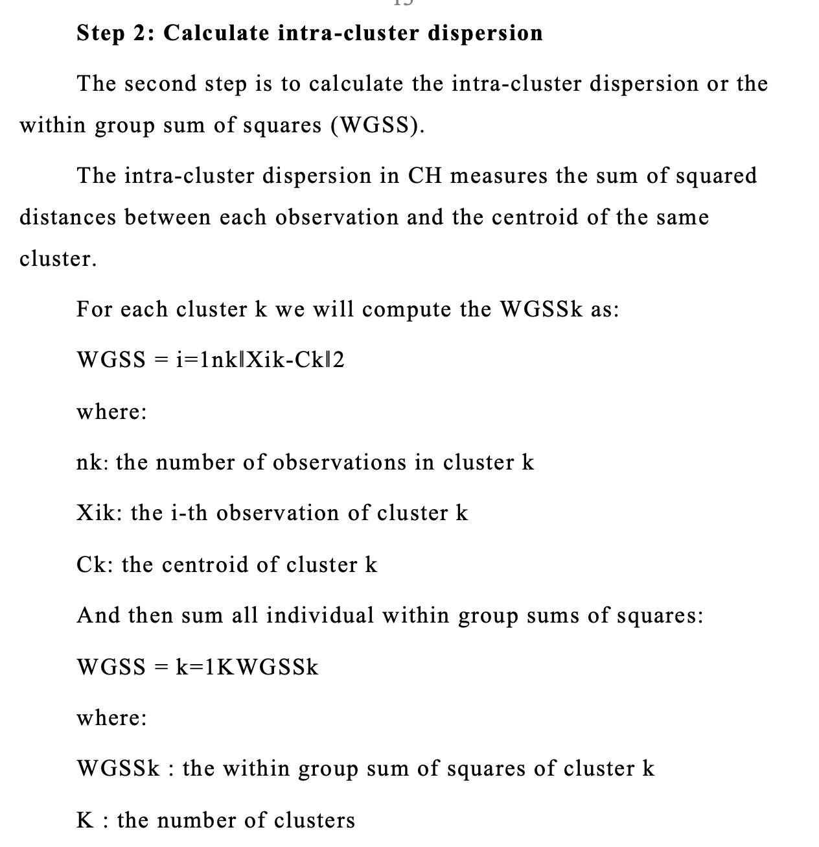
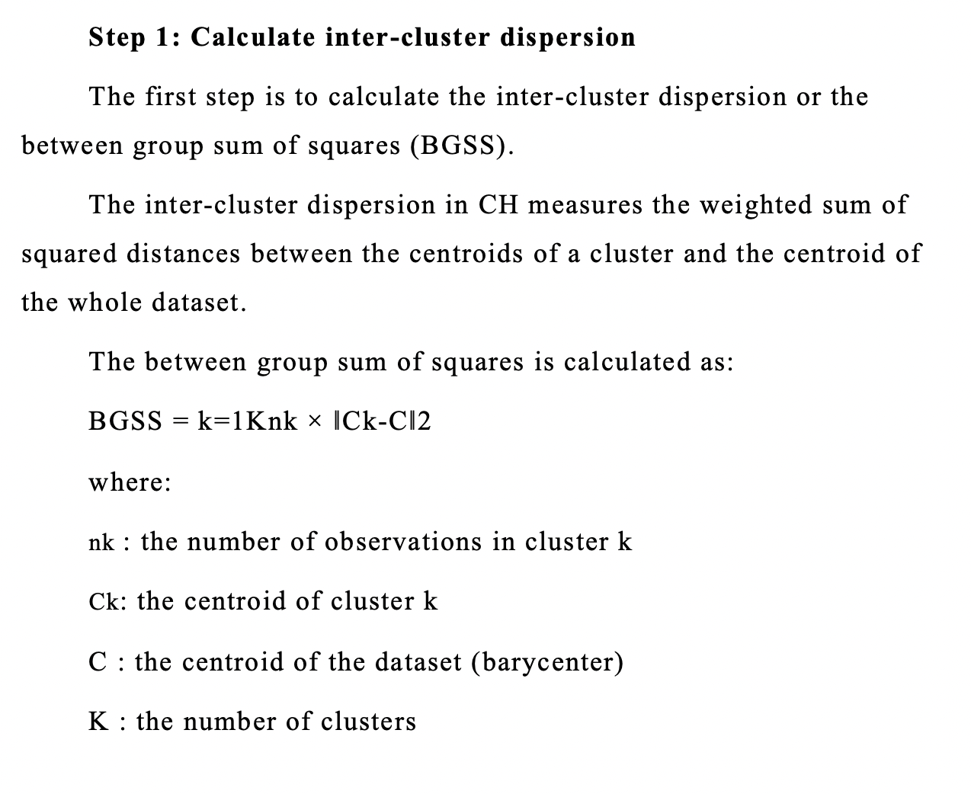
Calinski-harabasz index
➤ The CH index (also known as variance ratio criterion) is a measure of how similar an object with 3 steps
14

Slide 15
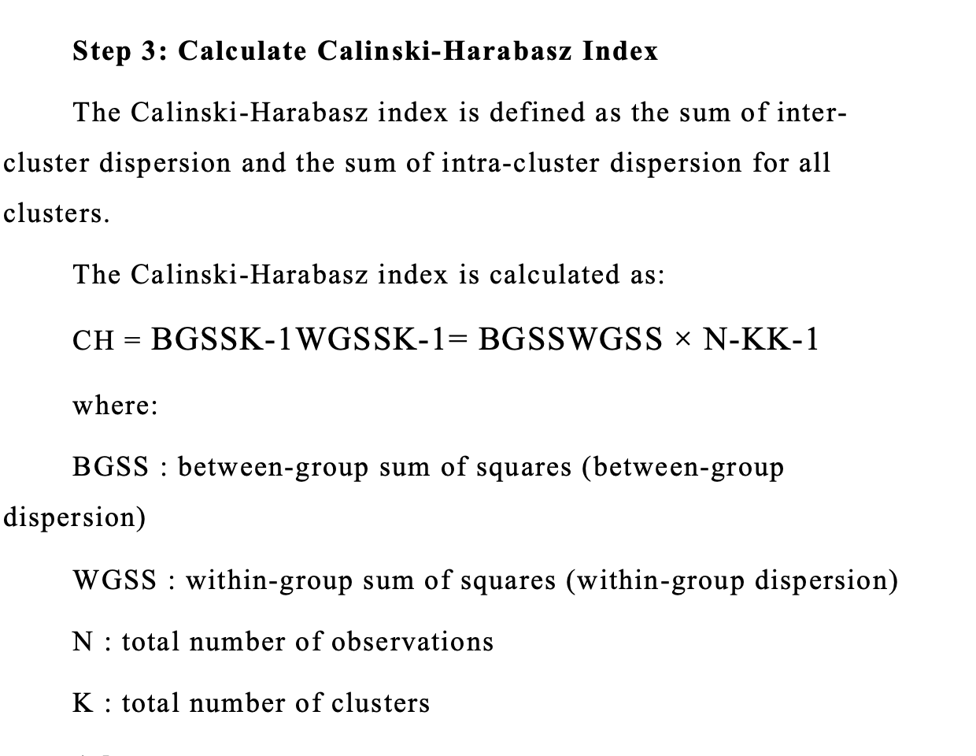
Calinski-harabasz index
15

Slide 16
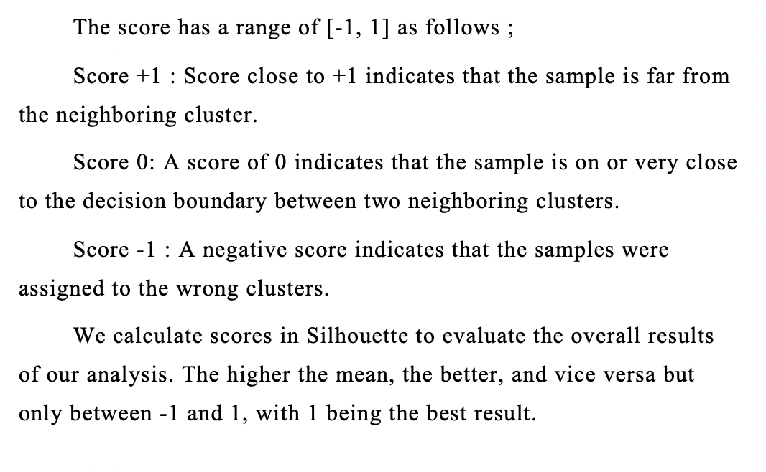
Silhouette index
➤ Silhouette measures the distance of a data point in the cluster to the center point of the cluster. Silhouette point:
16

Slide 17
EDA
17

Slide 18

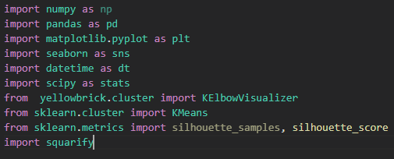
➤ Loading packages.
18

Slide 19
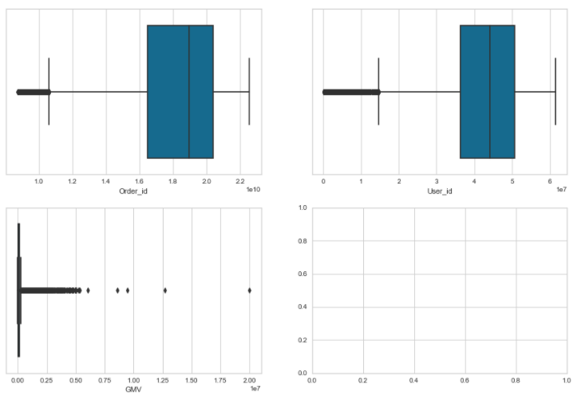
➤ Box plots of all variables.
19

Slide 20
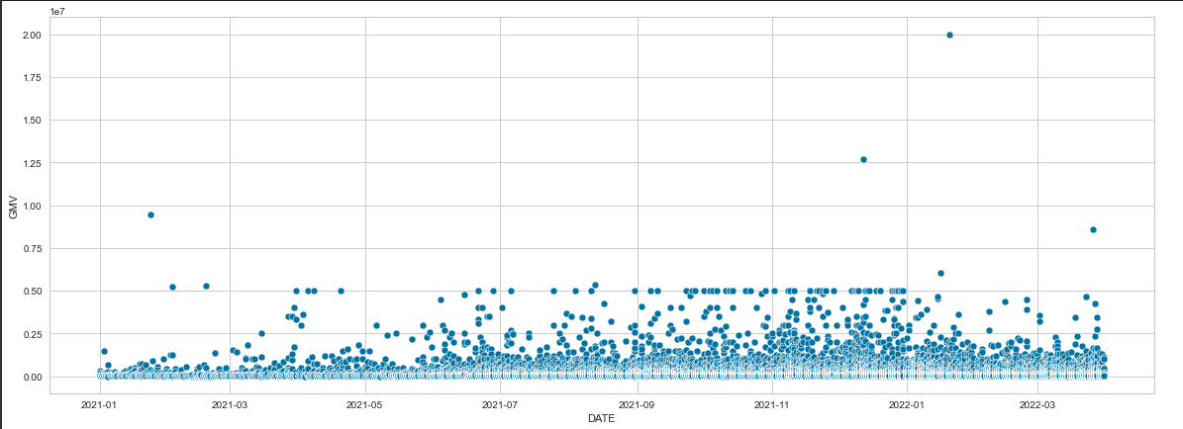
➤ Scatter plots between DATE and GMV variables.
20

Slide 21
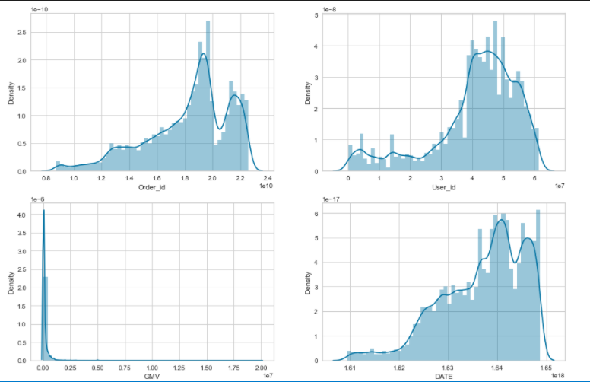
➤ Histogram of order_id, user_id, GMV, DATE variables.
21

Slide 22

Data analysis
22

Slide 23

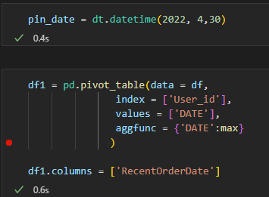
Create table RFM
➤ Code create pivot table.
23

Slide 24

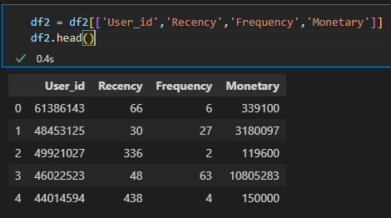
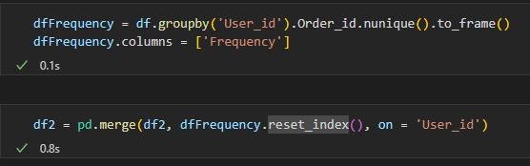
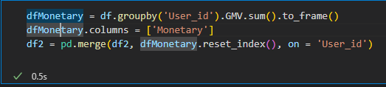
24

Slide 25
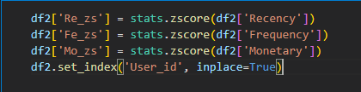
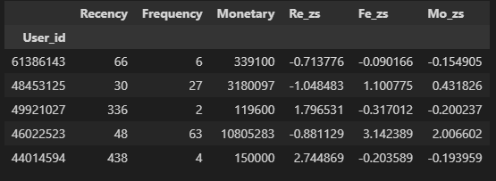
Standardization
➤ Code standardize data by Z-score method:
➤ Result after standardization:
25

Slide 26
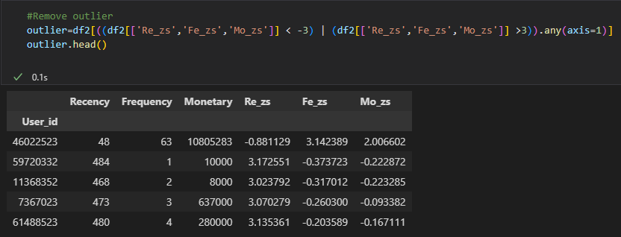
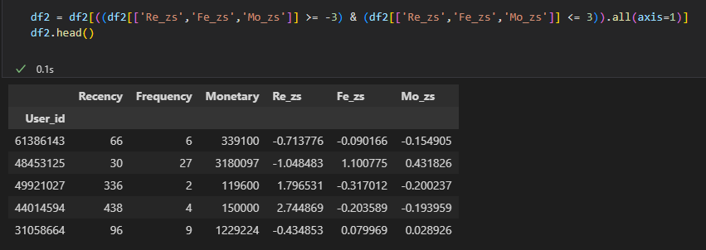
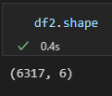
Remove outliers
➤ Outlier detection:
➤ Remove outlier:
➤ Shape of data frame after removing outliers:
26

Slide 27
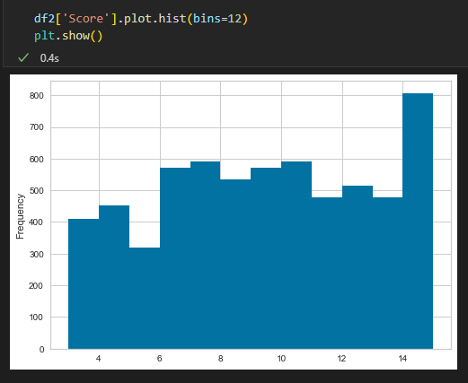
Customer segmentation using RFM
➤ Calculate level:
27

Slide 28
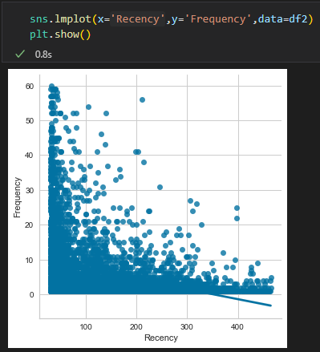
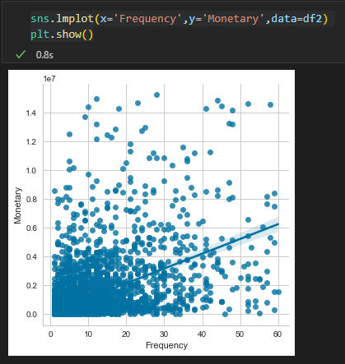
Customer segmentation using RFM
➤ Visualizing against each of the factors:
❁ Scatterplot:
28

Slide 29
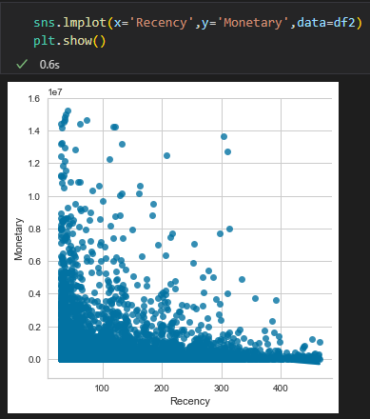
Customer segmentation using RFM
➤ Visualizing against each of the factors:
❁ Scatterplot:
29

Slide 30
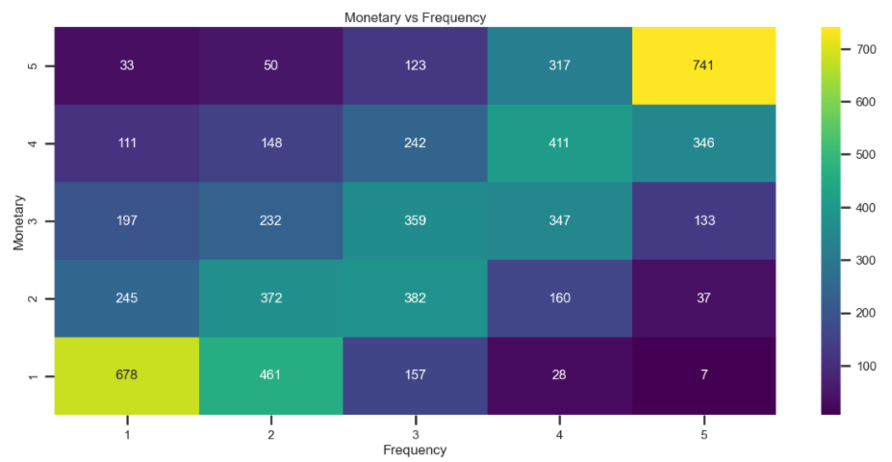
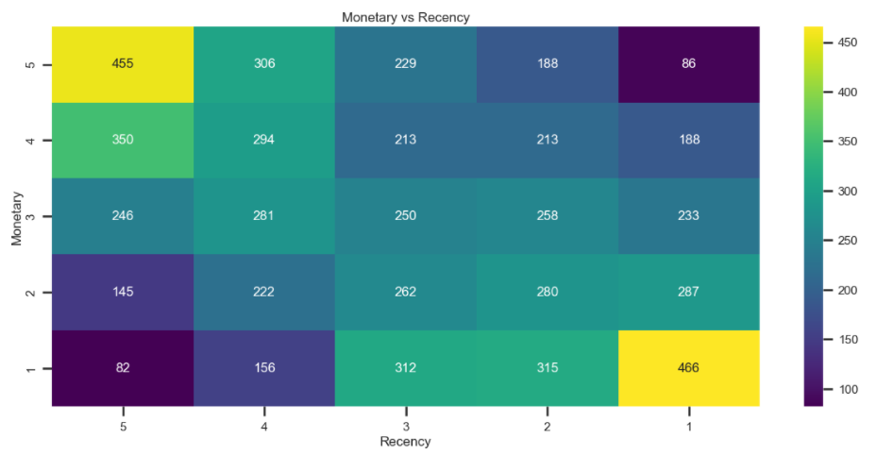
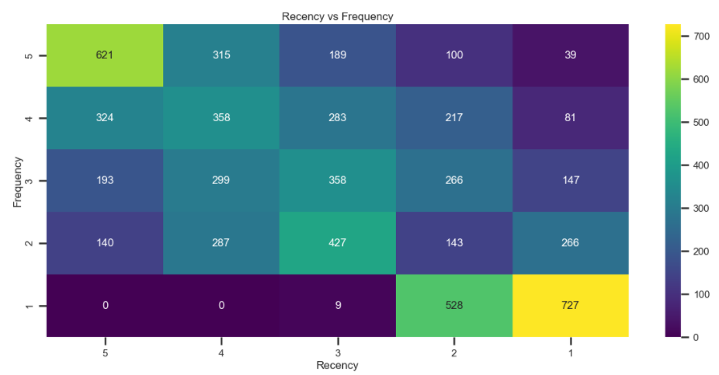
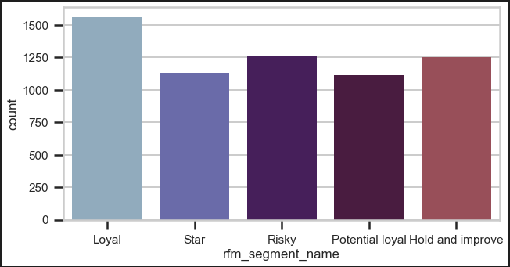
Customer segmentation using RFM
❁ Heatmap:
30

Slide 31
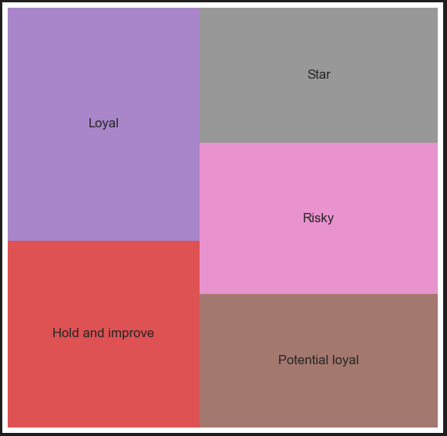
Customer segmentation using RFM
❁ Treemap:
31

Slide 32
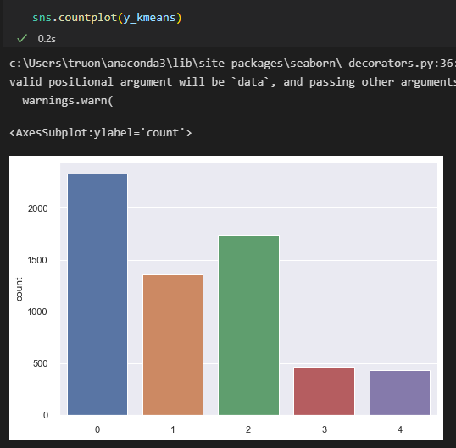
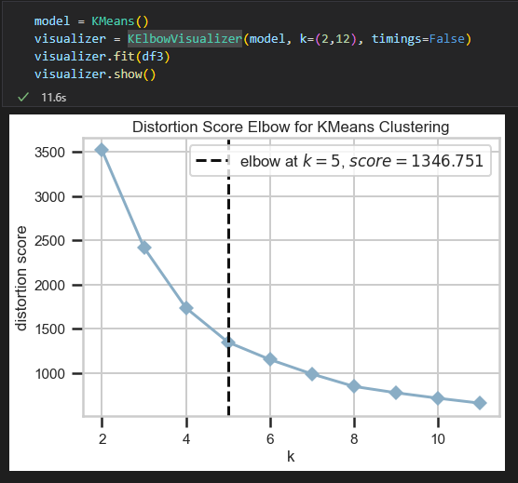
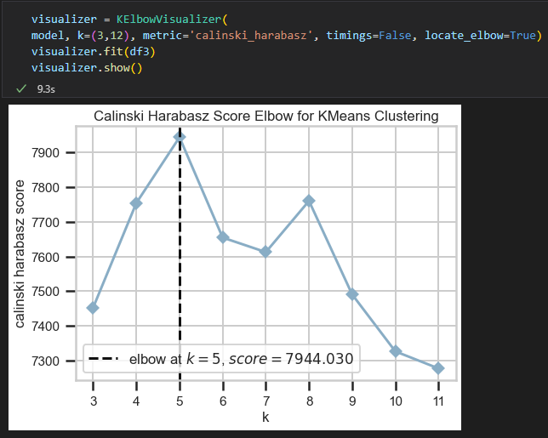
Customer segmentation with K-means
❁ Select K using elbow and calinski-harabasz index methods:
32

Slide 33
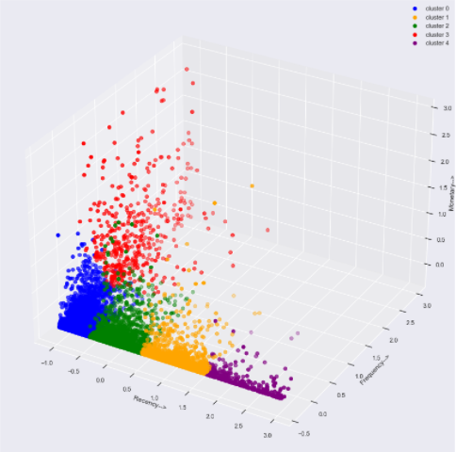
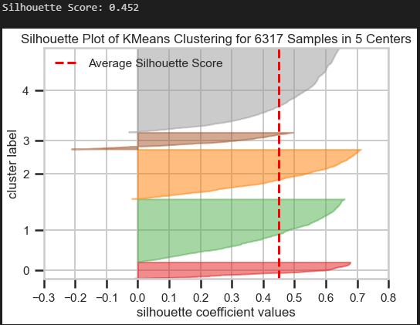
Customer segmentation with K-means
33

Slide 34
EXPERIMENT
34

Slide 35

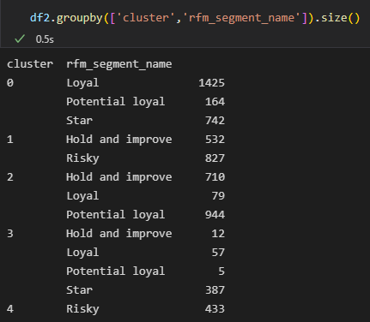

➤ Summary clusters and RFM segments
35

Slide 36
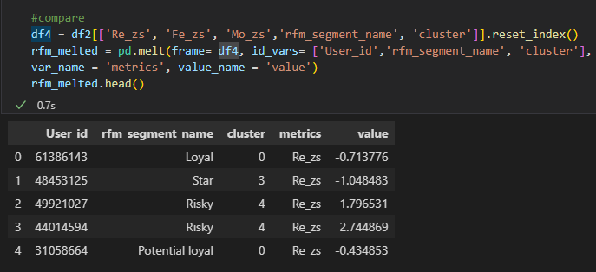
➤ Code show values R, F, M of cluster and rfm - segment-name
36

Slide 37


Competitive advantage
❁ Code show line plot RFM.
❁ Code show line plot K-means.
37

Slide 38
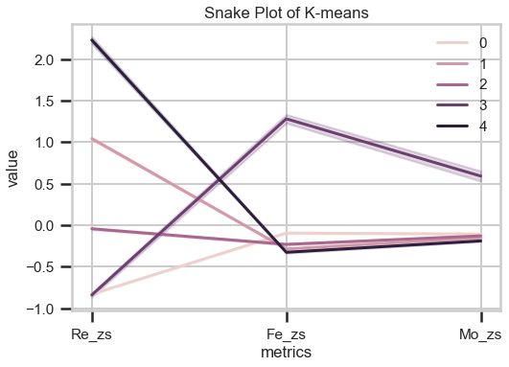
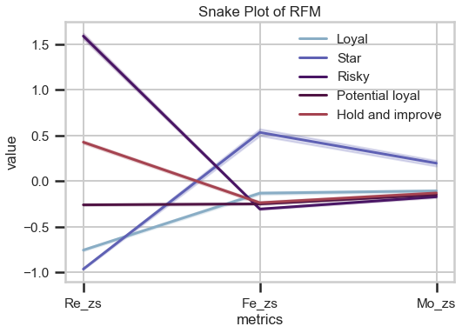
❁ Line plots K-means and RFM.
38

Slide 39
Conclusion
- We made two kinds of segmentation, RFM quantiles and K-means clustering methods.
- This data set is the transaction information of an online store, project is highly practical and will be studied further in the future..
39

Slide 40


Thank You!
Do you have any question?
40

