Slide 1
ANALYSIS WITH R/PYTHON COURSE
MENU
ANALYSIS
CONTACT
Data ANALYSIS
DATA
Using linear regression to forecast home values ​​in King County, USA

Slide 2
GROUP MEMBERS
MENU
ANALYSIS
CONTACT
Order | Name | Student ID | Contribution
1 | Phạm Thành Đạt | K194111601 | 20%
2 | Huỳnh Nhật Hào | K194111603 | 20%
3 | Trần Đức Duy | K194050694 | 20%
4 | Lương Trường Phước | K194111624 | 20%
5 | Trương Thành Sang | K194060799 | 20%

Slide 3
MAIN CONTENT
MENU
ANALYSIS
CONTACT
Introduction
Approach
Linear regression modeling
4. Evaluation
5. Conclusion

Slide 4
Chapter 1
MENU
ANALYSIS
CONTACT
Data ANALYSIS
INTRODUcTION

Slide 5
Chapter 1
Questions of research
Requirement & Objective
01
02
Research process
Tools used
03
04
MENU
ANALYSIS
CONTACT
Data ANALYSIS

Slide 6
01
Requirement & Objective
MENU
ANALYSIS
CONTACT
Data ANALYSIS

Slide 7
Requirement & Objective
MENU
ANALYSIS
CONTACT
Data ANALYSIS
There are many people who are concerned about the factors that affect house prices to ensure their interests. In fact, the house price is dependent on various factors such as bedrooms, bathrooms, floors, acreage…. The requirements are to find those factors with linear regression and to assess which of those is the most suitable to give the most effective forecasting results. Besides, we have to identify at least 3 regression models with more than 5 features for each model.

Slide 8
02
Questions of research
MENU
ANALYSIS
CONTACT
Data ANALYSIS

Slide 9
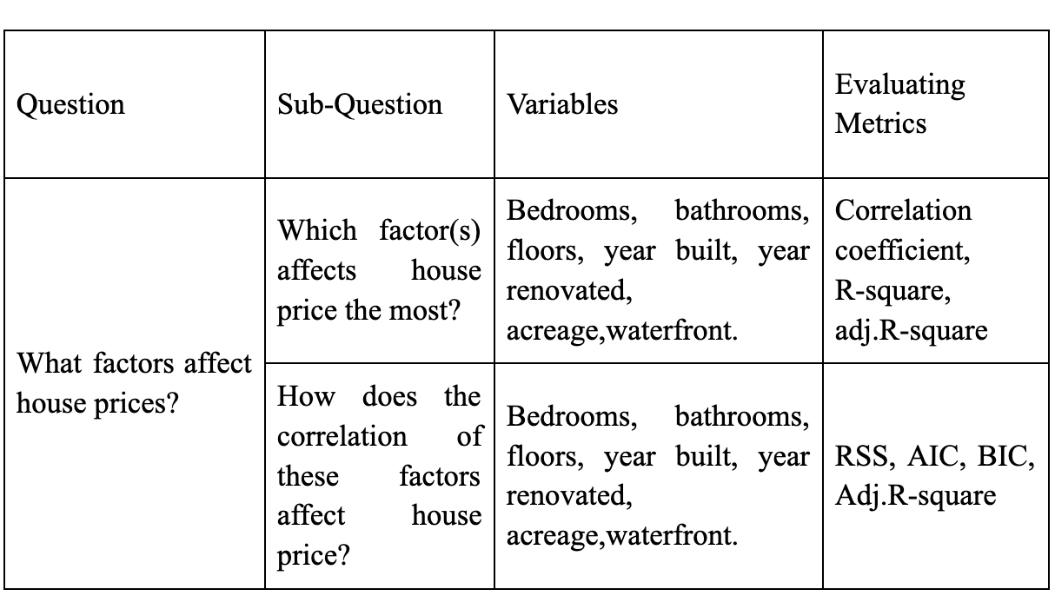
Questions of research
MENU
ANALYSIS
CONTACT
Data ANALYSIS

Slide 10
03
Research process
MENU
ANALYSIS
CONTACT
Data ANALYSIS

Slide 11
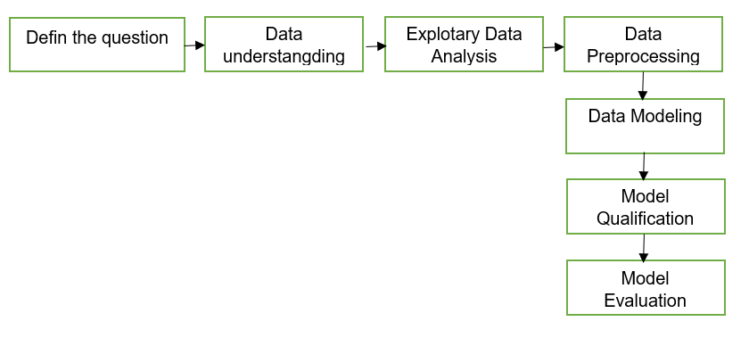
Research process
MENU
ANALYSIS
CONTACT
Data ANALYSIS

Slide 12
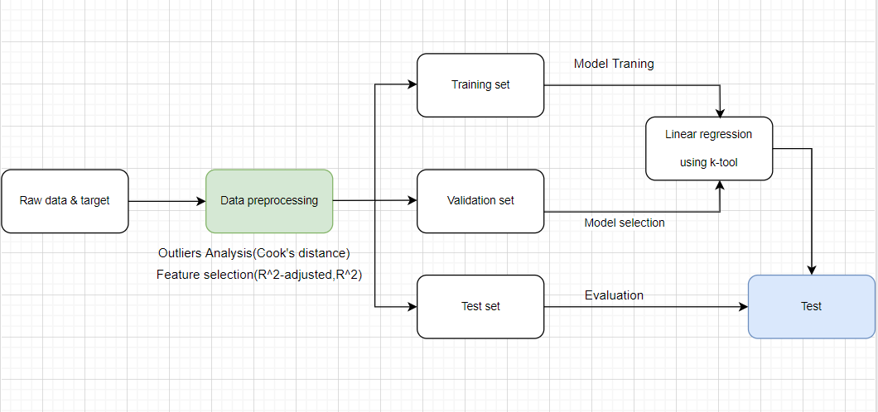
Traning model detail process
MENU
ANALYSIS
CONTACT
Data ANALYSIS

Slide 13
04
Tools used
MENU
ANALYSIS
CONTACT
Data ANALYSIS

Slide 14
Tools used
MENU
ANALYSIS
CONTACT
Data ANALYSIS
In this study, we use the Python programming language, the main algorithm is Linear Regression and the libraries that support all our work are statsmodels, SKlearn. Initially, we have to use EDA to get the insight and find out the problems of the given dataset. Next step, outlier detection and collinearity problems are the main purposes at data preprocessing, after that we select important features through validating Adjusted R-squared. Then, the model is built based on the Linear Regression using K-fold Cross Validation. Following this, we evaluate the model based on Adjusted R-squared, MSE and RMSE score.

Slide 15
ChapTer 2
MENU
ANALYSIS
CONTACT
Data ANALYSIS
APPROACH

Slide 16
ChapTer 2
Cook’s distance
01
04
Feature Selection
02
Mean squared error
R-Squared
Root mean squared error
MENU
ANALYSIS
CONTACT
Data ANALYSIS
Adjusted R-squared
05
Cross validation
06
03
07

Slide 17
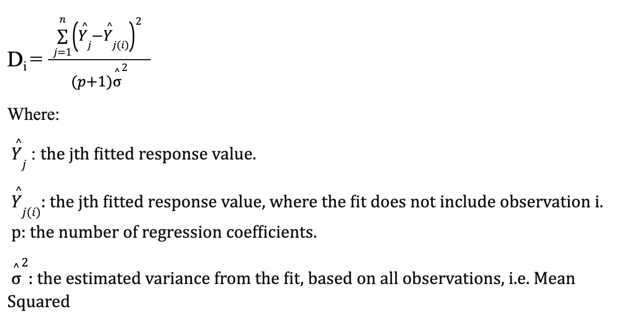
Cook’s distance
MENU
ANALYSIS
CONTACT
Data ANALYSIS

Slide 18
Feature Selection
MENU
ANALYSIS
CONTACT
Data ANALYSIS
Feature selection, one of the main components of feature engineering, is the process of selecting the most important features to input in machine learning algorithms.
Simpler models
Shorter training times
Variance reduction
Avoid the curse of high dimensionality

Slide 19
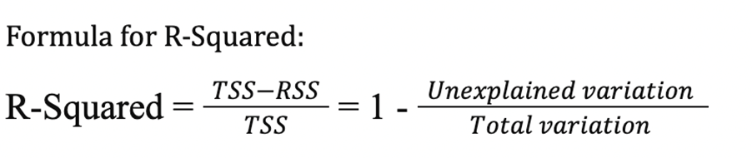
R-Squared
MENU
ANALYSIS
CONTACT
Data ANALYSIS
R-squared (R²) is a statistical measure that represents the proportion of the variance for a dependent variable that's explained by an independent variable or variables in a regression model.

Slide 20
Problems with R-squared
MENU
ANALYSIS
CONTACT
Data ANALYSIS
The R-squared isn’t perfect. In fact, it suffers from a major flaw. Its value never decreases no matter the number of variables we add to our regression model. That is, even if we are adding redundant variables to the data, the value of R-squared does not decrease. It either remains the same or increases with the addition of new independent variables.

Slide 21
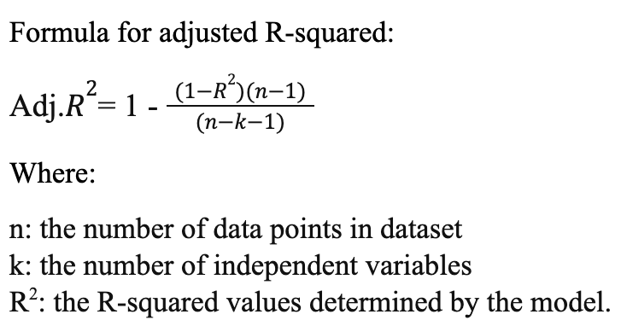
Adjusted R-squared
MENU
ANALYSIS
CONTACT
Data ANALYSIS
The Adjusted R-squared measures the proportion of variation explained by only those independent variables that really help in explaining the dependent variable. It penalizes us for adding independent variables that do not help in predicting the dependent variable.

Slide 22
Cross validation
MENU
ANALYSIS
CONTACT
Data ANALYSIS
Definition and techniques:
Cross-validation is a technique for evaluating a machine learning model and testing its performance. Cross-validation is commonly used in applied machine learning tasks. It helps to compare and select an appropriate model for the specific predictive modeling problem.
Cross-validation is easy to understand, easy to implement, and it tends to have a lower bias than other methods used to count the model’s efficiency scores. All this makes cross-validation a powerful tool for selecting the best model for the specific task.

Slide 23
Cross validation
MENU
ANALYSIS
CONTACT
Data ANALYSIS
K-fold cross validation:
K-fold cross validation is a technique that minimizes the disadvantages of the hold-out method. K-fold introduces a new way of splitting the dataset which helps to overcome the “test only once bottleneck”.

Slide 24
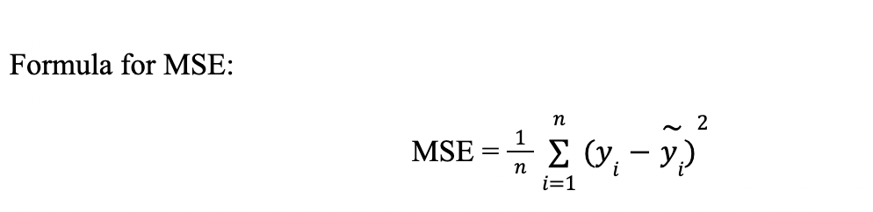
Mean squared error
MENU
ANALYSIS
CONTACT
Data ANALYSIS
MSE is a risk function, corresponding to the expected value of the squared error loss. The fact that MSE is almost always strictly positive (and not zero).

Slide 25
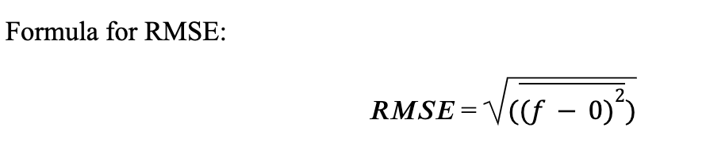
Root mean squared error
MENU
ANALYSIS
CONTACT
Data ANALYSIS
Root Mean Square Error (RMSE) is the standard deviation of the residuals (prediction errors)

Slide 26
ChapTer 3
MENU
ANALYSIS
CONTACT
Data ANALYSIS
LINEAR REGRESSION MODELING

Slide 27
ChapTer 3
EDA
01
04
Preprocessing
02
R-Squared
MENU
ANALYSIS
CONTACT
Data ANALYSIS
Modeling
05
Model validation
03
06
Use data to experiment

Slide 28
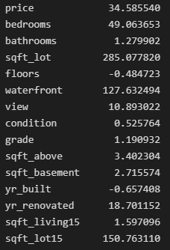
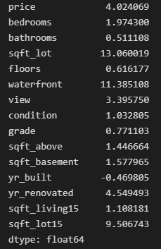
EDA Sample Variance
MENU
ANALYSIS
CONTACT
Data ANALYSIS
Kurtosis
Skewness

Slide 29
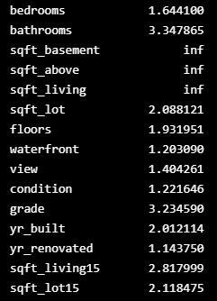
EDA Multicollinearity problem
MENU
ANALYSIS
CONTACT
Data ANALYSIS

Slide 30
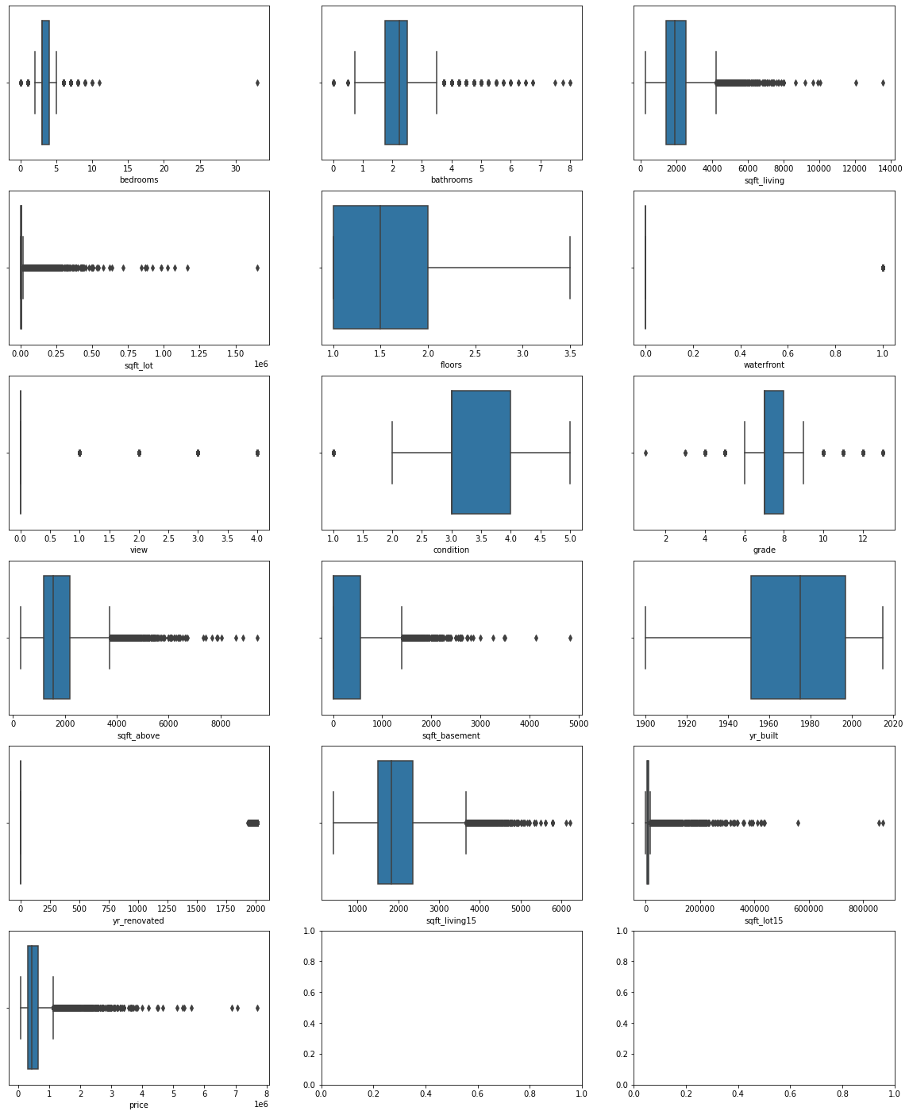
EDA Box plots
MENU
ANALYSIS
CONTACT
Data ANALYSIS

Slide 31
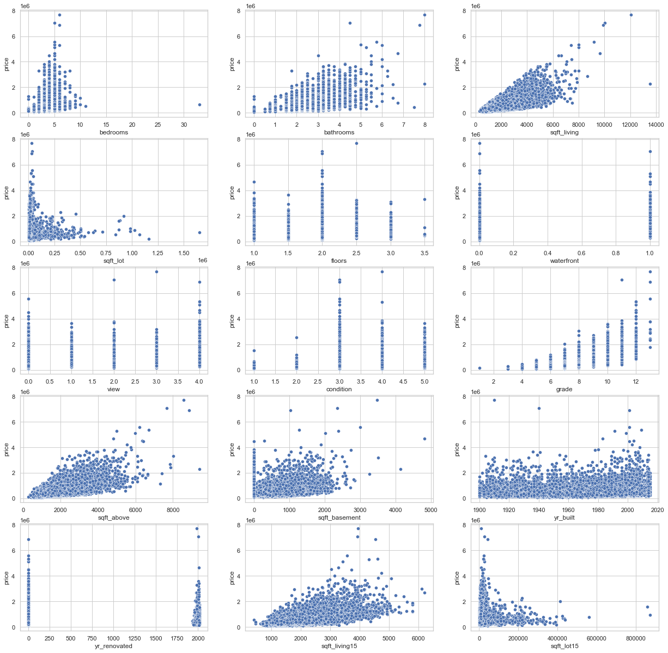
EDA Scatter Plots
MENU
ANALYSIS
CONTACT
Data ANALYSIS

Slide 32
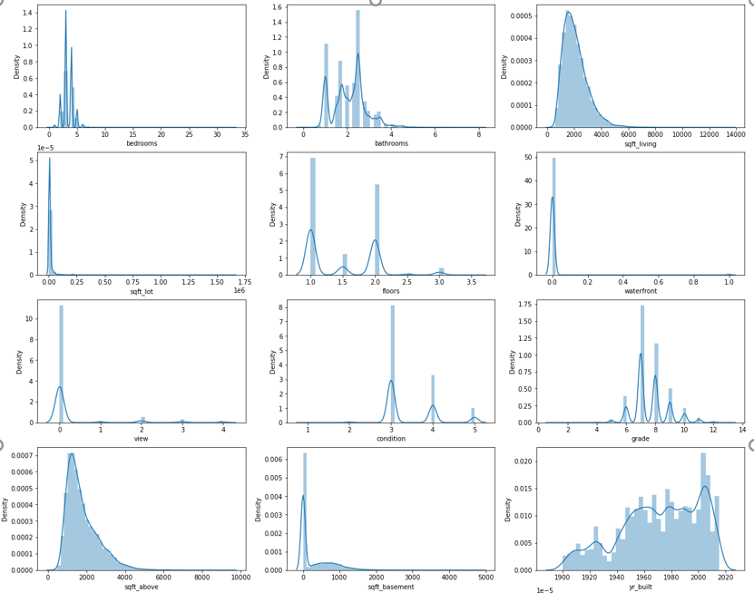
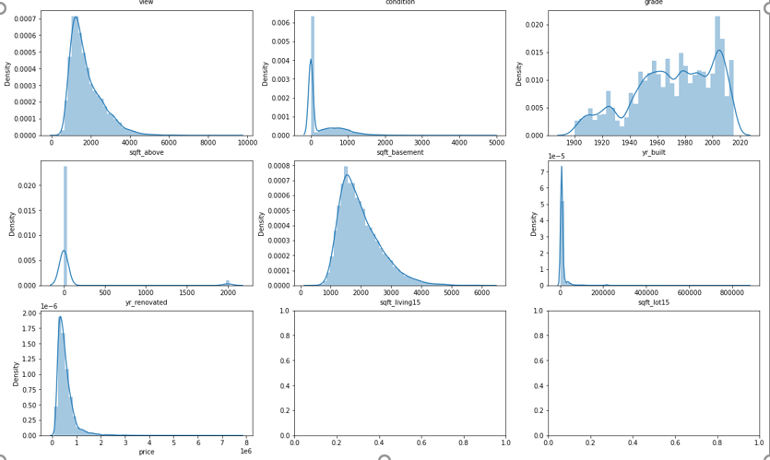
EDA Histogram
MENU
ANALYSIS
CONTACT
Data ANALYSIS

Slide 33
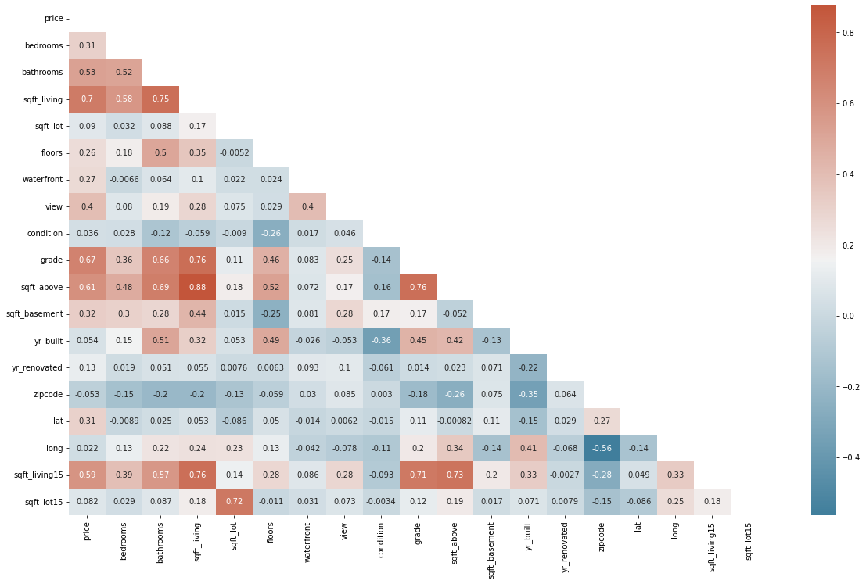
EDA Correlation matrix
MENU
ANALYSIS
CONTACT
Data ANALYSIS

Slide 34
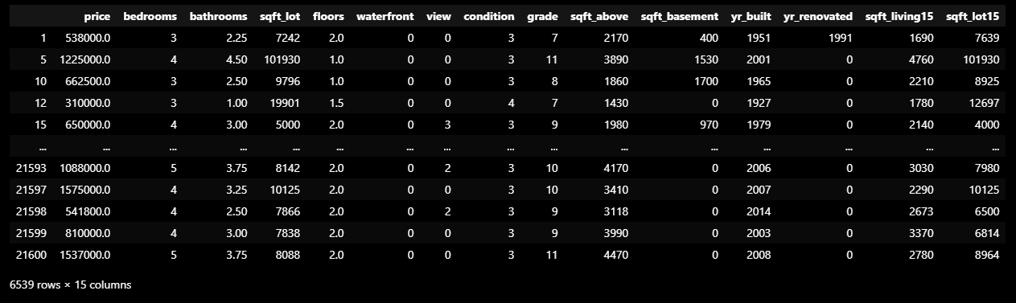
Preprocessing Outlier analysis
MENU
ANALYSIS
CONTACT
Data ANALYSIS

Slide 35
Preprocessing Multicollinearity problem
MENU
ANALYSIS
CONTACT
Data ANALYSIS

Slide 36
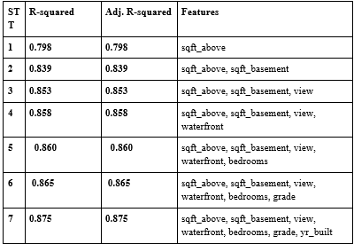
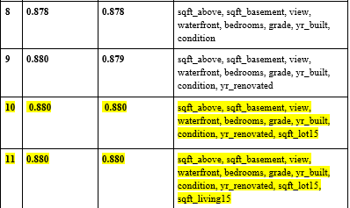
Preprocessing Future selection
MENU
ANALYSIS
CONTACT
Data ANALYSIS

Slide 37
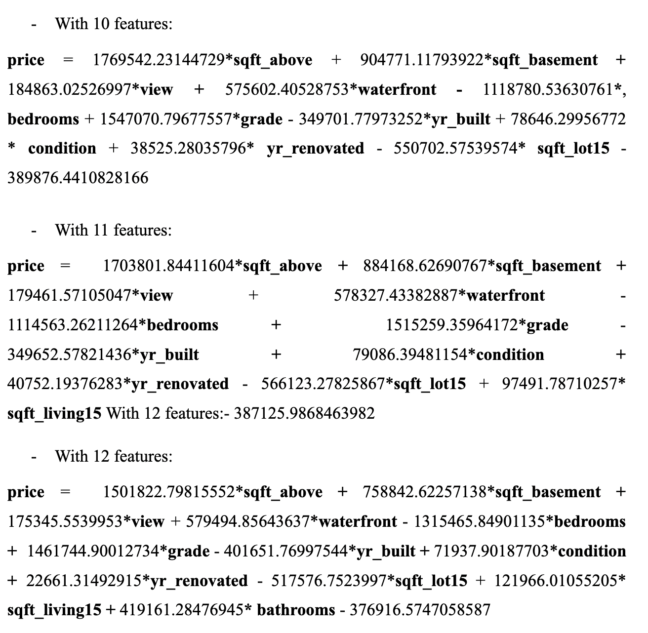
MENU
ANALYSIS
CONTACT
Data ANALYSIS
MODELING

Slide 38
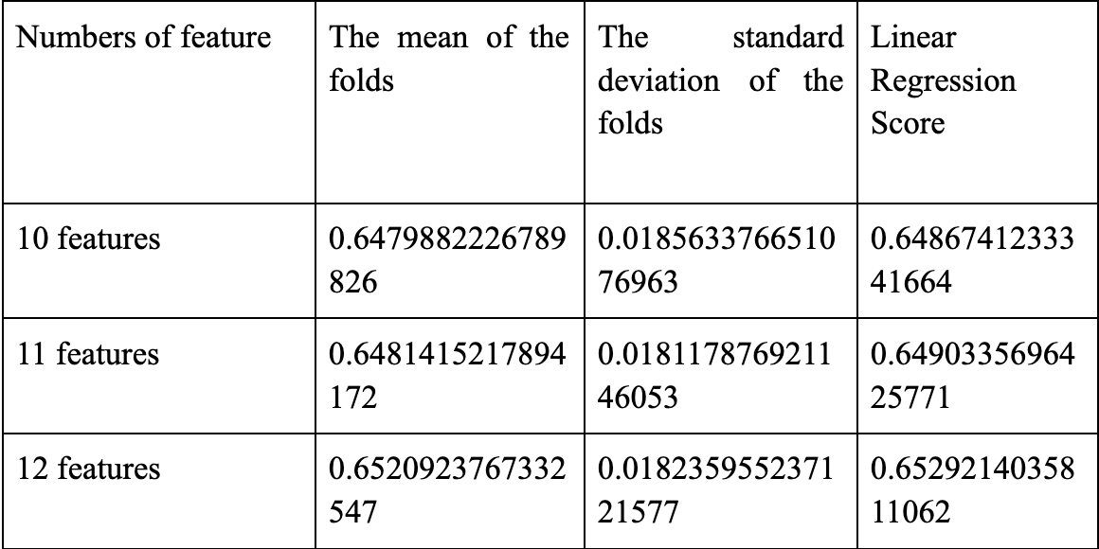
MENU
ANALYSIS
CONTACT
Data ANALYSIS
MODEL VALIDATION

Slide 39
MENU
ANALYSIS
CONTACT
Data ANALYSIS
USE DATA TO EXPERIMENT
After building and evaluating and selecting the most optimal model, we will apply the model to solve a specific case
From the above requirement, the model predicted the price he had to pay to get the desired house as:
price = 1483424,95743491 * 1292 + 741673.34740902 * 323 + 179291.02242302 * 0 + 541257.85049297 * 1 - 1255549.11397273 * 4 + 1459108.78914243 * 9 - 400516.57319204 * 2014 + 73226.265968675539265995995995 2
-380346,27274930326 = 688933401,3688245 (USD)

Slide 40
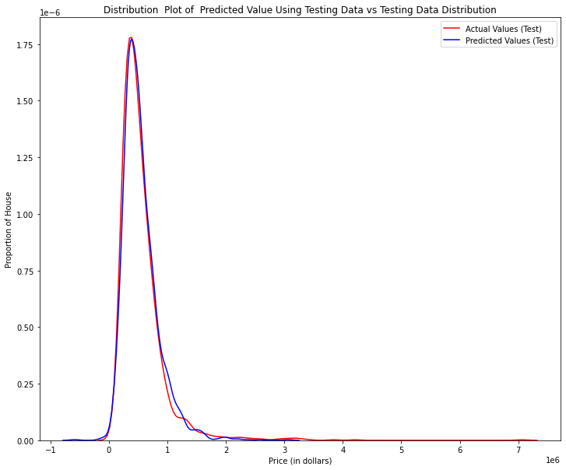
MENU
ANALYSIS
CONTACT
Data ANALYSIS
USE DATA TO EXPERIMENT

Slide 41
ChapTer 4
MENU
ANALYSIS
CONTACT
Data ANALYSIS
Conclusion

Slide 42
MENU
ANALYSIS
CONTACT
Data ANALYSIS
After building and evaluating the model, we have determined that a linear regression model with 12 features is the most appropriate model.
The model shows that the variables sqft_above, grade, bedrooms have the strongest impact on the price target variable.
The size of the data set is quite small
The data set was collected in 2015 so it is not highly applicable at present

Slide 43
THANKS!
MENU
ANALYSIS
CONTACT
Data ANALYSIS
Do you have any questions?

