Slide 1
REDUX SAGA CRUD GENERATOR
Author: KHẢI TRƯƠNG

Slide 2
Share What?
A problem in coding
How to solve it?
Results in two weeks

Slide 3
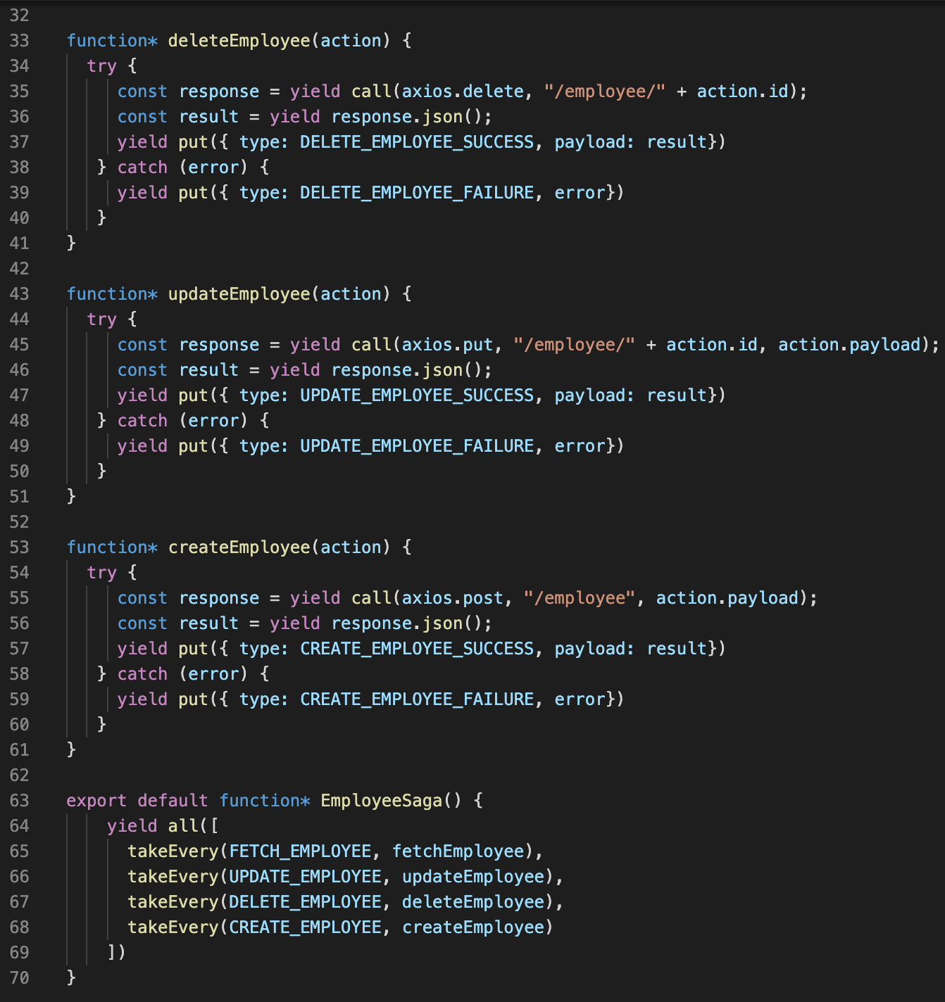
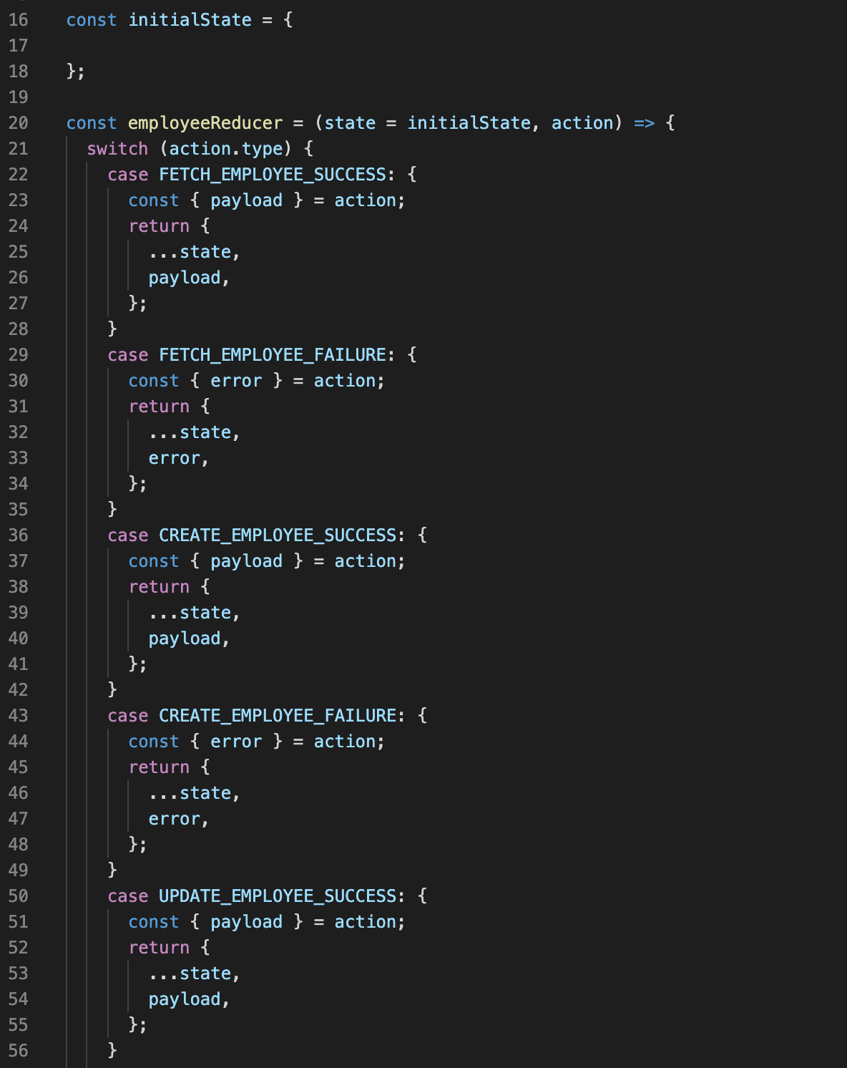
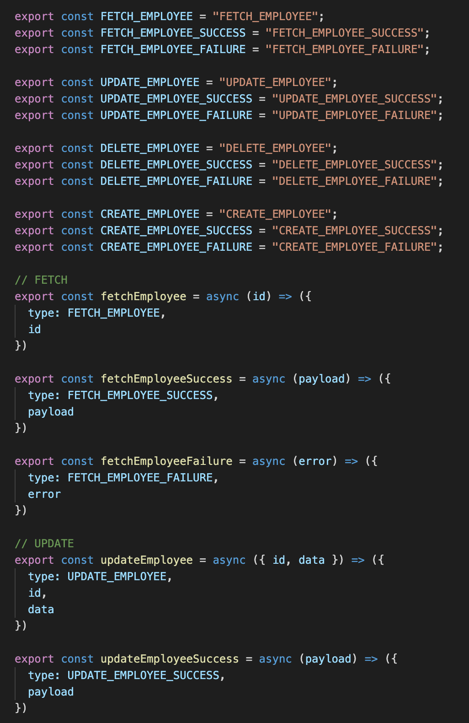

Slide 4

WHAT IF I TOLD YOU
CODE CAN GENERATE NEW CODE

Slide 5

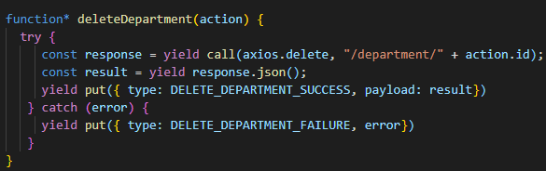
THINK FOR A MINUTE
Replace Employee by another entity name

Slide 6

HIGH level design
Check existed files
Templates (text file)
JS
Copy files
Generator infos
Replace entity name
Load required libraries

Slide 7

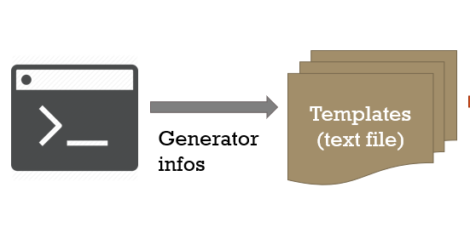

Details
Inquirer.js

Slide 8
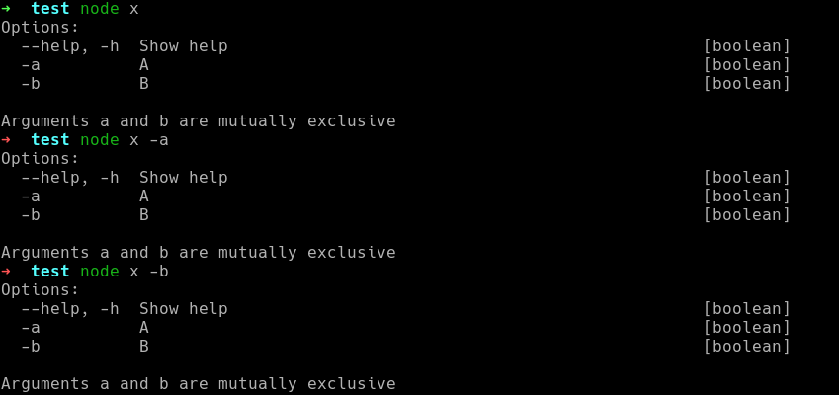
Details

Slide 9
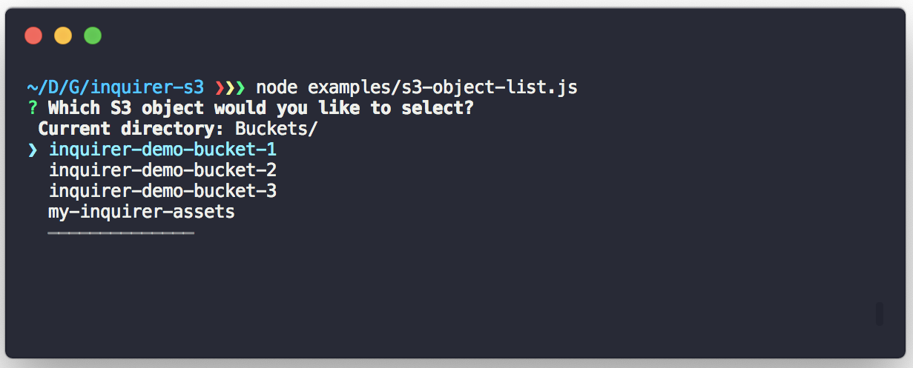
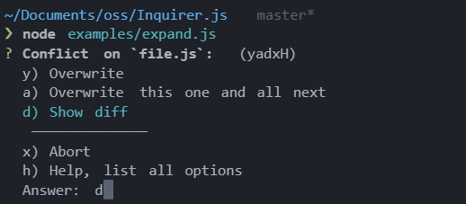
Details
Inquirer.js

Slide 10

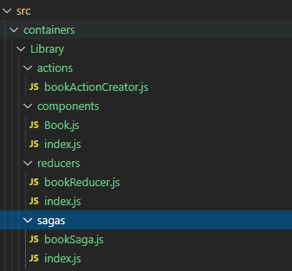


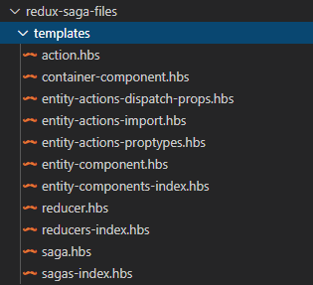


Slide 11
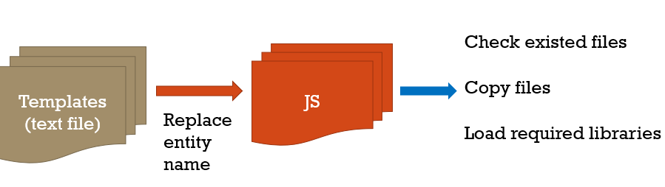

Slide 12

Some extra things
Generate CRUD from a pre-defined JSON file
Config CRUD Generator

Slide 13


Slide 14


