Slide 1
REDUX SAGA CRUD GENERATOR
Author: KHẢI TRƯƠNG

Slide 2
Share What?
A problem in coding
How to solve it?
Results in two weeks

Slide 3
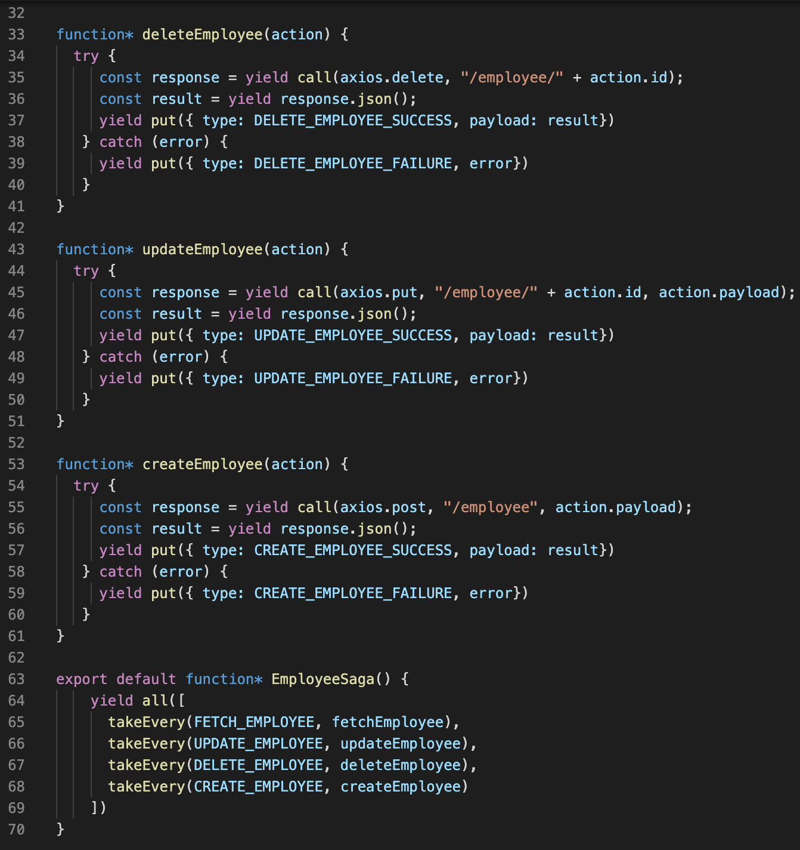
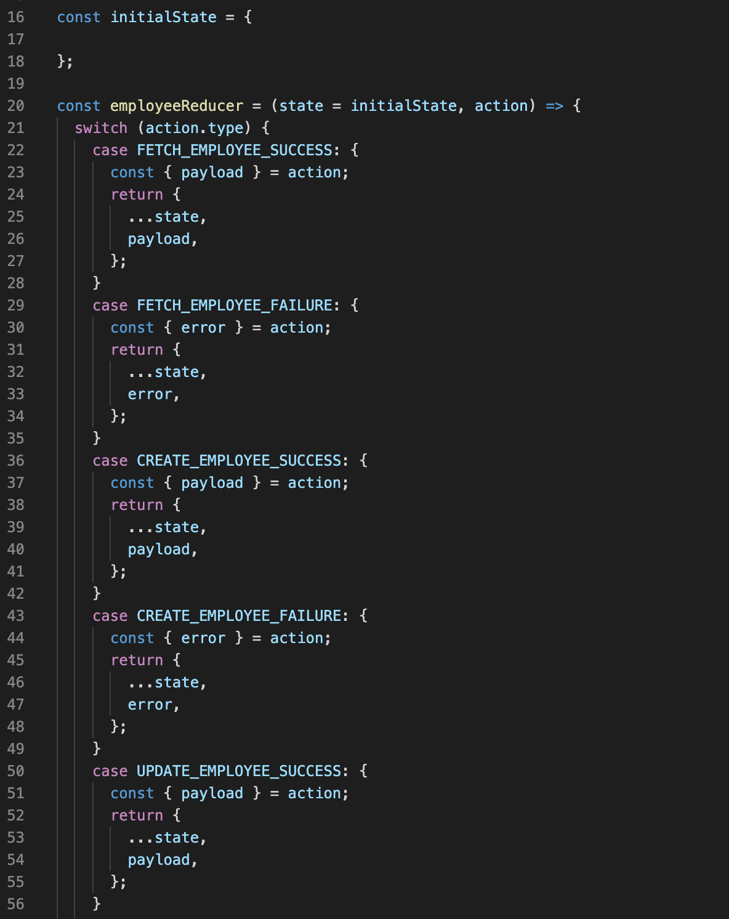
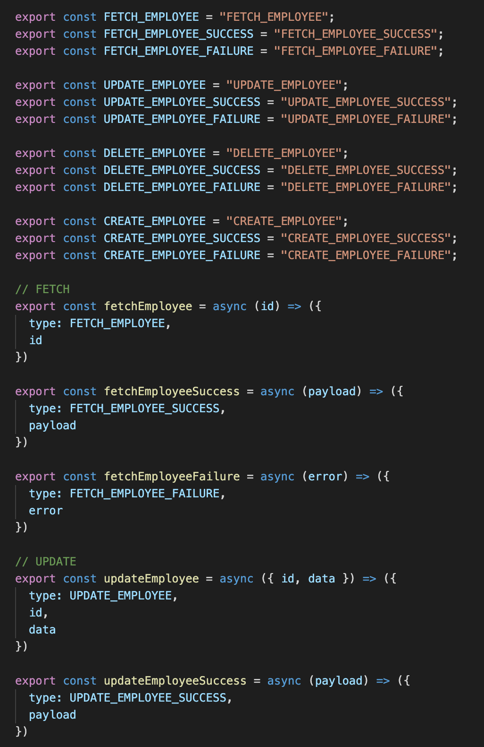

Slide 4

WHAT IF I TOLD YOU
CODE CAN GENERATE NEW CODE

Slide 5
How?

