Slide 1
Python教材
Python入门-Outlook
Wen-yan_Sun
2022/12/09

Slide 2
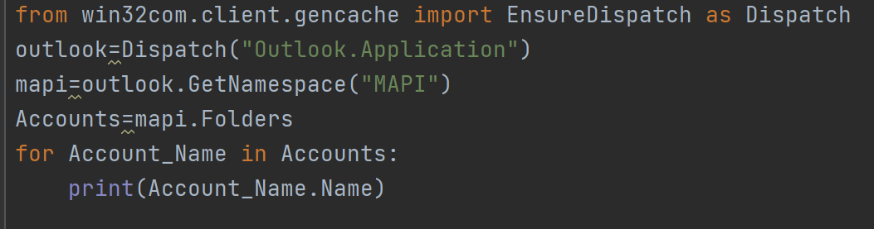
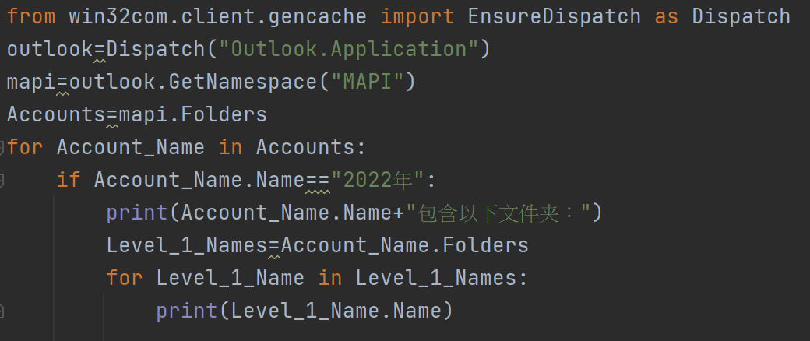
Python教材
读取Outlook内容
读取一级文件夹名称：
## 获取一级文件夹名称: # 引用Outlook第一種 # from win32com.client.gencache import EnsureDispatch as Dispatch # outlook=Dispatch("Outlook.Application") # 引用Outlook第二種（上课所用的方法） import win32com.client as win32 outlook=win32.Dispatch("Outlook.Application") mapi=outlook.GetNamespace("MAPI") Accounts=mapi.Folders for Account_Name in Accounts: print(Account_Name.Name)
from win32com.client.gencache import EnsureDispatch as Dispatch outlook=Dispatch("Outlook.Application") mapi=outlook.GetNamespace("MAPI") Accounts=mapi.Folders for Account_Name in Accounts: if Account_Name.Name=="2022年": print(Account_Name.Name+"包含以下文件夹：") Level_1_Names=Account_Name.Folders for Level_1_Name in Level_1_Names: print(Level_1_Name.Name)
# ###直接獲取二级文件夹内文件夾:
for i in Accounts["2022年"].Folders["Python-Outlook"].Folders:
print(i.Name)
读取二级文件夹名称：

Slide 3
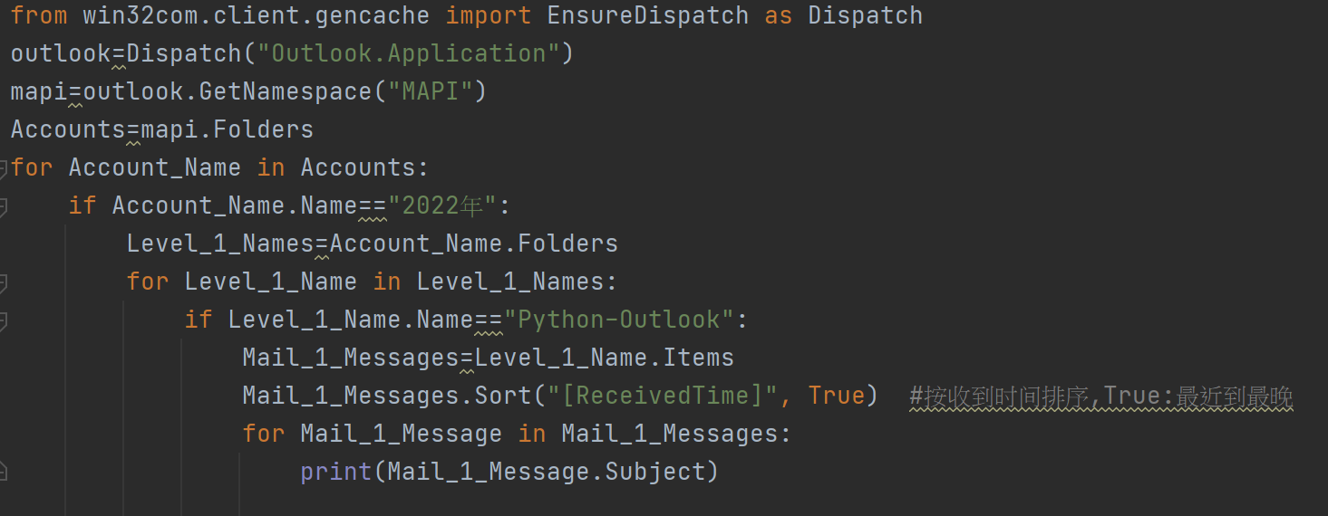
Python教材
读取Outlook内容
读取二级文件夹内邮件主旨：
# ### 获取二级文件夹内邮件主旨: from win32com.client.gencache import EnsureDispatch as Dispatch outlook=Dispatch("Outlook.Application") mapi=outlook.GetNamespace("MAPI") Accounts=mapi.Folders for Account_Name in Accounts: if Account_Name.Name=="2022年": Level_1_Names=Account_Name.Folders for Level_1_Name in Level_1_Names: if Level_1_Name.Name=="Python-Outlook": Level_2_Names = Level_1_Name.Folders for Level_2_Name in Level_2_Names: if Level_2_Name.Name=="123": Mail_1_Messages=Level_1_Name.Items Mail_1_Messages.Sort("[ReceivedTime]", True) #按收到时间排序,True:最近到最晚 for Mail_1_Message in Mail_1_Messages: print(Mail_1_Message.Subject)

Slide 4
Python教材
读取Outlook内容
Mail Item的一些属性：
属性/方法 | 注解 | 备注
Item.CreationTime | 创建邮件的时间
Item.ReceivedTime | 接收邮件的日期 | [:10]:日期,[:19]:日期+时间
Item.SenderName | 发件人 | Wen-yan Sun(孫文彥_PSZ)
Item.To | 收件人 | Wen-yan Sun(孫文彥_PSZ)
Item.CC | 副本收件人
Item.BCC | 密件副本收件人 | 只有读取寄件夹邮件中邮件才会显示
Item.Subject | 主题
Item.Body | 正文
Item.UnRead | 是否已读 | True:未读,False:已读
Item.Attachments | 附件集合
attachment.FileName | 附件名称 | attachment为变量
attachment.SaveAsFile(path+attachment.FileName) | 保存附件 | attachment,path为变量
Items.Sort("[ReceivedTime]",True) | 按照收件顺序排序Items | True:降序,False:升序(默认False)

Slide 5
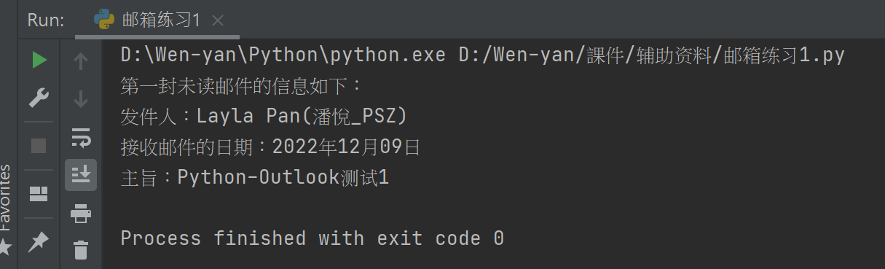
Python教材
读取Outlook内容
练习：
读取自己邮箱中第一封未读邮件的发件人，接收邮件的日期（格式XXXX年XX月XX日），主题，然后将读取状态变更为未读

Slide 6
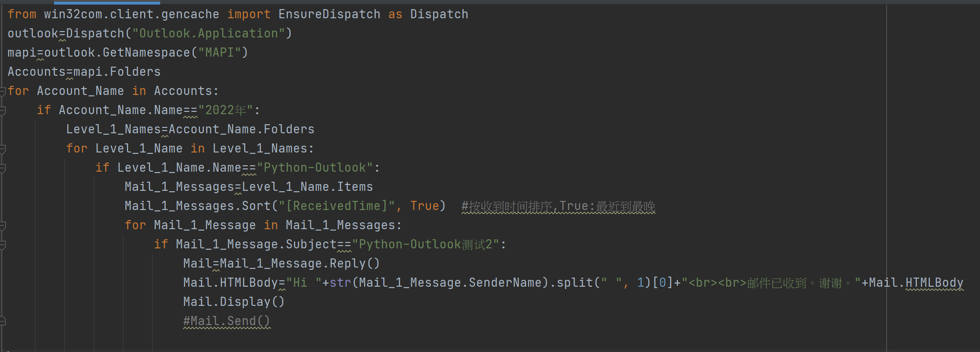
Python教材
回复邮件
回复邮件：MailItem.Reply()
全部回复：MailItem.ReplyAll()
# ## 邮件的回复: from win32com.client.gencache import EnsureDispatch as Dispatch outlook=Dispatch("Outlook.Application") mapi=outlook.GetNamespace("MAPI") Accounts=mapi.Folders for Account_Name in Accounts: if Account_Name.Name=="2022年": Level_1_Names=Account_Name.Folders for Level_1_Name in Level_1_Names: if Level_1_Name.Name=="Python-Outlook": Mail_1_Messages=Level_1_Name.Items Mail_1_Messages.Sort("[ReceivedTime]", True) #按收到时间排序,True:最近到最晚 for Mail_1_Message in Mail_1_Messages: if Mail_1_Message.Subject=="Python-Outlook测试2": # if Mail_1_Message.Subject.find("Python-Outlook") !=-1: Mail=Mail_1_Message.Reply() #全部回复ReplyAll() Mail.HTMLBody="Hi "+str(Mail_1_Message.SenderName).split(" ", 1)[0]+"<br><br>邮件已收到。谢谢。"+Mail.HTMLBody Mail.Display() Mail.Send()

Slide 7
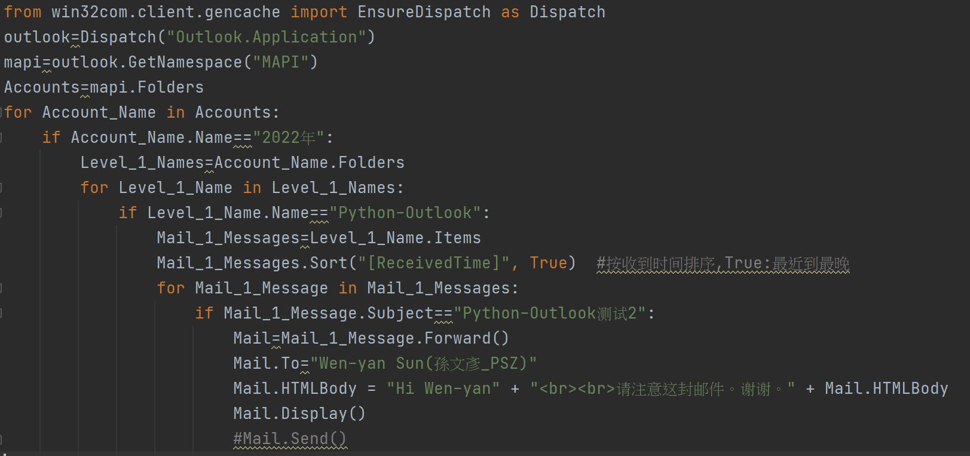
Python教材
转寄邮件
邮件的转寄：Forward（）
from win32com.client.gencache import EnsureDispatch as Dispatch outlook=Dispatch("Outlook.Application") mapi=outlook.GetNamespace("MAPI") Accounts=mapi.Folders for Account_Name in Accounts: if Account_Name.Name=="2022年": Level_1_Names=Account_Name.Folders for Level_1_Name in Level_1_Names: if Level_1_Name.Name=="Python-Outlook": Mail_1_Messages=Level_1_Name.Items Mail_1_Messages.Sort("[ReceivedTime]", True) #按收到时间排序,True:最近到最晚 for Mail_1_Message in Mail_1_Messages: if Mail_1_Message.Subject=="Python-Outlook测试2": Mail=Mail_1_Message.Forward() Mail.To="Wen-yan Sun(孫文彥_PSZ)" Mail.HTMLBody = "Hi Wen-yan" + "<br><br>请注意这封邮件。谢谢。" + Mail.HTMLBody Mail.Display() Mail.Send()

Slide 8
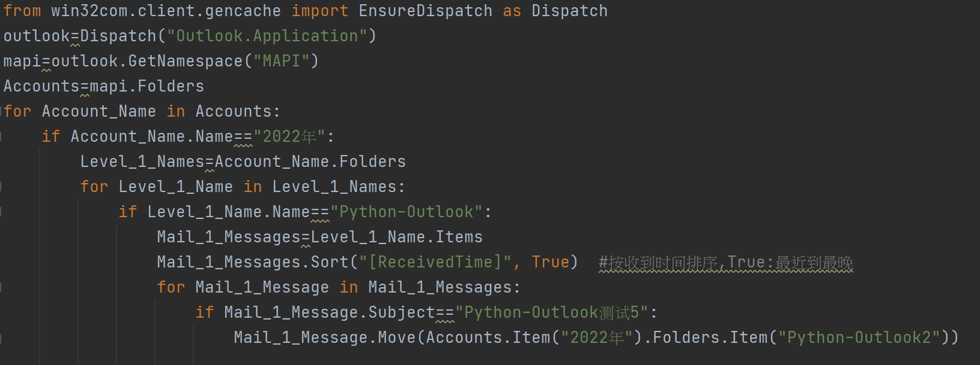
Python教材
转移邮件
邮件的转移：Move（）
from win32com.client.gencache import EnsureDispatch as Dispatch outlook=Dispatch("Outlook.Application") mapi=outlook.GetNamespace("MAPI") Accounts=mapi.Folders for Account_Name in Accounts: if Account_Name.Name=="2022年": Level_1_Names=Account_Name.Folders for Level_1_Name in Level_1_Names: if Level_1_Name.Name=="Python-Outlook": Mail_1_Messages=Level_1_Name.Items Mail_1_Messages.Sort("[ReceivedTime]", True) #按收到时间排序,True:最近到最晚 for Mail_1_Message in Mail_1_Messages: if Mail_1_Message.Subject=="Python-Outlook测试4": Mail_1_Message.Move(Accounts.Item("2022年").Folders.Item("Python-Outlook2"))

Slide 9
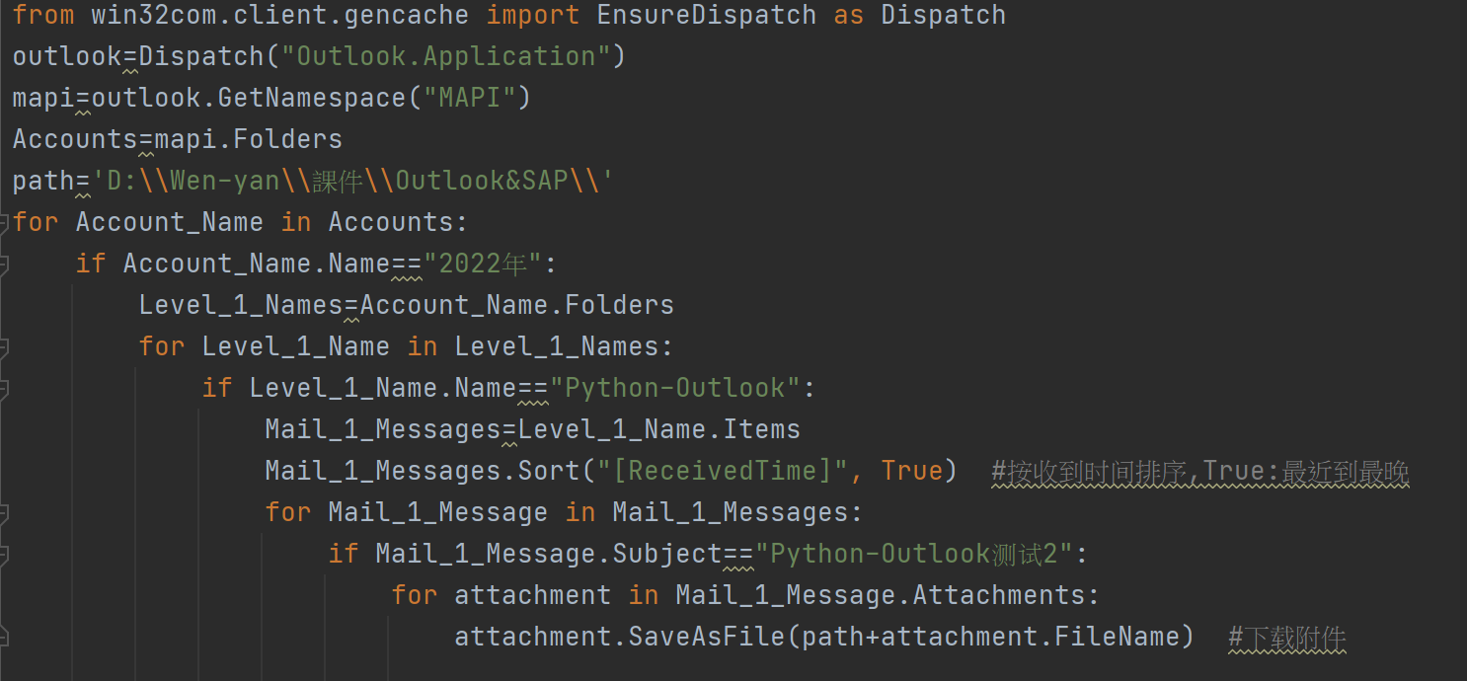
Python教材
下载附件
下载附件：SaveAsFile
from win32com.client.gencache import EnsureDispatch as Dispatch outlook=Dispatch("Outlook.Application") mapi=outlook.GetNamespace("MAPI") Accounts=mapi.Folders path='C:\\Users\\wen-yan_sun.PSZ\\Desktop\\' for Account_Name in Accounts: if Account_Name.Name=="2022年": Level_1_Names=Account_Name.Folders for Level_1_Name in Level_1_Names: if Level_1_Name.Name=="Python-Outlook": Mail_1_Messages=Level_1_Name.Items Mail_1_Messages.Sort("[ReceivedTime]", True) #按收到时间排序,True:最近到最晚 for Mail_1_Message in Mail_1_Messages: if Mail_1_Message.Subject=="Python-Outlook测试2": #邮件主旨为Python-Outlook测试2 for attachment in Mail_1_Message.Attachments: attachment.SaveAsFile(path+attachment.FileName)

Slide 10
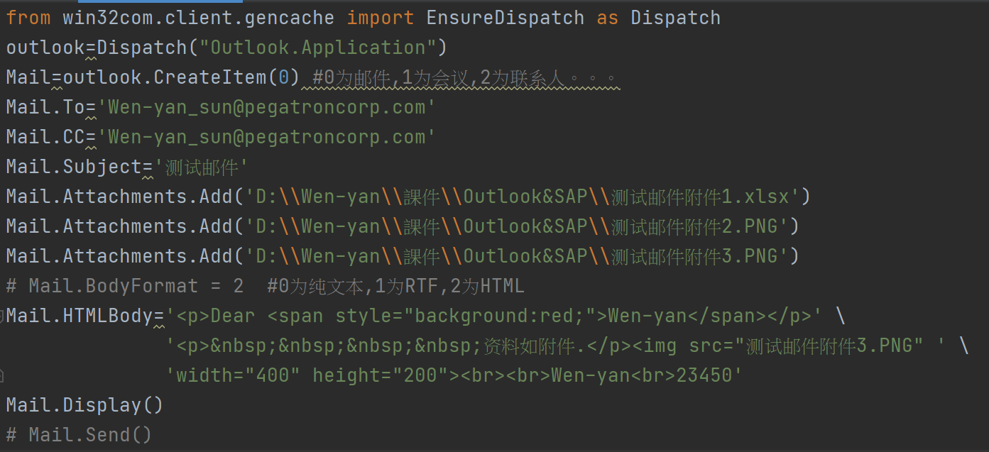
Python教材
新建邮件
新建邮件：CreateItem（）
from win32com.client.gencache import EnsureDispatch as Dispatch outlook=Dispatch(“Outlook.Application”) Mail=outlook.CreateItem(0) Mail.To=‘wen-yan_sun@pegatroncorp.com’ Mail.CC=‘wen-yan_sun@pegatroncorp.com’ Mail.Subject=‘庫存’ Mail.Attachments.Add(‘D:\\steef\\steef123456.XLS') Mail.Attachments.Add('D:\\steef\\steef\\image001.PNG') Mail.Attachments.Add('D:\\steef\\steef\\image002.PNG') Mail.HTMLBody='<p>Dear <span style="background:red;">Sir</span></p>' \ '<p>&nbsp;&nbsp;&nbsp;&nbsp;资料如附件.</p><img src="image001.PNG" ' \ 'width="400" height="200"><br><br>SAP<br>66097' Mail.Display() Mail.Send()

Slide 11
HTML教材
Thank you
Thank you

