Slide 1

VIDEO STREAMING SERVICE
May 31th, 2023

Slide 2
Outline
What is this project about ?
System overview
Software components

Slide 3
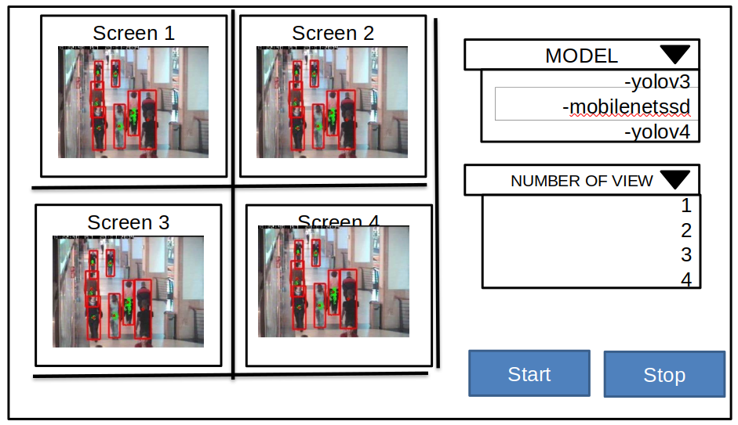
What is this project about?
Create a system that has a website that streams videos from video server. The main goal is to create a system that runs on docker for ease of installation and can be scale up easily.
This is the desired website UI:

Slide 4
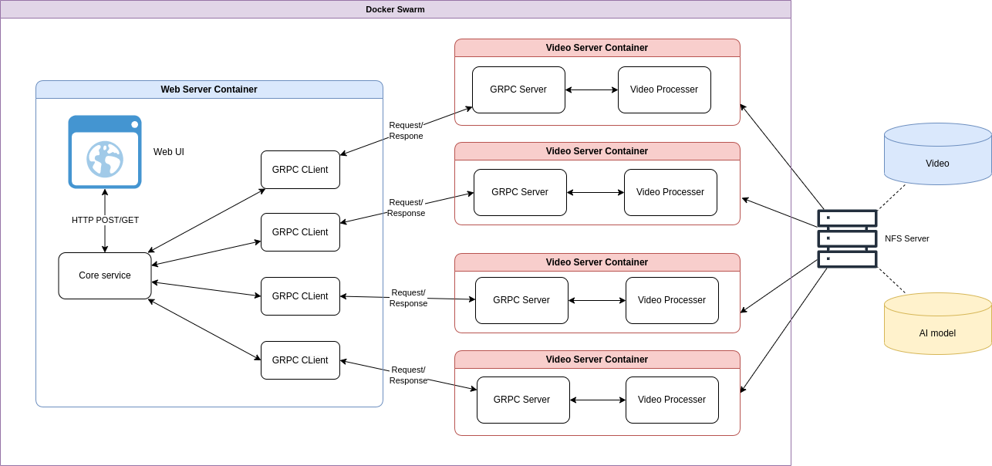
2. System overview
Here is an overview of the system architecture:
Both Video Server and Web Server run as a container on a docker swarm for better orchestration
Web server is responsible for running a Web UI and requests frame data from video server.
Video servers are responsible for processing the video mounted from NFS volume and response frame data to the corresponding GRPC client
NFS server runs separately from the docker swarm environment and provides access to Video and AI model volume

Slide 5
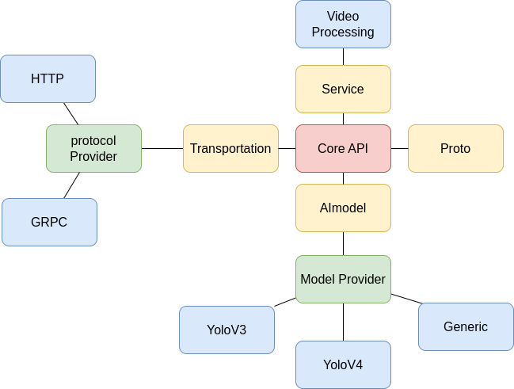
3. Software Components
3.1 Video Server
The software of the video server comprises four main components:
Proto: This component handles GRPC protocol buffers.
Service: This component manages video processing.
Transportation: This component handles requests and responses between the web server and the video server. The protocol provider is utilized to offer the appropriate protocol service based on the user's configuration. Each protocol adheres to the same class interface.
=> This approach decouples the protocol creation from the main code, facilitating the inclusion or switching to new transport protocols.
AI model: This component handles object detection using specific models. It employs the same mechanism as transportation, resulting in the same decoupling effect.

Slide 6
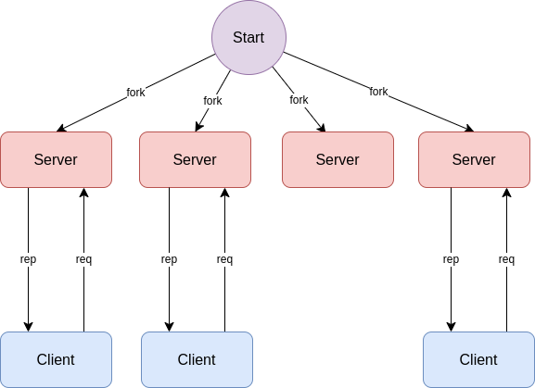
3. Software Components
3.1 Video Server
At the beginning, the program spawns multiple processes equal to the number of CPUs available. Each process creates an instance of the server, and in this case is GRPC server, each bind to the same port and listen for incoming client requests.
Once a request is received from a client, the server processes the video and streams back the processed frame data to the client.
The reason i chose to use multiprocessing instead of multithreading because multithreading can cause issues with reading videos in OpenCV and may result in thread errors. Additionally, Python has the Global Interpreter Lock (GIL) which can limit the effectiveness of multithreading for certain tasks.

Slide 7
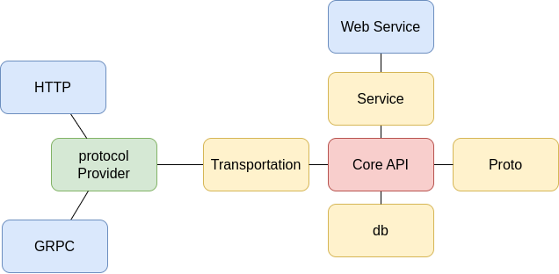
3. Software Components
3.2 Web Server
The software of the web server is quite similar to that of the video server. However, there are a few key differences:
Db: This component handles persistent storage and is responsible for storing the user interface (UI) configurations provided by the users.
Service: In contrast to the video server, the service component of the web server now handles web services instead of video processing.

Slide 8
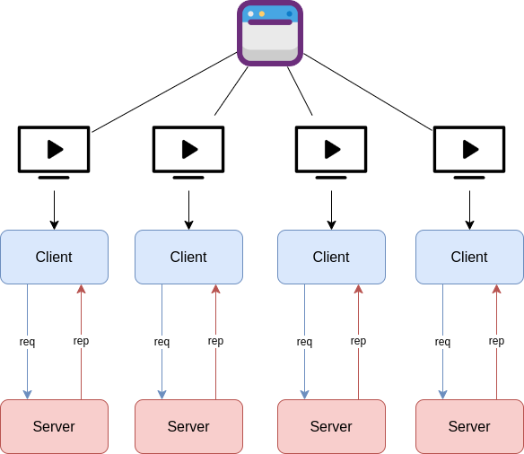
3. Software Components
3.2 Web Server
Each view on the same window spawns a new thread that create an instance of client, in this case is GRPC Client, that all connect to the same port and send request to the server.
Client then will wait for frame data stream from server and send an ack back when it finishes
This approach allows multiple views to be handled concurrently

