Slide 1

LOOK ASIDE LOAD BALANCER INVESTIGATION
June 13th, 2023

Slide 2
Outline
What is this project about ?
System overview
Services overview
System Evaluation
Conclusion

Slide 3
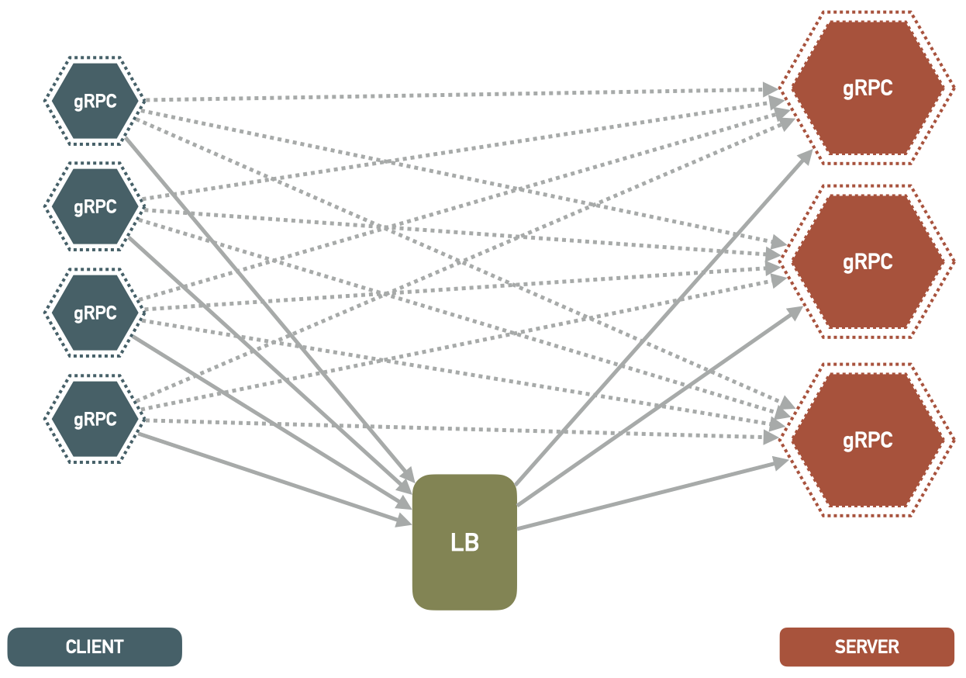
What is this project about?
Based on the Video Streaming Project. This project expand on the Lookaside load balancer design. The picture below illustrates this approach. The client gets at least one address from lookaside LB. Then the client uses this address to make GRPC connection to the server.

Slide 4
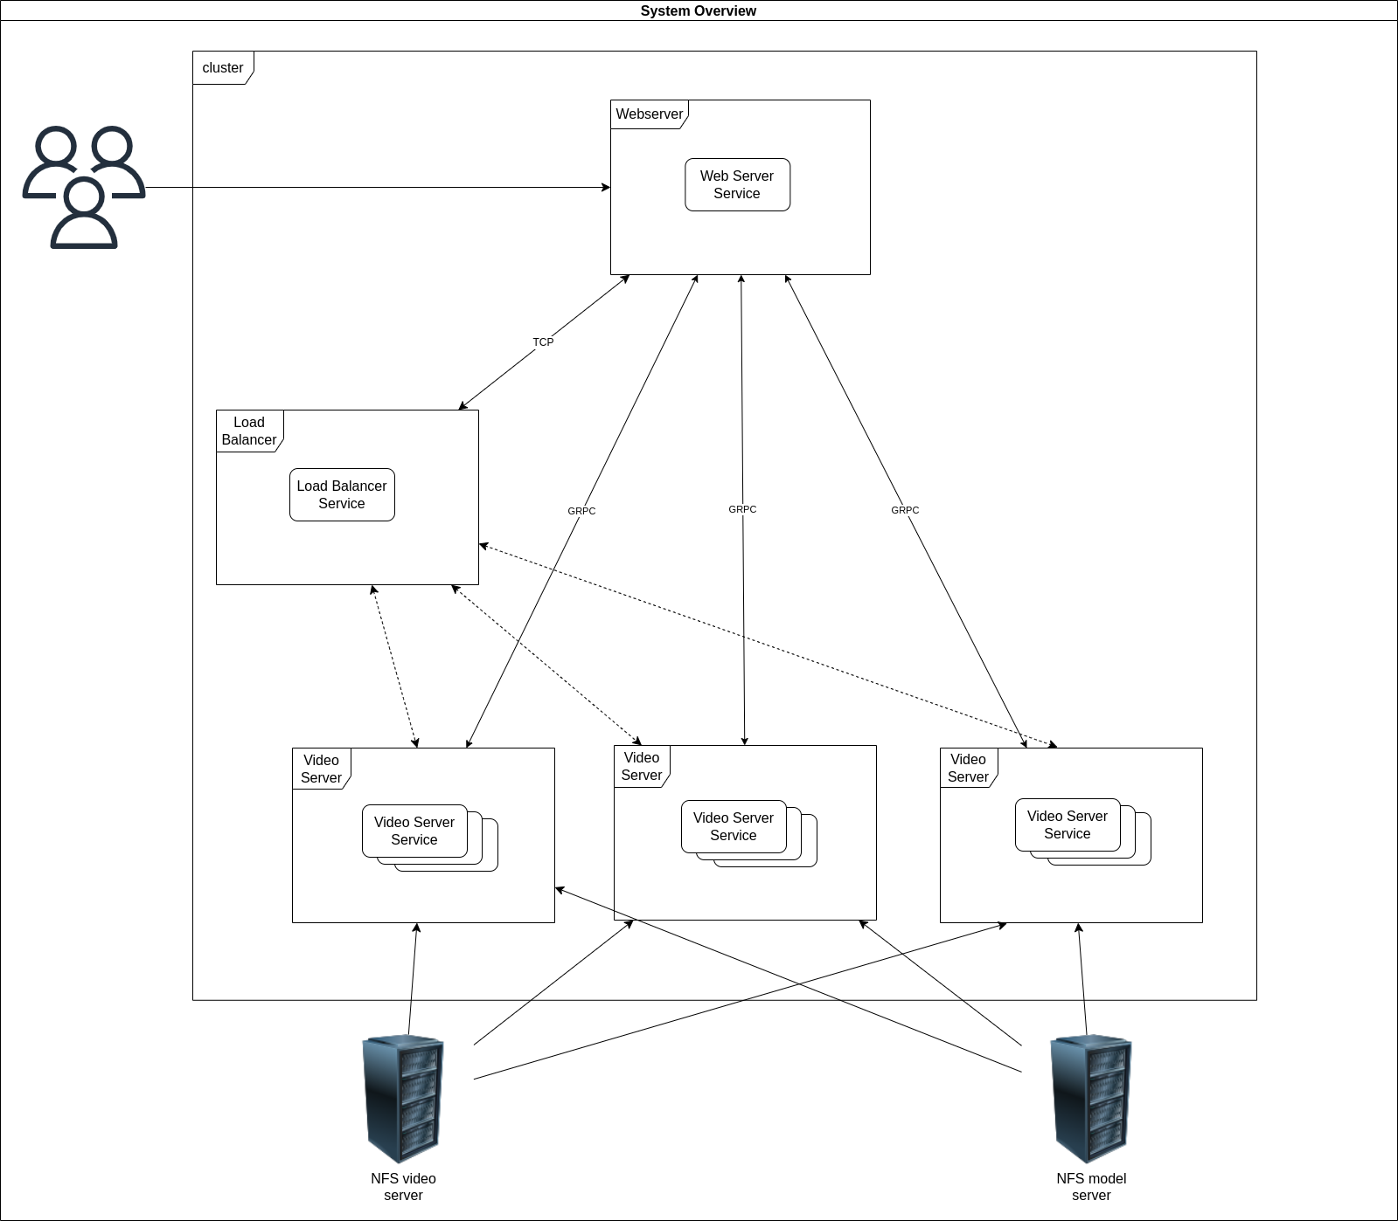
2. System overview
Here is an overview of the system architecture:
Web Server node is responsible for web UI and communication
Load Balancer listens to request from Web Server Node, create new instance of Video Server service and send that information back to Web Server Node
Video server Node are responsible for processing video and response frame data to Web Server Node

Slide 5
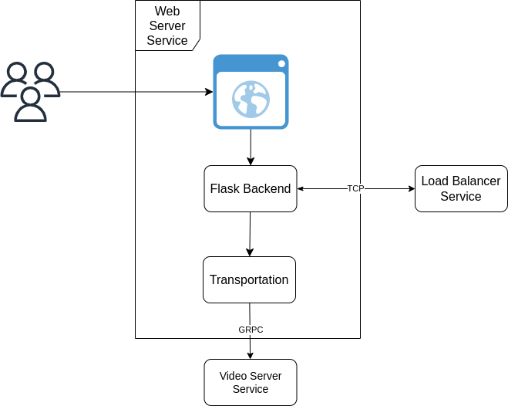
3. Services overview
3.1 Web Server service
Using Flask as its backend and GRPC as it transportation protocol
The backend will communicate with Load Balancer through TCP connection

Slide 6
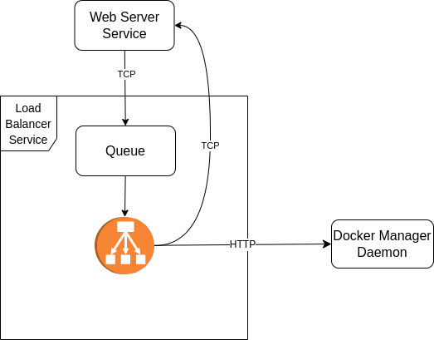
3. Services overview
3.2 Load Balancer service
Listen for request from Webserver Service and store those request in a queue
Process request from the queue to decide to create or remove a service on a swarm through communication with Docker Daemon

Slide 7
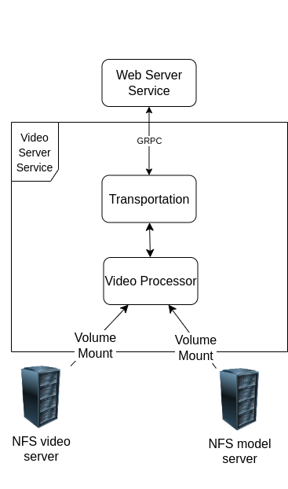
3. Services overview
3.3 Video Server service
Mounting Videos and Ai models from NFS volume and processing them
Response frame data to Web Server service request

Slide 8
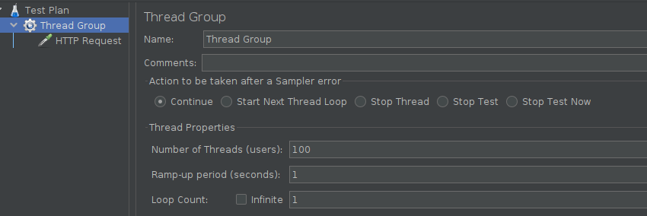
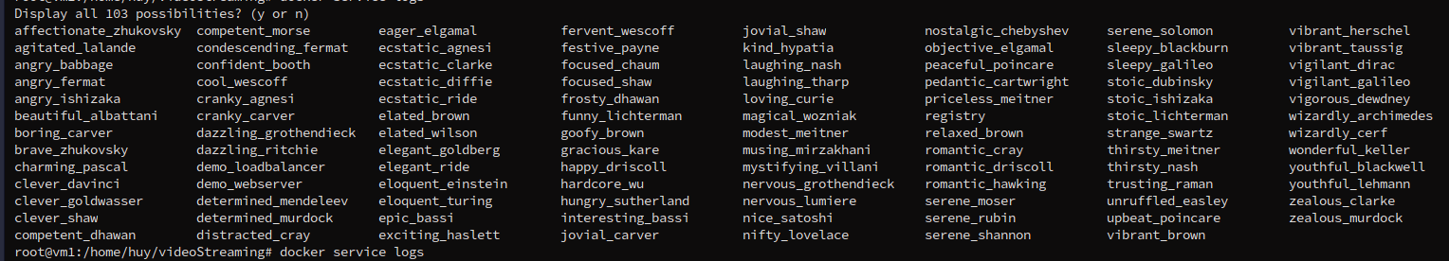
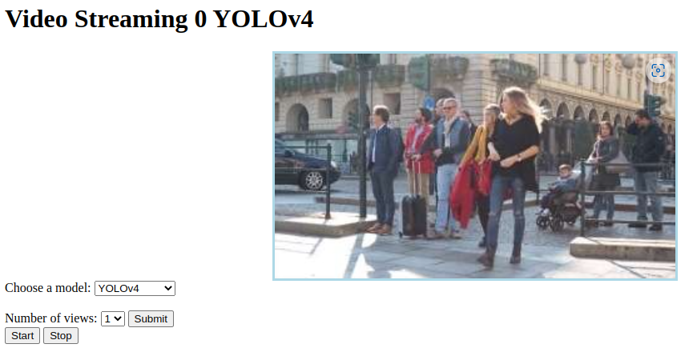
4. System evaluation
4.1 Testing with Jmeter
Using jmeter, I have been able to send up to 100 consecutive request to the web server.
Even with those amounts of requests coming, you still can open up that website in your browser and watch the video.
Of course the performance is miserable. But we can say that this is just a limitation in hardware.
Still can expand more with better hardware

Slide 9
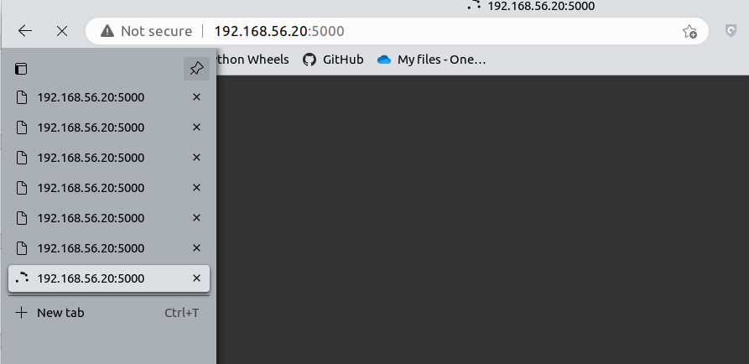
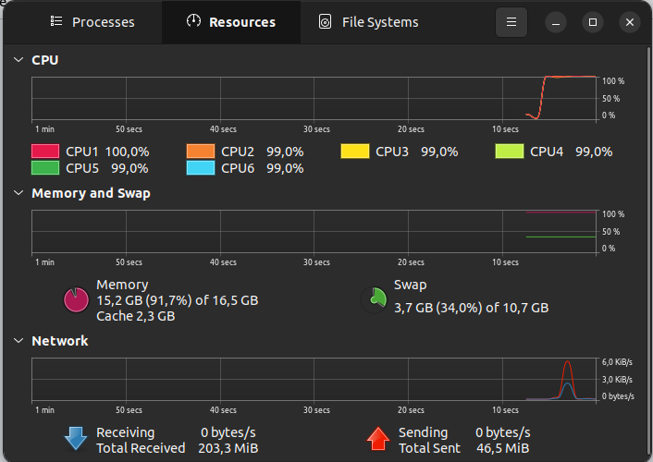
4. System evaluation
4.2 Testing manually
We only be able to open up to 6 new tabs because the 7 tab refuse to load anything until I close one of other tab
The 7 tabs won't send any request to flask backend too
During this time period, the CPU consumption is reaching its limit
I have also tried to send smaller image from video server but result are still the same
Because the browser had to render the image sending from flask backend, it used up all the resources of the computer causing new tabs stop loading

Slide 10
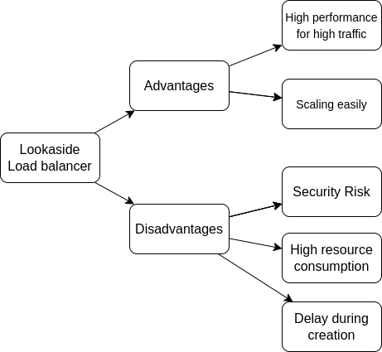
5. Conclusion
Here is my conclusion of this system

