Slide 1

VIDEO STREAMING
CENTRALIZED
ARCHITECTURE INVESTIGATION
June 13th, 2023

Slide 2
Outline
What is this project about ?
System overview
Software components

Slide 3
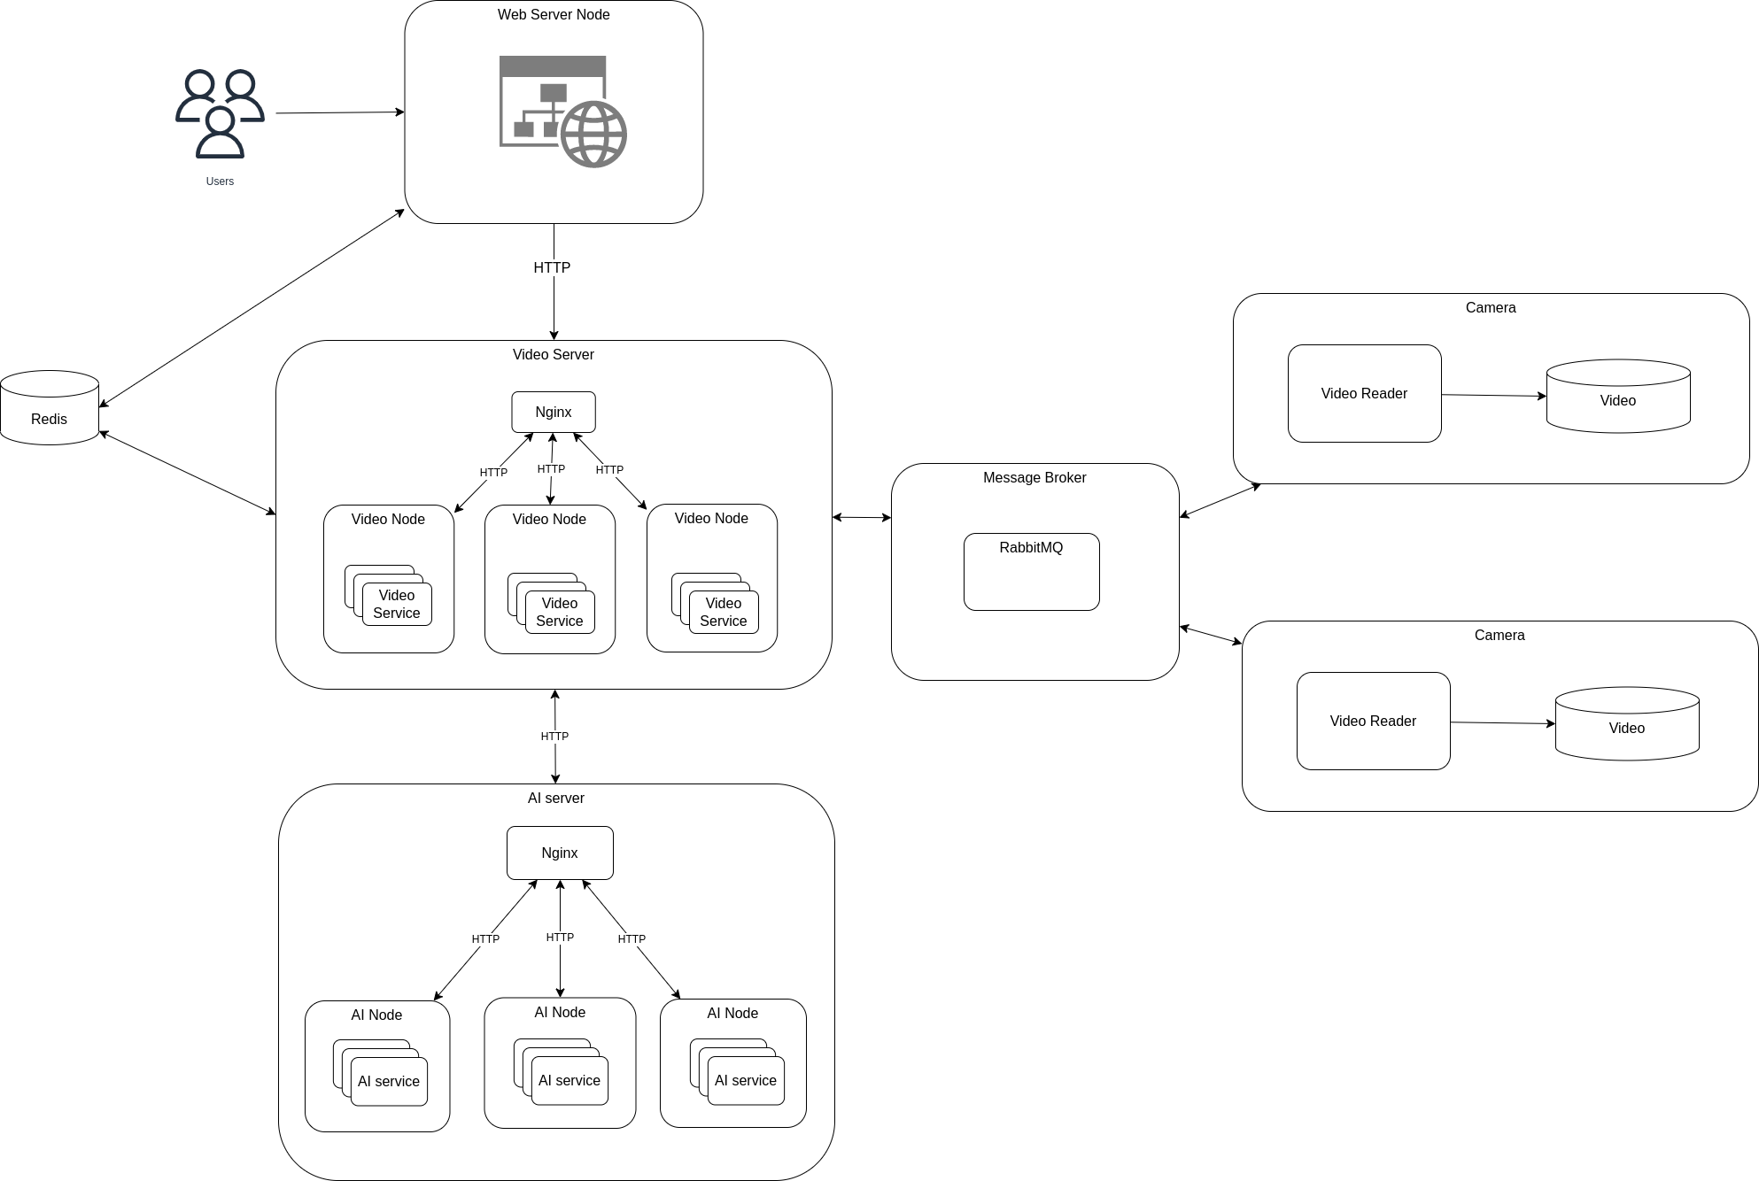
What is this project about?
This project is an experimentation with centralized architecture for Video Streaming Service

Slide 4
2. System overview
Here is an overview of the system architecture:
Web Server:
Hosting web service
Handle user interaction
Video Server:
Handle video request from Web Server
Get video data store inside of Message Broker
Request facial detection from AI Server
RabbitMQ:
Exchange video and camera data between components
Redis:
Store camera information
AI server:
Handle face detection request
Camera Node:
Read video and store frame data to RabbitMQ

Slide 5
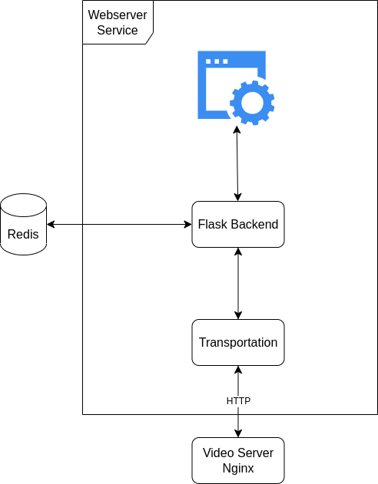
2. Service Overview
2.1 Web Server Service
Using Flask as its backend and HTTP as it transportation protocol

Slide 6
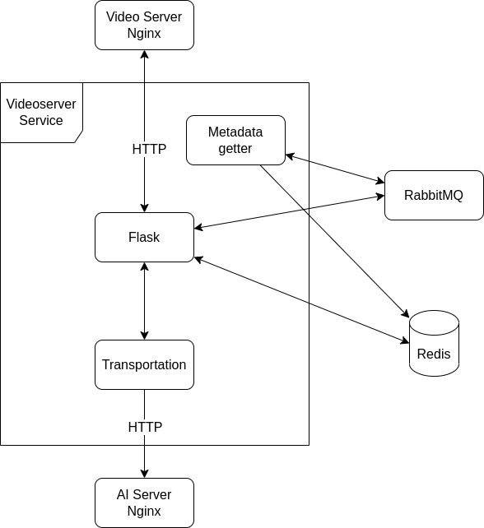
2. Service Overview
2.2 Video Server Service
Using flask as its HTTP request handler
Metadata getter is an always running thread that get camera metadata from rabbitMQ

Slide 7
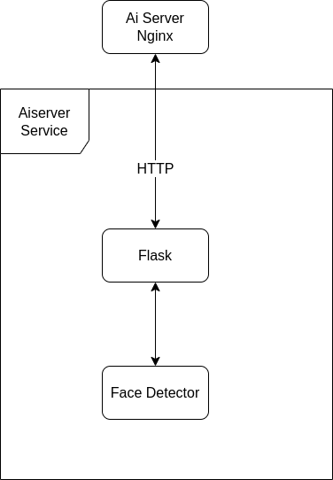
2. Service Overview
2.3 Ai Server Service
Using flask as its HTTP request handler
Face Detector will process the image and send back the bounding box information of those faces

Slide 8
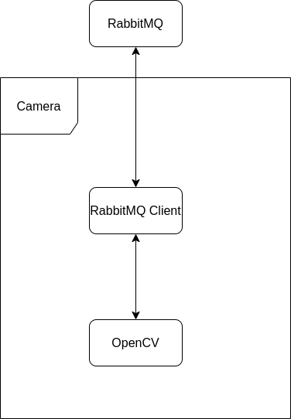
2. Service Overview
2.4 Camera

Slide 9
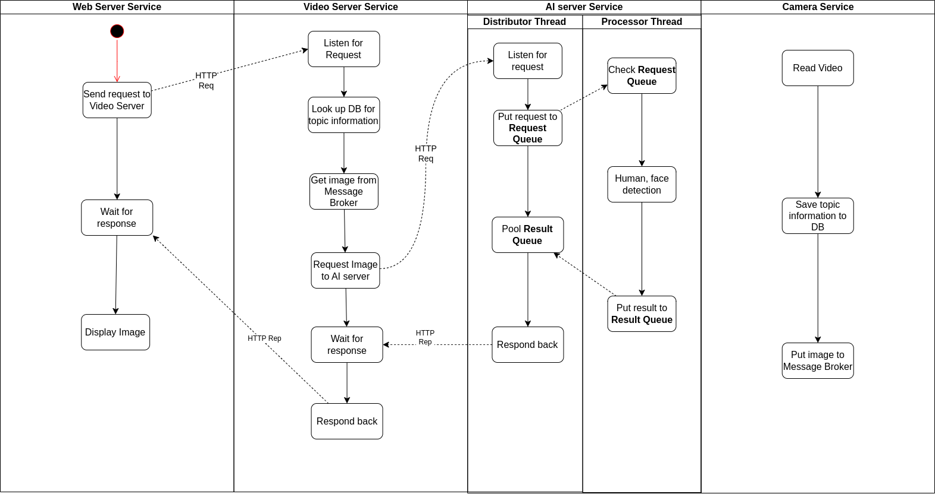
2. Service Overview
2.5 Flow diagram
Here is an diagram of how these service interact with each other

Slide 10
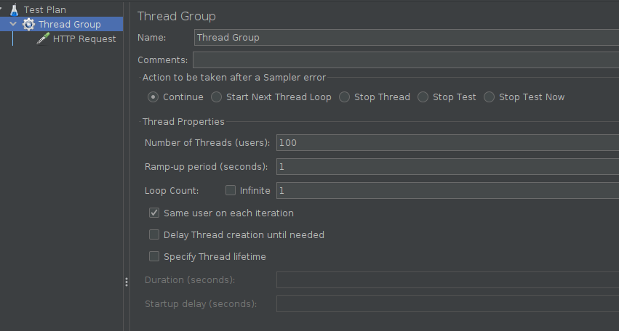
3. System Evaluation
3.1 Testing with Jmeter
Using jmeter, I have been able to send up to 100 consecutive request to the web server.
Even with those amounts of requests coming, you still can open up that website in your browser and watch the video.
Of course the performance is miserable. But we can say that this is just a limitation in hardware.
Still can expand more with better hardware

Slide 11
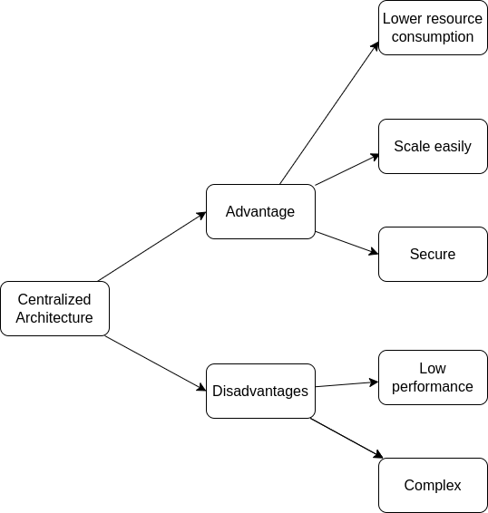
4. Conclusion
Here is my conclusion of this system

