Slide 1

SENTIMENT ANALYSIS
TRUONG NGUYEN NGOC QUY
NGUYEN MINH KHOI

Slide 2
TABLE OF CONTENT
BUSINESS OBJECTIVE
01
02
BUILD PROJECT
Emotional Intelligence
PREDICTION BY UPLOADING
03
04
PREDICTION BY INPUTTING

Slide 3
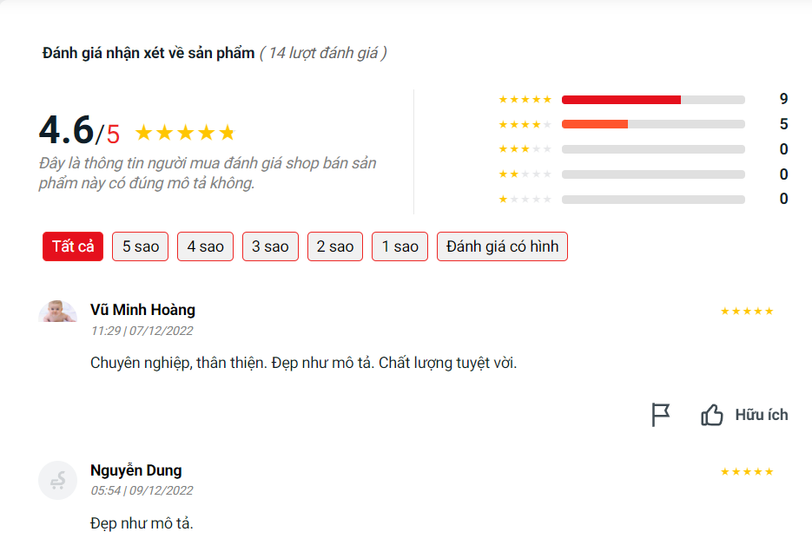
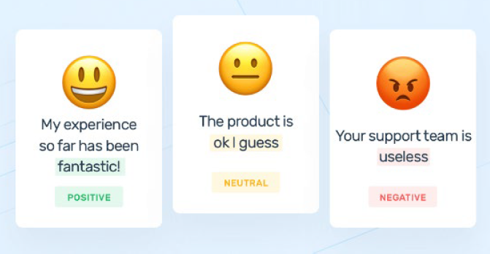

01 - BUSINESS OBJECTIVE
History of previous customer reviews
Sentiment Analysis

Slide 4
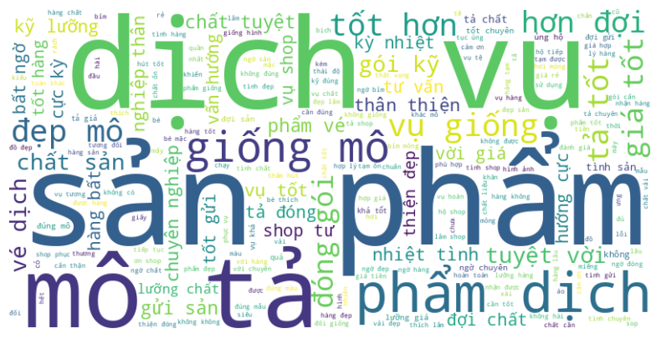
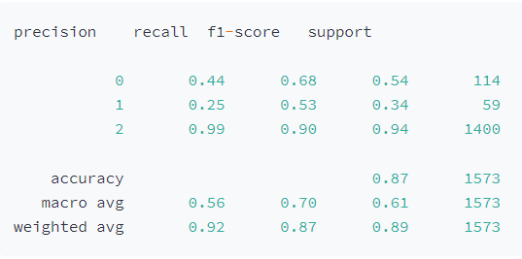
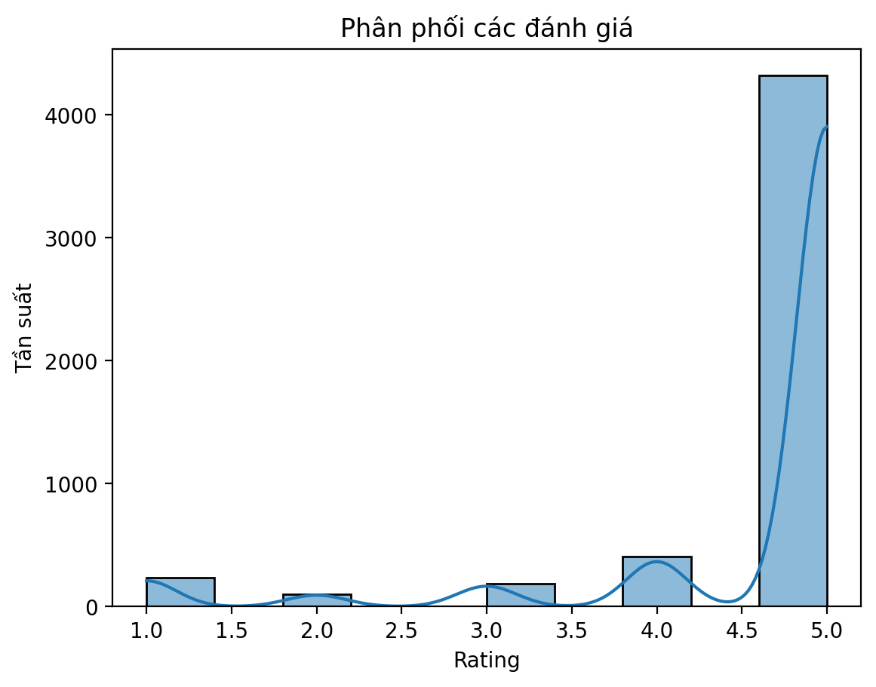
02 – BUILD PROJECT
Word Cloud
NAÏVE BAYES MACHINE LEARNING MODEL
Rating allocation
Frequency
Rating

Slide 5
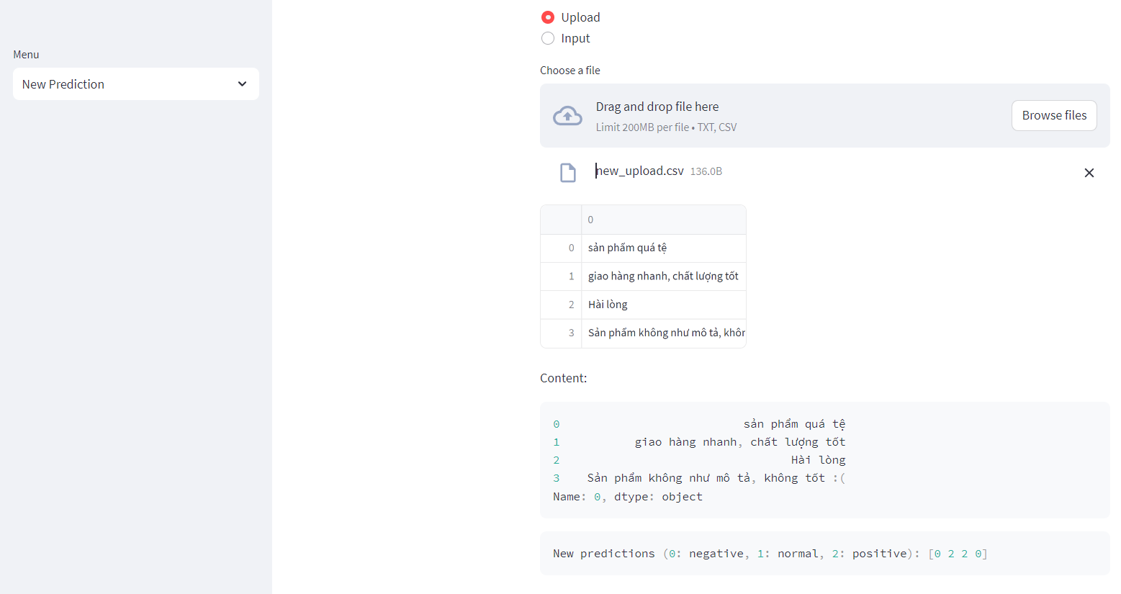
03 – PREDICTION BY UPLOADING CSV FILE

Slide 6
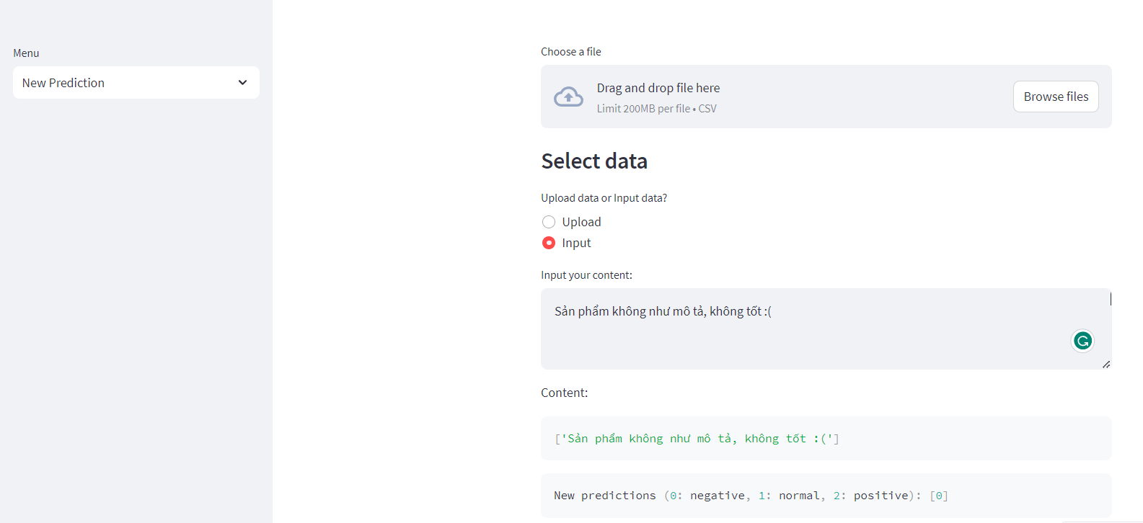
04 – PREDICTION BY INPUTTING

Slide 7
THANK YOU VERY MUCH!

