Slide 1

Predicting best investment opportunity on real estate using Zillow home value index
IST-652 Final Project
By: ThulasiRam RuppaKrishnan
Professor: Jason Anastasopoulos

Slide 2

Introduction
Buying and owning real estate is an exciting investment strategy, that can be both satisfying and lucrative. Unlike stock and bond investors, prospective real estate owners can use leverage to buy a property by paying a portion of the total cost up front, then paying off the balance, plus interest, over time. While a traditional mortgage generally requires a 20% to 25% down payment, in some cases, a 5% down payment is all it takes to purchase an entire property.
Real estate is generally a great investment option. It can generate ongoing passive income and can be a good long-term investment if the value increases over time. You may even use it as a part of your overall strategy to begin building wealth.
The goal of the project is to predict the Zillow home value index and find out the zipcodes that are great for investment opportunity

Slide 3
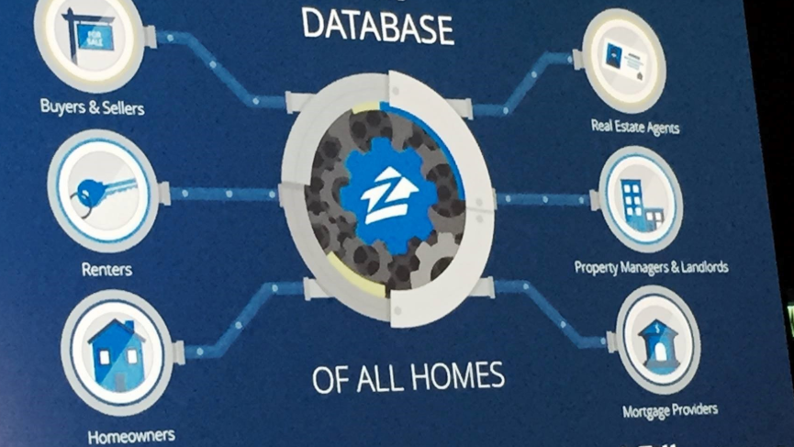
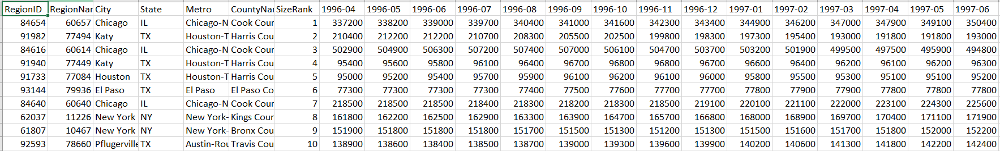
About the Data
Zillow has data on 110 million homes across the United States, not just those homes currently for sale. In addition to giving value estimates of homes, it offers several features including value changes of each home in a given time frame (such as one, five, or 10 years)
(files.zillowstatic.com/research/public/Zip/Zip_Zhvi_SingleFamilyResidence.csv)
The dataset (Zip_Zhvi_SingleFamilyResidence.csv) is a comma-separated files with the following variables
RegionID | Unique Identifier for a Region
RegionName | Region identified by zip code
City | City identified by zip code
State | State identified by zip code
Metro | Metro identified by zip code
CountyName | County identified by zip code
SizeRank | Size identified based on population
1996-04 | Zhvi by zip code and year month
1996-05 | Zhvi by zip code and year month
1996-06 | Zhvi by zip code and year month
. . . | Zhvi by zip code and year month
2019-08 | Zhvi by zip code and year month
2019-09 | Zhvi by zip code and year month
Table 1.1 Sample Zip_Zhvi_SingleFamilyResidence dataset

Slide 4
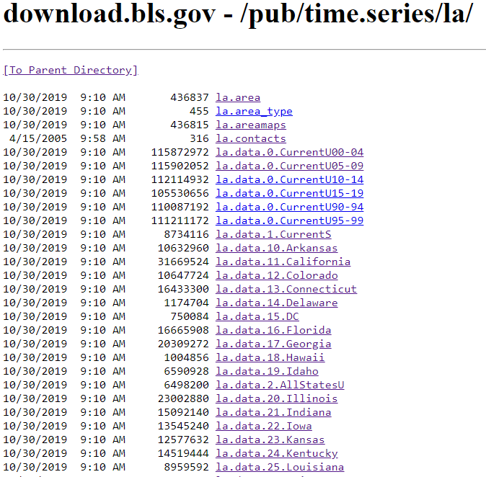
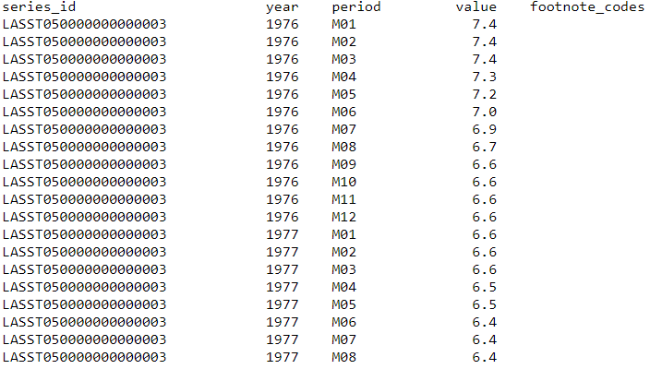
Additional Dataset
Unemployment rate from Bureau of Labor Statistics and Census data
series_id | Unique identifier for a metric published by bureau LASST100000000000003 represents Unemployment Rate by state where the two digits (10) followed by "LASST" represents the identifier for state (10 → Delaware)
year | year when the metrics value is recorded
period | identifier for month when the metric value is recorded
value | metric value where the metric in this case is unemployment rate
footnote_codes | notes/comments if applicable

Slide 5
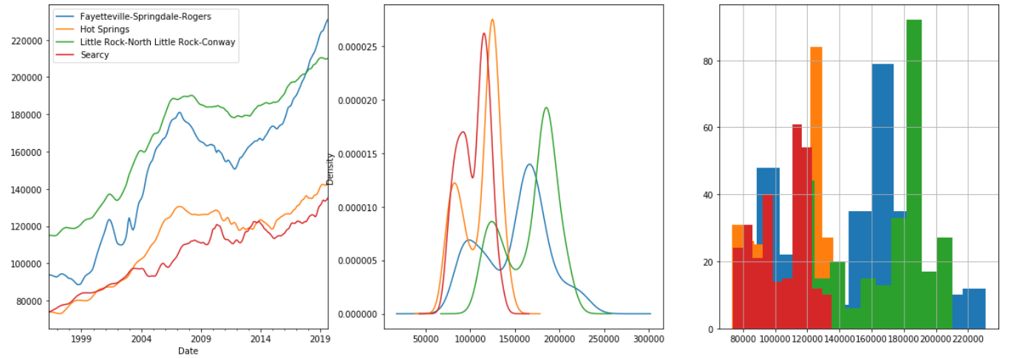
Analysis
After cleaning the dataset, exploratory data analysis is performed on top of this dataset to study each variable and its interaction with one another
Figure 1.1
Figure 1.1: This gives the distribution of median housing value for Hot Springs, Little Rock, Fayetteville, Searcy and its trend

Slide 6
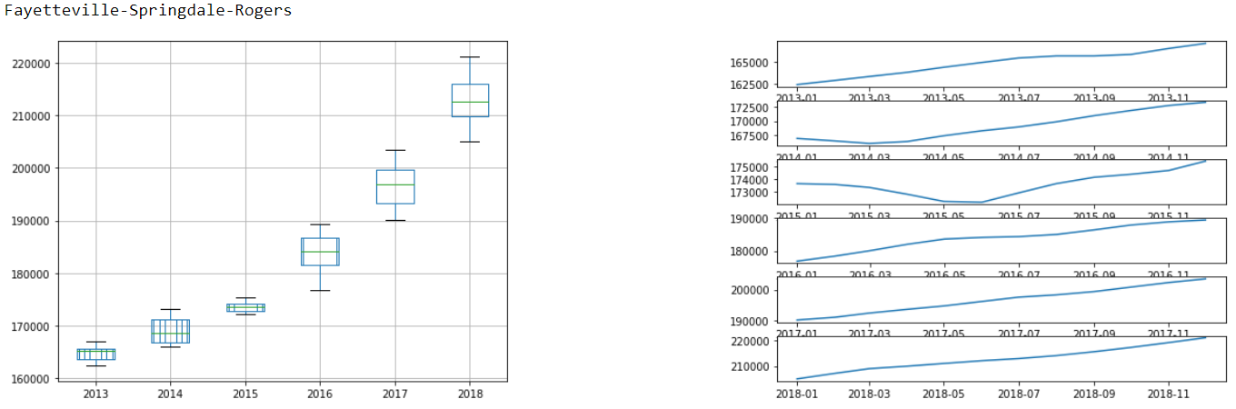
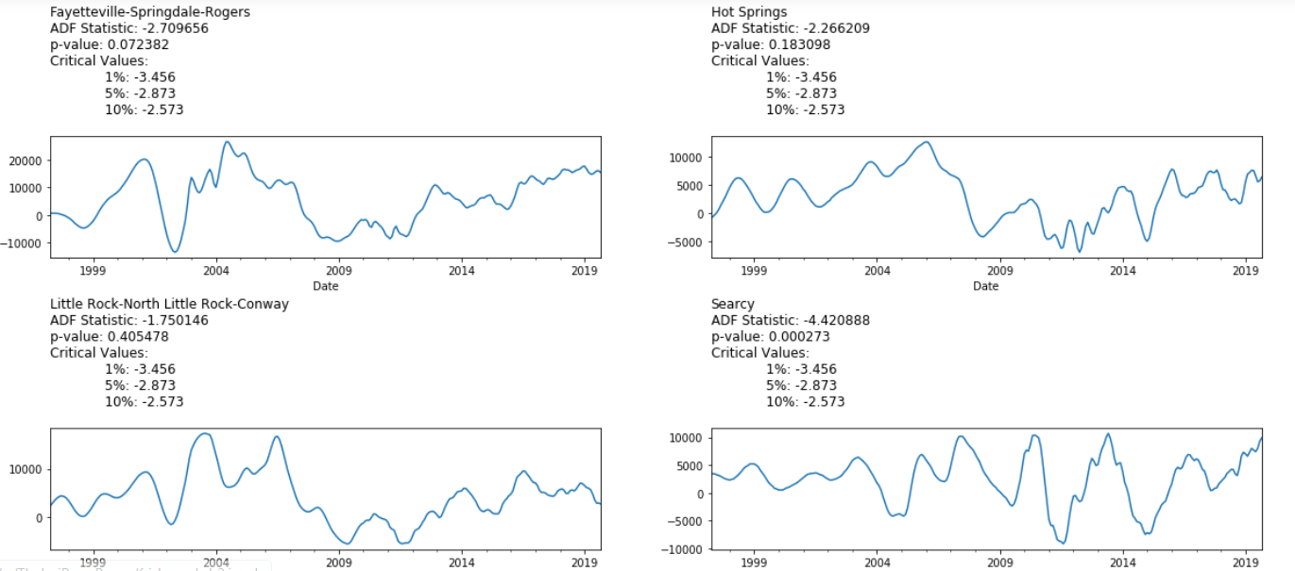
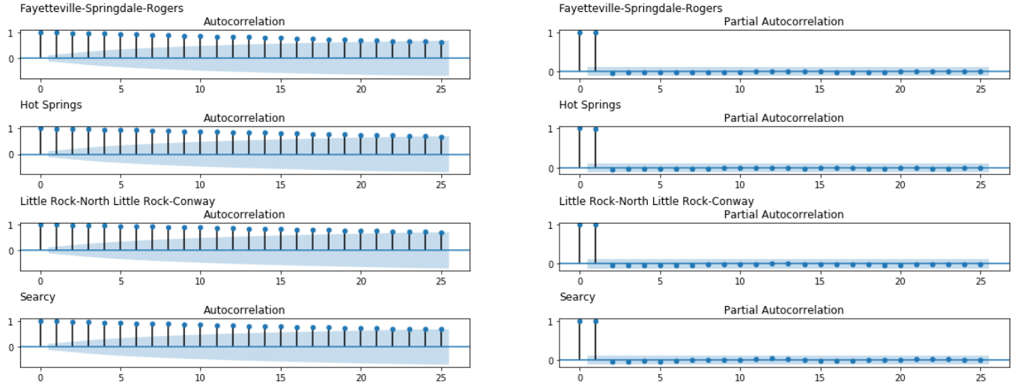
Analysis Continued..
Figure 1.2
Figure 1.6
Figure 1.2: Shows the boxplot and annual trend compared to each other to see the variations and any seasonal input for Fayetteville
Figure 1.6: Shows the stationary observation of Hot Springs, Little Rock, Fayetteville, Searcy
Figure 1.7: Shows the autocorrelation and partial auto correlation details on Hot Springs, Little Rock, Fayetteville, Searcy
Figure 1.7

Slide 7
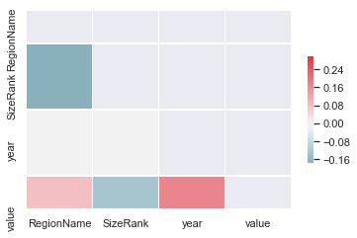
Correlation Findings
Figure 1.8: This gives the correlation matrix between all the dependent variable
It is observed that the home value is positively correlated with Year and negatively corelated with size rank as expected
Figure 1.8

Slide 8
Model and Prediction
OLS Regression for predicting ZHVI using Zillow data
OLS chooses the parameters of a linear function of a set of explanatory variables by the principle of least squares: minimizing the sum of the squares of the differences between the observed dependent variable (values of the variable being predicted) in the given dataset and those predicted by the linear function.
OLS Regression Results
==============================================================================
Dep. Variable: value R-squared: 0.986
Model: OLS Adj. R-squared: 0.986
Method: Least Squares F-statistic: 2.449e+04
Date: Sun, 10 Nov 2019 Prob (F-statistic): 0.00
Time: 10:00:53 Log-Likelihood: -3.3450e+06
No. Observations: 286604 AIC: 6.692e+06
Df Residuals: 285766 BIC: 6.700e+06
Df Model: 837
Covariance Type: nonrobust
===============================================================================

Slide 9
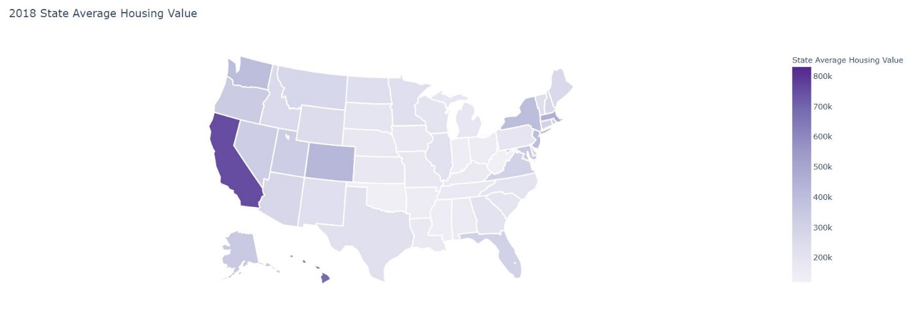
Results
State Average Housing Value is plotted in the US MAP

Slide 10
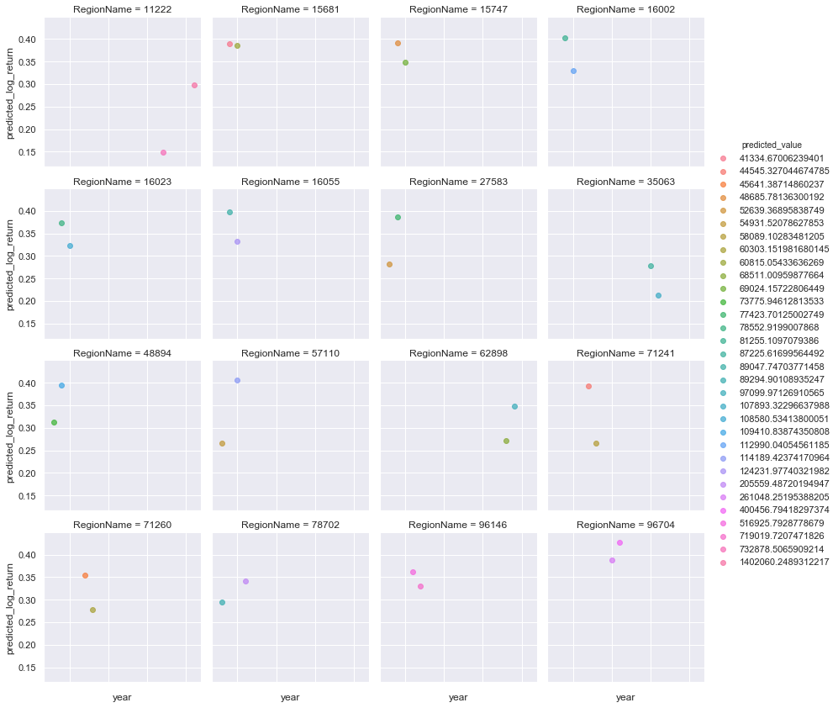
Results
Figure 2.5
Figure 2.5: Shows the top 10 zip codes which yielded consistently higher returns in the past

Slide 11
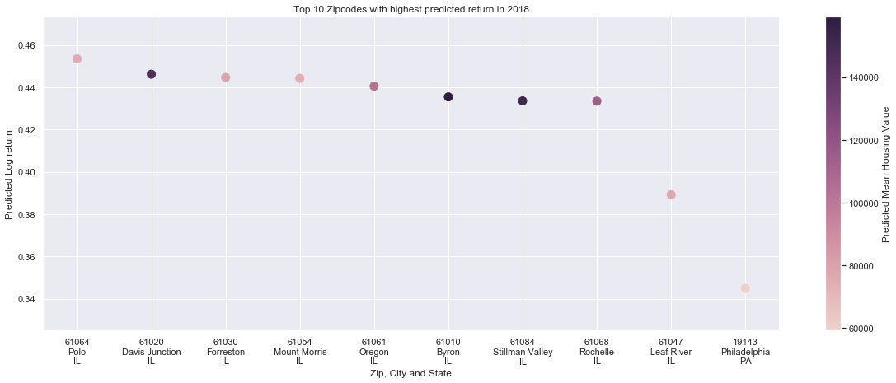
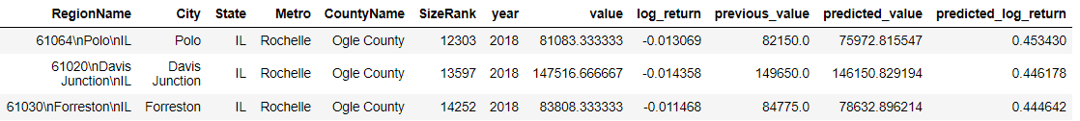
Results Continued..
Figure 2.6: Shows the top 10 zip codes with highest return in 2018
Table 2.1: It gives the top 3 zipcodes which are best for investment for the year 2018 based on the maximum log return
Figure 2.6
Table 2.1

