Slide 1
Advanced Topic Presentation - D3
Interactive Data Driven Visualization
By
ThulasiRam RuppaKrishnan
IST-719 : Information Visualization
Professor : Gary Krudys

Slide 2
D3 stands for Data-Driven Documents
Open Source
Data Driven
Interactive
Notes:
D3 stands for Data-Driven Documents. It is an open-source JavaScript library developed by Mike Bostock to create custom interactive data visualizations in the web browser using SVG, HTML and CSS.
D3.js, at its core, is not a data visualization library, but a framework to manipulate elements of a document according to a dataset

Slide 3
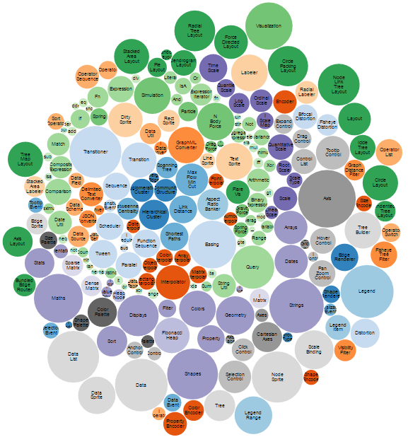
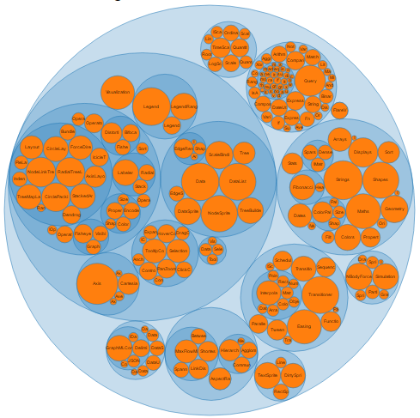
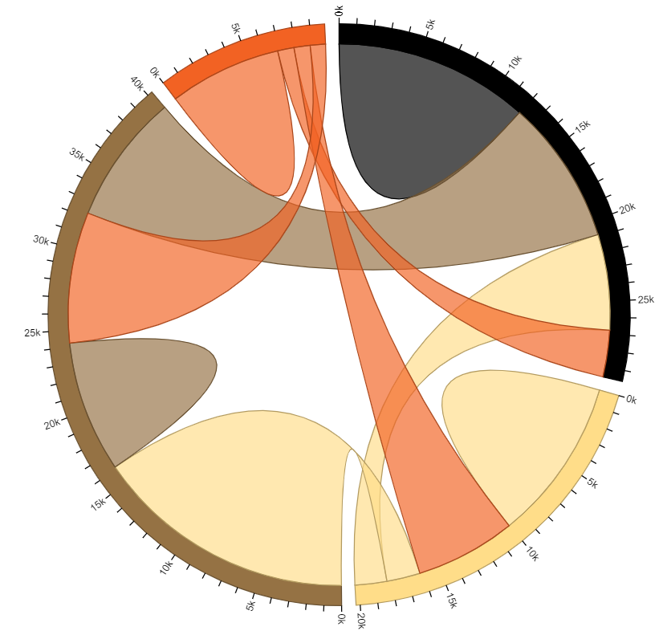
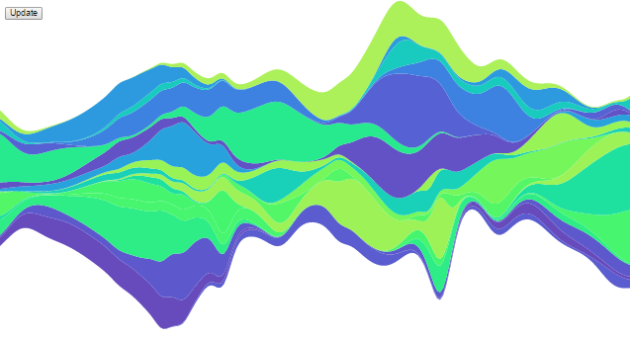
D3 Sample Charts

Slide 4
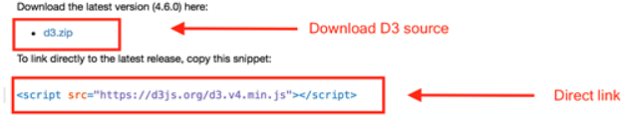
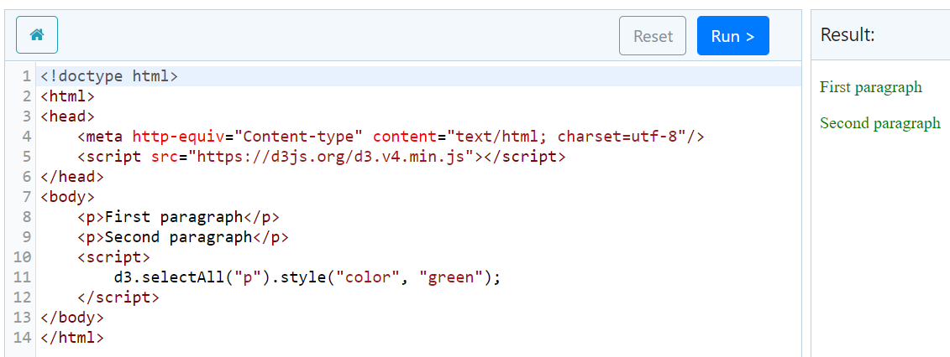
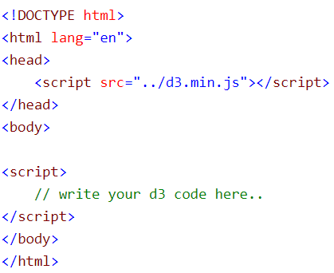
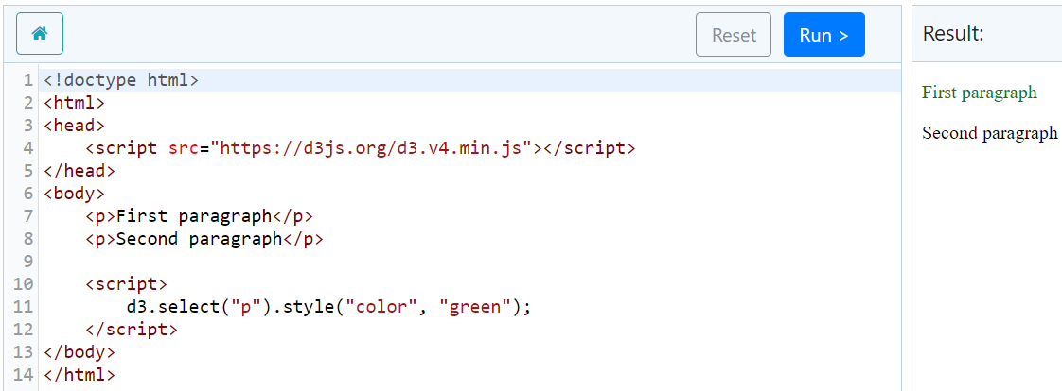
How It works - Basic
1
3
2
4

Slide 5
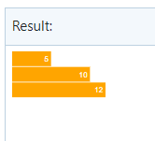
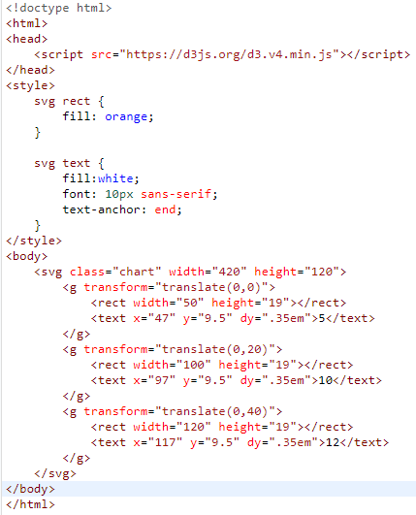
How It works - Charts

Slide 6
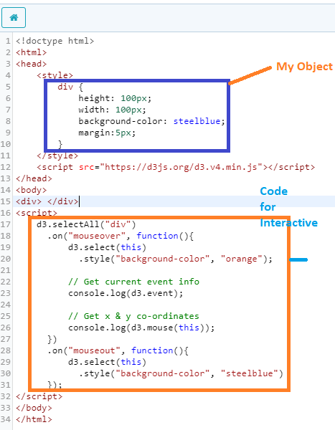
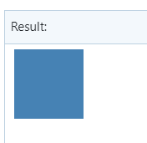
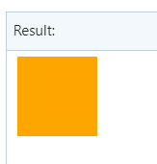

How It works – Interactive Elements

Slide 7
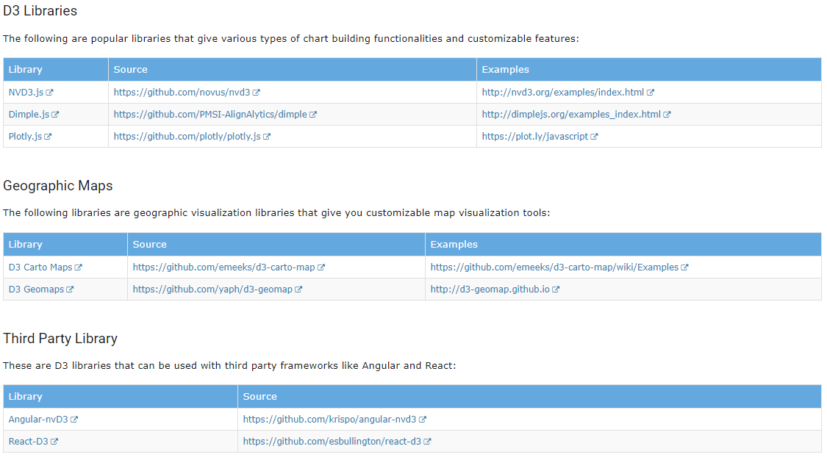
Useful Libraries
http://nvd3.org/examples/scatter.html
https://plotly.com/javascript/gapminder-example/

Slide 8
D3 Vs Plotly
D3
Plotly
Built on top of D3
Steep Learning Curve
Easy to learn
JavaScript Framework
Integrate with Python, R and MATLAB
Integrate with JavaScript, React, Angular, Python and R
Companies → New Relic, Weebly, and Repro
Manipulating documents based on data
Strictly a Data Visualization Framework
Companies → Wellzesta, Algo Edge Technologies

Slide 9



By
ThulasiRam RuppaKrishnan
IST-719 : Information Visualization
Professor : Gary Krudys

Slide 10
References
https://www.tutorialsteacher.com/d3js/
https://comparisons.financesonline.com/d3-js-vs-plotly
https://hackernoon.com/taking-data-visualization-to-another-level-4d1c47bb01a2
https://comparisons.financesonline.com/d3-js-vs-plotly

