Slide 1
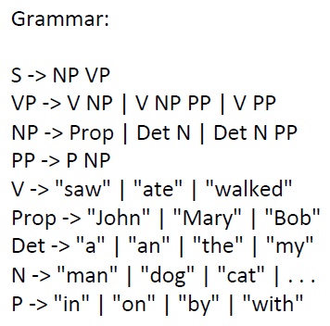
S
S
S
NP
VP
NP
VP
NP
VP
V
NP
PP
Prop
V
PP
DET
N
PP
V
NP
P
NP
DET
N
PP
P
NP
P
NP
DET
N
Prop
DET
N
P
NP
DET
N
DET
N
DET
N
John ate in the park
The man with a cat saw my dog
Bob saw a man in the park with a telescope

