Slide 1
CHAPTER 3 ASSEMBLERs From D. M. Dhamdhere

Slide 2
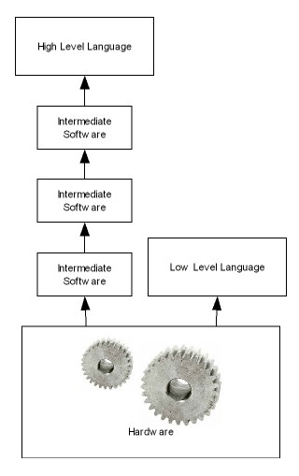
Assembly language
Machine dependent
Low level programming language

Slide 3
Elements of Assembly Language Programming
3 basic facilities
Mnemonic operation codes
Symbolic operands
Data declaration
Statement Format
Operand Format
Machine Instruction Format

Slide 4
Elements of Assembly Language Programming
3 basic facilities that simplify programming:
1) Mnemonic operation codes:
also called mnemonic opcodes. Ex. ADD, SUB etc.
Short names for machine instructions
easier to remember and use than numeric operation codes.
Their use also enables the assembler to detect use of invalid operation codes in a program.

Slide 5
Elements of Assembly Language Programming
2) Symbolic operands
Uses symbolic names ( with data or instructions ) as operands.
Frees programmer from having to think of numeric addresses in a program.
3) Data declaration
variety of notations, including the Decimal notation.
Avoids the need to manually specify constants in binary. (representations that a computer can understand, for example, specify -5 as (11111011)₂ in the two's complement representation.)

Slide 6
Elements of Assembly Language Programming
3 basic facilities that simplify programming:
1) Mnemonic operation codes
Ex. ADD, SUB etc.
2) Symbolic operands
Ex. N, RESULT , ANS etc.
3) Data declarations
ADD AREG, 5

Slide 7
START 101
READ N
MOVER BREG, ONE
MOVEM BREG, TERM
AGAIN MULT BREG, TERM
MOVER CREG, TERM
ADD CREG, ONE
MOVEM CREG, TERM
COMP CREG, N
BC LE, AGAIN
MOVEM BREG, AGAIN
PRINT RESULT
STOP
N DS 1
RESULT DS 1
ONE DC ‘1’
TERM DS 1
END
DS – declare storage
DC – declare constant
+ 09 0 113
+ 04 2 115
+ 05 2 116
+ 03 2 116
+ 04 3 116
+ 01 3 115
+ 05 3 116
+ 06 3 113
+ 07 2 104
+ 05 2 114
+ 10 0 114
+ 00 0 000
+ 00 0 001

Slide 8
Statement Format
Optional
Optional
Label
Opcode
Operand specification
, Operand Specification
AGAIN MULT BREG, TERM

Slide 9
A simple assembly language
I am always a register..!!!
Statement
Operand1
Operand2
I am always a symbolic name..!!!..!!!

Slide 10
<operand specification> syntax
<symbolic name> [± <displacement> ] [(<index register>)]
AREA refers to the memory word with which the name AREA is associated.
AREA+5 refers to the memory word that is 5 words away from the word with the name AREA. Here '5' is the displacement or offset from AREA.
AREA(4) implies indexing the operand AREA with index register 4.
Here, the operand address is obtained by adding the contents of index register 4 to the address of AREA.

Slide 11
<operand specification> syntax
AREA+5 (4) is a combination of the previous two specifications.

Slide 12
MOVER and MOVEM
MOVEM
MOVEM
Source
, Dest
MOVER
MOVER
Dest
, Source

Slide 13
Summary of Elements of assembly language
No need to memorize numeric operation codes
Mnemonic operation code
Data declarations
Symbolic Operands
Memory bindings to these names by assembler
Avoids manual conversion

Slide 14
Operand specification
Symbolic name
+ (Displacement)
Index register
AREA+5(4)

Slide 15
Mnemonic Operation Codes
Instruction Opcode | Assembly Mnemonic | Remarks
00 | STOP | Stops execution
01 | ADD | First operand is
02 | SUB | Modified
03 | MULT
04 | MOVER | Register ← memory move
05 | MOVEM | Memory ← register move
06 | COMP | Sets condition code
07 | BC | Branch on Condition
08 | DIV | Analogous to SUB
09 | READ | Performs reading and
10 | PRINT | printing

Slide 16
Syntax for BC
BC
Condition code
Memory Address
LT, LE, GT, GE, EQ, ANY
What if we want to have an unconditional jump?
Ans : Use ANY

Slide 17
Machine instruction format and example
Sign(1)
Opcode(2)
Reg Operand(1)
Memory Operand(3)
MOVER BREG, ONE
+ 04 2 115

Slide 18
START 101
READ N
MOVER BREG, ONE
MOVEM BREG, TERM
AGAIN MULT BREG, TERM
MOVER CREG, TERM
ADD CREG, ONE
MOVEM CREG, TERM
COMP CREG, N
BC LE, AGAIN
MOVEM BREG, AGAIN
PRINT RESULT
STOP
N DS 1
RESULT DS 1
ONE DC ‘1’
TERM DS 1
END
+ 09 0 113
+ 04 2 115
+ 05 2 116
+ 03 2 116
+ 04 3 116
+ 01 3 115
+ 05 3 116
+ 06 3 113
+ 07 2 104
+ 05 2 114
+ 10 0 114
+ 00 0 000

Slide 19
Types of Assembly Statements
Imperative statement
Declaration statement
Assembler Directive

Slide 20
Assembly language statements
An action to be performed during execution
For declaring constants or assigning value
1.
Imperative
3.
Assembler directives
2.
Declaration
Instructs the assembler to perform certain actions

Slide 21
1. Imperative statement
It indicates an action to be performed.
Each imperative statement typically translates into one machine instruction.
These are executable statements.
Examples:
MOVER BREG,X
STOP
READ X
PRINT Y
ADD AREG,Z

Slide 22
2. Declaration statement
Used for reserving memory area.
Syntax :
[Label] DS <constant>
or
Label DC ‘<value>’
DS = Declare storage
DC = Declare constant

Slide 23
DS statement reserves area of memory and associates name with them.
ex. A DS 10
It reserves 10 word of memory for variable A.
DC statement constructs memory words containing constants.
ex. ONE DC ‘1’
It associates the name ONE with a memory word containing the value ‘1’

Slide 24
Declaration Statements Summary
DS
(Declare Storage)
Reserves area of memory and associates names with them
Example : A DS 1
DC
(Declare constant)
Construct memory words containing constants
Example : ONE DC ‘1’

Slide 25
Does DC really create constants?
DC doesn’t really implement the constants because…
DC just initializes the memory word with the given value.
These values are not protected by assembler
They may be changed by moving the new value in that memory word.
ONE DC ‘1’
MOVEM BREG,ONE

Slide 26
Similarities with the implementation of constants in HLL
1. Immediate Operands
2. literals

Slide 27
1. Constant as immediate operand
Can be used only if the architecture of the target machine supports it.
ADD AREG,5
How to write equivalent instructions for this??
ADD AREG ,FIVE
----
FIVE DC ‘5’

Slide 28
2. Constant as Literal
???
Operand with syntax = ‘ value ’
What is the Difference between literal and constant..??
ADD AREG, =‘5’
The location of a literal cant be specified. So its value cant be changed like constant…
A literal is a value that is expressed as itself and constant is a data type that substitutes a literal

Slide 29
2. Literal
???
What is the Difference between literal and immediate operand..??
( Literal )
ADD AREG, =‘5’
No Architectural provision is needed for literal like immediate operand..
( Imm. operand )
ADD AREG,5

Slide 30
3. Assembler Directive
The first word of the target program should be placed in the memory word with the address specified..
START
END
Indicates the end of the source program..

Slide 31
1. START
START <Constant>
Indicates that first word of the target program should be placed in the memory word with address <constant>.
Ex: START 500
First word of the target program is stored from memory location 500 onwards.
2. END
Indicates end of the source program.

Slide 32
Perform following :
Write an Assembly language Program to find Factorial of a given number.
Write equivalent machine code for the program.

Slide 33
START 101
READ N
MOVER BREG, ONE
MOVEM BREG, TERM
AGAIN MULT BREG, TERM
MOVER CREG, TERM
ADD CREG, ONE
MOVEM CREG, TERM
COMP CREG, N
BC LE, AGAIN
MOVEM BREG, RESULT
PRINT RESULT
STOP
N DS 1
RESULT DS 1
ONE DC ‘1’
TERM DS 1
END

Slide 34
START 101
READ N
MOVER BREG, ONE
MOVEM BREG, TERM
AGAIN MULT BREG, TERM
MOVER CREG, TERM
ADD CREG, ONE
MOVEM CREG, TERM
COMP CREG, N
BC LE, AGAIN
MOVEM BREG, RESULT
PRINT RESULT
STOP
N DS 1
RESULT DS 1
ONE DC ‘1’
TERM DS 1
END
+ 09 0 113
+ 04 2 115
+ 05 2 116
+ 03 2 116
+ 04 3 116
+ 01 3 115
+ 05 3 116
+ 06 3 113
+ 07 2 104
+ 05 2 114
+ 10 0 114
+ 00 0 000

Slide 35
START 101
READ N
MOVER BREG, ONE
MOVEM BREG, TERM
AGAIN MULT BREG, TERM
MOVER CREG, TERM
ADD CREG, ONE
MOVEM CREG, TERM
COMP CREG, N
BC LE, AGAIN
DIV BREG, TWO
MOVEM BREG, RESULT
PRINT RESULT
STOP
N DS 1
RESULT DS 1
ONE DC ‘1’
TERM DS 1
TWO DC ‘2’
END
+ 09 0 114
+ 04 2 116
+ 05 2 117
+ 03 2 117
+ 04 3 117
+ 01 3 116
+ 05 3 117
+ 06 3 114
+ 07 2 104
+ 08 2 118
+ 05 0 115
+ 10 0 115
+ 00 0 000

Slide 36
Design of Assembler or Analysis and synthesis phases of an assembler

Slide 37
Design Specification of assembler
Identify the information necessary to perform the task
Design the suitable data structures to record the information
Determine the processing necessary to obtain and manage the information
Determine the processing necessary to perform the task

Slide 38
Two phases of assembler
2.
Synthesis
1.
Analysis

Slide 39
op
code
mnemonic
length
ADD | 01 | 1
SUB | 02 | 1
Mnemonics table
Source
Program
Analysis phase
Synthesis phase
Target
Program
symbol
address
AGAIN | 104
N | 113
Symbol table

Slide 40
1. Analysis phase
Main Task : Building of Symbol table
For this, it must determine the address with which the symbolic names are associated.
“To implement memory allocation a data structure called location counter (LC) is used”.
LC is initialized to the constant in the START statement.
The processing involved in maintaining the location counter as LC processing.
Memory allocation
LC
Processing

Slide 41
Tasks of analysis phase
1. Separate label, opcode & operand
2. Build the symbol table
Analysis
3. Perform LC processing
4. Construct IC

Slide 42
2. Synthesis Phase
MOVER BREG, ONE
Which information do we need to convert this instruction in to the equivalent machine language instruction???
1.
Address of the memory word for ONE
2.
Machine Operation code for MOVER

Slide 43
1.
Address of the memory word for ONE
2.
Machine Operation code for MOVER
Depends on the source program..!!
Doesn’t depend on the source program..!!

Slide 44
Data structure used by Synthesis phase..
1. Symbol Table
2. Mnemonic Table
Name | Address
Mnemonic | Opcode
Built by the analysis phase…
Used during the synthesis phase…

Slide 45
Tasks of Synthesis phase
1. Obtain the machine opcode corresponding to the mnemonic
2. Obtain the address of a memory operand from symbol table
Synthesis
3. Synthesize the machine instruction

Slide 46
Types of Assembler or single pass and two pass assembler.

Slide 47
Pass structure of Assembler or Types of Assembler
2.
Two pass assembler
1.
Single Pass Assembler

Slide 48
Two pass assembler
1st Pass
Performs analysis
2nd Pass
Performs synthesis

Slide 49
Two pass assembler
1st Pass
Performs analysis
2nd Pass
Performs synthesis
Constructs
1.
Data structures
(symbol table)
Intermediate Code
2.
Intermediate form of source prog

Slide 50
op
code
mnemonic
length
ADD | 01 | 1
SUB | 02 | 1
Mnemonics table
Source
Program
Analysis phase
Synthesis phase
Target
Program
symbol
address
AGAIN | 104
N | 113
Symbol table

Slide 51
1) Two Pass Assembler
1st Pass
LC processing is performed and symbols are entered into the symbol table. Hence first pass performs analysis of the source program.
So, Two pass translation of assembly lang. program can handle forward reference easily.

Slide 52
2nd Pass
The second pass synthesizes the target form using the address information found in the symbol table.
First pass constructs an intermediate representation of the source program and that will be used by second pass.
IR consists of two main components: data structure + IC (intermediate code)

Slide 53
Design of a two pass assembler
1. Separate label, opcode & operand
2. Build the symbol table
1st pass
3. Perform LC processing
4. Construct IC

Slide 54
2nd Pass
2nd Pass
Synthesize the machine instruction

Slide 55
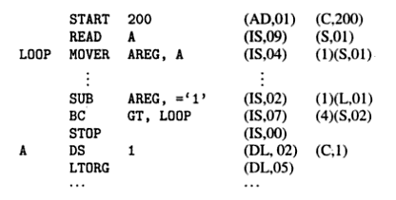

Slide 56
2) One Pass Assembler
It requires 1 scan of the source program to generate machine code.
“The process of forward references is handled using a technique called back patching”.
The operand field of an instruction containing forward references is left blank initially.
A table of instruction containing forward references is maintained separately called table of incomplete instruction (TII).

Slide 57
This table can be used to fill-up the addresses in incomplete instruction.
The address of the forward referenced symbols is put in the blank field with the help of back patching list.

Slide 58
Single Pass translation
Problem of Forward reference
Handled by Process called Back patching

Slide 59
Back patching
The operand field of an instruction is containing forward reference is kept blank initially.
The address of that symbol is put into field when its address is encountered.

Slide 60
START 101
MOVER BREG, ONE
MOVEM BREG, TERM
AGAIN MULT BREG, TERM
MOVER CREG, TERM
ADD CREG, ONE
MOVEM CREG, TERM
COMP CREG, N
BC LE, AGAIN
MOVEM BREG, AGAIN
PRINT RESULT
STOP
N DS 1
RESULT DS 1
ONE DC ‘1’
TERM DS 1
END
+ 09 0 113
+ 04 2 115
+ 05 2 116
+ 03 2 116
+ 04 3 116
+ 01 3 115
+ 05 3 116
+ 06 3 113
+ 07 2 104
+ 05 2 114
+ 10 0 114
+ 00 0 000
READ N

Slide 61
Back patching
Table of Incomplete Instruction (TII)
Instruction address | Symbol
101 | N
102 | ONE

Slide 62
After the END statement is processed…
Symbol Table
TII
Addresses of all the symbols defined in prog
Information of all forward references

Slide 63
Back patching
The assembler can now process each entry in TII to complete the concerned instruction.
Example – (101,N)
Example – (102,ONE)

Slide 64
Back patching
Example – (101,N)
Example – (102,ONE)
Obtain the Address of N from symbol table
Insert It into the instruction at location 101
Obtain the Address of ONE from symbol table
Insert It into the instruction at location 102

Slide 65
Advanced Assembler Directives

Slide 66
Advanced Assembler Directives
EQU
LTORG
ORIGIN

Slide 67
1. ORIGIN
ORIGIN < Address Specification >
2.
constant
1.
Operand Specification
2.
constant
1.
Operand Specification
ORIGIN LAST+1
ORIGIN 217

Slide 68
ORIGIN instructs the assembler to put the address given by <address specification> in LC.
It is useful when your target program does not consist of a single contiguous area of memory.
Operand Specification – Ability to perform Relative LC Processing, not absolute.

Slide 69
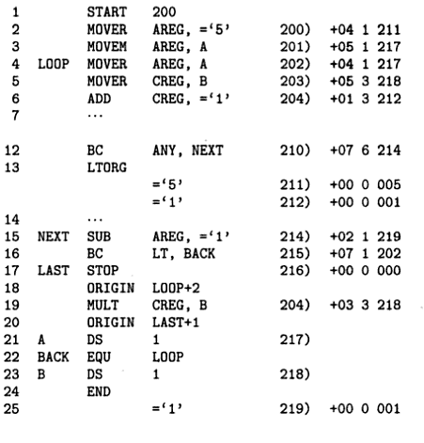
ORIGIN LOOP + 2
ORIGIN LAST + 1

Slide 70
ORIGIN LOOP + 2 puts the address 204 in LC because symbol LOOP is associated with the address 202.
The next statement MULT CREG, B is therefore given the address 204.

Slide 71
2. EQU
Defines the symbol to represent <add spec>
Symbol EQU < address specification >
1.
Operand Specification
2.
constant
BACK EQU LOOP
BACK EQU 200
It associates the name with the address.
However, the address in LC is not affected.

Slide 72
BACK EQU LOOP

Slide 73
BACK EQU LOOP, the assembler associates the symbol BACK with the address of LOOP i.e. with 202.

Slide 74
3. LTORG
Literals can be handled in two steps.
1) First, the literal is treated as if it is a <value> in a DC statement.
2) Second, This memory word is used as the operand in place of the literal.

Slide 75
Q. Where should the assembler place the word corresponding to the literal?
Ans :
LTORG statement permits the programmer to specify where literals should be placed.
By Default assembler places the literals after END statement.
At every LTORG statement, as also at the END statement, assembler allocates memory to the literals of the literal pool.
Pool contains all literals used in the program since the start of the program or since the last LTORG statement.

Slide 76
NOTE s:
All references to literals are forward references by definition.
If a program does not use an LTORG statement, the assembler would enter all literals used in the program into a single pool and allocate memory to them after END statement.

Slide 77
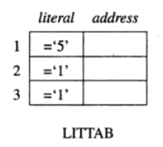
MOVER AREG, =‘5’
211
ADD CREG, =‘1’
212
211
211
LTORG
=‘5’
212
=‘1’
SUB AREG, =‘1’
219
219
END
=‘1’

Slide 78
MOVER AREG, =‘5’
211
ADD CREG, =‘1’
212
211
LTORG
=‘5’
212
=‘1’
219
SUB AREG, =‘1’
219
END
=‘1’

Slide 79
The literals ='5' and ='1' are added to the literal pool in Statements 2 and 6, respectively.
The first LTORG statement (Statement 13) allocates the addresses 211 and 212 to the values '5' and ‘1’.
A new literal pool is now started. The value 1 is put into this pool in Statement 15. This value is allocated the address 219 while processing the END statement.
The literal ='1' used in Statement 15 therefore refers to location 219 of the second pool of literals rather than location 212 of the first pool.
Notes:
Scope of the lierals defined by LTORG is upto the END statement.

Slide 80
Design of Two-pass Assembler or Data structures of assembler pass I or OPTAB, SYMTAB, LITTAB & POOLTAB.

Slide 81
Pass -1 of the Assembler
OPTAB
SYMTAB
LITTAB
Table of mnemonic opcodes and its class
Contains symbol name, address
Table of literals used in the program

Slide 82
1. OPTAB
Contains
1. mnemonic opcode
2. class
3. mnemonic information
The class field indicates whether the opcode belongs to an imperative statement (IS), a declaration statement (DS), or an assembler directive (AD).
If an imperative, the mnemonics info field contains the pair (machine code, instruction length), else it contains the id of a routine to handle the declaration or directive statement.

Slide 83
2. Class
IS
(Imperative)
DS
(Declarative)
AD
(Assembler Directive)

Slide 84

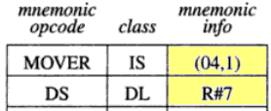
2.Class
IS
DL
AD
3. Mnemonic info
(Machine Opcode, Inst Length)
3. Mnemonic info
ID of a routine

Slide 85
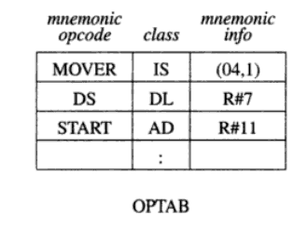
OPTAB

Slide 86
2. SYMTAB
A SYMTAB entry contains 3 fields :
1. symbol name,
2. field address
3. length.
To find address, we must fix the addresses of all program elements preceding it. This function is called memory allocation.

Slide 87
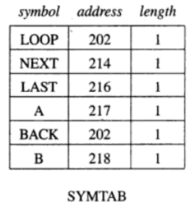
SYMTAB

Slide 88
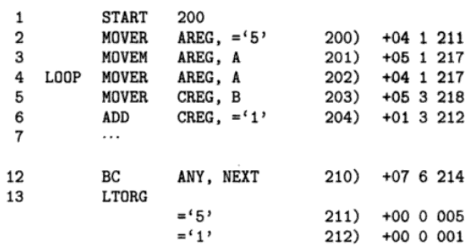
LITTAB
A table of literals used in the program.
Contains two fields.
1. Literal
2. Address

Slide 89
POOLTAB
Awareness of different literal pools is maintained using table POOLTAB.
It contains the literal number of the starting literal of each literal pool.
At any stage, the current literal pool is the last pool in LITTAB.
On encountering an LTORG statement (or the END statement), literals in the current pool are allocated addresses starting with the current value in LC and LC is appropriately incremented.

Slide 90

POOLTAB

Slide 91
POOLTAB

Slide 92
Intermediate Code

Slide 93
Intermediate Code Format
Intermediate Code Format
Variant I
Variant II

Slide 94
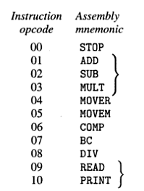
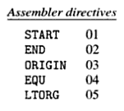

Address
Opcode
Operands
(Statement Class, Code)
AD
IS
DL

Slide 95
Address
Opcode
Operands
(Operand Class, Code)
Class
C
(Constant)
Ex. 200
L
(Literal)
Ex. ‘1’
S
(symbol)
Ex. ONE

Slide 96
How to convert to Variant – I?
Opcode is converted to (Statement Class, Code)
First operand is represented by a single digit no. which is a code
for a register (1-4 for AREG - DREG)
or
Condition Code itself (1-6 for LT- - ANY)
Second operand, which is a memory operand, is represented by a pair of the form
(Operand Class, Code)
C – Constants Ex . START 200 (AD, 01) (C , 200)
L - Literals Ex . SUB AREG, =‘1’ (IS , 02) (L, 01)
S - Symbols Ex . READ A (IS , 09) (S, 01)
Code contains ordinal no. of operand’s entry in LITTAB and SYMTAB
So, It is written as sequential no. for both.

Slide 97
How to convert to Variant – I?
Opcode is converted to (Statement Class, Code)
First operand is represented by a single digit no. which is a code
for a register (1-4 for AREG - DREG)
or
Condition Code itself (1-6 for LT- - ANY)

Slide 98
How to convert to Variant – I?
Second operand, which is a memory operand, is represented by a pair of the form
(Operand Class, Code)
C – Constants Ex . START 200 (AD, 01) (C , 200)
L - Literals Ex . SUB AREG, =‘1’ (IS , 02) (1) (L, 01)
S - Symbols Ex . READ A (IS , 09) (S, 01)
Code contains ordinal no. of operand’s entry in LITTAB and SYMTAB
So, It is written as sequential no. for both.

Slide 99
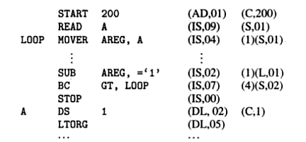
Intermediate code – Variant I
Assembly Language Code Variant I
(AD,05)

Slide 100
How to convert to Variant - II
variant requires extra work in Pass I since Operand fields are completely Processed.
However this processing simplifies tasks of Pass II.
In Variant II, for Declarative Statements and Assembler Directives, Processing of Variant field is essential, to support LC processing.
N DS 1
ONE DC ‘1’
START 200
Declarative Statement
Assembler Directive
Processing of these fields is necessary.
Hence these fields contains processed forms in Variant II.
For Imperative Statements Operand field is Partially Processed. It is processed only to identify Literal references.
And Literals are entered into LITTAB and represented as (L,m) in LC.
What is not processed at all in Pass I…?
Ans : Symbolic References

Slide 101
How to convert to Variant - II
Variant 1 requires extra work in Pass I since Operand fields are completely Processed.
However this processing simplifies tasks of Pass II.
In Variant II, for Declarative Statements and Assembler Directives, Processing of Variant field is essential, to support LC processing.
N DS 1
ONE DC ‘1’
START 200
Declarative Statement
Assembler Directive

Slide 102
N DS 1
ONE DC ‘1’
START 200
Declarative Statement
Assembler Directive
Processing of these fields is necessary.
Hence these fields contains processed forms in Variant II.
For Imperative Statements Operand field is Partially Processed. It is processed only to identify Literal references.
And Literals are entered into LITTAB and represented as (L,m) in LC.
What is not processed at all in Pass I…?
Ans : Symbolic References, Register Code, Conditional Code

Slide 103
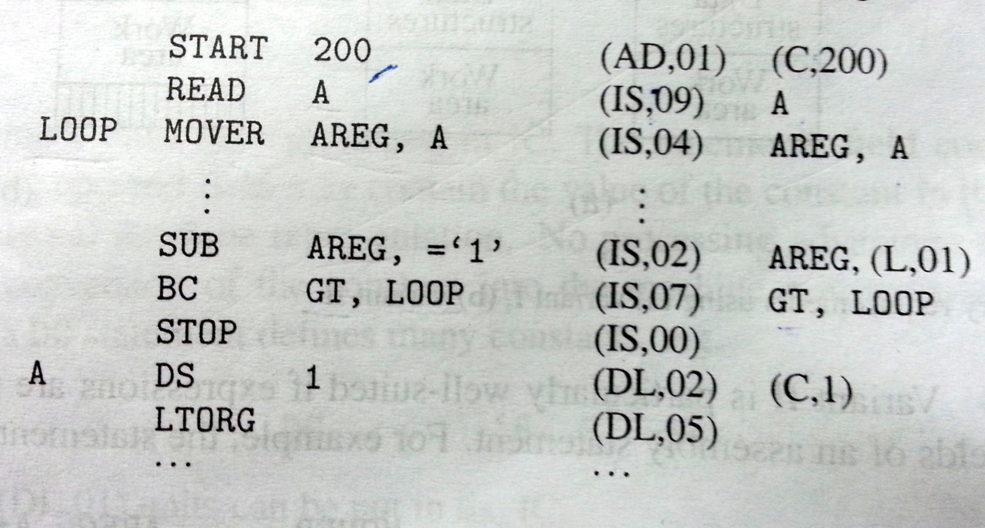
Intermediate code – Variant I I
Assembly Language Code Variant II
(AD,05)

Slide 104
Compression of Variant I and Variant II

Slide 105
Variant I
It requires extra work in Pass 1, because Operand fields are completely Processed.
However, this processing simplifies the task of Pass 2.
So Pass 2 doesn’t require more processing and its work is simple.
IC is quite compact.
It can be as compact as target code itself if each operand reference like (S, n) can be represented in same no. of bits as an operand address in a machine instruction.
Pass 2
Pass 1
Data
Structures
Data
Structures
Work
Area
Work
Area

Slide 106
Variant II
It reduces the work of pass 1 by transferring the burden of operand processing from Pass 1 to Pass 2.
The Memory operand of typical Imperative statement is same as in source code.
So, IC is less Compact.
On other hand, by making Pass 2 to perform more work, the functions and memory requirements of both the passes get better balanced.
Pass 1
Pass 2
Data
Structures
Data
Structures
Work
Area
Work
Area

Slide 107
One Pass Assembler | Two Pass Assembler
1) Scan the program only once and creates the equivalent machine code. | 1) Scan the program two times and creates the equivalent machine code.
2) Problem of forward reference is there. ( Assembler program requires that the symbols should be defined somewhere in the program. But in some cases symbols may be used prior to its definition. Such a reference is called as Forward Reference. ) | 2) It can easily handle forward references.
3) Variable and functions are required to be declared first. | 3) Variable and functions are not required to be declared first.
4) Sophisticated Optimization is needed to generate high quality code. | 4) It can optimize compiled code by performing analysis on the parsed code before compiling.

Slide 108
?????

