Slide 1

Programming
Arrays

Slide 2
Arrays
An array is a collection of data elements that are of the same type (e.g., a collection of integers, collection of characters, collection of doubles).
All the data items of an array are stored in consecutive memory locations in RAM. The elements of an array are of same data type and each item can be accessed using the same name.

Slide 3
Declaration of single-dimensional Array
An array must be declared before it is used.
During declaration, the size of the array has to be specified.
The size used during declaration of the array informs the compiler to allocate and reserve the specified memory locations.
Syntax:-
data_type array_name[size];
Ex:
int a[5]; float x[10];

Slide 4
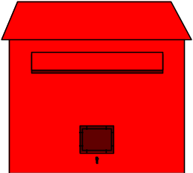
Array Declaration
  // array of 10 uninitialized ints
  int Ar[10];
0
1
2
3
4
5
6
7
8
9
Ar
--
--
--
--
--
--
--
--
--
--
0
1
2
3
4
5

Slide 5
Initialization of Array
Initialize elements after declaring array, otherwise they contain garbage.
Initialization is same way as ordinary variable declared.
Initialize array by two ways.
1) compile time
2) Run time

Slide 6
Compile time initialization
Syntax:
Data_type arr_name[size]= {list of values};
Example:
int number[5]={1,2,3}
If number of values in list is less than number of elements then only that elements will initialized & remaining will set to zero.
In above example 1st three element set to 1,2,3 and remaining is zero or null.
If size mitted then compiler allocate space.

Slide 7
Run time Initialization
An array can be explicitly initialized at run time.
This approach is usually applied for initializing large arrays.
Ex:- scanf can be used to initialize an array.
int x[3];
scanf(“%d%d%d”,&x[0],&x[1],&x[2]);
The above statements will initialize array elements with the values entered through the key board.

Slide 8
Continue..
for(i=0;i<100;i=i+1)
{
if(i<50)
sum[i]=0.0;
else
sum[i]=1.0;
}
The first 50 elements of the array sum are initialized to 0 while the remaining 50 are initialized to 1.0 at run time.

Slide 9
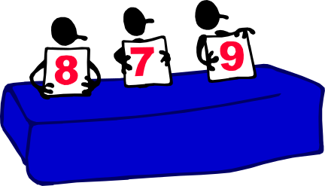

Array Applications
Given a list of test scores, determine the maximum and minimum scores.
Read in a list of student names and rearrange them in alphabetical order (sorting).
Given the height measurements of students in a class, output the names of those students who are taller than average.

Slide 10

Subscripting
Declare an array of 10 integers:
  int Ar[10]; // array of 10 ints
To access an individual element we must apply a subscript to array named Ar.
  A subscript is a bracketed expression.
    The expression in the brackets is known as the index.
  First element of array has index 0.
    Ar[0]
  Second element of array has index 1, and so on.
    Ar[1], Ar[2], Ar[3],…
  Last element has an index one less than the size of the array.
    Ar[9]
Incorrect indexing is a common error.

Slide 11
Subscripting
  // array of 10 uninitialized ints
  int Ar[10];
  Ar[3] = 1;
  int x = Ar[3];
--
1
--
--
--
--
0
1
2
3
4
5
6
7
8
9
Ar
--
--
--
1
--
--
--
--
--
--
Ar[0]
Ar[1]
Ar[2]
Ar[3]
Ar[4]
Ar[5]
Ar[6]
Ar[7]
Ar[8]
Ar[9]

Slide 12
Subscripting Example 1
  //Find sum marks of n students.
#include <stdio.h>
#include <conio.h>
  void main( ) {
  int marks[10],i,n,sum=0; // array for 10 integers
  printf(“Enter no. of students”);
  scanf(“%d”,&n);
  for(i=0;i<n;i++)
  {
  printf(“enter marks:%d”,i++);
  scanf(“%d”, &marks[i]);
  sum+=marks[i];
  }
  printf(“sum=%d”, sum);
  getch();
  }

Slide 13
Declaration of two-dimensional Array
In two dimensional arrays the array is divided into rows and columns.
These are well suited to handle a table of data.
Syntax:
data_type array_name[row_size][column_size];
Ex:-
int arr[3][3];

Slide 14
Initialization of two-dimensional Array
Two-dimensional arrays may be initialized by following their declaration with a list of initial values enclosed in braces.
Ex:
int a[2][3]={0,0,0,1,1,1};
initializes the elements of the first row to zero and the second row to one. The initialization is done row by row.

Slide 15
Continue..
The above statement can also be written as
int a[2][3] = {{ 0,0,0},{1,1,1}};
by surrounding the elements of each row by braces.
We can also initialize a two-dimensional array in the form of a matrix as shown below
int a[2][3]={
{0,0,0},
{1,1,1}
};

Slide 16
Multi-Dimensional Array
In multidimensional arrays the array is divided into rows and columns& called as n-dimensional array.
while considering multidimensional arrays we will be discussing mainly about two dimensional arrays and a bit about three dimensional arrays.
Syntax:
data_type array_name[size1][size2]
[size3]------[sizeN];

Slide 17
Example(3*3 Matrix)
#include<stdio.h>
#include<conio.h>
Void main() {
int i, j, a[3][3];
printf(“enter elements of 3*3 matrix”);
for(i=0; i<3; i++)
for(j=0; j<3; j++)
{
printf(“a[%d][%d]=”, i ,j);
scanf(“%d”, &a[i][j]); }

Slide 18
Continue…
printf(“elements in 3*3 matrix”);
for(i=0; i<3; i++)
{
printf(“\n \t \t”);
for(j=0; j<3; j++)
printf(“%d”, a[i][j]);
}
getch();

Slide 19
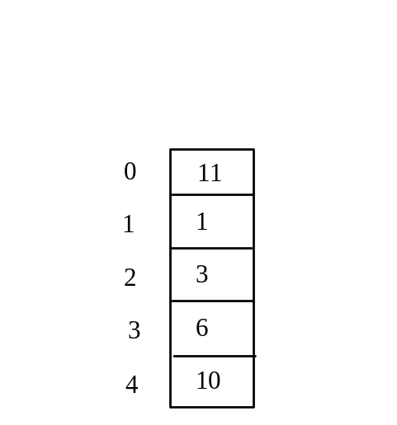
Program with Arrays
int main()
{
int values[5]= {11,1,3,6,10};
for (int i = 1; i < 5; i++)
{
values[i] = values[i] + values[i-1];
}
values[0] = values[1] + values[4];
}

Slide 20
Printing arrays
To print an array, you have to print each element in the array using a loop like the following:
for (int i = 0; i < ARRAY_SIZE; i++)
{
printf( “myList[i] “);
}

Slide 21
Summing All Elements
Use a variable named total to store the sum. Initially total is 0. Add each element in the array to total using a loop like this:
double total = 0;
for (int i = 0; i < ARRAY_SIZE; i++)
{
total += myList[i];
}

