Slide 1
OS
Chapter – 2
Threads
Prepared By : Sheetal J. Nagar
Atmiya Institute of Technology & Science, Rajkot

Slide 2
Topics Covered
Thread Introduction
Thread Structure
Types of Threads
Difference between Process and threads
Difference between Kernel level thread and User level thread
Multithreading Models

Slide 3
1) What is thread?
In traditional operating systems, each process has an address space and a single thread of execution.
In many situations, it is desirable to have multiple threads of control in the same address space running in parallel, as though they were separate processes (except for the shared address space).
“Thread is the smallest unit of processing that can be scheduled by an operating system”.
Because threads have some of the properties of processes, they are sometimes called “lightweight processes”.

Slide 4
2) Thread Structure
  The thread has
    a program counter that keeps track of which instruction to execute next.
    registers, which holds its current working variables.
    stack, which contains the execution history, with one frame for each procedure called but not yet returned from.

Slide 5
  “A thread must execute in some process”.
  But the thread and its process are different concepts and can be treated separately.
  What threads add to the process model is to allow multiple executions to take place in the same process environment (same address space), to a large degree independent of one another.
  Having multiple threads running in parallel in one process is similar to having multiple processes running in parallel in one computer.

Slide 6
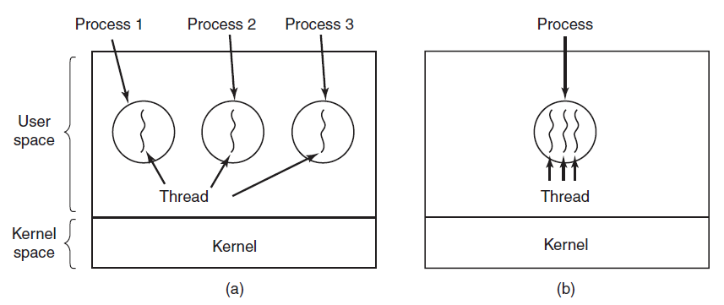
(a) Three processes each with one thread.
(b) One process with three threads.

Slide 7
In Fig. (a) we see three traditional processes. Each process has its own address space and a single thread of control. Each of them operates in a different address space,
In Fig. (b) we see a single process with three threads of control. all three of them share the same address space.
Like a traditional process (i.e., a process with only one thread), a thread can be in any one of several states: new, ready, running, blocked, or terminated.

Slide 8
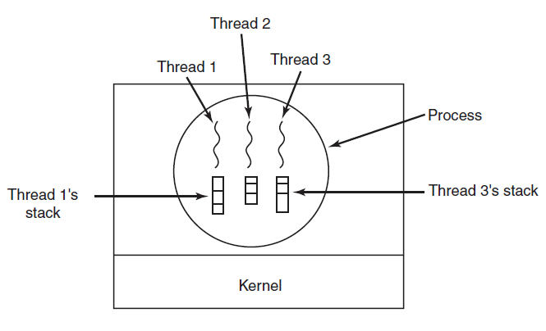
Fig : Each thread has its own stack

Slide 9
3) Types of threads

Slide 10
Types of threads
1) User Level Threads
2) Kernel Level Threads

Slide 11
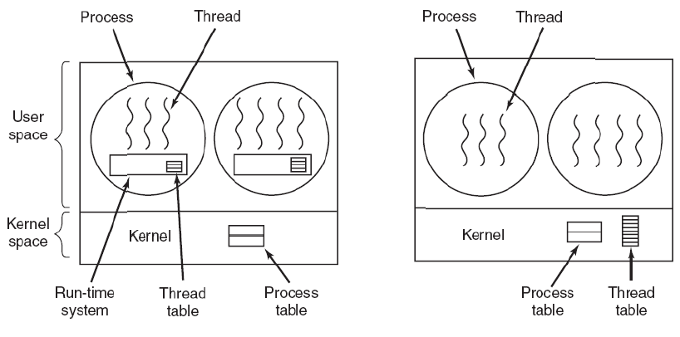
1) User Level Threads
  User level threads are implemented in user level libraries.
  The kernel knows nothing about user level threads and manages them as if they were single threaded processes.
Run-time
System

Slide 12
  When threads are managed in user space, each process needs its own private thread table to keep track of the threads in that process.
  This table keeps track only of the thread properties, such as each thread’s program counter, stack pointer, registers, state, and so forth.
  The thread table is managed by the run-time system.

Slide 13
Advantages of User level Threads
    Simple Representation: Each thread is represented simply by a PC, registers, stack and a small control block, all stored in the user process address space.
    Simple Management: This simply means that creating a thread, switching between threads and synchronization between threads can all be done without interference of the kernel.
    Fast and Efficient: Thread switching is not much more expensive than a procedure call.
    It can be implemented on an Operating System that does not support threads.
    A user level thread does not require modification to operating systems.
    They allow each process to have its own customized scheduling algorithm.

Slide 14
Disadvantages of User Level Thread
    There is a lack of coordination between threads and operating system kernel. Therefore, process as a whole gets “one time slice” irrespective of whether process has one thread or 1000 threads within. It is up to each thread to give up control to other threads.
    Here, If a thread starts running, no other thread in that process will ever run unless the first thread voluntarily gives up the CPU.
    A user level thread requires non-blocking systems call. Otherwise, entire process will be blocked in the kernel, even if a single thread is blocked but other runnable threads are present.

Slide 15
2) Kernel Level Threads
  Here, kernel knows about threads and manages the threads.
  Instead of thread table in each process, the kernel has a thread table that keeps track of all threads in the system. (In addition to the traditional process table to keep track of processes)
  Kernel provides system call to create and manage threads.

Slide 16
Advantages of Kernel Level Threads
    Because kernel has full knowledge of all threads, scheduler may decide to give more time to a process having large number of threads than process having small number of threads.
    Blocking of one thread in a process will not affect the other threads in the same process as Kernel knows about multiple threads present so it will schedule other runnable thread.
    So, Kernel threads do not require any new, non-blocking system calls.
Notes:
Kernel threads do not require any new, non-blocking system calls.

Slide 17
  Disadvantages of Kernel Level Threads
    The kernel level threads are slow and inefficient. As threads are managed by system calls, at considerably greater cost.
    Since kernel must manage and schedule threads as well as processes. It requires a full Thread Control Block (TCB) for each thread to maintain information about threads.
    As a result there is significant overhead and increased in kernel complexity.

Slide 18
User Level Threads | Kernel Level Threads
1) The user level threads are faster and easier to create and manage. | 1) The kernel-level threads are slower and complex to create and manage.
2) Supported above the kernel and implemented by thread library at user level. | 2) Directly supported from the OS.
3) Can run on any OS. | 3) Specific to the OS.
4) A library provides support for thread creation , scheduling and management with no support from kernel. | 4) Thread creation , scheduling and management is done in kernel space with the help of OS directly.
5) Kernel is unaware of User level threads. | 5) Kernel has full knowledge of these threads.
6) Process as a whole gets “one time slice” irrespective of whether process has one thread or 1000 threads within. | 6) Scheduler may decide to give more time to a process having large number of threads than process having small number of threads.

Slide 19
Process | Thread
1) Process is heavy weight and uses more resources. | 1) Thread is light weight and uses less resources than a process.
2) Process switching needs interaction with operating system | 2) Thread switching does not need to interact with operating system.
3) All the processes have separate address space. | 3) All the threads of a process share common address space.
4) Process switching is more expensive . | 4) Thread switching is less expensive.
5) Processes are complex to create because it requires separate address space. | 5) Threads are easier to create because they don't require separate address space.
6) If one process terminates, its resources are deallocated and all its threads are terminated. | 6) If a thread in a process terminates, another thread of the same process can run.
7) Processes can live on its own. | 7) Threads can't live on its on. It must lie within a process.

Slide 20
Multithreading Models

Slide 21
  Multithreading Model
Support for threads may be provided either at the user level for user threads, or by the kernel for kernel threads.
User threads are supported above the kernel and are managed without kernel support, whereas kernel threads are supported and managed directly by the operating system.
Ultimately, there must exist a relationship between user threads and kernel threads. There are three common ways of establishing this relationship.

Slide 22
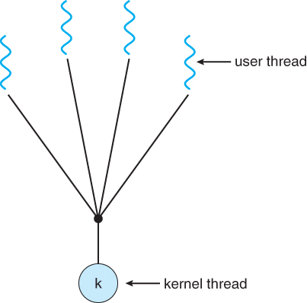
  1) Many-to-One Model
The many-to-one model maps
many user-level threads to one kernel thread.
Also, because only one thread can access the kernel at a time, multiple threads are unable to run in parallel on multiprocessors.
Thread management is done by the thread library in user space, so it is efficient; but the entire process will block if a thread makes a blocking system call.

Slide 23
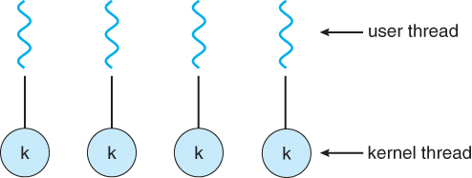
  2) One-to-One Model
The one-to-one model maps
each user thread to a kernel thread.
It provides more concurrency than the many-to-one model.
It allows multiple threads to run in parallel on multiprocessors.
The only drawback to this model is that creating a user thread requires creating the corresponding kernel thread.
So, there is an overhead of creating kernel threads .

Slide 24
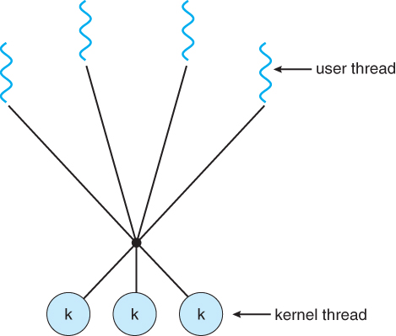
  3) Many-to-Many Model
The many-to-many model multiplexes
many user-level threads to a smaller or equal number of kernel threads.
The number of kernel threads may be specific to either a particular application or a particular machine.
Developers can create as many user threads as necessary, and the corresponding kernel threads can run in parallel on a multiprocessor.

Slide 25
THANK YOU

