Slide 1
Data Flow Diagrams
Software Engineering

Slide 2
Where do they fit in?
Life Cycle Phases
Planning
Feasibility Study
Analysis
Design
Code and Unit test
Analysis (What do we do?)
  Fact finding
    investigate business process and the current system
  modelling the current and required systems
  deliverables -
    requirements specification
    logical models of the required system

Slide 3
Data Flow Diagrams (DFD)
DFDs describe the flow of data or information into and out of a system
  what does the system do to the data?
A DFD is a graphic representation of the flow of data or information through a system
3
Notes:
3
BCS - GP1
Use example of borrow library book here to illustrate the different components.
Student is external passes in request (book and student details) into validate student process output valid student request into reserve book process. Two data stores, students and loans. Output back to student is book;
Case study - Just A Line system

Slide 4
4 Main Elements
external entity - people or organisations that send data into the system or receive data from the system
process - models what happens to the data i.e. transforms incoming data into outgoing data
data store - represents permanent data that is used by the system
data flow - models the actual flow of the data between the other elements

Slide 5
Notation
Data Flow
Entity
Process
Data Store
Data Flow
Entity
Process
D
Data Store

Slide 6
Levelled DFDs
Even a small system could have many processes and data flows and DFD could be large and messy
  use levelled DFDs - view system at different levels of detail
  one overview and many progressively greater detailed views
4
Notes:
4
BCS - GP1
sides of context process box = system boundary
Example context diagram for library, inputs= book request, book return and output = book; external entity = student.
Go through the case study - context Fig 3.4 pg 32; level 1- Fig 3.5 pg 32 level 2 - Fig 3.6 pg 33

Slide 7
Level 0 - Context Diagram
models system as one process box which represents scope of the system
identifies external entities and related inputs and outputs

Slide 8
Level 1 - overview diagram
gives overview of full system
identifies major processes and data flows between them
identifies data stores that are used by the major processes
boundary of level 1 is the context diagram

Slide 9
Level 2 - detailed diagram
level 1 process is expanded into more detail
each process in level 1 is decomposed to show its constituent processes
boundary of level 2 is the level 1 process

Slide 10
Rules for DFDs
Numbering
Labelling
Balancing
5
Notes:
5
BCS - GP1
Balancing - Give example of Level 1 with 3 processes, 1,2,3 and inputs between them. In level 2 add in extra flow and leave out one of the flows. Also at level 2 introduce new flows that are internal to level 2 to show that that is OK
e.g. for combining dataflows - use level 1 diagram with customer inputting deposit to accept booking process and cutomer inputting balance to issue ticket process. Context diagram then has one input flow of payment = deposit +balance.

Slide 11
Numbering
On level 1 processes are numbered 1,2,3…
On level 2 processes are numbered x.1, x.2, x.3… where x is the number of the parent level 1 process
Number is used to uniquely identify process not to represent any order of processing
Data store numbers usually D1, D2, D3...

Slide 12
Labelling
Process label - short description of what the process does, e.G. Price order
Data flow label - noun representing the data flowing through it e.G. Customer payment
Data store label - describes the type of data stored
Make labels as meaningful as possible

Slide 13
Balancing and data stores
Balancing
  any data flows entering or leaving a parent level must by equivalent to those on the child level
Data stores
  data stores that are local to a process need not be included until the process is expanded

Slide 14
Data Flows
Allowed to combine several data flows from lower level diagrams at a higher level under one data flow to reduce clutter
Flows should be labelled except when data to or from a data store consists of all items in the data store

Slide 15
Key Definitions
Logical process models describe processes without suggesting how they are conducted
Physical process models include process implementation information

Slide 16
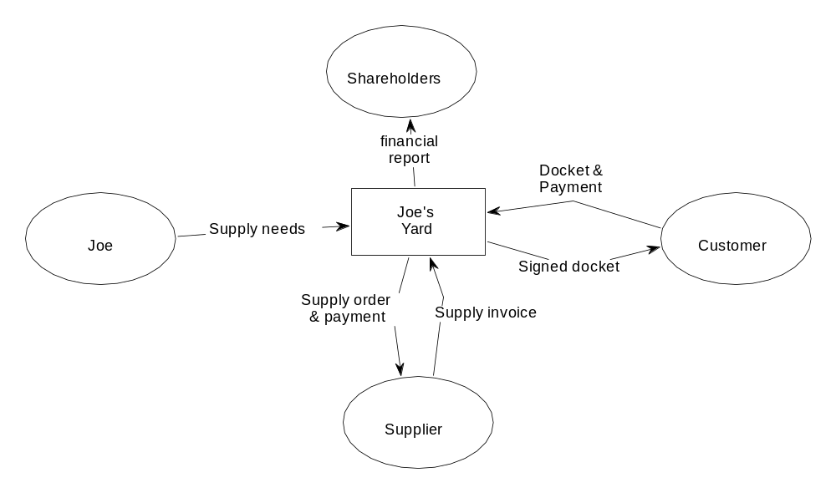
Context diagram

