Slide 1
Dynamic Memory
Allocation
UNIT - 8

Slide 2
Memory allocation
In computer science, is the act of allocating memory to a program for its usage, typically for storing variables, code or data.
Memory allocation is a widely discussed topic in the field of operating systems, as computers have limited memory, and many programs need memory to run.
To find out more, you can look up on the various memory allocation algorithms and techniques that can be used.

Slide 3
Memory allocation in C
If we know the type of variable & storage required in advanced then static memory allocation is used.
Dynamic memory allocation is the allocation of memory storage for use in a computer program during the runtime of that program.
When memory required to store data, programmer can get block of memory from os from free memory area called as heap.
C language provide mem. Management function in malloc.h & stdlib.h.

Slide 4
Memory Allocation Function
  Allocates the memory block of requested size & returns pointer to first byte of block using malloc() function.
  Allocates the multiple memory block each of same size &also initializes all bytes to zero using calloc() function.
  Modifies size of previously allocated memory block using realloc() function.
  Deallocated using the free() function.
  Returns the number of bytes required to store specific data type or variable using sizeof function.

Slide 5
Advantages
Memory allocation at run time.
No wastage of memory.
Memory block which are no longer required can be made free.
Faster Speed.
Data can be rearranged efficiently.

Slide 6
Memory Leakage
Occurs when memory allocated is not released even though is not required & it is wastage of memory resource.
This leads to less memory available for other programs & sometimes result is slowdown or system crash problem.

Slide 7
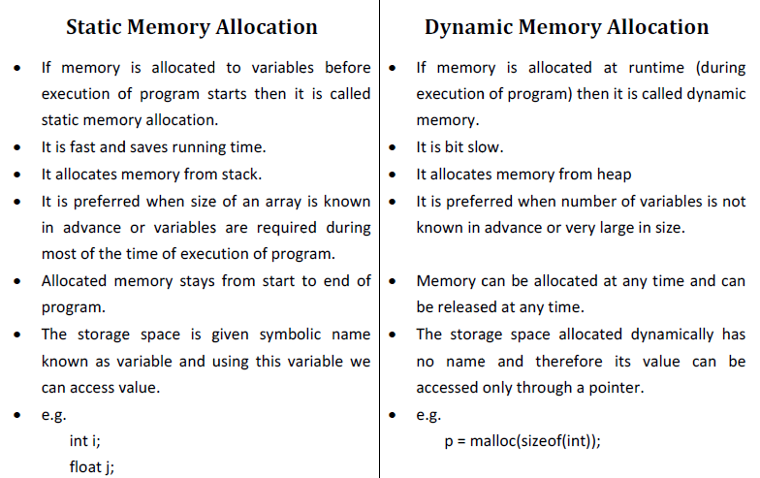
Static v/s Dynamic

Slide 8
Malloc() Function
Allocates certain amount bytes of memory during execution.
Allocate size_in_bytes byte of memory From heap, if allocation succeeds a pointer to block of memory is returned else NULL returned.
Returns uninitialized memory for you to use.
Syntax:
ptr_var=(cast_type *) malloc(size_in_bytes);

Slide 9
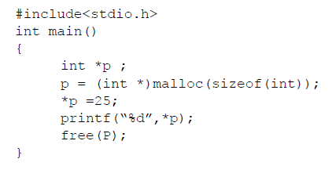
Example

Slide 10
Calloc() Function
calloc stands for "contiguous allocation".
calloc() allocates multiple blocks of memory each of same size and sets all bytes to zero.
Syntax:
Ptr_var = (cast_type *)calloc(n, block-size);

Slide 11
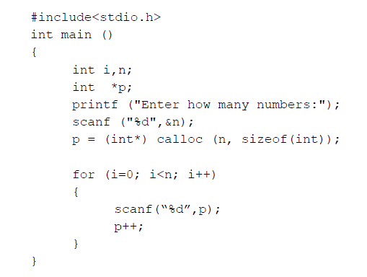
Example

Slide 12
Realloc() function
If suppose we allocated more or less memory than required,
then we can change the size of the previously allocated memory space using realloc.
Change size of memory block allocated previously by malloc() or calloc().
Syntax:
void *realloc(pointer, new-size);

Slide 13
Example
int main()
{
char *p1;
int m1 = 10; m2 = 20;
p1 = (char*) malloc (m1);
strcpy(p1, "Codesdope");
p1 = (char*) realloc (p1, m2);
strcat(p1, "Practice");
printf("%s\n", p1);
return 0;
}

Slide 14
Free() function
Release memory block which are no longer needed.
Frees the memory space pointed to by p, which must have been returned by a previous call to malloc(), calloc(), or realloc(). (release memory Blocks it points to, not pointer)
If free(p) has already been called before, undefined behavior occurs.
If p is NULL, no operation is performed.
Syntax:
free(void * p);

Slide 15
Malloc v/s calloc
 | Malloc() | Calloc()
Definition | Malloc means memory allocation. | Calloc means contiguous allocation.
Number of arguments | Takes single arguments. (i.e.,number of bytes) | Takes two arguments. (Number of blocks & Size of blocks).
Initialization | Does not initialize memory allocated. | Initialize allocated memory to zero.
Number of blocks | Allocate single block of required memory. | Allocate multiple block of required memory.
Syntax | Void * malloc (size_t); | Void * calloc (size_t_num, size_t_size);
Manner of allocation | Allocate memory of size from heap. | Allocate memory, the size of which is equal to number* size
Speed | Fast | Comparatively slow

Slide 16
Initialization
Most C programs use malloc() to allocate blocks of memory.
A common error is assuming that malloc() zeros memory.
Initializing large blocks of memory can impact performance and is not always necessary.
Programmers have to initialize memory using memset() or by calling calloc(), which zeros the memory.

Slide 17
Buffer Overflows
Dynamically allocated memory is vulnerable to buffer overflows.
Exploiting a buffer overflow in the heap is generally considered more difficult than smashing the stack.
Buffer overflows can be used to corrupt data structures used by the memory manager to execute arbitrary code.

