Slide 1
Chapter : 4
"Deadlock"
Prepared By : Sheetal J. Nagar
Atmiya Institute of Technology & Science, Rajkot

Slide 2
Deadlock Definition
  “A set of processes is deadlocked if each process in the set is waiting for an event that only another process in the set can cause”.

Slide 3
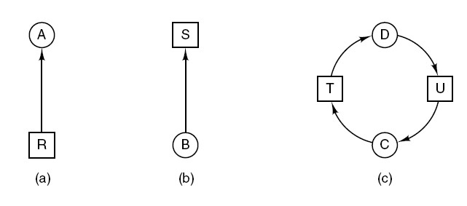
Deadlock Modeling
(a) Holding a resource
(b) Requesting a resource
(c) Deadlock
Resource allocation graphs.

Slide 4
4 necessary conditions for deadlock

Slide 5
Mutual exclusion condition
  Each resource is either currently assigned to exactly one process or is available.
Hold and wait condition
  Process currently holding resources granted earlier can request more resources.
No preemption condition
  Previously granted resources cannot be forcibly taken away from process. They must be explicitly released by the process holding them.
Circular wait condition There must be a circular chain of 2 or more processes. Each process is waiting for resource that is held by next member of the chain.

Slide 6
NOTE:
All four of these conditions must be present for a deadlock to occur.

Slide 7
Strategies to deal with the deadlocks
1. Just ignore the problem. Maybe if you ignore it, it will ignore you.
2. Detection and recovery. Let them occur, detect them, and take action.
3. Dynamic avoidance by careful resource allocation.
4. Prevention, by structurally negating one of the four conditions.

Slide 8
1
Deadlock Ignorance

Slide 9
1) Deadlock ignorance. OR Ostrich Algorithm.
  Pretend (imagine) that there’s no problem.
  This is the easiest way to deal with problem.
  This method is reasonable if
      Deadlocks occur very rarely
      Cost of prevention is high

Slide 10
2
Deadlock
Detection and Recovery

Slide 11
2) Deadlock Detection and Recovery.
a) Deadlock Detection
  1. Deadlock detection with single resource of each type
  2. Deadlock detection with multiple resources of each type
b) Deadlock Recovery

Slide 12
1. Deadlock detection with single resource of each type
we can construct a resource graph.
If this graph contains one or more cycles, a deadlock exists.
Any process that is part of a cycle is deadlocked.
If no cycles exist, the system is not deadlocked.

Slide 13
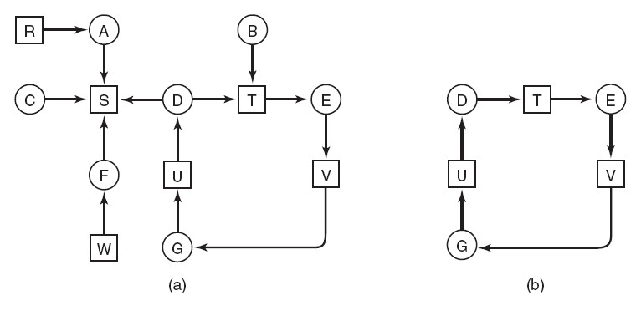
1. Deadlock detection with single resource of each type
1. Process A holds R and wants S.
2. Process B holds nothing but wants T.
3. Process C holds nothing but wants S.
4. Process D holds U and wants S and T.
5. Process E holds T and wants V.
6. Process F holds W and wants S.
7. Process G holds V and wants U.

Slide 14
1. Deadlock detection with single resource of each type

Slide 15
Algorithm: Deadlock detection with single resource of each type
For each node, N in the graph, perform the following five steps with N as the starting node.
Initialize L to the empty list, label all arcs as unmarked.
Add current node to end of L, check to see if node now appears in L two times. If it does, graph contains a cycle (listed in L), algorithm terminates.
From given node, see if any unmarked outgoing arcs. If so, go to step 5; if not, go to step 6.
Pick an unmarked outgoing arc (at random) and mark it. Then follow it to the new current node and go to step 3.
If this is initial node, graph does not contain any cycles, algorithm terminates. Otherwise, dead end. Remove it, go back to previous node, make that one current node, go to step 3.

Slide 16
2. Deadlock detection with multiple resource of each type
Matrix-based algorithm can be used.
Let the number of resource classes be m with
  E1 resources of class 1
  E2 resources of class 2, and generally,
  Ei resources of class i (1 ≤ i ≤ m)
E - Existing resource vector
A - Available resource vector
C - Current allocation matrix
R – Request matrix.
“Every resource is either allocated or is available”.

Slide 17
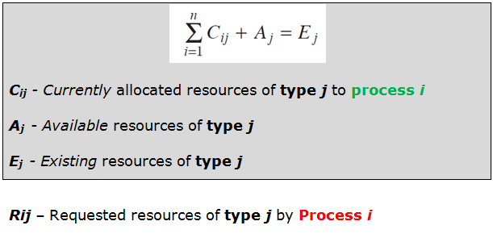
Deadlock detection with multiple resource of each type

Slide 18
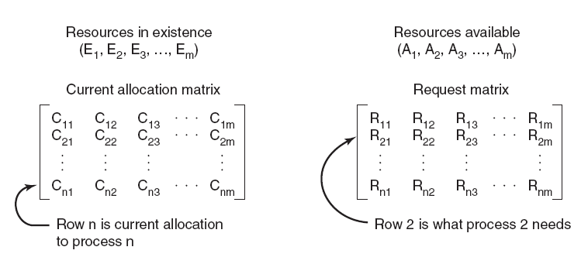
Deadlock detection with multiple resource of each type
Let A be the available resource vector.
Ai gives the number of instances of resource i that are currently available.

Slide 19
Deadlock detection with multiple resource of each type
Mathematically, A ≤ B holds if and only if
Each process is initially said to be unmarked.
As the algorithm progresses, processes will be marked (✓), indicating that they are able to complete and are thus not deadlocked.
When the algorithm terminates, any unmarked processes are known to be deadlocked.
A ≤ B
Ai ≤ Bi for 1 ≤ i ≤ m

Slide 20
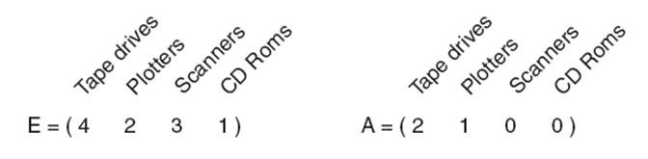
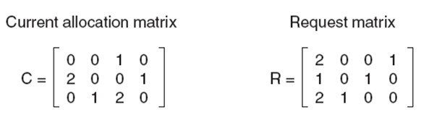
2. Deadlock detection with multiple resource of each type
P1 holds 1 Scanner
And wants 2 Tape Drives and 1 CD Rom
P2 holds 2 Tape Drives and 1 CD ROM
And wants 1 more Tape Drive and 1 Scanner

Slide 21
A = (4 2 3 1)
A = (4 2 2 1)
A = (2 2 2 0)
✓
✓
✓
P3 can be satisfied, so P3 completes, returns resources A = (2 2 2 0)
P2 can be satisfied, so P2 completes, returns resources A = (4 2 2 1)
P1 can be satisfied, so P1 completes.
Now all processes are marked, so no deadlock.

Slide 22
Algorithm: Deadlock detection with Multiple resource of each type
Look for an unmarked process, Pi, for which the i-th row of R is less than or equal to A.
If such a process is found, add the i-th row of C to A, mark the process, and go back to step 1.
If no such process exists, the algorithm terminates.
Note : When the algorithm finishes, all the unmarked processes, if any, are deadlocked.

Slide 23
Deadlock Recovery

Slide 24
Deadlock Recovery
Recovery through preemption
Recovery through rollback
Recovery through killing processes

Slide 25
  a) Recovery through preemption
    Temporarily take a resource away from its current owner and
    give it to another process.
    It is highly dependent on the nature of the resource.
    Recovering this way is frequently difficult or impossible.
    Choosing the process to suspend depends largely on which ones have resources that can easily be taken back.

Slide 26
  b) Recovery through Rollback
    Checkpoints are placed periodically.
    Checkpointing a process means that ‘its state is written to a file’ so that it can be restarted later.
    The checkpoint contains information regarding which resources are currently assigned to the process.
    When a deadlock is detected, a process is rolled back to a point before it acquired some resource by starting one of its earlier checkpoints.
    In effect, the process is reset to an earlier moment when it did not have the resource, which is now assigned to one of the deadlocked processes.

Slide 27
  c) Recovery through killing processes
    The crudest, but simplest way to break a deadlock is to
    kill one or more processes.
    One possibility is to kill a process in the cycle in such a way that, other processes will be able to continue.
    If this does not help, it can be repeated until the cycle is broken.
    Alternatively, a process not in the cycle can be chosen as the victim in order to release its resources.
    In this approach, the process to be killed is carefully chosen because it is holding resources that some process in the cycle needs.

Slide 28
Safe and unsafe states

Slide 29
  Safe State
    “A state is said to be safe if it is not deadlocked and there is some scheduling order in which every process can run to completion even if all of them suddenly request their maximum number of resources immediately”

Slide 30
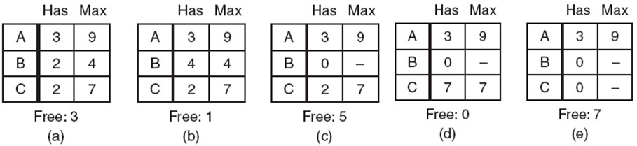
  Safe State Example
A total of 10 instances of the resource exist.
So with 7 resources already allocated,
There are 3 still free.
Thus the state of Fig. (a) is safe because by careful scheduling, we can avoid deadlock

Slide 31
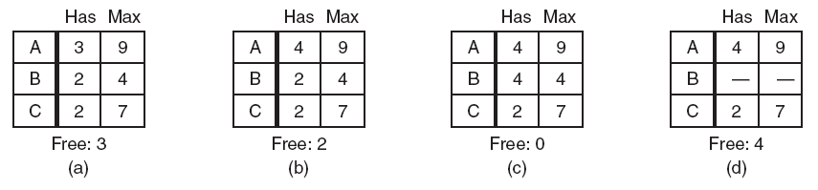
  Unsafe State Example
4
Thus the state of Fig. (b) is not safe because few processes cannot complete.

Slide 32
It is worth noting that an “unsafe state is not a deadlocked state”.
But from a safe state the system can guarantee that all processes will finish; from an unsafe state, no such guarantee can be given.

Slide 33
3
Banker’s Algorithm for
Deadlock Avoidance

Slide 34
  Banker’s algorithm
Banker’s algorithm for single resource
Banker’s algorithm for Multiple resource

Slide 35
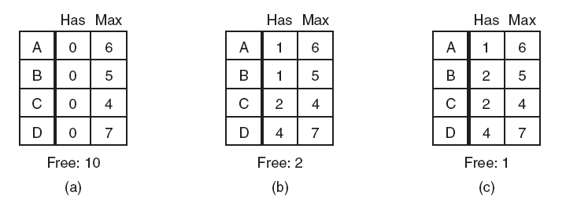
a) Banker’s algorithm for single resource
Safe
Safe
Unsafe

Slide 36
a) Banker’s algorithm for single resource
if (granting a request leads to safe state)
{
Request is granted (✓)
}
else
{
Request is denied (×)
}

Slide 37
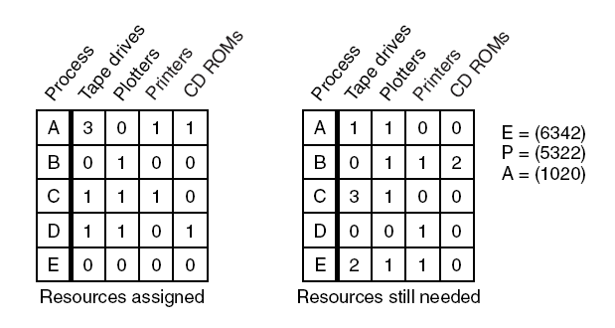
b) Banker’s algorithm for multiple resources
E = ( 6 3 4 2 )
A = ( 1 0 2 0 )
P = ( 5 3 2 2 )
  E = P + A

Slide 38
A = ( 1 0 2 0 )
A = ( 2 1 2 1 )
A = ( 5 1 3 2 )
A = ( 5 2 3 2 )
E = ( 6 3 4 2 )
A = ( 6 3 4 2 )
✓
✓
✓
✓
✓
D can be satisfied, and Returns the assigned resources, so A = (2 1 2 1)
A can be satisfied, and Returns the assigned resources, so A = (5 1 3 2)
B can be satisfied, and Returns the assigned resources, so A = (5 2 3 2)
C can be satisfied, and Returns the assigned resources, so A = (6 3 4 2)
E can be satisfied, and Returns the assigned resources, so A = (6 3 4 2)

Slide 39
b) Banker’s algorithm for multiple resources
Look for each row in R, whose “Still Needed” resources are all smaller than or equal to A. If no such row exists, the system will eventually deadlock since no process can run to completion (assuming processes keep all resources until they exit).
Assume the process of the row chosen requests all the resources it needs (which is guaranteed to be possible) and finishes. Mark (✓) that process as terminated and add all its resources to the vector A.
Repeat step 1 and 2 until either all processes are marked terminated (in which case the initial state was safe) or no process is left whose resources needs can be met (in which case there is a deadlock).

Slide 40
4
Deadlock Prevention

Slide 41
Deadlock Prevention
  Deadlock can be prevented by attacking the one of the four conditions that leads to deadlock.

Slide 42
  1) Attacking the Mutual Exclusion Condition
    No deadlock if no resource is ever assigned exclusively to a single process.
    Some devices can be spooled such as printer, by spooling printer output; several processes can generate output at the same time.
    Only the printer daemon process uses physical printer.
    Thus deadlock for printer can be eliminated.
    Not all devices can be spooled.

Slide 43
  1) Attacking the Mutual Exclusion Condition
    Principle:
    Avoid assigning a resource when that is not absolutely necessary.
    Try to make sure that as few processes as possible actually claim the resource.

Slide 44
  2) Attacking the Hold and Wait Condition
    Require processes to request all their resources before starting execution.
    A process is allowed to run if all resources it needed is available. Otherwise nothing will be allocated and it will just wait.
    Problems:
    A process may not know required resources at start of run.
    Resource will not be used optimally.
    It also ties up resources other processes could be using.

Slide 45
  2) Attacking the Hold and Wait Condition
    Variation:
    A process must give up all resources before making a new request. Process is then granted all prior resources as well as the new ones only if all required resources are available.

Slide 46
  3) Attacking the No Preemption Condition
    To attack this condition, forcibly take a resource away from a process.
    When a process P0 request some resource R which is held by another process P1 then resource R is forcibly taken away from the process P1 and allocated to P0.
    Problem :
    Consider a process holds the printer, halfway through its job (half page printed); taking the printer away from this process without having any ill effect is not possible.

Slide 47
  4) Attacking the Circular Wait Condition
    Provide a global numbering of all the resources.
    Now the rule is this: processes can request resources whenever they want to, but all requests must be made in numerical order.
    A process need not acquire them all at once.
    Circular wait is prevented if a process holding resource n cannot wait for resource m, if m > n.
    No way to complete a cycle.

Slide 48
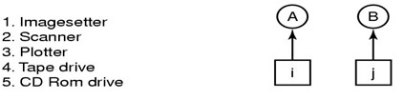
  4) Attacking the Circular Wait Condition
(a) Numerically ordered resources (b) A resource graph
    Assuming i and j are distinct resources, with different numbers.
    If i < j, then B is not allowed to request i because that is lower than what it already has.
    If i > j, then A is not allowed to request j because that is lower than what it already has.
    Either way, deadlock is impossible.

Slide 49
Reference Books:
    “Operating System Concepts” by Silberschatz, Peter B. Galvin and Greg Gagne
    “Modern Operating Systems” by Andrew S Tanenbaum

Slide 50
THANK YOU

