Slide 1
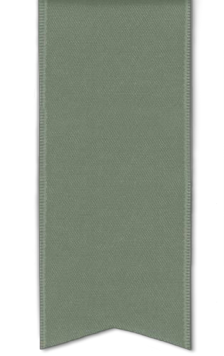
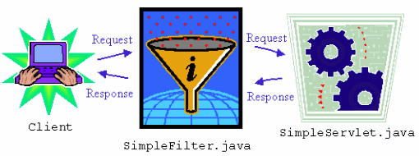
SERVLET FILTERS

Slide 2
What is Filter?
Filter is a small program that run on the server before the servlet or JSP page with which it is associated.
Filter can be attached to one or more servlets or JSP pages and can examine the
request information going into these resources.
Filter can Invoke the resource in normal manner.
Filter can Invoke the resource with modified request information.
Filter can Invoke the resource but modify response before sending it to the client.
Filter can Prevent resource from being invoked and instead redirect to a different resource, return a particular status code, or generate replacement output.

Slide 3
What it can be used for ?
Security verification
Internationalization
Scaling map
Debugging
Authentication blocking request based on user identity.
Logging and auditing – Tracking uses of a web application.
Image Conversion – Scaling maps and so on.
Data Compression – Making downloads smaller.
XSL/T Transformation of XML content -

Slide 4
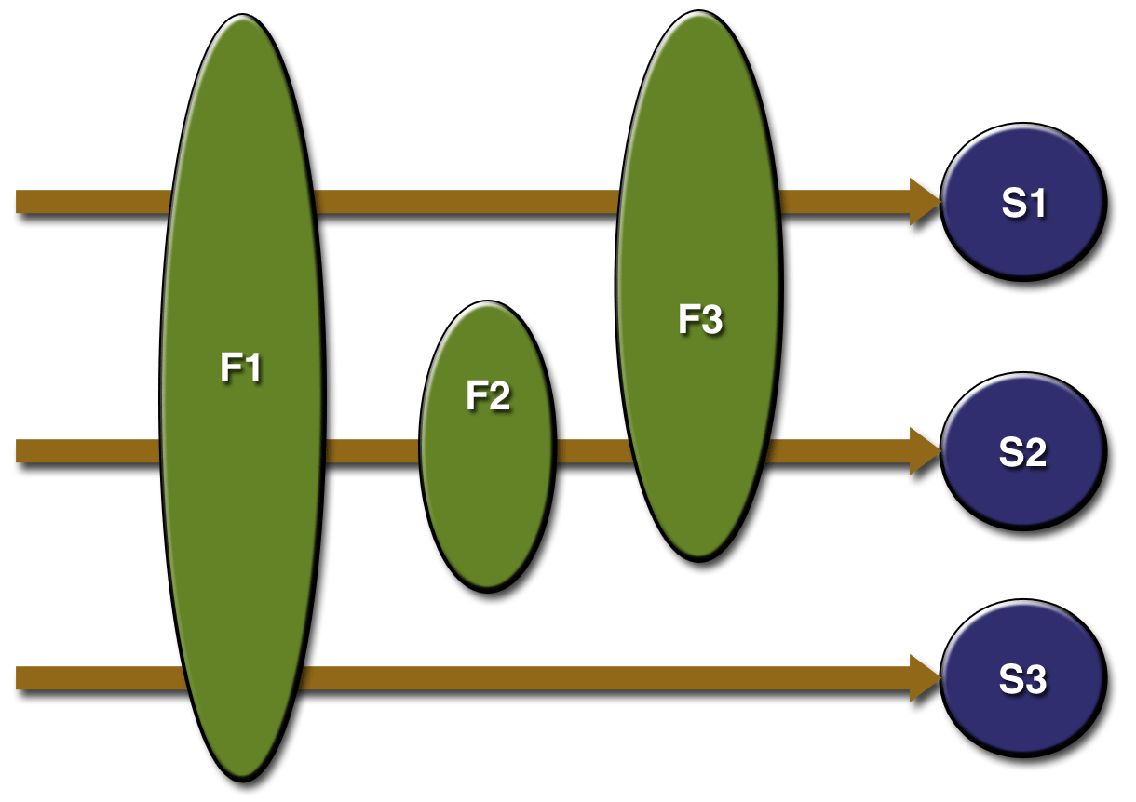
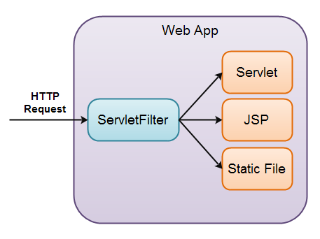
One or many filters

Slide 5
Creating a Basic Filter
Create a class that implements the Filter Interface. [ init, doFilter , destroy ]
Put the filtering behavior in the doFilter method.
Call the doFilter method of the FilterChain object.
Register the filter with the appropriate servlets and JSP page.
Disable the invoker servlet. **

Slide 6
Create a class that implements the Filter Interface
Must implement javax.servlet.Filter
public void init(FilterConfig config) throws ServletException
public void doFilter(ServletRequest request, ServletResponse response, FilterChain
chain) throws ServletException, IOException
  Executed each time servlet is invoked.
  FilterChain is used to invoke next filter that is associated with the servlet or jsp page, if no more
filters it will invoke servlet or jsp page itself.
public void destroy()

Slide 7
Register the Filter
Use filter and filter-mapping tags to register filter in servlet.
<filter>
<filter-name> … </filter-name>
<filter-class> … </filter-class>
</filter>
<filter-mapping>
<filter-name> … </filter-name>
<url-pattern> … </url-pattern>
</filter-mapping>

Slide 8
Understanding filter and mapping tags
In filter element we can have icon, filter-name, display-name, filter-class, init-param.
In filter-mapping element filter-name, url-pattern, servlet-name, dispatcher.
dispatcher : Optional used to specifies what type of request this filter-mapping
should apply to.
Possible values are REQUEST, FORWARD, INCLUDE and ERROR

Slide 9
Initialization Parameter in Filter
Developers, End Users, Deployers
<filter>
<filter-name>SomeFilter</filter-name>
<filter-class>somePackage.SomeFilterClass</filter-class>
<init-param>
<param-name>param1</param-name>
<param-value>value1</param-value>
</init-param>
String val1 = config.getInitParameter("param1");
</filter>

Slide 10
Examples
Example-1:Simple Example of Filter
In this example, we are simply displaying information that filter is invoked automatically after the post processing of the request.
Example-2:Authentication Filter
Here, we have to create 4 files :
index.html
MyFilter.java
AdminServlet.java
web.xml

Slide 11
Filter using Annotation
@WebFilter(filterName=“DemoFilter” ,urlPatterns={“/mypattern”})

