Slide 1


GTU Advance Java Unit-6 Hibernate
Facilitator,
Asst.Prof.Nirali Varnagar
Department of Computer Engineering
Atmiya University, Rajkot

Slide 2
Outline:
Overview of Hibernate
Hibernate Architecture
Hibernate Mapping Types
Hibernate O/R Mapping
Hibernate Annotation, Hibernate Query Language

Slide 3
Hibernate framework:
It simplifies the development of java application to interact with the database. Hibernate is an open source, lightweight, ORM (Object Relational Mapping) tool.
Hibernate is an Object-Relational Mapping (ORM) solution for JAVA.
It is an open source persistent framework created by Gavin King in 2001.
It is a powerful, high performance,Object-Relational Persistence and Query service for any Java Application.

Slide 4
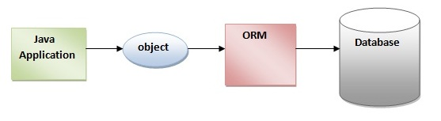
An ORM tool simplifies the data creation, data manipulation and data access. It is a programming technique that maps the object to the data stored in the database.

Slide 5
Object
Student
ID
Name
Address
Email
Hibernate mapping
ID | Name | Address | Email
Relational Database

Slide 6
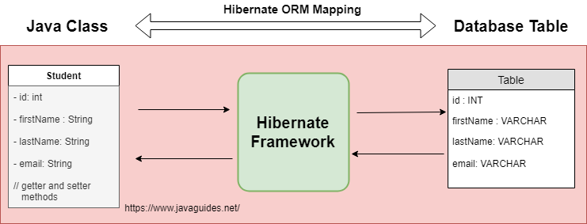

Slide 7
Problems
Mapping Member variable to columns
Mapping RelationShips
Handling Data type
Managing change to the object state

Slide 8
Difference Between Hibernate and JDBC

Slide 9
Key | JDBC | Hibernate
Basic | It is database connectivity technology | It is a framework,
Lazy Loading | It does not support lazy loading | Hibernate support lazy loading
Transaction management | We need to maintain explicitly database connection and transaction. | Hibernate itself manage all transaction
Caching | We need to write code for implementing caching | Hibernates provides two types of caching : First level Cache Second level cache No Extra code is required to use first level cache.
Performance | Low performance | High Performance

Slide 10
Lazy loading is just a fancy name given to the process of initializing a class when it’s actually needed.

Slide 11
Advantages of Hibernate Framework
There are many advantages of Hibernate Framework. They are as follows:
Opensource and Lightweight: Hibernate framework is opensource under the LGPL(GNU Lesser General Public License ) license and lightweight.
2) Fast performance: The performance of hibernate framework is fast because cache is internally used in hibernate framework. There are two types of cache in hibernate framework first level cache and second level cache. First level cache is enabled by default.
3) Database Independent query: HQL (Hibernate Query Language) is the object-oriented version of SQL. It generates the database independent queries. So you don't need to write database specific queries. Before Hibernate, If database is changed for the project, we need to change the SQL query as well that leads to the maintenance problem.

Slide 12
4) Automatic table creation: Hibernate framework provides the facility to create the tables of the database automatically. So there is no need to create tables in the database manually.
5) Simplifies complex join: To fetch data form multiple tables is easy in hibernate framework.
6) Provides query statistics and database status: Hibernate supports Query cache and provide statistics about query and database status.

Slide 13
GTU Advance Java Unit-6 Hibernate-Session-II
Facilitator,
Asst.Prof.Nirali Varnagar
Department of Computer Engineering
Atmiya University, Rajkot

Slide 14
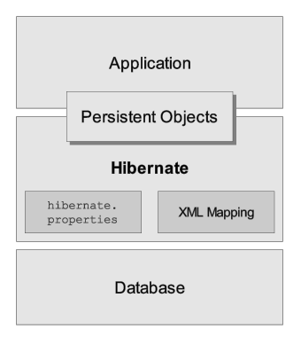
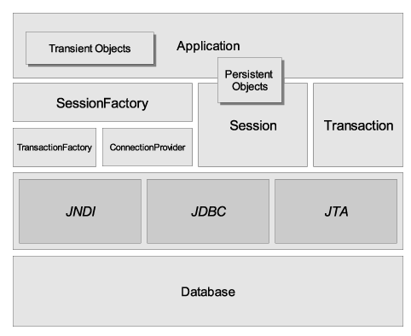
Hibernate Basics

Slide 15
Hibernate Basics
SessionFactory
A threadsafe (immutable) cache of compiled mappings for a single database.
A factory for Session.
Expensive to create.

Slide 16
Hibernate Basics
Session
A single-threaded, short-lived object representing a conversation between the application and the persistent store.
Wraps a JDBC connection.
Factory for Transaction.
Holds a mandatory (first-level) cache of persistent objects, used when navigating the object graph or looking up objects by identifier.

Slide 17
Hibernate Basics
Persistent Objects and Collections
Short-lived, single threaded objects containing persistent state and business function.
These might be ordinary JavaBeans/POJOs, the only special thing about them is that they are currently associated with (exactly one) Session.
As soon as the Session is closed, they will be detached and free to use in any application layer (e.g. directly as data transfer objects to and from presentation).

Slide 18
Hibernate Basics
Transient Objects and Collections
Instances of persistent classes that are not currently associated with a Session.
They may have been instantiated by the application and not (yet) persisted or they may have been instantiated by a closed Session.

Slide 19
Hibernate Basics
Transaction
(Optional) A single-threaded, short-lived object used by the application to specify atomic units of work.
Abstracts application from underlying JDBC, JTA or CORBA transaction.
Multiple transactions per Session.

Slide 20
Hibernate Basics
ConnectionProvider
(Optional) A factory for (and pool of) JDBC connections. Abstracts application from underlying Datasource or DriverManager. Not exposed to application, but can be extended/implemented by the developer.
TransactionFactory
(Optional) A factory for Transaction instances. Not exposed to the application, but can be extended/implemented by the developer.

Slide 21
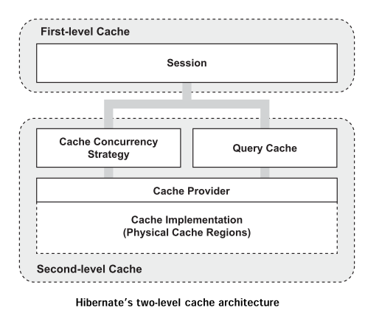
Hibernate Cache Architecture

Slide 22
Caching is a mechanism to enhance the performance of a system. It is a buffer memory that lies between the application and the database. Cache memory stores recently used data items in order to reduce the number of database hits as much as possible.
1. First-level Cache
2. Second-level Cache
Read more in reference book.

Slide 23
HQL
Hibernate Query Language (HQL) is same as SQL (Structured Query Language) but it doesn't depends on the table of the database. Instead of table name, we use class name in HQL. So it is database independent query language.
Advantage of HQL
There are many advantages of HQL. They are as follows:
database independent
supports polymorphic queries
easy to learn for Java Programmer

Slide 24
Difference HQL and SQL (IMP question)

Slide 25
Differences between SQL and HQL:
SQL is based on a relational database model whereas HQL is a combination of object oriented
programming with relational database concepts.
SQL manipulates data stored in tables and modifies its rows and columns.
HQL is concerned about objects and its properties.
SQL is concerned about the relationship that exists between two tables while HQL
considers the relation between two objects.

Slide 26
Summary:
1. HQL is similar to SQL and is also case insensitive.
2. HQL and SQL both fire queries in a database. In the case of HQL, the queries are in the form of objects that are translated to SQL queries in the target database.
3. SQL works with tables and columns to manipulate the data stored in it.
4. HQL works with classes and their properties to finally be mapped to a table structure in a database.
5. HQL supports concepts like polymorphism, inheritance, association, etc. It is a powerful and easy-to-learn language that makes SQL object oriented.
6. SQL lets you modify the data through insert, update, and delete queries. You can add tables, procedures, or views to your database. The permissions on these added objects can be changed.

Slide 27
Example of HQL vs SQL
Java class student:
Package com;
Public class student
{
int rollno;
String name;
Public void setrollno(int rollno)
{
this.rollno=rollno;
}
Public int getrollno()
{
Return rollno;
}
public void setname(String name)
{
this.name=name;
}
Public void getname()
{
Return name;
}
}

Slide 28
To store java bean data into database we require table as follows: Table name: stu_info
Stu_rollno | Stu_name
1 | Diya
2 | Dhaval
SQL: To fetch all records:
Select * from stu_info;
HQL: To fetch all records
Select * from student;
OR
From student;
OR
Select * from student s;
OR from student s;

Slide 29
GTU Advance Java Unit-6 Hibernate-Session-III How to start with Programming using Hibernate framework
Facilitator,
Asst.Prof.Nirali Varnagar
Department of Computer Engineering
Atmiya University, Rajkot

Slide 30
Hibernate - Configuration
Hibernate requires to know in advance where to find the mapping information that defines how your Java classes relate to the database tables. Hibernate also requires a set of configuration settings related to database and other related parameters.
All such information is usually supplied as a standard Java properties file called hibernate.properties, or as an XML file namedhibernate.cfg.xml.

Slide 31
S.N. | Properties and Description
1 | hibernate.dialect This property makes Hibernate generate the appropriate SQL for the chosen database.
2 | hibernate.connection.driver_class The JDBC driver class.
3 | hibernate.connection.url The JDBC URL to the database instance.
4 | hibernate.connection.username The database username.
5 | hibernate.connection.password The database password.

Slide 32
<?xml version="1.0" encoding="UTF-8"?>
<hibernate-configuration>
<session-factory>
<property name="hibernate.dialect"> org.hibernate.dialect.OracleDialect</property>
<property name="hibernate.connection.driver_class">oracle.jdbc.OracleDriver</property>
<property name="hibernate.connection.url"> jdbc:oracle:thin:@localhost:1521:XE</property>
<property name="hibernate.connection.username"> system</property>
<property name="hibernate.connection.password"> system</property>
<property name="hibernate.hbm2ddl.auto">create</property>
<mapping resource="hibernate.hbm.xml"/>
</session-factory>
</hibernate-configuration>

Slide 33
Hibernate O/R Mapping

Slide 34
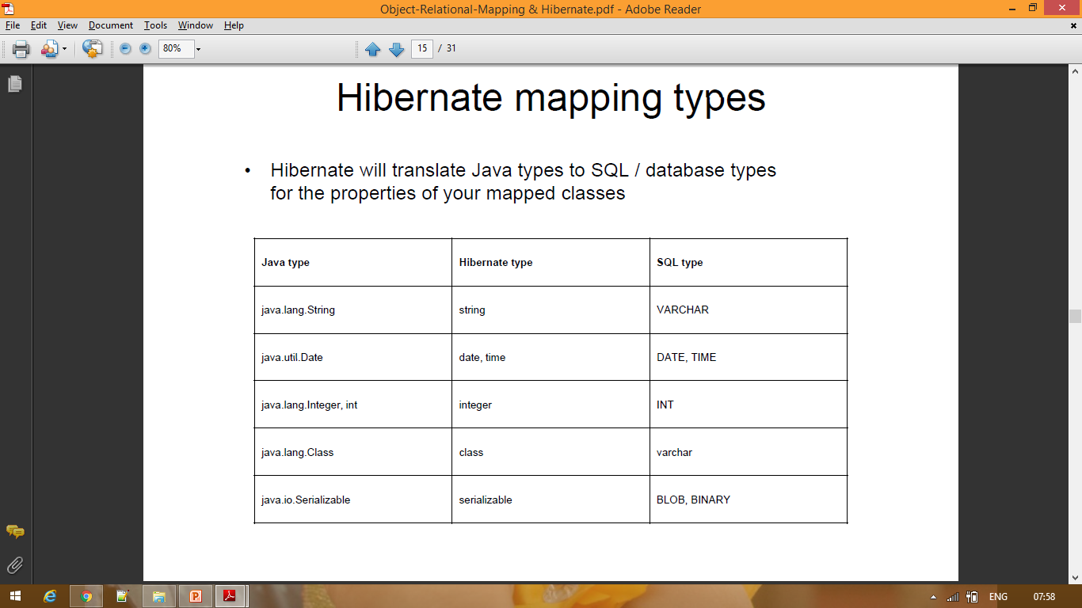

Slide 35
<?xml version="1.0" encoding="UTF-8"?>
<hibernate-mapping>
<class name="com.student" table=“stu">
<id name="rno" column="Rollno" type="integer">
<generator class="assigned"/>
</id>
<property name="name" column="Stu_name" type="string"/>
</class>
</hibernate-mapping>

Slide 36
Hibernate framework Interfaces

Slide 37
Query Interface
It is an object oriented representation of Hibernate Query. The object of Query can be obtained by calling the createQuery() method Session interface.
The query interface provides many methods. There is given commonly used methods:
public int executeUpdate() is used to execute the update or delete query.
public List list() returns the result of the relation as a list.
public Query setFirstResult(int rowno) specifies the row number from where record will be retrieved.
public Query setMaxResult(int rowno) specifies the no. of records to be retrieved from the relation (table).
public Query setParameter(int position, Object value) it sets the value to the JDBC style query parameter.
public Query setParameter(String name, Object value) it sets the value to a named query parameter.

Slide 38
Example of HQL to get all the records
Query qry = s.createQuery("select s.name from student s");
java.util.List list=qry.list();
System.out.println(list);
Example of HQL to get records with pagination
Query query=session.createQuery("from Emp");
query.setFirstResult(5);
query.setMaxResult(10);
List list=query.list();//will return the records from 5 to 10th number

Slide 39
Example of HQL delete query
Query qry = session.createQuery("delete from student p
where p.rno=:var");
qry.setParameter("var",110);
int res = qry.executeUpdate();
HQL with Aggregate functions
→You may call avg(), min(), max() ,sum()etc. aggregate functions by HQL. Let's see some common examples:
Example to get total salary of all the employees
Query q=session.createQuery("select sum(salary) from
Emp");

Slide 40
Example to get maximum salary of employee
Query q=session.createQuery("select max(salary) from Emp");
Example to get minimum salary of employee
Query q=session.createQuery("select min(salary) from Emp");

Slide 41
Example to count total number of employee ID
Query q=session.createQuery("select count(id) from Emp");
Example to get average salary of each employees
Query q=session.createQuery("select avg(salary) from Emp");

