Slide 1

Unit-7
Spring Framework
Facilitator: Nirali Varnagar

Slide 2
Syllabus:
Java Web Frameworks: Spring MVC
Overview of Spring, Spring Architecture, bean life cycle, XML Configuration on Spring, Aspect – oriented Spring, Managing Database, Managing Transaction

Slide 3
Introduction:
Spring framework is an open source Java platform that provides comprehensive infrastructure support for developing robust Java applications very easily and very rapidly.
Spring framework was initially written by Rod Johnson and was first released under the Apache 2.0 license in June 2003.

Slide 4
Advantages of Spring Framework Architecture
There are many advantages of Spring Framework. They are as follows:
Lightweight: Spring framework is lightweight because of its POJO implementation. The Spring Framework doesn't force the programmer to inherit any class or implement any interface. That is why it is said non-invasive, Enable you to write powerful, scalable applications using POJOs.
Easy to develop JavaEE application: The Dependency Injection feature of Spring Framework and it support to various frameworks makes the easy development of JavaEE application.
Easy to test: The Dependency Injection makes easier to test the application. The EJB or Struts application require server to run the application but Spring framework doesn't require server.

Slide 5
Loose Coupling: The Spring applications are loosely coupled because of dependency injection and handles injecting dependent components without a component knowing where they came from (IoC).
Powerful abstraction: It provides powerful abstraction to JavaEE specifications such as JMS, JDBC, JPA and JTA.
Declarative support: It provides declarative support for caching, validation, transactions and formatting.
Portable :can use server-side in web/ejb app, client-side in swing app, business logic is completely portable.
Cross-cutting behavior : Resource Management is cross-cutting concern, easy to copy-and-paste everywhere.

Slide 6
Configuration information: Spring provides one consistent way of configuring everything, separate configuration from application logic, varying configuration.
Lifecycle : Responsible for managing all your application components, particularly those in the middle tier container sees components through well-defined lifecycle: init(), destroy()

Slide 7
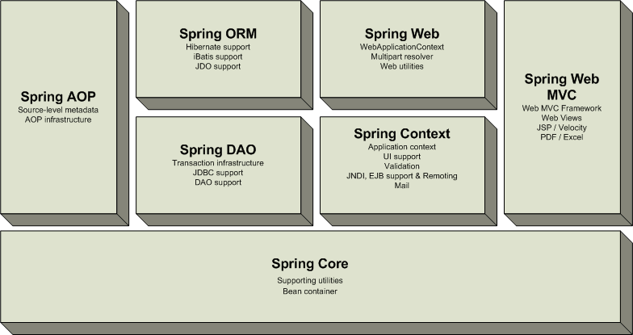
Overview of the Spring Framework
Very loosely coupled, components widely reusable and separately packaged.

Slide 8
Modules of the Spring Framework
The Spring Framework can be considered as a collection of frameworks-in-the-framework:
Core - Inversion of Control (IoC) and Dependency Injection.
AOP :- These modules support aspect oriented programming implementation where you can use Advices, Pointcuts etc. to decouple the code.
DAO - Data Access Object support, transaction management, JDBC-abstraction
ORM - Object Relational Mapping data access, integration layers for JPA, JDO, Hibernate, and iBatis
MVC - Model-View-Controller implementation for web-applications
Context-This module supports internationalization (I18N), EJB,Remote Access, Authentication and Authorization, Remote Management like RMI,HTTP Invoker,Hessain, Messaging Framework, Web Services, Email, Testing, …

Slide 9
Modules of the Spring Framework
Expression Language:- It is an extension to the EL defined in JSP. It provides support to setting and getting property values, method invocation, accessing collections and indexers, named variables, logical and arithmetic operators, retrieval of objects by name etc.

Slide 10
How to Start Using Spring
create the class
create the xml file to provide the values
create the test class
Load the spring jar files
Run the test class

Slide 11
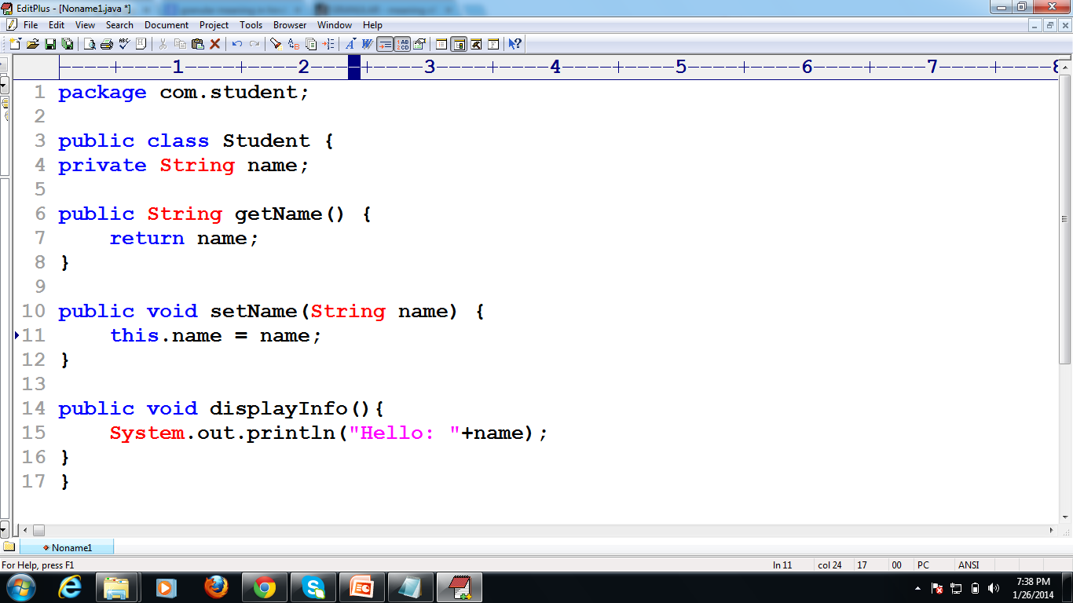
Create Java class

Slide 12
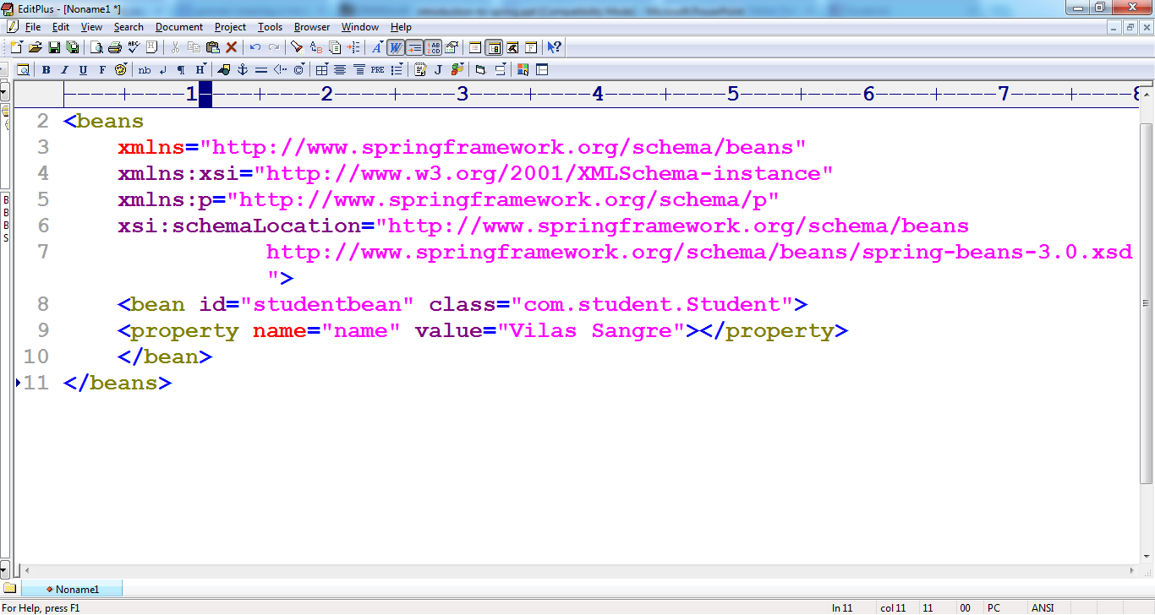
Create the xml file

Slide 13
Create the test class
package com;
import org.springframework.context.ApplicationContext;
Import org.springframework.context.support.ClassPathXmlApplicationContext;
public class Test {
public static void main(String[] args) {
ApplicationContext context; context = new ClassPathXmlApplicationContext("bean.xml");
Student obj;
obj = (Student) context.getBean("s1");
obj.getName();}}

Slide 14
Load the jar files required for spring framework
There are mainly three jar files required to run this application.
org.springframework.core-3.0.1.RELEASE-A
com.springsource.org.apache.commons.logging-1.1.1
org.springframework.beans-3.0.1.RELEASE-A

Slide 15
Spring - Bean Life Cycle
The life cycle of a Spring bean is easy to understand. When a bean is instantiated, it may be required to perform some initialization to get it into a usable state. Similarly, when the bean is no longer required and is removed from the container, some cleanup may be required.
Though, there is lists of the activities that take place behind the scenes between the time of bean Instantiation and its destruction, here only two important bean lifecycle callback methods which are required at the time of bean initialization and its destruction.

Slide 16
To define setup and teardown for a bean, we simply declare the <bean> with init-method and/or destroy-method parameters.
The init-method attribute specifies a method that is to be called on the bean immediately upon instantiation. Similarly, destroy-method specifies a method that is called just before a bean is removed from the container.

Slide 17
Initialization callbacks:
The org.springframework.beans.factory.InitializingBean interface specifies a single method:
void afterPropertiesSet() throws Exception;
So you can simply implement above interface and initialization work can be done inside afterPropertiesSet() method as follows:
public class ExampleBean implements InitializingBean
{
public void afterPropertiesSet() {
// do some initialization work
} }

Slide 18
In the case of XML-based configuration metadata, you can use the init-method attribute to specify the name of the method that has a void no-argument signature. For example:
<bean id="exampleBean" class=“com.ExampleBean" init-method="init"/>
Following is the class definition:
public class ExampleBean {
public void init()
{ // do some initialization work } }

Slide 19
Destruction callbacks
The org.springframework.beans.factory.DisposableBean interface specifies a single method:
void destroy() throws Exception;
So you can simply implement above interface and finalization work can be done inside destroy() method as follows:
public class ExampleBean implements DisposableBean {
public void destroy() {
// do some destruction work
} }

Slide 20
In the case of XML-based configuration metadata, you can use the destroy -method attribute to specify the name of the method that has a void no-argument signature. For example:
<bean id="exampleBean" class=“com.ExampleBean" destroy-method="destroy"/>
Following is the class definition:
public class ExampleBean {
public void destroy() {
// do some destruction work } }

Slide 21
Dependency Injection
Dependency Injection (DI) is a design pattern that removes the dependency from the programming code so that it can be easy to manage and test the application. Dependency Injection makes our programming code loosely coupled.
Two ways to perform Dependency Injection in Spring framework
Spring framework provides two ways to inject dependency
By Constructor
By Setter method

Slide 22
Spring IoC + AOP
IoC container
  Setter based and constructor based dependency injection
  Portable across application servers
  Promotes good use of OO practices such as programming to interfaces.
  Beans managed by an IoC container are reusable and decoupled from business logic
AOP
  Spring uses Dynamic AOP Proxy objects to provide cross-cutting services
  Reusable components
  Aopalliance support today
  Integrates with the IoC container
  AspectJ support in Spring 1.1

Slide 23
Spring IoC

Slide 24
Inversion of Control
Dependency injection
  Beans define their dependencies through constructor arguments or properties
  The container provides the injection at runtime
Decouples object creators and locators from application logic
Easy to maintain and reuse
Testing is easier
Useful for separating dao and business layer
Useful for separating controllers and business layer
The code is more extensible, easier to read, and modules/layers can easily be replaced
Notes:
Inversion of Control has already been referred to as Dependency Injection. The basic principle is that beans define their dependencies (i.e. the other objects they work with) only through constructor arguments or properties. Then, it is the job of the container to actually inject those dependencies when it creates the bean. This is fundamentally the inverse (hence the name Inversion of Control) of the bean instantiating or locating its dependencies on its own using direct construction of classes, or something like the Service Locator pattern. While we will not elaborate too much on the advantages of Dependency Injection, it becomes evident upon usage that code gets much cleaner and reaching a higher grade of decoupling is much easier when beans do not look up their dependencies, but are provided them, and additionally do not even know where the dependencies are located and of what actual type they are.
As touched on in the previous paragraph, Inversion of Control/Dependency Injection exists in two major variants:
setter-based dependency injection is realized by calling setters on your beans after invoking a no-argument constructor to instantiate your bean. Beans defined in the BeanFactory that use setter-based dependency injection are true JavaBeans. Spring generally advocates usage of setter-based dependency injection, since a large number of constructor arguments can get unwieldy, especially when some properties are optional.
constructor-based dependency injection is realized by invoking a constructor with a number of arguments, each representing a collaborator or property. Although Spring generally advocates usage of setter-based dependency injection as much as possible, it does fully support the constructor-based approach as well, since you may wish to use it with pre-existing beans which provide only multi-argument constructors, and no setters. Additionally, for simpler beans, some people prefer the constructor approach as a means of ensuring beans can not be constructed in an invalid state.

Slide 25
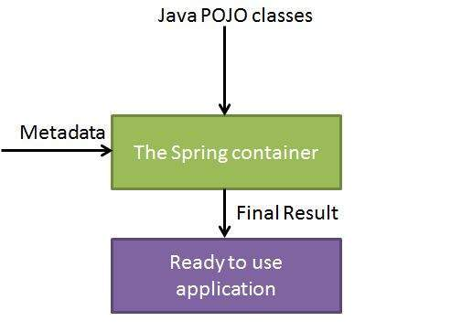

Slide 26
Spring provides following two distinct types of containers.
1.BeanFactory
Package:
org.springframework.beans.factory.*
2.ApplicationContext
Package:
org.springframework.context.*

Slide 27
The Spring container is at the core of the Spring Framework. The container will create the objects, wire them together, configure them, and manage their complete lifecycle from creation till destruction.
The Spring container uses dependency injection (DI) to manage the components that make up an application. These objects are called Spring Beans.

Slide 28
Spring Bean Definition
Typical java bean with a unique id
In spring there are basically two types
  Singleton
    One instance of the bean created and referenced each time it is requested
  Prototype (non-singleton)
    New bean created each time
    Same as new ClassName()
Beans are normally created by Spring as late as possible

Slide 29
Spring Bean Definition
The bean class is the actual implementation of the bean being described by the BeanFactory.
Bean examples – DAO, DataSource, Transaction Manager, Persistence Managers, Service objects, etc
Spring config contains implementation classes while your code should program to interfaces.
Bean behaviors include:
  Singleton or prototype
  Autowiring
  Initialization and destruction methods
    init-method
    destroy-method
Beans can be configured to have property values set.
  Can read simple values, collections, maps, references to other beans, etc.

Slide 30
What is a bean definition?
Defines a bean for Spring to manage
  Key attributes
    class (required): fully qualified java class name
    id: the unique identifier for this bean
    configuration: (singleton, init-method, etc.)
    constructor-arg: arguments to pass to the constructor at creation time
    property: arguments to pass to the bean setters at creation time
    Collaborators: other beans needed in this bean (a.k.a dependencies), specified in property or constructor-arg
Typically defined in an XML file

Slide 31
Simple Spring Bean Example
<bean id=“orderBean” class=“example.OrderBean” init-method=“init”>
<property name=“minimumAmountToProcess”>10</property>
<property name=“orderDAO”>
<ref bean=“orderDAOBean”/>
</property>
</bean>
public class OrderBean implements IOrderBean{
…
public void setMinimumAmountToProcess(double d){
this. minimumAmountToProcess = d;
}
public void setOrderDAO(IOrderDAO odao){
this.orderDAO = odao;
}
}

Slide 32
Spring BeanFactory
BeanFactory is core to the Spring framework
  Lightweight container that loads bean definitions and manages your beans.
  Configured declaratively using an XML file, or files, that determine how beans can be referenced and wired together.
  Knows how to serve and manage a singleton or prototype defined bean
  Responsible for lifecycle methods.
  Injects dependencies into defined beans when served
Avoids the use of singletons and factories
Spring uses a BeanFactory to create, manage and locate “beans” which are basically instances of a class
  Typical usage is an XML bean factory which allows configuration via XML files

Slide 33
Spring ApplicationContext
A Spring ApplicationContext allows you to get access to the objects that are configured in a BeanFactory in a framework manner.
ApplicationContext extends BeanFactory
  Adds services such as international messaging capabilities.
  Add the ability to load file resources in a generic fashion.
Several ways to configure a context:
  XMLWebApplicationContext – Configuration for a web application.
  ClassPathXMLApplicationContext – standalone XML application context
  FileSystemXmlApplicationContext
Allows you to avoid writing Service Locators

Slide 34
Configuring an XMLWebApplicationContext
<context-param>
<param-name>contextConfigLocation</param-name>
<param-value>
/WEB-INF/applicationContext.xml
</param-value>
</context-param>
<listener>
<listener-class> org.springframework.web.context.ContextLoaderListener
</listener-class>
</listener>

Slide 35
Configuring an XMLWebApplicationContext
<context-param>
<param-name>contextConfigLocation</param-name>
<param-value>
/WEB-INF/applicationContext.xml
</param-value>
</context-param>
<servlet>
<servlet-name>context</servlet-name>
<servlet-class> org.springframework.web.context.ContextLoaderServlet
</servlet-class>
<load-on-startup>1</load-on-startup>
</servlet>
Notes:
For example WebSphere initializes Listeners after Servlets are loaded which is a bad thing in this case.

Slide 36
Spring AOP

Slide 37
Aspect Oriented Programming (AOP) compliments OOPs in the sense that it also provides modularity. But the key unit of modularity is aspect than class.
AOP breaks the program logic into distinct parts (called concerns). It is used to increase modularity by cross-cutting concerns.
A cross-cutting concern is a concern that can affect the whole application and should be centralized in one location in code as possible, such as transaction management, authentication, logging, security etc.

Slide 38
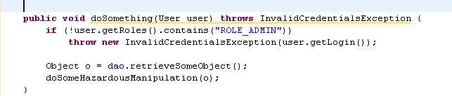
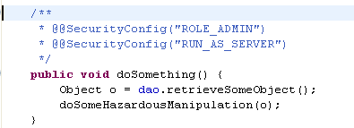
Spring principles: AOP
Without AOP
With AOP

Slide 39
Ex:
class A{
public void m1(){...}
public void m2(){...}
public void m3(){...}
public void m4(){...}
public void m5(){...}
public void n1(){...}
public void n2(){...}
public void p1(){...}
public void p2(){...}
public void p3(){...}
}
There are 5 methods that starts from m, 2 methods that starts from n and 3 methods that starts from p.

Slide 40
Where use AOP?
AOP is mostly used in following cases:
to provide declarative enterprise services such as declarative transaction management.
It allows users to implement custom aspects.

Slide 41
AOP concepts and terminologies are as follows:
Join point
Advice
Pointcut
Introduction
Target Object
Aspect
Interceptor
AOP Proxy
Weaving

Slide 42
Join point
Join point is any point in your program such as method execution, exception handling, field access etc. Spring supports only method execution join point.
Advice
Advice represents an action taken by an aspect at a particular join point. There are different types of advices:
Before Advice: it executes before a join point.
After Returning Advice: it executes after a joint point completes normally.
After Throwing Advice: it executes if method exits by throwing an exception.
After (finally) Advice: it executes after a join point regardless of join point exit whether normally or exceptional return.
Around Advice: It executes before and after a join point.

Slide 43
Pointcut
It is an expression language of AOP that matches join points.
Introduction
It means introduction of additional method and fields for a type. It allows you to introduce new interface to any advised object.
Target Object
It is the object i.e. being advised by one or more aspects. It is also known as proxied object in spring because Spring AOP is implemented using runtime proxies

Slide 44
AOP implementations are provided by:
AspectJ
Spring AOP
JBoss AOP

Slide 45
Spring AspectJ AOP implementation provides many annotations:
@Aspect declares the class as aspect.
@Pointcut declares the pointcut expression.
The annotations used to create advices are given below:
@Before declares the before advice. It is applied before calling the actual method.
@After declares the after advice. It is applied after calling the actual method and before returning result.
@AfterReturning declares the after returning advice. It is applied after calling the actual method and before returning result. But you can get the result value in the advice.
@Around declares the around advice. It is applied before and after calling the actual method.
@AfterThrowing declares the throws advice. It is applied if actual method throws exception.

Slide 46
Example

Slide 47
Spring Database Components

Slide 48
Consistent Abstract Classes for DAO Support
Extend your DAO classes with the proper xxxDAOSupport class that matches your persistence mechanism.
JdbcDaoSupport
  Super class for JDBC data access objects.
  Requires a DataSource to be set, providing a JdbcTemplate based on it to subclasses.
HibernateDaoSupport
  Super class for Hibernate data access objects.
  Requires a SessionFactory to be set, providing a HibernateTemplate based on it to subclasses.
JdoDaoSupport
  Super class for JDO data access objects.
  Requires a PersistenceManagerFactory to be set, providing a JdoTemplate based on it to subclasses.
SqlMapDaoSupport
  Supper class for iBATIS SqlMap data access object.
  Requires a DataSource to be set, providing a SqlMapTemplate

Slide 49
Consistent Exception Handling
Spring has it’s own exception handling hierarchy for DAO logic.
No more copy and pasting redundant exception logic!
Exceptions from JDBC, or a supported ORM, are wrapped up into an appropriate, and consistent, DataAccessException and thrown.
This allows you to decouple exceptions in your business logic.
These exceptions are treated as unchecked exceptions that you can handle in your business tier if needed. No need to try/catch in your DAO.
Define your own exception translation by subclassing classes such as SQLErrorCodeSQLExceptionTranslator

Slide 50
Spring and Testing
Easier test driven development (TDD)
Integration testing
  Can use a standalone Spring configuration with mock objects for testing.
  Consider XMLApplicationContext or FileSystemApplicationContext.
Unit testing
  Allows you to test outside the container without using the Spring container.
Easy to test POJOs

Slide 51
Spring - Transaction Management
ACID:
Atomicity: A transaction should be treated as a single unit of operation which means either the entire sequence of operations is successful or unsuccessful.
Consistency: This represents the consistency of the referential integrity of the database, unique primary keys in tables etc.
Isolation: There may be many transactions processing with the same data set at the same time, each transaction should be isolated from others to prevent data corruption.
Durability: Once a transaction has completed, the results of this transaction have to be made permanent and cannot be erased from the database due to system failure.

Slide 52
Local vs. Global Transactions
Local transactions are specific to a single transactional resource like a JDBC connection, whereas global transactions can span multiple transactional resources like transaction in a distributed system.

Slide 53
Programmatic vs. Declarative
Spring supports two types of transaction management:
Programmatic transaction management: This means that you have manage the transaction with the help of programming. That gives you extreme flexibility, but it is difficult to maintain.
Declarative transaction management: This means you separate transaction management from the business code. You only use annotations or XML based configuration to manage the transactions

Slide 54
Spring MVC Framework

Slide 55
Benefits of the Spring Web MVC Framework
The Spring Web MVC Framework is a robust, flexible, and well-designed framework for rapidly developing web applications using the MVC design pattern.The benefits achieved from using this Spring module are similar to those you get from the rest of the Spring Framework
Easier testing—This is a common theme you will find across all the Spring classes.The fact that most of Spring’s classes are designed as JavaBeans enables you to inject test data using the setter methods of these classes. Spring also provides mock classes to simulate Java HTTP objects (HttpServletRequest, for example), which makes unit testing of the web layer much simpler.

Slide 56
Benefits of the Spring Web MVC Framework
Bind directly to business objects—Spring MVC does not require your business (model) classes to extend any special classes; this enables you to reuse your business
objects by binding them directly to the HTML forms fields. In fact, your controller classes are the only ones that are required to extend Spring classes (or implement a Spring controller interface).
Clear separation of roles—Spring MVC nicely separates the roles played by the various components that make up this web framework. For example, when we dis-cuss concepts such as controllers, command objects, and validators, you will begin to see how each component plays a distinct role.

Slide 57
Benefits of the Spring Web MVC Framework
Simple but powerful tag library—Spring's tag library is small, straightforward, but powerful. For example. Spring uses the JSP expression language (EL) for arguments
to the <spring :bind> tag.
Web Flow—This module is a subproject and is not bundled with the Spring core distribution. It is built on top of Spring MVC and adds the capability to easily write wizard like web applications that span across several HTTP requests (an online shopping cart, for example).

Slide 58
Benefits of the Spring Web MVC Framework
View technologies and web frameworks—Although we are using JSP as our view technology. Spring supports odier view technologies as well, such as Apache Velocity and FreeMarker.This is a powerful concept because switching from JSP to Velocity is a matter of configura-tion. Furthermore, Spring provides integration support for Apache Struts.
■ Lighter-weight environment—As I mentioned in die previous chapter. Spring enables you to build enterprise-ready applications using POJOs; the environment
setup can be simpler and less expensive because you could develop and deploy your application using a lighter-weight servlet container.

Slide 59
Working Of MVC Framework
The Spring web MVC framework provides model-view-controller architecture and ready components that can be used to develop flexible and loosely coupled web applications. The MVC pattern results in separating the different aspects of the application (input logic, business logic, and UI logic), while providing a loose coupling between these elements.
The Model encapsulates the application data and in general they will consist of POJO.
The View is responsible for rendering the model data and in general it generates HTML output that the client's browser can interpret.
The Controller is responsible for processing user requests and building appropriate model and passes it to the view for rendering.

Slide 60
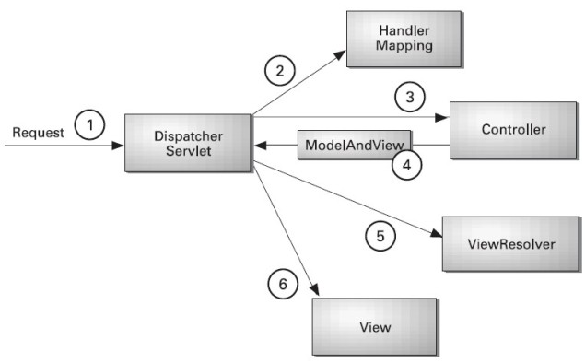
The DispatcherServlet
The Spring Web model-view-controller (MVC) framework is designed around a DispatcherServlet that handles all the HTTP requests and responses. The request processing workflow of the Spring Web MVC DispatcherServlet is illustrated in the following diagram:

Slide 61
Following is the sequence of events corresponding to an incoming HTTP request to DispatcherServlet:
After receiving an HTTP request, DispatcherServlet consults the HandlerMapping to call the appropriate Controller.
The Controller takes the request and calls the appropriate service methods based on used GET or POST method. The service method will set model data based on defined business logic and returns view name to the DispatcherServlet.
The DispatcherServlet will take help from ViewResolver to pickup the defined view for the request.
Once view is finalized, The DispatcherServlet passes the model data to the view which is finally rendered on the browser.
All the above mentioned components ie. HandlerMapping, Controller and ViewResolver are parts ofWebApplicationContext which is an extension of the plain ApplicationContext with some extra features necessary for web applications.

