Slide 1

Programming
Strings

Slide 2
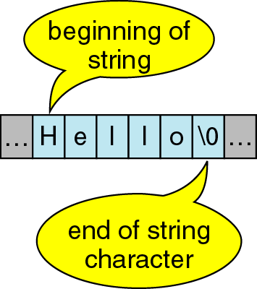
Character Strings
A sequence of characters is often referred to as a character “string”.
A string is stored in an array of type char ending with the null character '\0 '.

Slide 3
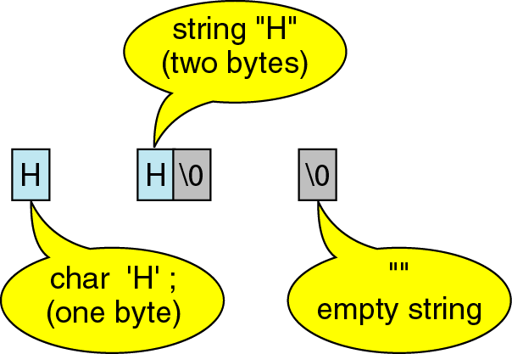
Character Strings
A string containing a single character takes up 2 bytes of storage.

Slide 4
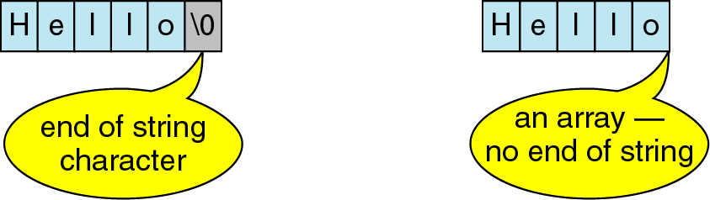
Character Strings

Slide 5
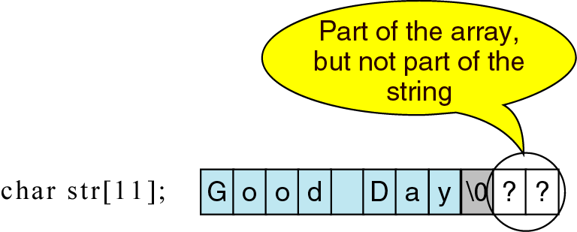
Character Strings

Slide 6
Character vs. String
A string constant is a sequence of characters enclosed in double quotes.
  For example, the character string:
  char s1[2]="a"; //Takes two bytes of storage.
  s1:
  On the other hand, the character, in single quotes:
  char s2= `a`; //Takes only one byte of storage.
  s2:
a | \0
a

Slide 7
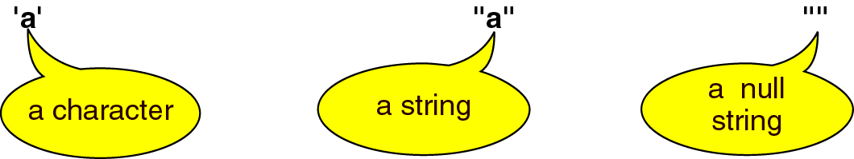
Character vs. String

