Slide 1

JDBC
http://www.java2all.com

Slide 2
JDBC Introduction
Chapter 1
http://www.java2all.com

Slide 3
Introduction to JDBC
http://www.java2all.com

Slide 4
JDBC - Java Database Connectivity.
JDBC provides API or Protocol to interact with different databases.
With the help of JDBC driver we can connect with different types of databases.
Driver is must needed for connection establishment with any database.
A driver works as an interface between the client and a database server.
http://www.java2all.com

Slide 5
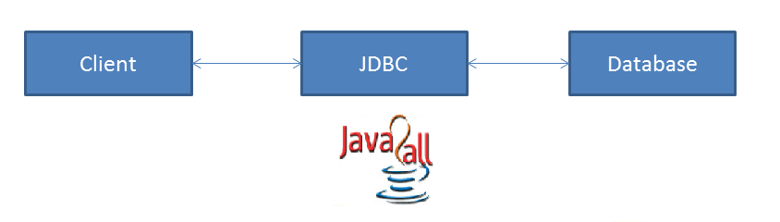
JDBC have so many classes and interfaces that allow a java application to send request made by user to any specific DBMS(Data Base Management System).
JDBC supports a wide level of portability.
JDBC provides interfaces that are compatible with java application
http://www.java2all.com

Slide 6
components and specification of JDBC:
http://www.java2all.com

Slide 7
Components of JDBC:
JDBC has four main components as under and with the help of these components java application can connect with database.
The JDBC API - it provides various methods and interfaces for easy communication with database.
The JDBC DriverManager - it loads database specific drivers in an application to establish connection with database.
The JDBC test suite - it will be used to test an operation being performed by JDBC drivers.
The JDBC-ODBC bridge - it connects database drivers to the database.
http://www.java2all.com

Slide 8
JDBC Specification:
Different version of JDBC has different specification as under.
JDBC 1.0 - it provides basic functionality of JDBC.
JDBC 2.0 - it provides JDBC API(JDBC 2.0 Core API and JDBC 2.0 Optional Package API).
JDBC 3.0 - it provides classes and interfaces in two packages(java.sql and javax.sql).
JDBC 4.0 - it provides so many extra features like Auto loading of the driver interface.
Connection management.
ROWID data type support.
http://www.java2all.com

Slide 9
Enhanced support for large object like BLOB(Binary Large Object) and CLOB(Character Large Object).
http://www.java2all.com

Slide 10
JDBC Architecture:
As we all know now that driver is required to communicate with database.
JDBC API provides classes and interfaces to handle request made by user and response made by database.
Some of the important JDBC API are as under.
DriverManager Driver
Connection Statement
PreparedStatement CallableStatement
ResultSet DatabaseMetaData
ResultSetMetaData
http://www.java2all.com

Slide 11
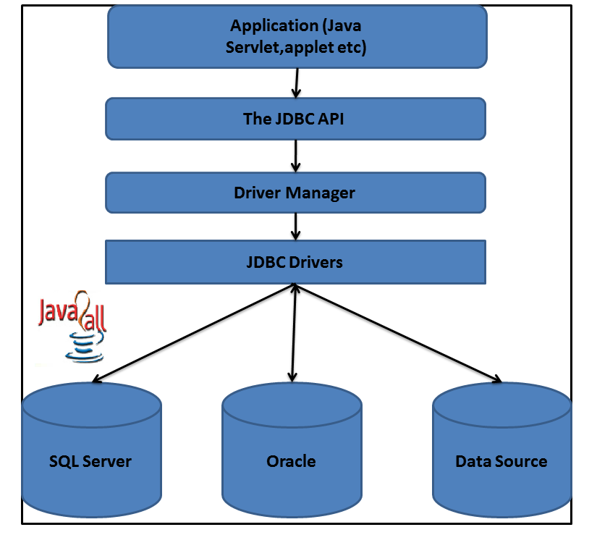
Here The DriverManager plays an important role in JDBC architecture.
It uses some database specific drivers to communicate our J2EE application to database.
http://www.java2all.com

Slide 12
As per the diagram first of all we have to program our application with JDBC API.
With the help of DriverManager class than we connect to a specific database with the help of spcific database driver.
Java drivers require some library to communicate with the database.
We have four different types of java drivers.
We will learn all that four drivers with architecture in next chapter.
http://www.java2all.com

Slide 13
Some drivers are pure java drivers and some are partial.
So with this kind of JDBC architecture we can communicate with specific database.
We will learn programmatically all this thing in further chapter.
http://www.java2all.com

Slide 14
JDBC Driver Types:
http://www.java2all.com

Slide 15
There are four categories of drivers by which developer can apply a connection between Client (The JAVA application or an applet) to a DBMS.
(1) Type 1 Driver : JDBC-ODBC Bridge.
(2) Type 2 Driver : Native-API Driver (Partly Java driver).
(3) Type 3 Driver : Network-Protocol Driver (Pure Java driver for database Middleware).
(4) Type 4 Driver : Native-Protocol Driver (Pure Java driver directly connected to database).
http://www.java2all.com

Slide 16
(1) Type 1 Driver: JDBC-ODBC Bridge :-
The JDBC type 1 driver which is also known as a JDBC-ODBC Bridge is a convert JDBC methods into ODBC function calls.
Sun provides a JDBC-ODBC Bridge driver by “sun.jdbc.odbc.JdbcOdbcDriver”.
The driver is a platform dependent because it uses ODBC which is depends on native libraries of the operating system and also the driver needs other installation for example, ODBC must be installed on the computer and the database must support ODBC driver.
http://www.java2all.com

Slide 17
Type 1 is the simplest compare to all other driver but it’s a platform specific i.e. only on Microsoft platform.
The JDBC-ODBC Bridge is use only when there is no PURE-JAVA driver available for a particular database.
Architecture Diagram:
http://www.java2all.com

Slide 18
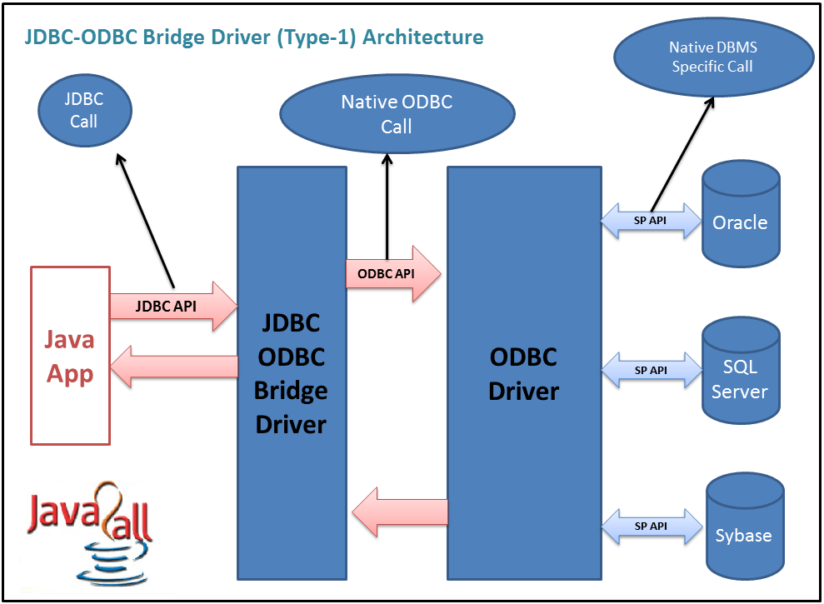
http://www.java2all.com

Slide 19
Process:
Java Application → JDBC APIs → JDBC Driver Manager → Type 1 Driver → ODBC Driver → Database library APIs → Database
Advantage:
(1) Connect to almost any database on any system, for which ODBC driver is installed.
(2) It’s an easy for installation as well as easy(simplest) to use as compare the all other driver.
http://www.java2all.com

Slide 20
Disadvantage:
(1) The ODBC Driver needs to be installed on the client machine.
(2) It’s a not a purely platform independent because its use ODBC which is depends on native libraries of the operating system on client machine.
(3) Not suitable for applets because the ODBC driver needs to be installed on the client machine.
http://www.java2all.com

Slide 21
(2) Type 2 Driver: Native-API Driver (Partly Java driver) :-
The JDBC type 2 driver is uses the libraries of the database which is available at client side and this driver converts the JDBC method calls into native calls of the database so this driver is also known as a Native-API driver.
Architecture Diagram :
http://www.java2all.com

Slide 22
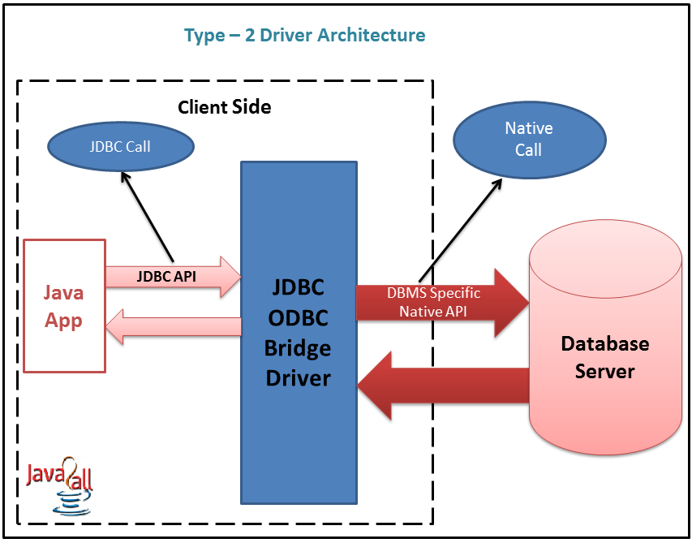
http://www.java2all.com

Slide 23
Process:
Java Application → JDBC APIs → JDBC Driver Manager → Type 2 Driver → Vendor Client Database library APIs → Database
Advantage:
(1) There is no implantation of JDBC-ODBC Bridge so it’s faster than a type 1 driver; hence the performance is better as compare the type 1 driver (JDBC-ODBC Bridge).
http://www.java2all.com

Slide 24
Disadvantage:
(1) On the client machine require the extra installation because this driver uses the vendor client libraries.
(2) The Client side software needed so cannot use such type of driver in the web-based application.
(3) Not all databases have the client side library.
(4) This driver supports all JAVA applications except applets.
http://www.java2all.com

Slide 25
(3) Type 3 Driver: Network-Protocol Driver (Pure Java driver for database Middleware) :-
The JDBC type 3 driver uses the middle tier(application server) between the calling program and the database and this middle tier converts JDBC method calls into the vendor specific database protocol and the same driver can be used for multiple databases also so it’s also known as a Network-Protocol driver as well as a JAVA driver for database middleware.
Architecture Diagram:
http://www.java2all.com

Slide 26
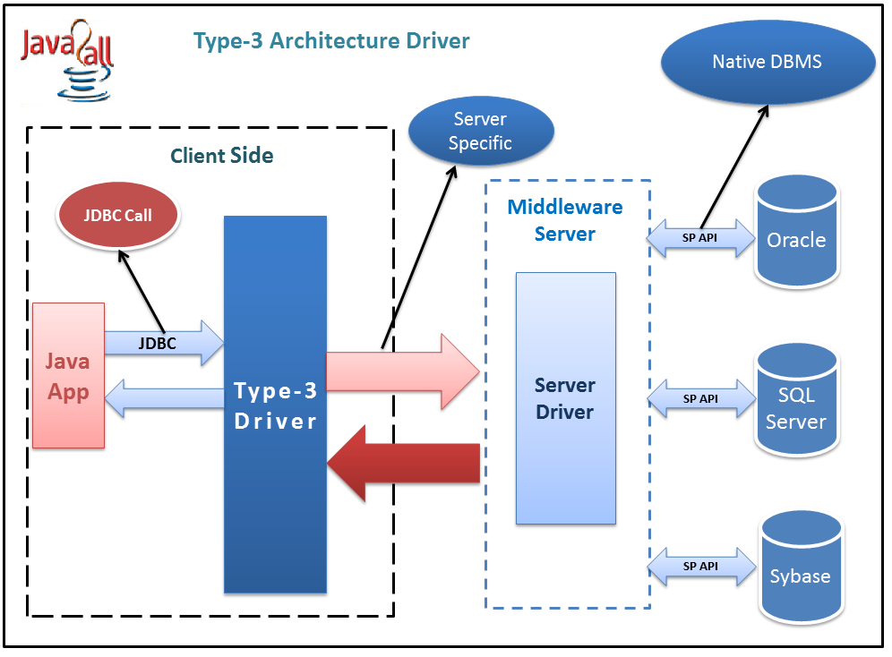
http://www.java2all.com

Slide 27
Process:
Java Application → JDBC APIs → JDBC Driver Manager → Type 3 Driver → Middleware (Server)→ any Database
Advantage:
(1) There is no need for the vendor database library on the client machine because the middleware is database independent and it communicates with client.
(2) Type 3 driver can be used in any web application as well as on internet also because there is no any software require at client side.
http://www.java2all.com

Slide 28
(3) A single driver can handle any database at client side so there is no need a separate driver for each database.
(4) The middleware server can also provide the typical services such as connections, auditing, load balancing, logging etc.
Disadvantage:
(1) An Extra layer added, may be time consuming.
(2) At the middleware develop the database specific coding, may be increase complexity.
http://www.java2all.com

Slide 29
(4) Type 4 Driver: Native-Protocol Driver (Pure Java driver directly connected to database) :-
The JDBC type 4 driver converts JDBC method calls directly into the vendor specific database protocol and in between do not need to be converted any other formatted system so this is the fastest way to communicate quires to DBMS and it is completely written in JAVA because of that this is also known as the “direct to database Pure JAVA driver”.
Architecture Diagram:
http://www.java2all.com

Slide 30
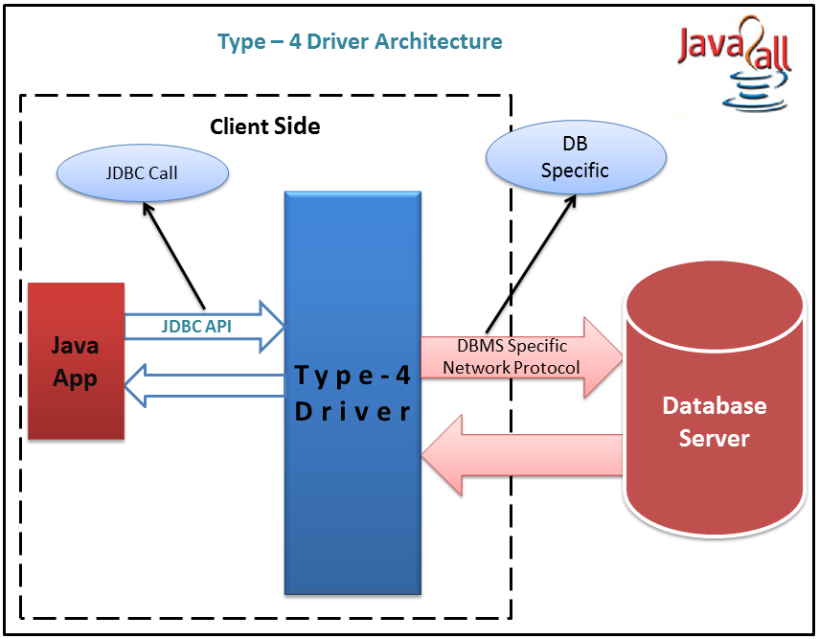
http://www.java2all.com

Slide 31
Process:
Java Application → JDBC APIs → JDBC Driver Manager → Type 4 Driver (Pure JAVA Driver) → Database Server
Advantage:
(1) It’s a 100% pure JAVA Driver so it’s a platform independence.
(2) No translation or middleware layers are used so consider as a faster than other drivers.
(3) The all process of the application-to-database connection can manage by JVM so the debugging is also managed easily.
http://www.java2all.com

Slide 32
Disadvantage:
(1) There is a separate driver needed for each database at the client side.
(2) Drivers are Database dependent, as different database vendors use different network protocols.
http://www.java2all.com

