Slide 1
Master Page and Theme

Slide 2
Master Page
Master pages enable the template based development of a website.
Master defines the overall layout of a web application and all pages are derived from master page so that they have a common look.
Master page having .master extension
Define master page using @Master directive on top a web page.

Slide 3
Master Page
The Content of master pages is fixed for all derived pages. To place the changing data for every pages
Master page provide <ContentPlaceHolder> where each page hold its local content.
<%@Master Language="C#“
Code File="MasterPage.master.cs" Inherits="MasterPage" %>

Slide 4
Master Page
<%@ Page Title=“ContentPage1" Language="C#" MasterPageFile="~/MasterPage.master" Code File="Default2.aspx.cs" %>
Major characteristics of a master page:
Defining common properties of a web
site, such as header, footer, banners, navigation menus
other elements that can be accessed by the content pages.
Allowing single or multiple content pages to access single or multiple master pages.

Slide 5
Master Page
Master pages are of two types:
Simple Master Page
Simple Master
Content Page
Final Page

Slide 6
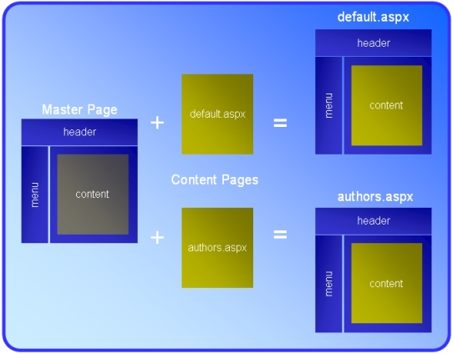

Slide 7
Master Page
Nested Master Page:
It implies that a master page can be included
inside another master page.
Simply, Main master page → another master page for some selected pages that is called nested master page.

Slide 8
Master Page
Nested Master Page
Content Page 1
Master Page 1
Content Page 2
Master Page 2
Final Page 1
Final Page 2

Slide 9
Themes
Themes in Asp. Net enable you to define the style properties and the change the appearance of a Web Page.
You can set theme in master page directive in master page as well in web.config also.
Theme can be defined as collection of element that is common look and feel for whole application.

Slide 10
Themes
→Advantages :
Providing flexibility to easily change the appearance of all web pages just by making changes in few files with minimum possible efforts.
Providing various options to customize a web page. E.g. in Orkut, you can change website appearance as per your requirement.

Slide 11
Themes
→ Skin
It is having .skin extension that contains tags, property settings and formatting options for server side controls. Such as Label, TextBox and Button.
Skin is divided into following groups:
→ Default
Default skin is applied automatically to all the controls of the same type in web page, when theme is applied to the page.

Slide 12
Themes
SkinID attributes is used to determine whether the applied skin is default or not. If SkinID is not present in current tag means it is a default skin.
→Named
It is a customized skin that is applied to controls when theme is applied.
It has SkinID property which allows different styles to different controls.

Slide 13
Themes
→CSS
Refers to a mechanism of adding fonts, colors, styles and behavior to web pages.
It is an Asp. Net file with .css extension and applies a style sheet as a part of theme in a web page.
It should include in App_theme folder.

