Slide 1

CAPSTONE PROJECT
Secure Data Hiding in Image Using Steganography
Presented By:
Student Name : Trupti Ghenand
College Name & Department : MIT Art’s,Commerce And Science College,Alandi

Slide 2
OUTLINE
Problem Statement
Technology used
Wow factor
End users
Result
Conclusion
Git-hub Link
Future scope

Slide 3
Problem Statement
With the rise of cyber threats, securing sensitive information during transmission is crucial. Traditional encryption methods, while effective, can be easily detected, making them vulnerable to attacks. This project aims to implement an image-based steganography technique where a secret message is embedded within an image, ensuring secure communication while maintaining the integrity of the visual content.

Slide 4
Technology used
Software Components
Programming Language: Python 3
Libraries & Modules:
OpenCV – Image processing and pixel manipulation.(cv2)
OS Module – File handling and system command execution(os)
Character Encoding: ASCII mapping for message storage in pixel values
Hardware Components
Processor: Intel Core i5/i7 or AMD Ryzen 5/7 (recommended for smooth processing)
RAM: Minimum 4GB (8GB recommended for handling large images)
Storage: SSD (preferred for faster read/write operations)
Graphics Processing Unit (GPU): Optional but beneficial for handling high-resolution images efficiently
Display: 1080p+ resolution for accurate image analysis
Input Devices: Keyboard for message input and password authentication
Operating System: Windows/Linux/macOS

Slide 5
Wow factors
Dual Security Mechanism: Steganography combined with password-based authentication
Minimal Image Distortion: Secret data hidden without noticeable changes
Lightweight & Fast Execution: Works efficiently on mid-range systems
No Need for Dedicated Steganography Software: Runs using standard Python libraries

Slide 6
End users
Cybersecurity Professionals – Secure data transmission use cases
Corporate & Government Agencies – Confidential communication
Students & Researchers – Learning steganography and cryptographic techniques

Slide 7
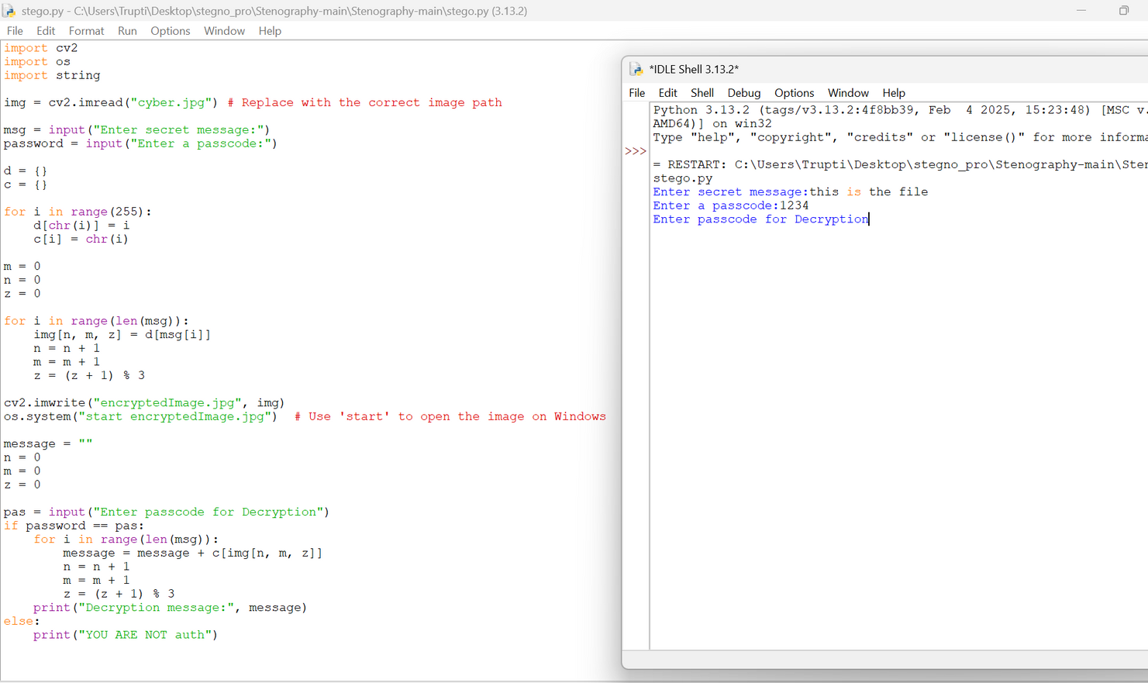
Results

Slide 8
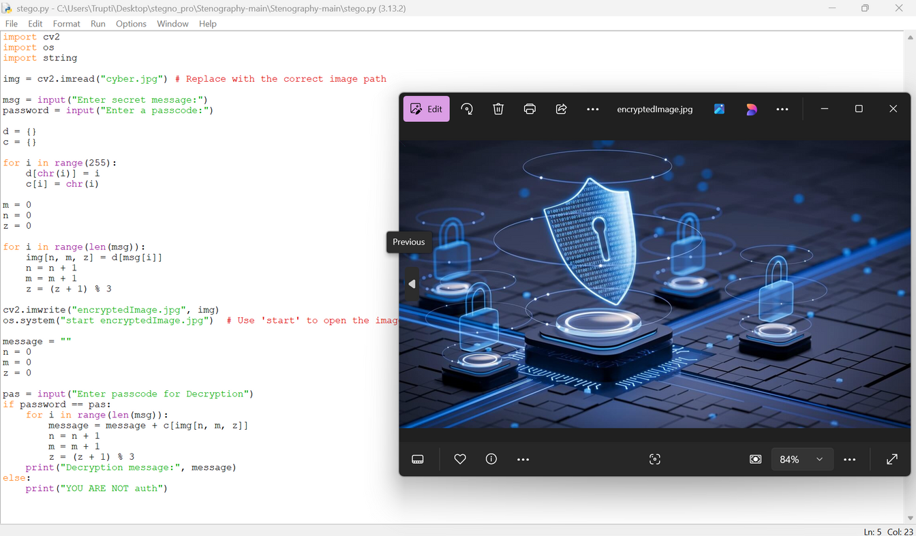
Results

Slide 9
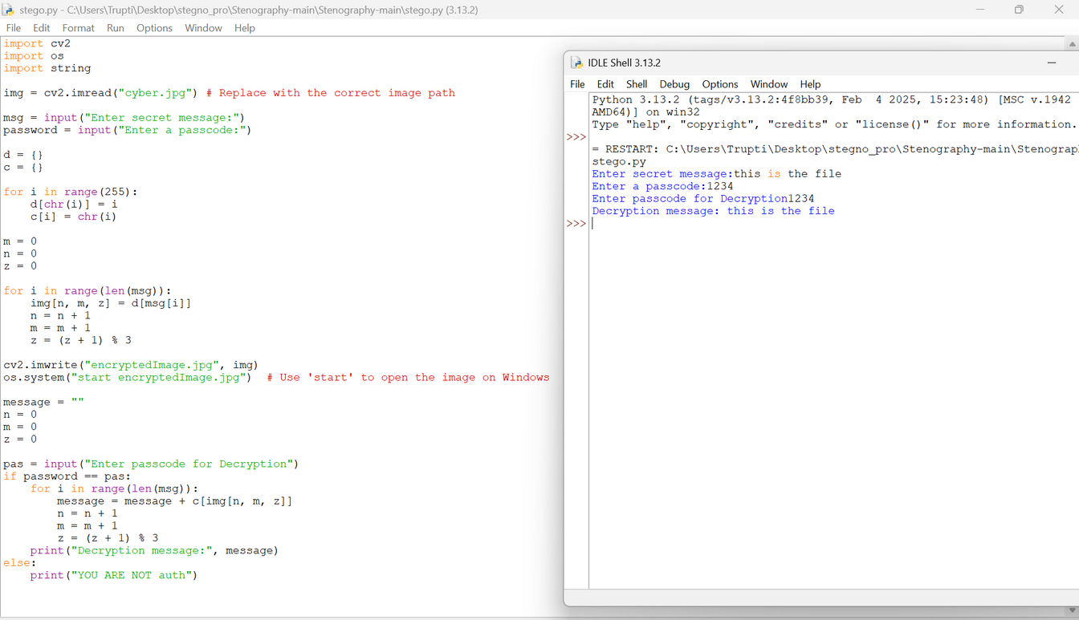
Results

Slide 10
Conclusion
This project provides a practical implementation of steganography for secure communication. It demonstrates how images can be used as a medium to store hidden information without raising suspicion. The approach can be further enhanced with cryptographic techniques and AI-based steganalysis resistance.

Slide 11
GitHub Link
https://github.com/trupti-K-ghenand/Steg_Project.git

Slide 12
Future scope(optional)
Advanced Cryptography: Implementing AES encryption for an additional security layer
Multi-Image Steganography: Distributing the message across multiple images
Robust Error Handling: Preventing data corruption due to incorrect input
Cross-Platform GUI: Making the tool more user-friendly
AI-Based Detection Resistance: Enhancing security against modern forensic analysis tools

Slide 13
THANK YOU

