Slide 1
STANDARD OPERATING PROCEDURE
Drug Management System
SharePoint-Based Document Lifecycle & Electronic Signature Workflow
SOP-DMS-001 | Version 1.0 | March 2026 | Treta Infotech

Slide 2
Agenda
1. System Overview & Purpose
2. SharePoint List Setup & Choice Column Configuration
3. Screen-by-Screen Walkthrough (Add, Edit, View, CTD)
4. Approve / Reject Workflow
5. User Group Roles & Permissions (Admin, HR, User)
6. Power Automate Flow 1 — Adobe Sign Implementation
7. Power Automate Flow 2 — Adobe Auto Save Signed Document
8. Troubleshooting & FAQ
Drug Management System — SOP-DMS-001 | Version 1.0 | March 2026

Slide 3
1. System Overview & Purpose
What is the Drug Management System? A SharePoint SPFx web application for managing pharmaceutical regulatory documents through their full lifecycle. Business Objectives • Single source of truth for regulatory & clinical documents
• Structured review-and-approval workflow
• Adobe Sign integration for electronic signatures
• Role-based access via SharePoint Groups
• eCTD-aligned CTD folder hierarchy
Drug Management System — SOP-DMS-001 | Version 1.0 | March 2026

Slide 4
1. Technology Stack
Frontend | SPFx v1.20, React 17, Fluent UI
Data Layer | PnPjs (SharePoint REST API)
Automation | Microsoft Power Automate
eSignature | Adobe Sign (Acrobat Sign)
State Mgmt | Jotai
Drug Management System — SOP-DMS-001 | Version 1.0 | March 2026

Slide 5
1. Document Lifecycle
Draft
Under Review
Pending Approval
Approved
Signed
Draft → Under Review → Pending Approval → Approved → Signed
Rejected documents return to Draft for revision.
Drug Management System — SOP-DMS-001 | Version 1.0 | March 2026

Slide 6
2. SharePoint List Setup
Key Lists • Project Documents — document metadata • eSignature — queues docs for Adobe Sign • Categories — master category list • Drugs — compound master data • Templates — reusable document templates
Updating Choice Columns 1. Settings gear → Site Contents
2. Open target list → List Settings
3. Click the column (e.g. "Category")
4. Add/remove values in the text area
5. Click OK — changes are immediate
Drug Management System — SOP-DMS-001 | Version 1.0 | March 2026

Slide 7
3. Add Document — Step by Step
1. Click "+ Add Document" in the toolbar 2. Fill required fields: Title, Category, Drug, Phase, Version 3. Upload the file (.docx / .pdf / .xlsx) 4. Click Save — success toast confirms upload Tip: Only Admin and HR group members can add documents.
Drug Management System — SOP-DMS-001 | Version 1.0 | March 2026

Slide 8
3. Edit & View Document
Edit Document • Click the pencil icon in the Actions column • Edit panel opens with current values pre-filled • Replace file if needed; increment version manually • Save to commit changes View Document • Click the eye icon on any document
• Read-only metadata panel opens
• Click "Open Document" to open or download the file
Drug Management System — SOP-DMS-001 | Version 1.0 | March 2026

Slide 9
3. CTD Folder Structure
Module | Category | Sections
Module 1 | Administrative | 1.1, 1.2
Module 2 | Summaries | 2.4, 2.5
Module 3 | Quality | 3.2.A, 3.2.P
Module 4 | Nonclinical | 4.2.1, 4.2.2
Module 5 | Clinical | 5.3.1, 5.3.5
Navigate the CTD tree (left panel) to filter documents by module and section.
Drug Management System — SOP-DMS-001 | Version 1.0 | March 2026

Slide 10
4. Approve / Reject Workflow
Stage | Actor | Actions
Pending Approval | Approver | Approve or Reject
Approved | System | Trigger eSignature
Rejected | Author | Review comments, Revise, Resubmit
Approving: Open document → Review content → Click Approve → Add optional comment → Confirm. Rejecting: Open document → Click Reject → Enter mandatory reason → Confirm.
Drug Management System — SOP-DMS-001 | Version 1.0 | March 2026

Slide 11
5. User Group Roles & Permissions
Group | SharePoint Level | Permissions
DMS-Admin | Full Control | Add/edit/delete all docs, manage lists, trigger flows, manage groups
DMS-HR | Contribute | Add/edit own docs, submit for review, view all docs
DMS-User | Read | Browse, search, view and download approved documents only
To add a user: Site Settings → Site Permissions → [Group] → New → Add Users → enter email → Share.
Drug Management System — SOP-DMS-001 | Version 1.0 | March 2026

Slide 12
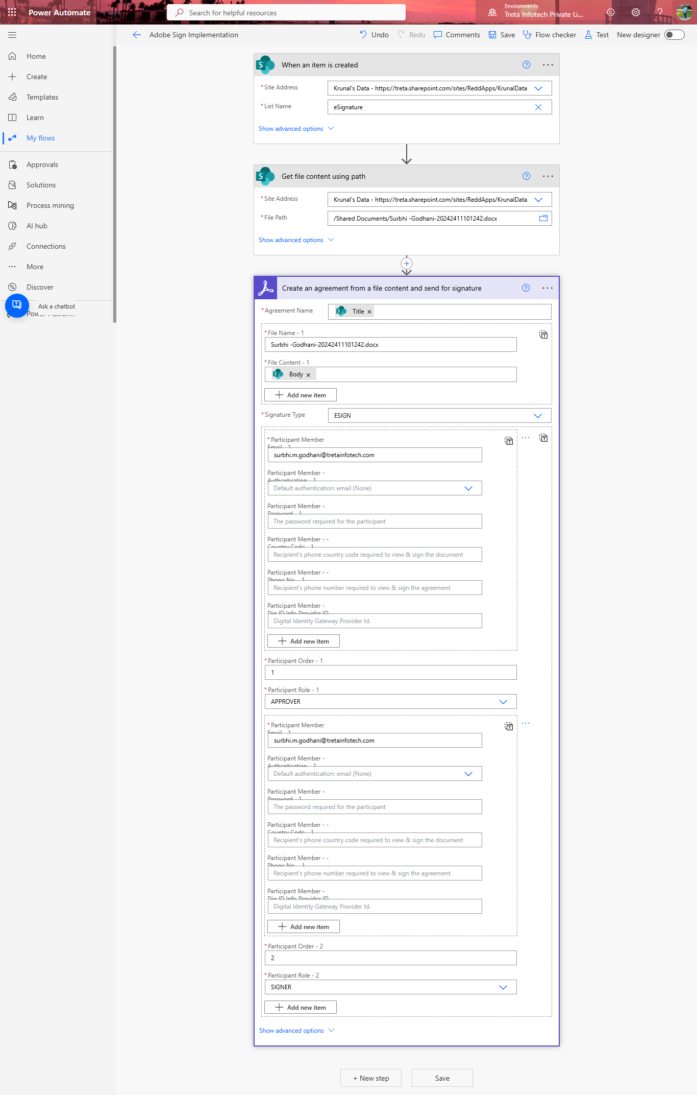
6. Flow 1 — Adobe Sign Implementation
Trigger: New item created in the eSignature SharePoint list Steps: 1. Trigger — item created in eSignature list 2. Get file content using path from SharePoint 3. Create agreement & send for signature (Adobe Sign) • Participant 1: APPROVER (reviews document) • Participant 2: SIGNER (applies e-signature) Setup: Power Automate → Connections → + New → Adobe Acrobat Sign → Sign in.
Drug Management System — SOP-DMS-001 | Version 1.0 | March 2026

Slide 13
6. Flow 1 — Agreement Configuration
Field | Value
Agreement Name | Title (from eSignature list item)
File Name | Dynamic filename from list item
Signature Type | ESIGN
Participant 1 Role | APPROVER (Order 1)
Participant 2 Role | SIGNER (Order 2)
Participant Email | surbhi.godhan@tretainfotech.com
Drug Management System — SOP-DMS-001 | Version 1.0 | March 2026

Slide 14
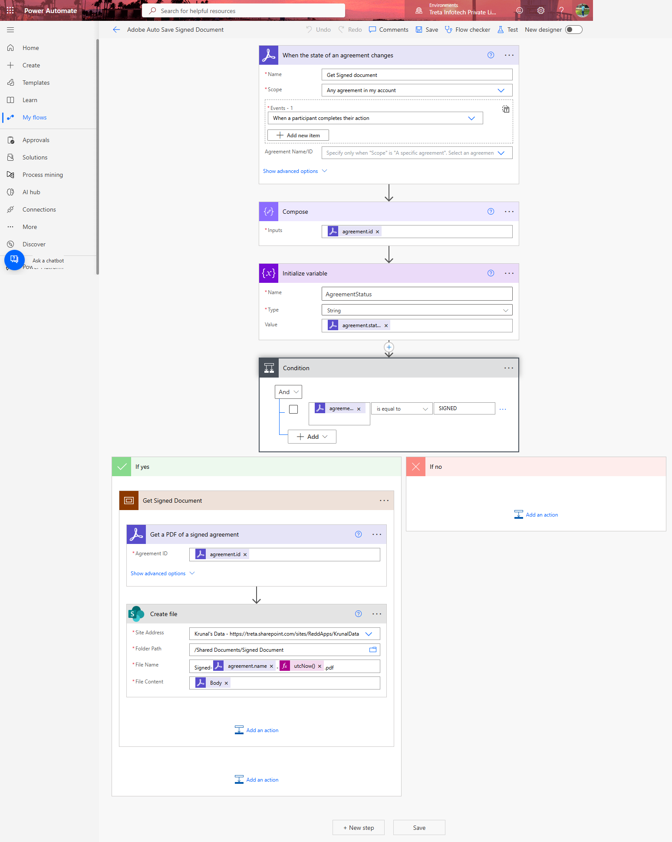
7. Flow 2 — Adobe Auto Save Signed Document
Trigger: When the state of an Adobe Sign agreement changes Steps: 1. Trigger — agreement state change 2. Compose — extract agreement.id 3. Initialize variable — store AgreementStatus 4. Condition — if AgreementStatus = "SIGNED" 5. (If Yes) Get PDF of signed agreement 6. (If Yes) Create file in SharePoint Folder: /Shared Documents/Signed Document Name: Signed_[agreement.name]_[utcNow()].pdf
Drug Management System — SOP-DMS-001 | Version 1.0 | March 2026

Slide 15
7. Flow 2 — SharePoint File Configuration
Field | Value
Site Address | https://treta.sharepoint.com/sites/ReddApps/KrunalData
Folder Path | /Shared Documents/Signed Document
File Name | Signed_[agreement.name]_[utcNow()].pdf
File Content | Body (PDF binary from Get Signed Document)
Prerequisite | "Signed Document" folder must exist in Shared Documents
Drug Management System — SOP-DMS-001 | Version 1.0 | March 2026

Slide 16
8. Troubleshooting & FAQ
Issue | Resolution
No "Add Document" button | Move user to DMS-HR group
Doc stuck on Pending Approval | Contact Approver or Admin
Adobe Sign email not received | Check Participant email in Flow 1
Signed PDF not saved | Create "Signed Document" folder in Shared Docs
Flow — Unauthorized error | Re-authenticate Adobe Sign connection
Choice missing from dropdown | Admin adds value via List Settings → Column
Drug Management System — SOP-DMS-001 | Version 1.0 | March 2026

Slide 17
Thank You
For queries, contact your SharePoint Administrator or Power Platform support team.
SOP-DMS-001 | Drug Management System | Treta Infotech | March 2026

